Slide 1


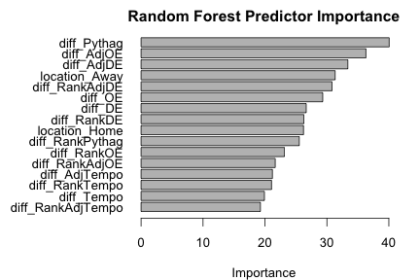
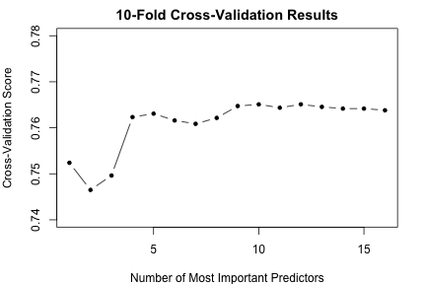




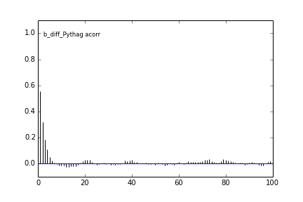
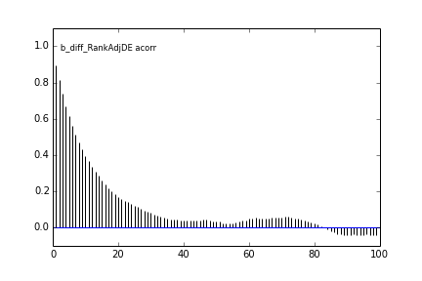
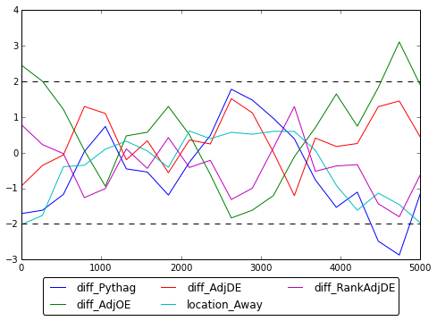

Bayesket Ball: A Bayesian Take on College Basketball
Stephen Fang, Micah Lanier, & Jeffrey Shen
Applied Mathematics 207, School of Engineering and Applied Sciences, Harvard University
Background
Variable Selection
Results
Featuring 351 teams, NCAA men’s basketball is a major source of excitement in American sports. The annual 64-team NCAA tournament attracts more advertising spending than the Super Bowl, and prompts $12 billion in gambling on its outcome.
Our goal: apply Bayesian statistical analysis to determine what team features predict game outcomes, and simulate the 2015 NCAA tournament. We apply lessons from AM 207 to construct and sample from a complex model parameter space.
This work is inspired in part by news organizations that produce similar analysis:
Despite all we have learned, iterating over Bayesian model features is computationally intensive. First, we trained a random forest on the data set using location (home, away, or neutral) and quantitative features that measure the differences in team statistics.
How Did We Do?
After training our model and testing it against a held-out testing dataset, we correctly predicted 76% of regular season games. Our coding process would result in 50% accuracy by random chance.
What Really Matters
Our model suggests the existence of a significant home court advantage. Otherwise, Ken Pomeroy’s measurements of offensive and defensive efficiency explain a significant amount of the remaining variation.
We then computed the relative importance of each predictor and iterated over the N most important predictors with 10-fold cross validation to estimate the test accuracy. As N increases, the cross-validation accuracy score increases at first but levels off after N = 5. Therefore, we included the 5 most important features from the random forest as our predictors. As for priors, we fitted a logistic regression on 2014 data and assigned the coefficient estimates as the prior means and used uninformative prior standard deviations at 10.
2015 NCAA Tournament
We used our model to simulate the entire 2015 NCAA Tournament 10,000 times. The most likely winners:
Data
Our analysis utilizes NCAA men’s basketball team statistics and game records from KenPom.com. We used Python’s BeautifulSoup to retrieve and extract game data. Before model fitting, we calculated differences of team features between opponents to quantify their relative (not absolute) attributes.
Final Four | Championship
(1)
99% | 77%
(1)
52% | 12%
Teams | Games
351 | 33,000 (2010-2015)
Model Building
(1)
56% | 4.8%
We used Metropolis-Hastings algorithm to perform sampling from our Bayesian logistic regression. For our final model, we sampled 10,000 samples after 5,000 burn-in samples and taking every 1 out of 10 samples using thinning. In addition, we also used slice sampling to perform sampling. The results are comparable.
(2)
48% | 2.5%
Team Features
Ken Pomeroy produces basketball statistics adjusted for team possessions and game tempo. We used several of his statistics and ideas as features in our own models:
(2)
44% | 1.3%
Correlation Plots
…and losers:
(13)
0% | 0%
Feature/Concept | Meaning
Location | Our analysis explores the well-known concept of home-court advantage.
Efficiency | Offensive/defensive (OE/DE) efficiency weights points scored by game possessions.
Tempo | A measurement of game speed based on possessions. Useful for comparing quick teams to slower, methodical ones.
Pythagorean Percentage | Single-feature weighting of offensive and defensive efficiency; helps us measure their joint importance.
Most common championship outcome: over (24%)
The Final Four
What can we say about the actual 2015 Final Four?
We simulated their matchups 10,000 times as well:
Geweke Statistics
Posterior Distribution
Semi-Final Win | Championship
Coefficients | Mean | Std
Intercept | 0.4718 | 0.0456
Diff_Pythag | 1.1283 | 0.3014
Diff_AdjOE | 0.1190 | 0.0085
Diff_AdjDE | -0.1183 | 0.0245
Location_Away | -1.1234 | 0.0688
Diff_RankAdjDE | 0.0003 | 0.0014
(1)
72% | 71%
(1)
28% | 27%
Learn More
(1)
100% | 2.3%
More to come at: bayesketball.github.io
(7)
0% | 0%

