Slide 1
AM207 Final Project Bayesket Ball
Stephen Fang, Micah LANIER, Jeffrey SHEN

Slide 2
Introduction
A Bayesian approach to NCAA Men’s College Basketball.
Goal: use Bayesian logistic regression to predict game outcomes.
Employ AM 207 methods for parameter sampling.
Use posterior parameter samples to simulate the 2015 NCAA Tournament.

Slide 3
Data
Source: KenPom.com
“Tempo-adjusted” basketball statistics that compare teams with different playing styles.
351 NCAA teams.
More than 33,000 games since 2010.

Slide 4
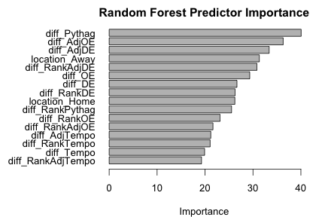
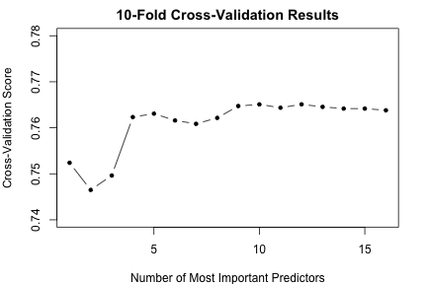
Variable Selection
Ranked predictors by relative importance using Random Forests
Iterated over the N most important predictors and compared 10-fold cross validation scores
Selected the 5 most important predictors for the final model

Slide 5
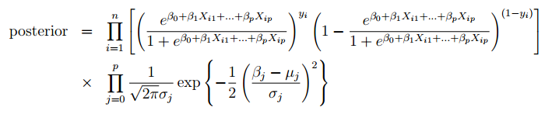

Bayesian Modeling Methodology
Bayesian Logistic Regression
Priors
Means from 2014 season and standard deviation = 10.
Posterior sampling over all parameters
Metropolis-Hastings Algorithm
Slice Sampling
Predictions on actual 2015 NCAA tournament data

Slide 6
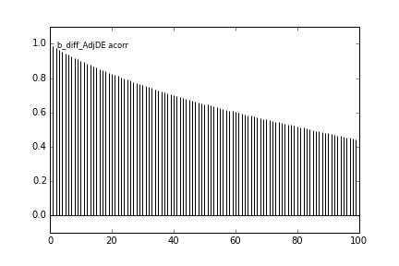
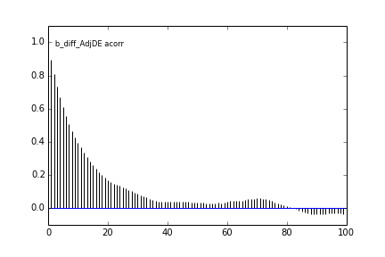
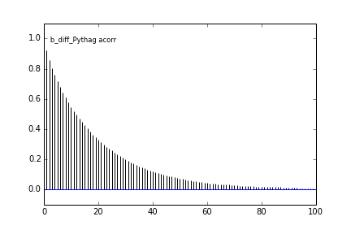
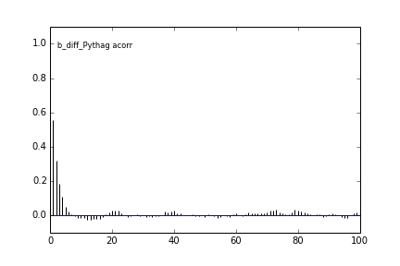
Bayesian Modeling Diagnostics
Autocorrelation
Resulting 10,000 samples from Metropolis-Hastings algorithm had high autocorrelation.
We used thinning=10 – took 1 sample out of 10.
This significantly reduced autocorrelation among our 10,000 samples.
Slice sampling did not require thinning.
MH without Thinning
MH with Thinning

Slide 7
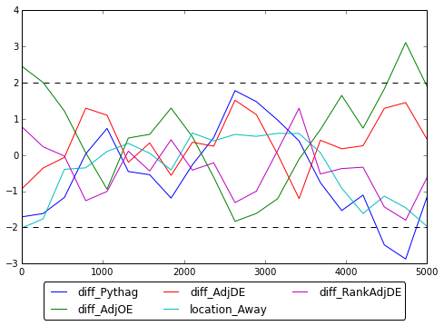
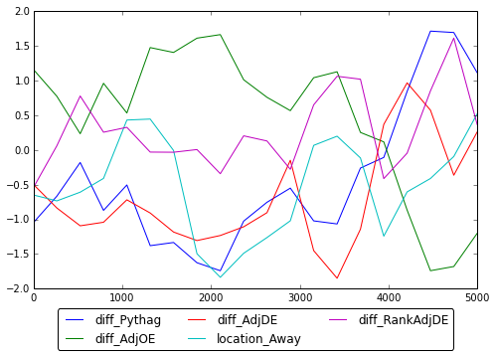
Bayesian Modeling Diagnostics & Prediction
Geweke Statistics
Both sampling techniques have Geweke Statistics between +/-2.
The plots show that both sampling techniques converged.
Prediction
Using the sampled 10,000 parameter coefficients, we tested our prediction on the 2015 NCAA results, and found the mean accuracy to approximately 76%.
Metropolis-Hastings with Thinning
Slice Sampling

Slide 8
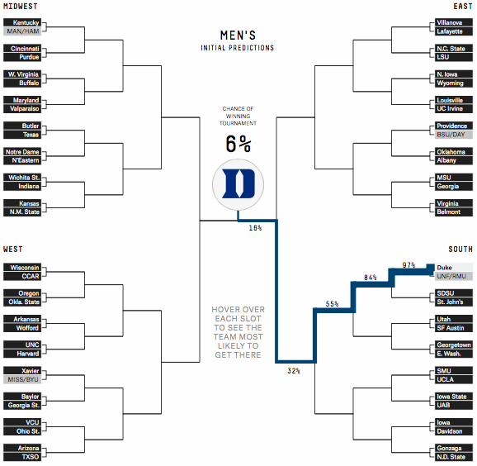
Monte Carlo NCAA Tournament Simulations
A popular part of news coverage.
Methodology: model the probability of each team winning and randomly simulate each game.
Winning teams advance until the championship.
Also simulated the real-life Final Four and championship game.
FiveThirtyEight’s effort.

Slide 9

Tournament Simulations
Team
Final Four
Championship
Actual Result
74%
35%
Lost in Final Four
49%
16%
Lost in Championship Game
47%
13%
Lost in Round of 32
37%
10%
Lost in Elite Eight
36%
6.5%
Won Championship
29%
6.1%
Lost in Round of 32

Slide 10
Final Four Simulations
Team
Semi-Final Win
Championship
Actual Result
59%
45%
Lost in Final Four
41%
29%
Lost in Championship Game
75%
23%
Won Championship
25%
3.2%
Lost in Final Four
Championship simulation: over (65%)

