Slide 1






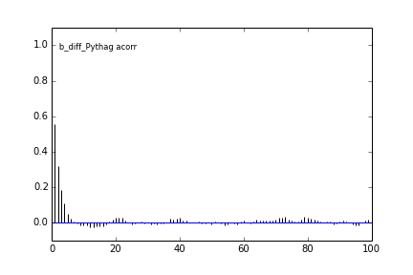
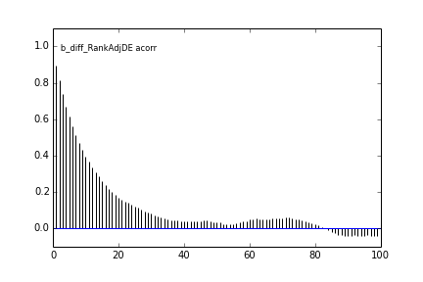
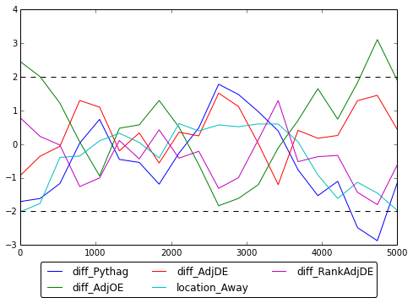

Bayesket Ball: A Bayesian Take on College Basketball
Stephen Fang, Micah Lanier, & Jeffrey Shen
Applied Mathematics 207, School of Engineering and Applied Sciences, Harvard University
Background
Variable Selection
Results
Featuring 351 teams, NCAA men’s basketball is a major source of excitement in American sports. The annual 64-team NCAA tournament attracts more advertising spending than the Super Bowl, and prompts $12 billion in gambling on its outcome.
Our goal: apply Bayesian statistical analysis to determine what team features predict game outcomes, and simulate the 2015 NCAA tournament. We apply lessons from AM 207 to construct and sample from a complex model parameter space.
This work is inspired in part by news organizations that produce similar analysis:
Despite all we have learned, iterating over Bayesian model features is time-consuming. TODO MORE
How Did We Do?
After training our model and testing it against a held-out testing dataset, we correctly predicted 76% of regular season games. Our coding process would result in 50% accuracy by random chance.
What Really Matters
TODO FEATURE INTERPRETATION
Anyone’s Game
We used our model to simulate the entire 2015 NCAA Tournament 10,000 times. The most likely winners:
Data
Our analysis utilizes NCAA men’s basketball team statistics and game records from KenPom.com. We used Python’s BeautifulSoup to retrieve and extract game data.
Final Four | Championship
(1)
99% | 77%
Teams | Games
351 | 33,000 from 2010-Present
(1)
52% | 12%
Model Building
(1)
56% | 4.8%
Team Features
Ken Pomeroy produces basketball statistics adjusted for team possessions and game tempo. We used several of his statistics as features in our own models:
We used Metropolis-Hastings algorithm to perform sampling from our Bayesian logistic regression. For our final model, we sampled 10,000 samples after 5,000 burn-in samples and taking every 1 out of 10 samples using thinning. In addition, we also used slice sampling to perform sampling. The results are comparable.
(2)
48% | 2.5%
(2)
44% | 1.3%
Correlation Plots
…and losers:
Feature | Meaning
Pythag | A simple weighting of offensive and defensive efficiency compared to division 1 team averages.
TODO | TODO
 | …etc.
(13)
0% | 0%
Most common championship outcome: over (24%)
The Final Four
What can we say about the actual 2015 Final Four?
We simulated their matchups 10,000 times as well:
Geweke Statistics
Posterior Distribution
Semi-Final Win | Championship
Coefficients | Mean | Std
Intercept | 0.4718 | 0.0456
Diff_Pythag | 1.1283 | 0.3014
Diff_AdjOE | 0.1190 | 0.0085
Diff_AdjDE | -0.1183 | 0.0245
Location_Away | -1.1234 | 0.0688
Diff_RankAdjDE | 0.0003 | 0.0014
(1)
72% | 71%
(1)
28% | 27%
(1)
100% | 2.3%
(7)
0% | 0%

