Slide 1

EXPLORATORY DATA ANALYSIS ON
Aspiring Mind Employment Outcome 2015 (AMEO)

Slide 2
About me
I'm Gaddam Huldah Grace, graduate in Computer Science Engineering from SR Engineering College in 2023. Passionate about the intersection of technology and data, I am eager to delve into the dynamic field of data science.
Fascinated by the potential of data to drive insights, innovation, and informed decision-making. Motivated to apply my analytical mindset and problem-solving abilities to real-world data challenges. Enthusiastic about exploring machine learning, data visualization, and predictive analytics to extract meaningful insights from complex datasets.
Recognize the immense impact data science can have in addressing societal challenges and driving business success. Inspired by the opportunity to leverage data-driven approaches to drive positive change and innovation.
Github link: https://github.com/HuldahGrace
linkedin: https://www.linkedin.com/in/huldah-grace-gaddam/

Slide 3
Objective
To perform Exploratory Data Analysis on Aspiring Minds from the Aspiring Mind Employment Outcome 2015 (AMEO) data.
Generating meaningful insights
To find out features which are most significant with respect to target variable(Salary).
Explore data distribution of each feature to identify patterns.
Finding relationship between gender and specialization.

Slide 4
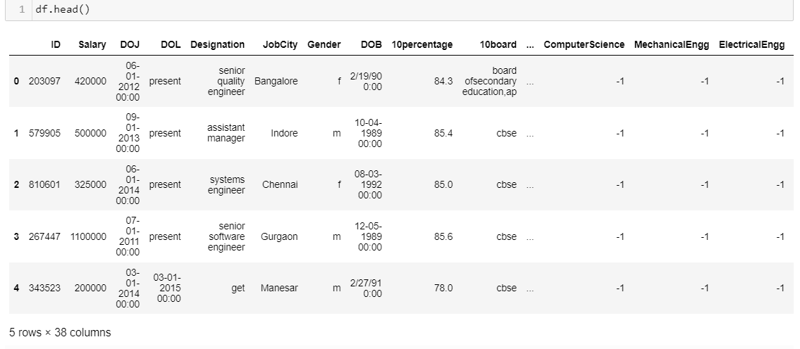
Dataset
Glimse of Dataset. This dataset consists of 38 properties with 3998 datapoints. Performing data cleaning and data analysis on above dataset and generating insights.

Slide 5
Data Description
The dataset was released by Aspiring Minds from the Aspiring Mind Employment Outcome 2015 (AMEO). The study is primarily limited only to students with engineering disciplines. The dataset contains the employment outcomes of engineering graduates as dependent variables (Salary, Job Titles, and Job Locations) along with the standardized scores from three different areas – cognitive skills, technical skills and personality skills. The dataset also contains demographic features.

Slide 6
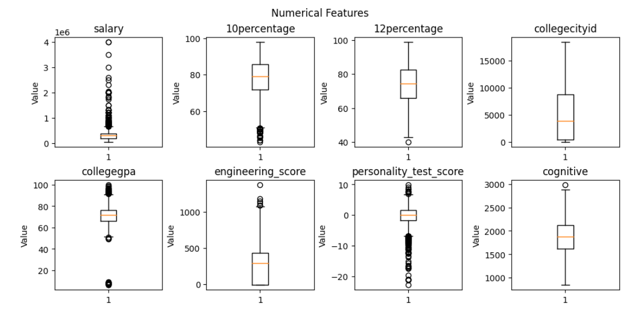
Visualization of Numerical Features

Slide 7
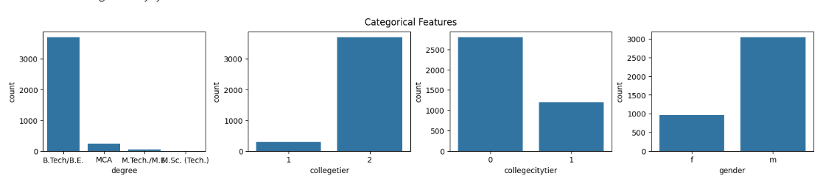
Data Distribution of Categorical Features

Slide 8
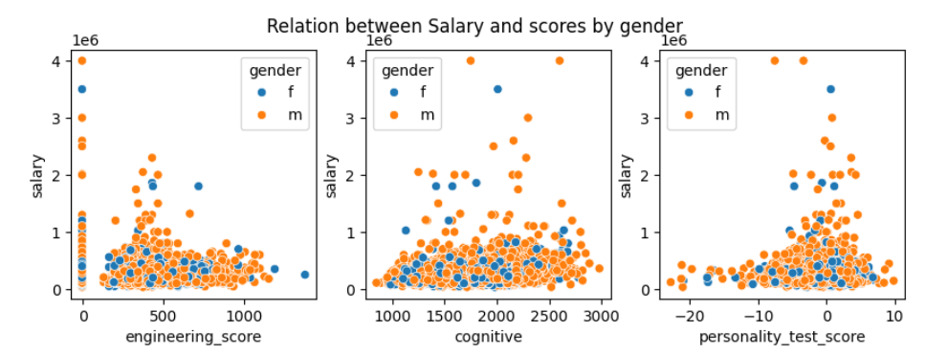
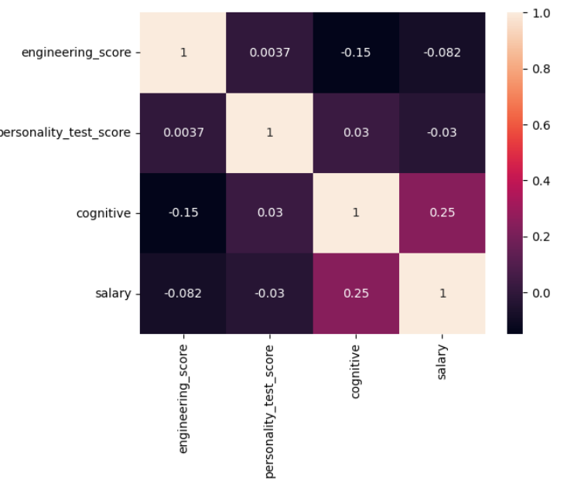
Salary On Scores
scores divided into 3 sectors: engineering, cognitive, personality.
most marks scored in cognitive and less in personality

Slide 9
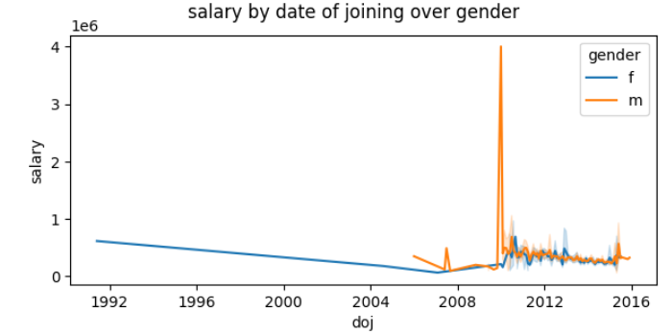
Salary by joining
Mostly men are having higher salary than females
Salary increased from 2008 to 2012

Slide 10
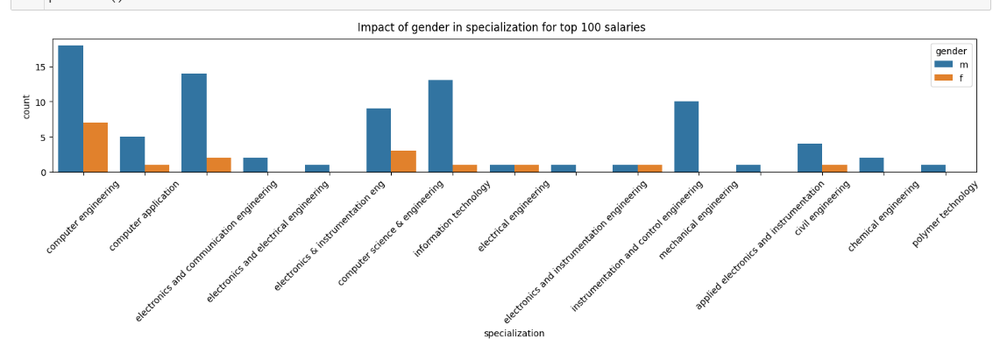
Gender VS Specialization
Mostly accepted computer engineering and least for polymer technology
Higher males than females. Gender is impacted.

Slide 11
Conclusion
The majority of students are BTech holders.
On average, junior managers receive higher salaries.
Engineering in communications and electronics pays more.
The majority of them had the lowest personality scores and the highest cognitive test scores.
Males earn more money than females do.
The majority come from computer engineering, with the least amount from polymer technology.

Slide 12

THANK YOU

