Slide 1

CODE REFACTORING AND BUG FIXING

Slide 2
About me
I'm Gaddam Huldah Grace, graduate in Computer Science Engineering from SR Engineering College in 2023. Passionate about the intersection of technology and data, I am eager to delve into the dynamic field of data science.
Github link: https://github.com/HuldahGrace
linkedin: https://www.linkedin.com/in/huldah-grace-gaddam/

Slide 3
SCENARIO:
A team of enthusiastic data scientists embarked on a mission to develop a Note Taking Application using Python, Flask, and HTML. However, their lack of experience in backend development has led to challenges in making the application fully functional. Recognizing your proficiency in backend development, you have been tasked with fixing the broken code and ensuring the application works seamlessly.
TASK TO DO:
Refactor the existing codebase and ensure the proper functioning of the Note Taking Application. Document all identified bugs during the debugging process. Remember, the task is not about recreating the app from scratch. Your goal is to fix the already existing codebase and make the application work as intended.

Slide 4
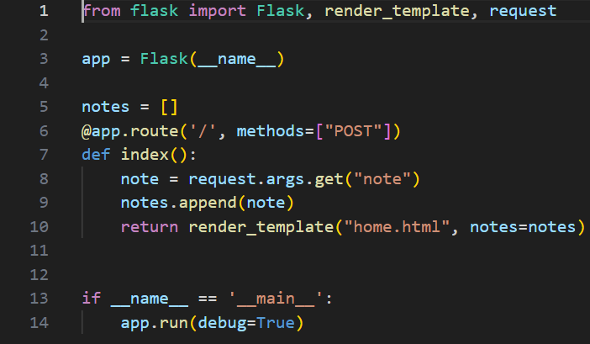
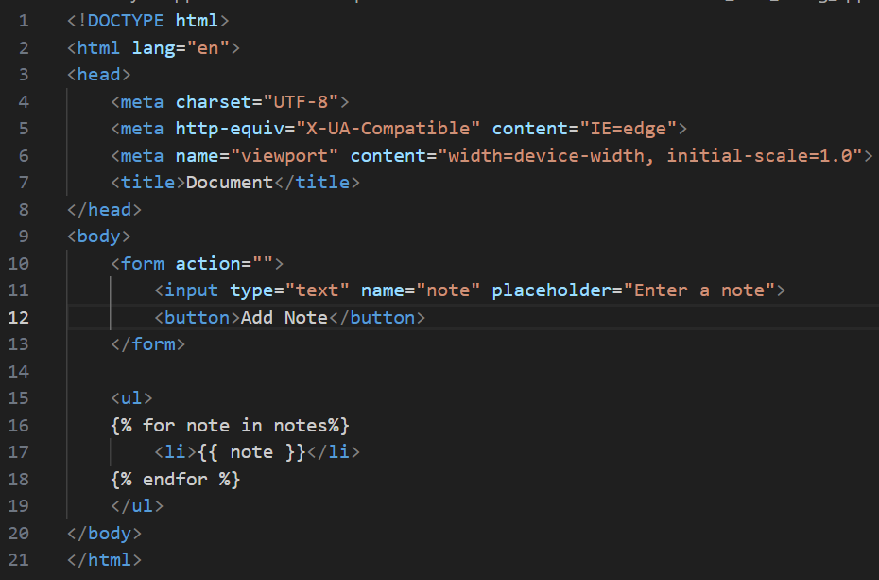
INITAIL CODE

Slide 5
IDENTIFYING BUGS IN CODE
Method should be added in form tag inorder to sent form data to the server.
If needed can add type attribute.
Add GET request to fetching data from the server to avoid error like Method not Allowed.
request.form is used to access form data submitted with a POST request so change request.args to request.form

Slide 6
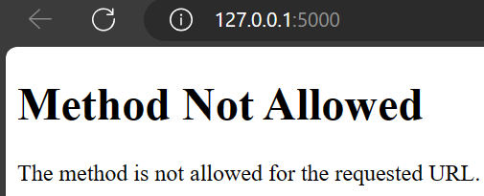
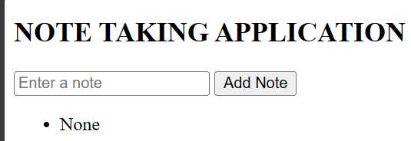
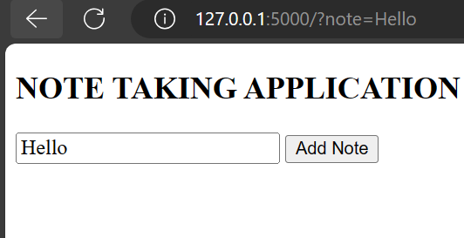
ERRORS OCCURED

Slide 7
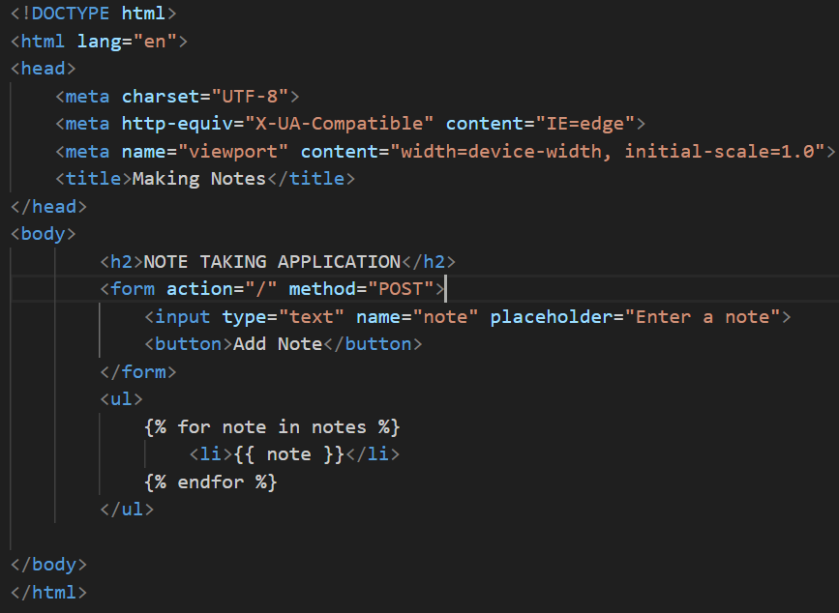
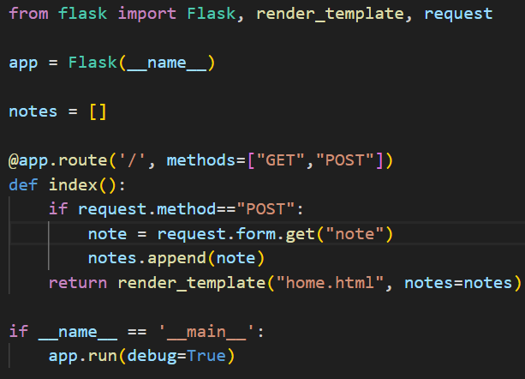
FINAL CODE

Slide 8
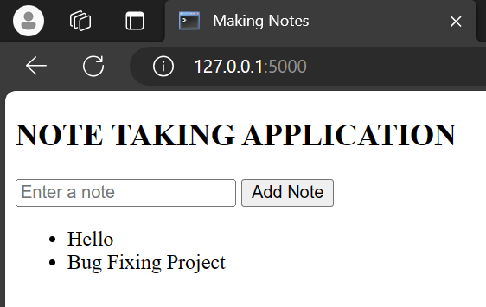
FINAL OUTPUT

Slide 9

THANK YOU

