Slide 1
1.2 Telecommunication churn
Gaddam Huldah Grace

Slide 2
Problem Statement
Build a predictive model to estimate the likelihood of customer churn for a telecommunication company.
The model should consider factors such as customer demographics, usage patterns, billing history, and customer service interactions.

Slide 3
Work Flow
Data Cleaning
Analysis
Feature Engineering
Predicting
Building model

Slide 4
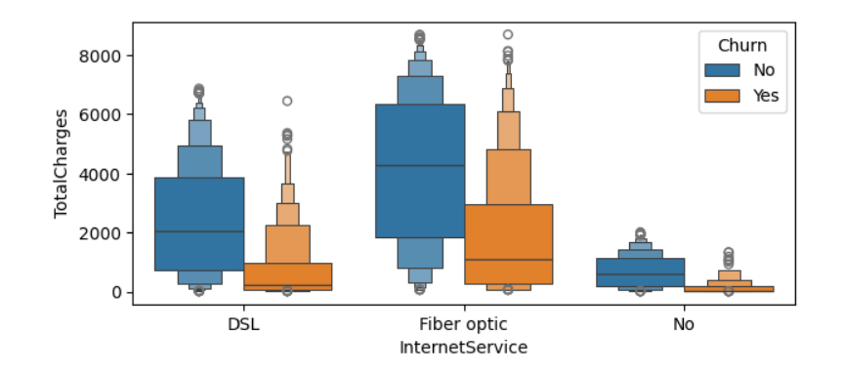
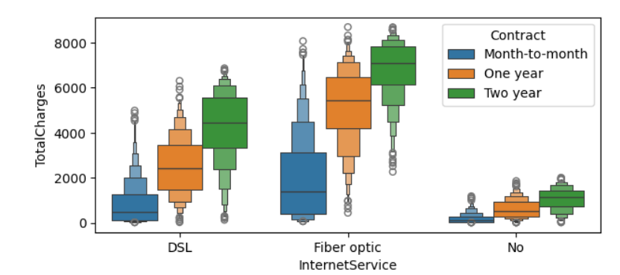
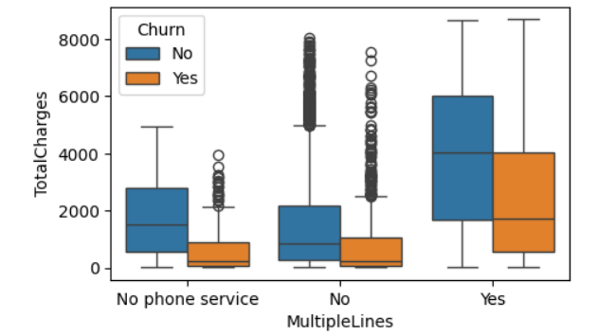
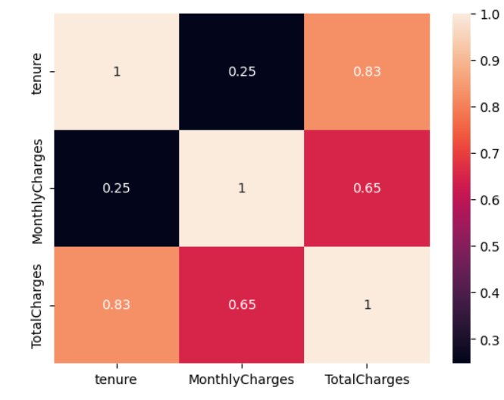
Analysis
Removed null values
TypeCasting
Performed Univariate, Bivariate , Multivariate analysis
Used Librabies: numpy, pandas, matplotlib, seaborn

Slide 5
Feature Engineering
For Both Test and Training Phase
Applied Standard Scaler for Numerical columns
Applied One Hot Encoding Technique for Categorical Columns

Slide 6
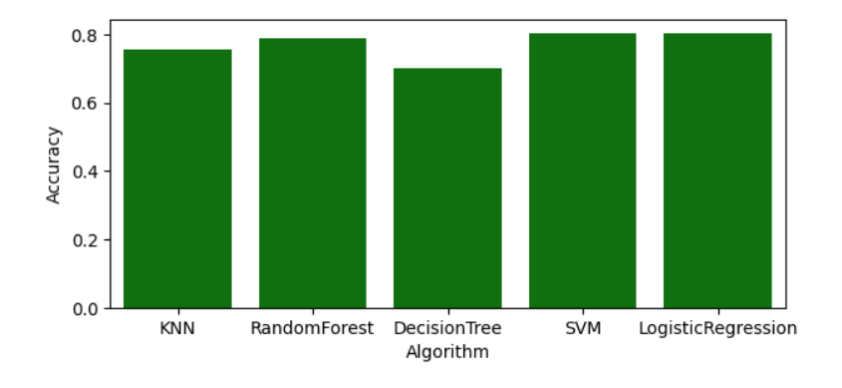
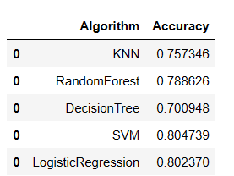
Result
Support Vector Machine has highest Accuracy

