Slide 1
Reading the Reading Room
Pneumonia classification from chest X-rays
Three baseline experiments, with declared reconstruction limits
Lung cropping with a CNN and ViT ensemble proposal
Samarth Shekhar 230042 Meghavi Rao 230044
Rachit Kumar 230128 Harshal Nerpagar 230076
Reading the Reading Room / Milestones 2 and 3
01
Notes:
All four members receive the same preparation guide, with no assigned slides. M2 reconstructs P7 through three declared experiments. M3 proposes lung cropping plus a pretrained small ViT with separate controls. Neither improvement has run. The shared guide and slide5 distinguish completed and pending scores.

Slide 2
Introduction and project objective
Task
Classify each pediatric chest X-ray as normal or pneumonia.
M2 objective
Reconstruct the published ensemble and report its actual errors.
M3 objective
Propose lung cropping and a pretrained ViT, with separate controls.
Reading the Reading Room / Milestones 2 and 3
02
Notes:
Meghavi. The task is normal-versus-pneumonia pediatric X-ray classification. Transfer learning uses features learned from larger datasets. M2 establishes the runnable baseline. M3 proposes cropping plus a ViT with separate controls. These are student benchmark experiments, with no clinical claim.

Slide 3
Literature reviewed in M1
Paper | Main idea
P1 Kermany 2018 | Pediatric CXR dataset and transfer learning
P2 CheXNet 2017 | DenseNet for chest X-ray classification
P3 Wang 2017 | Large chest X-ray dataset and localization benchmarks
P4 Stephen 2019 | Train a compact CNN from scratch
P5 Ayan and Unver 2019 | Compare VGG16 and Xception
P6 Rahman 2020 | Compare pretrained CNN backbones
P7 Chouhan 2020 | Five CNNs combined by majority vote SELECTED
P8 Rajaraman 2018 | CNN classification and activation-map interpretation
P9 Singh 2024 | Pretrained DeiT-Base Vision Transformer
Reading the Reading Room / Milestones 2 and 3
03
Notes:
Rachit summarizes only the lineage, not every result. We now pick P7. P9 is a useful recent comparison but it reports F1 and confidence intervals and uses a different split. Do not repeat the older claim that all papers use the identical test set. Sources for chosen papers: https://doi.org/10.3390/app10020559 ; https://pmc.ncbi.nlm.nih.gov/articles/PMC10827725/

Slide 4
Selected baseline and reconstruction protocol
P7 Chouhan et al. 2020
AlexNet, DenseNet121, InceptionV3, ResNet18 and GoogLeNet
Frozen early layers, trained late blocks, three-of-five vote
Paper partition | Normal | Pneumonia | Total
Train + original val | 1,349 | 3,883 | 5,232
Original test | 234 | 390 | 624
The 15-epoch audit held out 1,042 images and trained on 4,164.
The corrected five-epoch run uses all 5,232 with fresh image augmentation.
Paper schedules are 50 to 200 epochs. Author settings remain partly unknown.
Reading the Reading Room / Milestones 2 and 3
04
Notes:
P7 Figures4-8 specify early frozen weights and trainable late blocks/classifiers. Table1 has5232 training and624 test records. Run1 follows those counts with fixed cached features. Run2 deduplicates/reserves1042 validation and trains4164; selected epochs13,9,5,13,1 follow the predeclared validation criterion. Run3 restores5232 records, five fixed epochs and full-image FP32 training with fresh augmentation; BatchNorm running statistics update but early weights stay frozen. The paper schedules50-200 epochs and leaves author settings unspecified. The benchmark was inspected previously, not a blind holdout.

Slide 5
Three runs and their measured results
Run | Epochs | Train | Accuracy | Precision | Status
Initial cached | 5 | 5,232 | 87.18% | 83.12% | Complete
Cached audit | 15 | 4,164 | 85.74% | 81.55% | Complete
Online correction | 5 | 5,232 | 92.15% | 92.95% | Verified
Run 3 removes feature caching and samples new augmentation each epoch.
It restores the paper training partition and uses fixed epoch-five weights.
624 test records for every measured row. Crop and ViT remain untested.
Reading the Reading Room / Milestones 2 and 3
05
Notes:
Every speaker uses the same shared guide. Run1: original five epochs,5232 train, two fixed cached views. Run2: fifteen epochs,4164 train1042 group validation, four cached views cycled by epoch, validation-selected weights. Run3: five epochs,5232 train, full FP32 image forwards, fresh augmentation per example each epoch, ordinary BatchNorm running-statistics updates with paper weight boundaries, fixed final checkpoint. Pending has no final score. These bundled changes do not isolate epochs. All test scores use original624 records, fixed0.5 components and majority vote.

Slide 6
Final results compared with the paper
Metric | Paper reported | Our final 5 epochs
Accuracy | 96.39% | 92.15%
Pneumonia precision | 93.28% | 92.95%
Pneumonia recall | 99.62% | 94.62%
ROC AUC | 99.34% | 96.23%
Precision is close to the paper. Accuracy is 4.24 percentage points lower.
Our test: 624 images. Our training: 5 epochs per model. Paper: 50 to 200.
Several author settings remain unspecified, so this is a partial reproduction.
Reading the Reading Room / Milestones 2 and 3
06
Notes:
Say: Our ensemble correctly classified 92.15% of the 624 test images. Precision is close to the paper, but accuracy and pneumonia recall remain lower. This is a verified five-epoch baseline, not an exact match to the paper. The paper trained individual models for50-200 epochs and leaves several settings unspecified, so the gap cannot be attributed to epochs alone. Paper source: https://doi.org/10.3390/app10020559 . Our source: experiments/paper_online5/results/summary.json and independent_verification.json.

Slide 7
M3 proposed crop and CNN ViT system
Lung-focused input, complementary classifiers
1 Crop both lungs with a 10% margin
More input resolution for lung tissue, less peripheral variation
2 Combine the five CNNs with a pretrained small ViT
Patch self-attention may contribute different predictions
Two changes, separate hypotheses. Crop is the primary M3 change.
Weights and thresholds use validation only. Both improvements remain untested.
Reading the Reading Room / Milestones 2 and 3
07
Notes:
Rachit. The final proposal combines two interventions. Cropping remains the primary handout hypothesis, and the transformer is a separately tested extension. A fixed pretrained segmenter supplies both lung masks, crop union with10% margin on original pixels before224 resize. Start with ImageNet-pretrained DeiT-Tiny, not P9 DeiT-Base. Use probability aggregation with validation-only weights/thresholds and matching CNN-only aggregation controls. Neither crop nor ViT has run. Sources: https://github.com/mlmed/torchxrayvision ; https://github.com/facebookresearch/deit ; existing hybrid https://pmc.ncbi.nlm.nih.gov/articles/PMC10248870/

Slide 8
Comparisons and prediction before implementation
Run | Image region | Classifiers
A | Full X-ray | Five CNNs
B | Lung crop | Five CNNs
C | Full X-ray | CNNs plus pretrained ViT
D Final proposal | Lung crop | CNNs plus pretrained ViT
Combined prediction versus A
Macro F1 +0.01 to +0.04. Accuracy 0 to +3 percentage points.
Pneumonia recall loss no more than 2 points. Gains need not add up.
Reading the Reading Room / Milestones 2 and 3
08
Notes:
Harshal. A/B/C/D are planned, not results. B-A tests cropping, C-A tests ViT, D-B tests ViT on crops, D-C tests cropping in the hybrid. All use matched groups, per-model schedules and probability aggregation. Original P7 majority vote is separate, so improved voting cannot masquerade as ViT benefit. Crop prediction B-A macroF1+.01-.03, specificity+2-5pp. ViT prediction matched control macroF1+.01-.03 and accuracy+1-3pp. Combined D-A macroF1+.01-.04 and accuracy0-3pp with recall loss no more than2pp. Bounds cap at metric maxima and are not additive. JEPA and mixup remain optional future work.

Slide 9
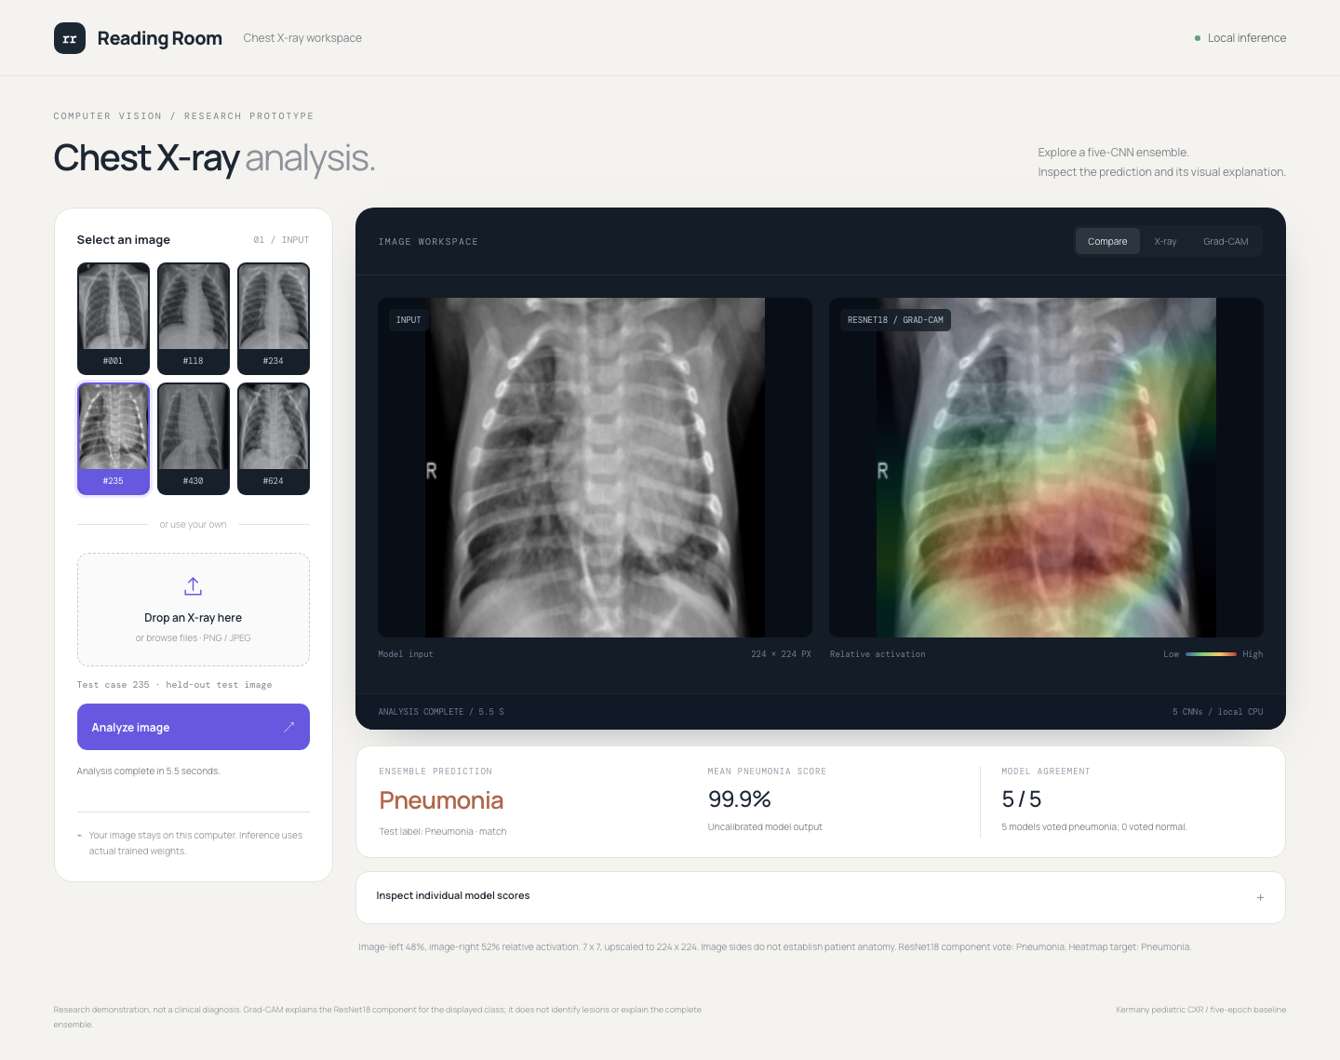
Live demo and next experiment
Real inference
Test samples or upload
Five trained CNN votes
ResNet18 Grad-CAM
Next: crop plus ViT
Four matched comparisons
No new crop or ViT results
JEPA and mixup later
Local demo: 127.0.0.1:8765. Demo uses original CNN weights. No clinical claim.
Reading the Reading Room / Milestones 2 and 3
09
Notes:
Samarth demonstrates the existing verified five-epoch CNN demo, which remains unchanged. Choose a sample or upload a PNG/JPEG, process, then explain the ResNet18 component Grad-CAM. The demo has no cropped input or ViT yet and is not a clinical diagnosis. Our proposed next system includes both, evaluated using A/B/C/D controls. JEPA and mixup are optional later experiments, not submission results.

