Slide 1

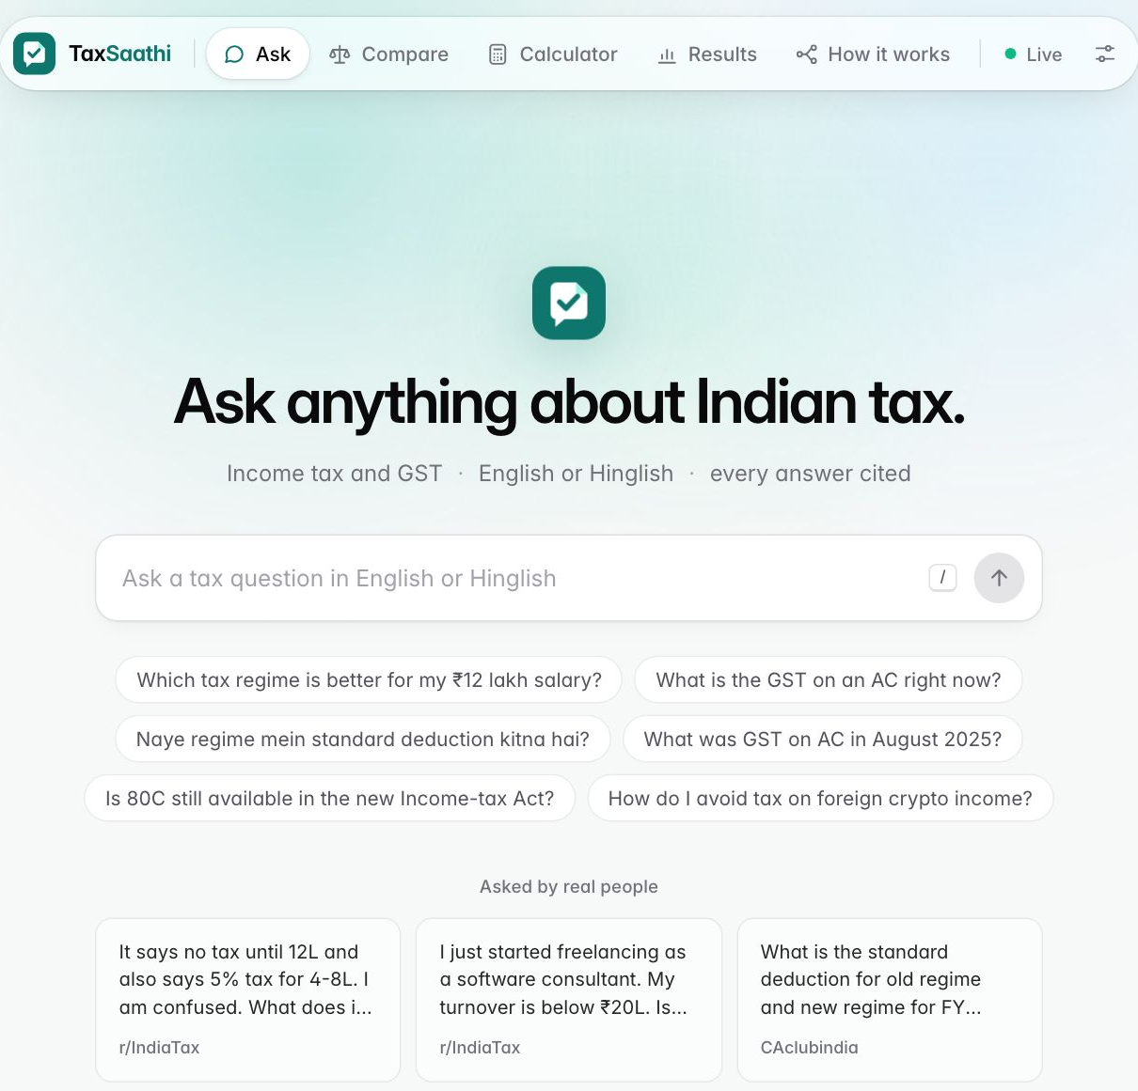
TaxSaathi
Ask an Indian tax question. Get a short answer that cites the official rule, for the right date.
Speech bubble
Folded corner
Check
your companion
an official source
verified
4th-year NLP course project · Team of 4 · 29 October 2026
The live app, 29 Oct 2026
Notes:
Good morning. We are presenting TaxSaathi.
"Saathi" means companion. It is a helper for Indian tax questions: income tax and GST, in English or in Hinglish.
Look at our logo. It is a speech bubble, because you chat with it. The top corner is folded like a page, because every answer comes from an official document. And there is a check mark, because the answer is checked: right law, right date, and every sentence has a source.
Three more promises. It knows the law changed, so it checks which date you mean. If it is not sure, it says so and sends you to a Chartered Accountant. And it never lets the AI do maths; a normal calculator program does that.
On the right is the real app, running live on our server.

Slide 2
Simple tax questions still need a paid CA
THE PROBLEM
1
2
3
Pay a CA
Search the web
Ask a chatbot
Typical fee ₹1,500–2,000, even for a one-line answer
Old blog posts and pre-reform rates, all mixed together
Sounds confident, shows no source, may not know the new law
7.8 crore+
1.67 crore
Most of these questions need one paragraph of the law, not a consultation.
income-tax returns filed for AY 2026-27
active GST taxpayers (June 2026)
TaxSaathi · NLP course project
2
Notes:
Here is the problem.
Most tax questions in India are simple. Which regime is better for me? What is the GST on cement now?
Today people have three options.
One: pay a CA. That costs money and time, even for a one-line answer.
Two: search the web. You get old blog posts mixed with new rules.
Three: ask a chatbot. It sounds sure of itself, but it shows no source, and it may not know the new law.
The scale is large. More than 7.8 crore income-tax returns were filed this year, and there are 1.67 crore GST taxpayers.
Our point: most of these questions only need one paragraph of the law, with a clear source.

Slide 3
Two big law changes in seven months
WHY NOW
22 Sep 2025
1 Apr 2026
GST 2.0
Income-tax Act, 2025
Most goods now 5% or 18%; a 40% rate for a few luxury and 'sin' goods
Replaces the 1961 Act: new section numbers and a new idea, the 'Tax Year'
Same question, different answer. "GST on an AC?" was 28% in August 2025. It is 18% today.
TaxSaathi · NLP course project
3
Notes:
Why build this now? Because the law changed twice, very quickly.
First, on 22 September 2025, GST 2.0 started. Most things now have 5% or 18% GST. A few luxury items have 40%.
Second, on 1 April 2026, a brand-new Income-tax Act came into force. It replaces the Act from 1961.
Section numbers changed. For example, the famous section 80C is now section 123. And it uses a new term, the "Tax Year".
So the same question has different answers depending on the date.
GST on an air conditioner was 28% in August 2025. Today it is 18%.
A chatbot trained on older internet text cannot know which one you mean. So in our system, the date is part of the question.

Slide 4
Who it is for
THREE PEOPLE WE DESIGNED FOR
P
Priya, 23
A
Arjun, 27
R
Ramesh-ji, 52
First salaried job, never filed
Freelancer, works for foreign clients
Hardware-shop owner, tier-3 town
"Old regime ya new regime, kaunsa better hai? Salary 9.5 lakh hai."
"I earn $5k a month remote. How much tax do I pay?"
"22 September ke baad cement pe GST kitna hai?"
NEEDS
NEEDS
NEEDS
A regime comparison she can trust
Right income type, and a clear 'see a CA' when it gets complex
Short, date-correct GST answers in Hinglish
TaxSaathi · NLP course project
4
Notes:
We designed for three people.
Priya is 23. She just got her first job. She wants to know: old regime or new regime? She often types in Hinglish.
Arjun is 27. He works remotely for foreign clients and is paid in dollars. He asks: I earn 5 thousand dollars a month, how much tax do I pay?
His case can get complicated, so he also needs the system to say "please see a CA" at the right time.
Ramesh-ji is 52. He runs a small hardware shop. He asks about GST on cement, in Hinglish, and the date matters a lot to him.
These personas are written by our team, but Arjun's question is almost word for word one that a real user typed into our app.

Slide 5
What TaxSaathi does: five promises
THE PRODUCT
1
Cites every sentence
"Standard deduction is ₹75,000" [1] → the card opens the official source
2
Uses the law for your date
"GST on AC in August 2025?" → 28% (the old rate), not today's 18%
3
Understands how people talk
"naye regime mein kitna", "1 lakh mahina", "$5k per month"
4
Says "ask a CA" when it should
"How do I avoid tax on foreign crypto?" → polite refusal + CA link
5
Exact maths, by a calculator
₹12 lakh salary → old regime ₹1,63,800, new regime ₹0
TaxSaathi · NLP course project
5
Notes:
TaxSaathi makes five promises.
One: every sentence has a citation, like a footnote. You can click it and see the official source.
Two: it uses the law for your date. Ask about August 2025, and you get the old GST rate.
Three: it understands how people really talk: Hinglish, "1 lakh mahina", or "5k dollars per month".
Four: it knows its limits. If you ask how to avoid tax on foreign crypto, it refuses politely and points you to a CA.
Five: the tax maths is done by a normal calculator program, not by the AI. On a 12 lakh salary, the new regime tax is zero and the old regime is 1 lakh 63 thousand 8 hundred.

Slide 6
Isn't this already solved?
LANDSCAPE
Kar Saathi
ClearTax and similar
General chatbots
TaxSaathi
Income Tax Dept, April 2026
Paid assisted filing
ChatGPT-style assistants
Open research prototype
• AI assistant in the new e-filing portal
• Filing, notices, refunds
• Accuracy and languages not published
• Experts file for you
• Plans from about ₹999
• Sells filing, not explanations
• Fluent answers
• No sources, no dates
• Even legal RAG tools hallucinate 17–33% (Magesh et al.)
• Every sentence cited, with dates
• Full step-by-step trace
• Published evaluation
• Free; hands hard cases to a CA
TaxSaathi is a student project and is not linked to the Income Tax Department.
TaxSaathi · NLP course project
6
Notes:
Is this already solved? Partly.
In April 2026 the Income Tax Department launched its own assistant, called Kar Saathi, inside the new filing portal.
We could not find published accuracy numbers or language support for it.
Companies like ClearTax sell assisted filing: an expert files for you, for a fee.
General chatbots are fluent, but they show no sources and no dates.
One study found that even legal research tools built on retrieval still make things up 17 to 33 percent of the time.
Our project is different in one way: everything is open. You see the source, the dates, every step, and our test results.
To be clear, we are a student project with no link to the government.

Slide 7
How it works: build a library once, then answer each question
SYSTEM DESIGN · FINAL VERSION C6
ONCE, BEFORE ANY QUESTION
Official sources
Acts 1961 & 2025, GST notices
Short cards
one rule each
Date stickers
valid from … to …
Two indexes
keywords + meaning
EVERY QUESTION
Tidy up
hide PAN · fix Hinglish
Sort
question / maths / off-topic
Find the date
which year's law?
Search twice
keywords + meaning, merged
Date filter
swap in the right year's version
Safety gate
reranker scores confidence
Calculator
all the numbers
AI writer
Qwen2.5-3B, on our server
Fact-check
cited sentences only
Answer
with sources + dates
Ask a CA
off-topic or unsure
TaxSaathi · NLP course project
7
Notes:
This is the whole system on one slide. There are two parts.
The grey part at the top is done once. Think of it as stocking a library.
We take official documents, cut them into small cards with one rule each, and put a date sticker on each card saying when that rule was valid. Then we build two indexes, like two catalogues for the same library.
The middle row runs for every question.
We hide personal numbers like PAN, and we fix Hinglish words. A small classifier sorts the question: a normal question, a maths question, or off-topic. We find the date the person is asking about.
Then we search twice and merge the results. The date filter removes cards from the wrong year, and if a card is out of date, it swaps in the same rule's version for that year.
The safety gate uses a second model, called a reranker, only to judge how confident we are. It does not change the order. That was an important lesson, which we show later.
At the bottom: numbers come from the calculator, the small AI model on our own server writes the explanation, and a fact-checker removes any sentence without a valid source.
If the question is off-topic or we are unsure, we refuse and suggest a CA.
This exact version is called C6, our final system. The teal boxes are explained on the next slides.

Slide 8
Search twice, then merge the two lists
STEP 1 · RETRIEVAL
Merged top 5 (illustration)
Keyword search (BM25)
Like the index at the back of a book: finds the exact words.
1
IT-DED-80C
high in both lists
2
IT-MAP-80C
Great for "80C", "Form 16", "44ADA"
Merge (RRF)
score = 1 / (60 + rank)
added up over both lists
high in one
3
IT-DED-80CCD1B
high in one
Meaning search (embeddings)
4
IT-DED-80D
Finds cards that mean the same thing in other words: "tax kam kaise karein" → deductions
lower
Uses rank, not raw score, so the two searches never need to agree on a scale.
IT-NEW-STDDED-TY2627
5
lower
TaxSaathi · NLP course project
8
Notes:
Our first step is search. We search in two different ways.
The first is keyword search, called BM25. It is like the index at the back of a textbook. It is very good at exact things like "80C" or "Form 16".
The second is meaning search, using embeddings. An embedding turns a sentence into a list of numbers, so sentences with similar meaning get similar numbers.
It can match "tax kam kaise karein" to the deductions card, even though the words are different.
Each search gives a ranked list. We merge them with Reciprocal Rank Fusion, or RRF.
Think of two judges in a competition. A card ranked high by both judges goes to the top. A card only one judge liked still gets a chance.
The formula: each card gets 1 divided by 60 plus its rank, added up over both lists.
The IDs on the right are an illustration of how this works.

Slide 9
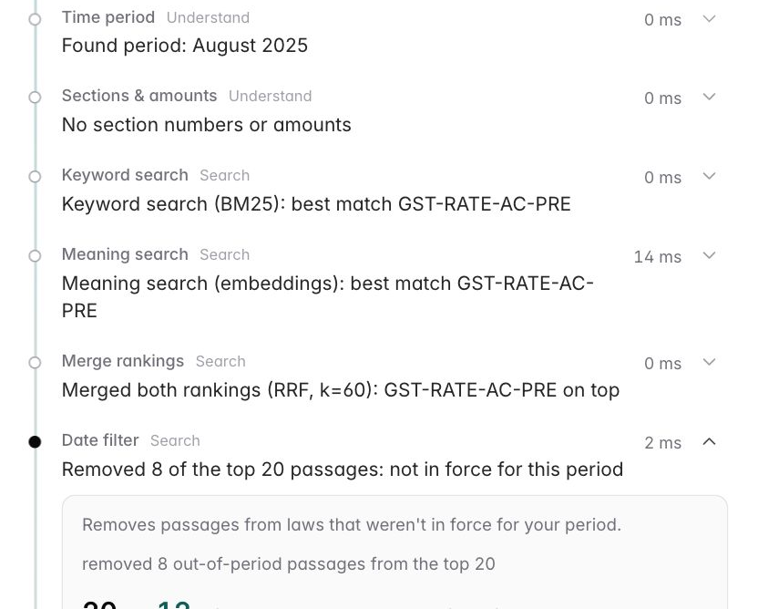
Every card has a date sticker
STEP 2 · THE RIGHT YEAR'S LAW
"What was GST on AC in August 2025?"
1 Jul 2017 → 21 Sep 2025
22 Sep 2025 → today
GST-RATE-AC-PRE
GST-RATE-AC-POST
AC at 28%
AC at 18%
KEPT: in force in Aug 2025
REMOVED: not yet in force
New: period swap. If a card is from the wrong year, the same rule's version for your year takes its place. Years before our sources keep the closest version.
Live trace: the date filter removed 8 of the top 20 passages
Hinglish phrasebook (rules, not AI): "salary pe tax kitna lagega" → "salary on tax how much will apply". Tax words like 80C are never changed.
TaxSaathi · NLP course project
9
Notes:
Our second step is about time.
Every card in our library has a date sticker: valid from this date, to that date.
The question is: what was the GST on an AC in August 2025?
We have two cards. One says 28 percent, valid until 21 September 2025. The other says 18 percent, valid from 22 September.
Because the question says August 2025, the date filter keeps the first card and removes the second.
New since our last update: period swap. If search finds the right rule but the wrong year's version, we do not just throw it away. We replace it with the same rule's version for the year you asked about. And if you ask about a year before our sources start, we keep the closest version instead of answering nothing.
On the right is the real trace from the live app. For this question the date filter removed 8 of the top 20 passages.
At the bottom: Hinglish. We use a simple phrasebook. "kitna" becomes "how much", "pe" becomes "on". Tax words like 80C are never changed. It is just a list of rules, so it is fast and easy to check.

Slide 10
Two safety checks: a bouncer and a fact-checker
STEP 3 · GUARDRAILS
1
The bouncer (safety gate)
2
The fact-checker (citation check)
Stops the question if:
• the sorter says it is off-topic, or
• even the best card gets a low score from a careful second reader (the reranker)
Sorter: TF-IDF + logistic regression, 342 training examples, 90% in 5-fold cross-validation
Result: "This needs a Chartered Accountant."
Reads every sentence the AI wrote:
• no card ID, or a made-up ID → deleted
• a number the calculator did not produce → removed
• "which regime is cheaper" always comes from the calculator
If too little is left, we show the best card's own text.
Result: no claim without a source.
TaxSaathi · NLP course project
10
Notes:
Our third step is safety. There are two checks.
The first is the bouncer at the door. It stops a question in two cases.
Case one: our sorter says the question is off-topic. The sorter is a simple classic model: TF-IDF plus logistic regression. It learned from 342 example questions, written separately from our test questions, and gets about 90% right in cross-validation.
Case two: a careful second reader, the reranker, reads the question and each card together. If even the best card gets a low score, we probably do not have the answer.
Then the system says: this needs a Chartered Accountant. Saying "I don't know" is a feature.
The second check is the fact-checker. The AI must put a card ID after every sentence. Any sentence with no ID, or a made-up ID, is deleted.
For calculation answers, any number the AI writes must come from the calculator, and the verdict, which regime is cheaper, always comes from the calculator. The AI only explains.
So every claim the user sees has a source.

Slide 11
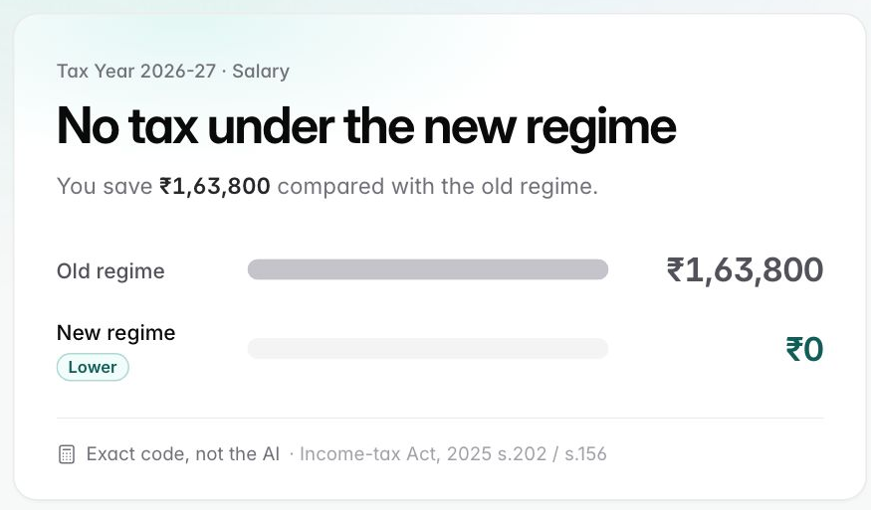
Maths is done by a calculator, never by the AI
STEP 4 · CALCULATOR
An AI doing tax maths is like a confident friend doing mental maths: usually close, sometimes badly wrong.
99
unit tests pass, incl. hand-worked examples
16/16
test calculations exactly right
0
numbers computed by the AI; it only explains
Live Calculator tab: ₹12 lakh salary, Tax Year 2026-27. Old regime ₹1,63,800, new regime ₹0 (rebate under s.156 of the 2025 Act).
TaxSaathi · NLP course project
11
Notes:
Our fourth step is the calculator.
Language models are bad at exact arithmetic. It is like asking a confident friend to do mental maths: usually close, sometimes badly wrong, and they never say "I'm not sure".
In tax, a small mistake costs real money. So the AI never computes anything.
We wrote a normal Python program instead. Same input, same output, every time. We call that deterministic.
It has 99 unit tests that pass, including examples we worked out by hand. On our answer key, all 16 calculation questions are exactly right.
It compares the old and new regime and says which one is cheaper. If you forget your salary, it asks you. It never guesses.
The screenshot is the live calculator. For a 12 lakh salary, the new regime tax is zero because of the rebate, and the old regime is 1 lakh 63 thousand 8 hundred.

Slide 12
Our data: a dated library and an answer key
DATA
Knowledge base (the library)
Answer key: 176 questions
107
17
short passages (cards)
official sources
72
100%
checked word-for-word against official pages
carry dates + a source link
GST 46 · General 23 · 1961 Act 16 · 2025 Act 12 · Map 10
Split 30 / 70: 53 dev · 123 test
We tune only on dev. The test set stays sealed until the final run.
Cards per law. Old and new versions of the same rule sit side by side, each with its own dates.
TaxSaathi · NLP course project
12
Notes:
Now our data. There are two parts.
First, the knowledge base: our library. It has 107 short passages from 17 official sources, like the Income-tax Acts of 1961 and 2025 and the GST Council notifications.
Every passage has dates and a source link. 72 of them we checked word for word against the official pages; the rest against reputable secondary sources.
Old and new versions of the same rule sit side by side, each with its own dates. That is what makes the date filter and the period swap possible.
Second, the answer key, which we call the gold set. It has 176 questions written by our team, with the correct passages and the key facts an answer must contain.
It includes 26 time-trap questions where the answer depends on the date, 18 off-topic questions that should be refused, and 12 in Hinglish.
We split it 30 to 70. We tune on the 53 dev questions only. The 123 test questions stay sealed, like a final exam paper we have not looked at.

Slide 13
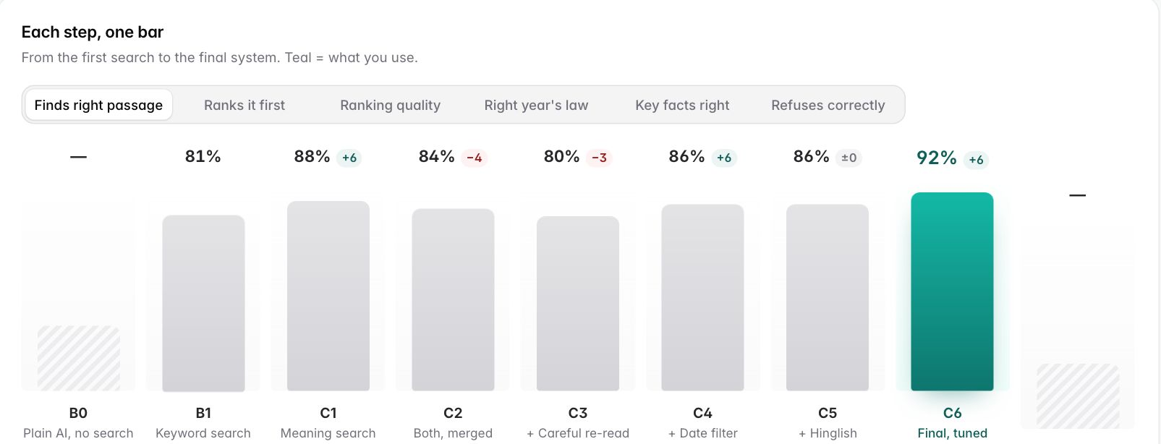
Experiment design: a ladder, one change per step
METHOD
B0
AI alone
no search
B1
Keywords
BM25
C1
Meaning
embeddings
C2
Both, merged
RRF
C3
+ reranker
reorders
C4
+ date filter
C5
+ Hinglish
C6
Final
reranker = gate only
Each step changes exactly one thing,
so any change in score comes from that one thing.
Recall@5
is the right card in the top 5?
MRR
how near the top is it?
Key facts
does the written answer contain them?
The same ladder, live in the app's Results tab
TaxSaathi · NLP course project
13
Notes:
How did we test this? With a ladder of experiments.
We start with the AI alone, B0. Then keyword search only, B1. Then meaning search only, C1. Then both merged, C2.
Then we add the reranker, then the date filter, then Hinglish. Finally C6, our final system.
The rule: each step changes exactly one thing. This is called an ablation study.
It is like cooking: add one spice at a time and taste after each, and you know which spice made the difference.
We measure three main things.
Recall at 5: is the right card somewhere in the top 5 results?
MRR, mean reciprocal rank: how close to the top is the first right card? First place scores 1, second place one half, third place one third.
Key facts: does the final written answer contain the facts from our answer key, like the right amount?
The app has a Results tab that shows this same ladder, shown on the right.

Slide 14
Results: the final system finds the right rule most often
RESULTS · 53 DEV QUESTIONS
0.92
Recall@5
keywords alone: 0.81 · target 0.85
0.83
MRR
keywords alone: 0.73
1.00
period accuracy
meaning search alone: 0.75
B0 AI alone (no search, so no bar) · B1 keywords · C1 meaning · C2 both merged · C3 + reranker reorders · C4 + date filter · C5 + Hinglish · C6 final. Axis starts at 0.5.
C3 dip: reranker reorders, MRR 0.755 → 0.656
TaxSaathi · NLP course project
14
Notes:
Here are the search results on the 53 dev questions. Higher is better. Light bars are Recall at 5, dark bars are MRR, and the teal pair is our final system.
B0, the AI alone, does not search at all, so it has no bars here. We judge it on the next slide.
Keyword search alone, B1, gets a Recall at 5 of 0.81 and an MRR of 0.73.
Meaning search alone, C1, finds the right card more often, but ranks it lower, and it gets the year wrong a quarter of the time.
Merging both, C2, gives the best balance of the simple systems.
Look at C3: when we let the reranker reorder the list, MRR dropped from 0.755 to 0.656. That surprised us.
The date filter, C4, makes period accuracy perfect: the system always picks the law for the right date.
Our final system, C6, is the best on every search score: Recall at 5 of 0.92, MRR of 0.83, and nDCG of 0.83.
That means for about 92 out of 100 questions, the right card is in the top 5. Our target, set before building, was 0.85.

Slide 15
Same AI model: 10% right alone, 69% with TaxSaathi
RESULTS · ANSWER QUALITY, 53 DEV QUESTIONS
Key facts right, by step (configs run with the AI writer)
10%
69%
key facts right: the AI alone (B0), answering from memory
key facts right: the same AI inside TaxSaathi (C6)
1.00
citations valid
1.00
sentences backed by a source
100%
off-topic questions refused
2.1%
good questions wrongly refused
Median answer time 16.8 s on our 4-core CPU server (no GPU).
TaxSaathi · NLP course project
15
Notes:
This is the slide that matters most.
We took the same small AI model, Qwen 2.5 with 3 billion parameters, running on our own server.
Alone, answering from memory, it got the key facts right only 10% of the time. It states the old rules, like the old slabs and 28 percent GST on ACs, and it never cites anything.
Put the same model inside TaxSaathi, and it gets 69% right. That is about six to seven times better, with no change to the model. Only the search, the dates and the checks changed.
And the answers are safe. Citation validity is 1.00: every citation points to a card we actually gave it. 1.00 of sentences are backed by a source. Every off-topic question was refused, and only 2.1% of good questions were wrongly refused; that is one question out of 48.
The honest part: one answer takes about 16.8 s, because the AI runs on a normal CPU without a graphics card.

Slide 16
Targets we set at the start: 4 of 5 met
SCORECARD
Target (fixed in milestone 1)
Goal
C6 result
Finds the right card (Recall@5)
≥ 0.85
0.92
MET
Answers backed by sources (faithfulness)
≥ 0.90
1.00
MET
Refuses off-topic questions
≥ 90%
100% (2.1% false)
MET
Calculator exactly right
100%
100% (16/16)
MET
Median answer time
≤ 5 s
16.8 s on CPU
NOT YET
Dev set, 53 questions. Latency needs a GPU or a hosted model: planned for milestone 5.
TaxSaathi · NLP course project
16
Notes:
At the very start of the project, in milestone 1, we wrote down five targets. Here is how the final system did.
Finding the right card: target 0.85, we got 0.92. Met.
Answers backed by sources: target 0.90, we got 1.00. Met. This is a simple automatic check; a stricter AI-judge version is planned.
Refusing off-topic questions: target 90 percent, we got 100%, with only 2.1% false refusals. Met.
Calculator: target 100 percent exact, we got 100 percent, all 16 calculations. Met.
Speed: target 5 seconds. We got 16.8 s. Not met. The time is almost all the AI model writing on a CPU. With a graphics card, or a hosted model, this should drop a lot. That is planned for milestone 5.
So: 4 of 5 targets met, and we know exactly why the fifth is not.

Slide 17
What we learned
THREE TAKEAWAYS
1
2
3
Two searches beat one
Dates need rules, not hope
Surprise: the "smarter" model hurt
Keywords catch "80C"; meaning catches paraphrases. Merged, MRR went 0.73 → 0.76.
Meaning search alone picked the right year 75% of the time. With the date filter: 100%.
Letting the reranker reorder dropped MRR 0.755 → 0.656. Used only as a safety gate (C6): 0.830.
The reranker's model card lists English and Chinese only. The multilingual version took about 25 s per question on our CPU: future work with a GPU.
TaxSaathi · NLP course project
17
Notes:
We learned three things.
One: two searches are better than one. Keyword search is great at exact codes like 80C. Meaning search is great when people use different words. Together they cover each other's blind spots.
Two: dates need clear rules. Meaning search alone picked the right year only 75% of the time. With our date filter it became 100%. We did not hope the AI would figure out dates. We wrote the rule.
Three was a surprise. The reranker is a slower, more careful model. We expected it to improve the order. It made it worse: MRR dropped from 0.755 to 0.656.
When we read its model card, we saw it was trained for English and Chinese only, and it often confused cards from different years.
So in our final system we kept the merged order and used the reranker only as the bouncer's confidence score. That gave our best result, an MRR of 0.83.
The lesson: measure every change. A fancier model is not always better.

Slide 18
Real people, real questions
REAL-WORLD CHECK · 80 QUESTIONS, NOT USED FOR TUNING
80
real questions people asked online, plus official FAQs
78%
right rule found, on fully covered questions
Reddit 36
Official FAQs 25
CAclubindia 12
Quora 7
Exact passage: 0.62. Most of the gap is time: 2025 posts ask about last year's law, while TaxSaathi answers with today's.
Does our library cover them?
Fully 64%
Partly 23%
Not 14%
57%
of real off-topic questions refused
Most common real confusion (10 posts):
"No tax up to ₹12 lakh, but 5% from ₹4 lakh?"
Both are true (slabs + rebate). We added an explainer card.
Real off-topic questions (NRI, crypto, US stocks) are harder than ours. Our clearest next step.
TaxSaathi · NLP course project
18
Notes:
Our answer key was written by us. So we also checked TaxSaathi on real questions that real people asked.
We collected 80: 36 from Reddit, 25 from official government FAQ pages, 12 from the CAclubindia forum, and 7 from Quora. We did not tune anything on them.
First question: does our library even cover them? 64% fully, 23% partly, and 14% not at all. Real forum posts often mix several problems in one.
On the fully covered ones, TaxSaathi finds the right rule 78% of the time. By exact passage it is 0.62. Most of that gap is about time: many posts are from 2025 and ask about last year's law, while TaxSaathi deliberately answers with the law in force today.
The most common confusion, in 10 posts: "no tax up to 12 lakh, but 5 percent from 4 lakh?" Both are true, because of the rebate. Our library did not explain this clearly, so we added an explainer card.
The weak spot: only 57% of real off-topic questions were refused. Real people ask about NRI rules, crypto and US stocks in ways our sorter had not seen. That is our clearest next step.

Slide 19
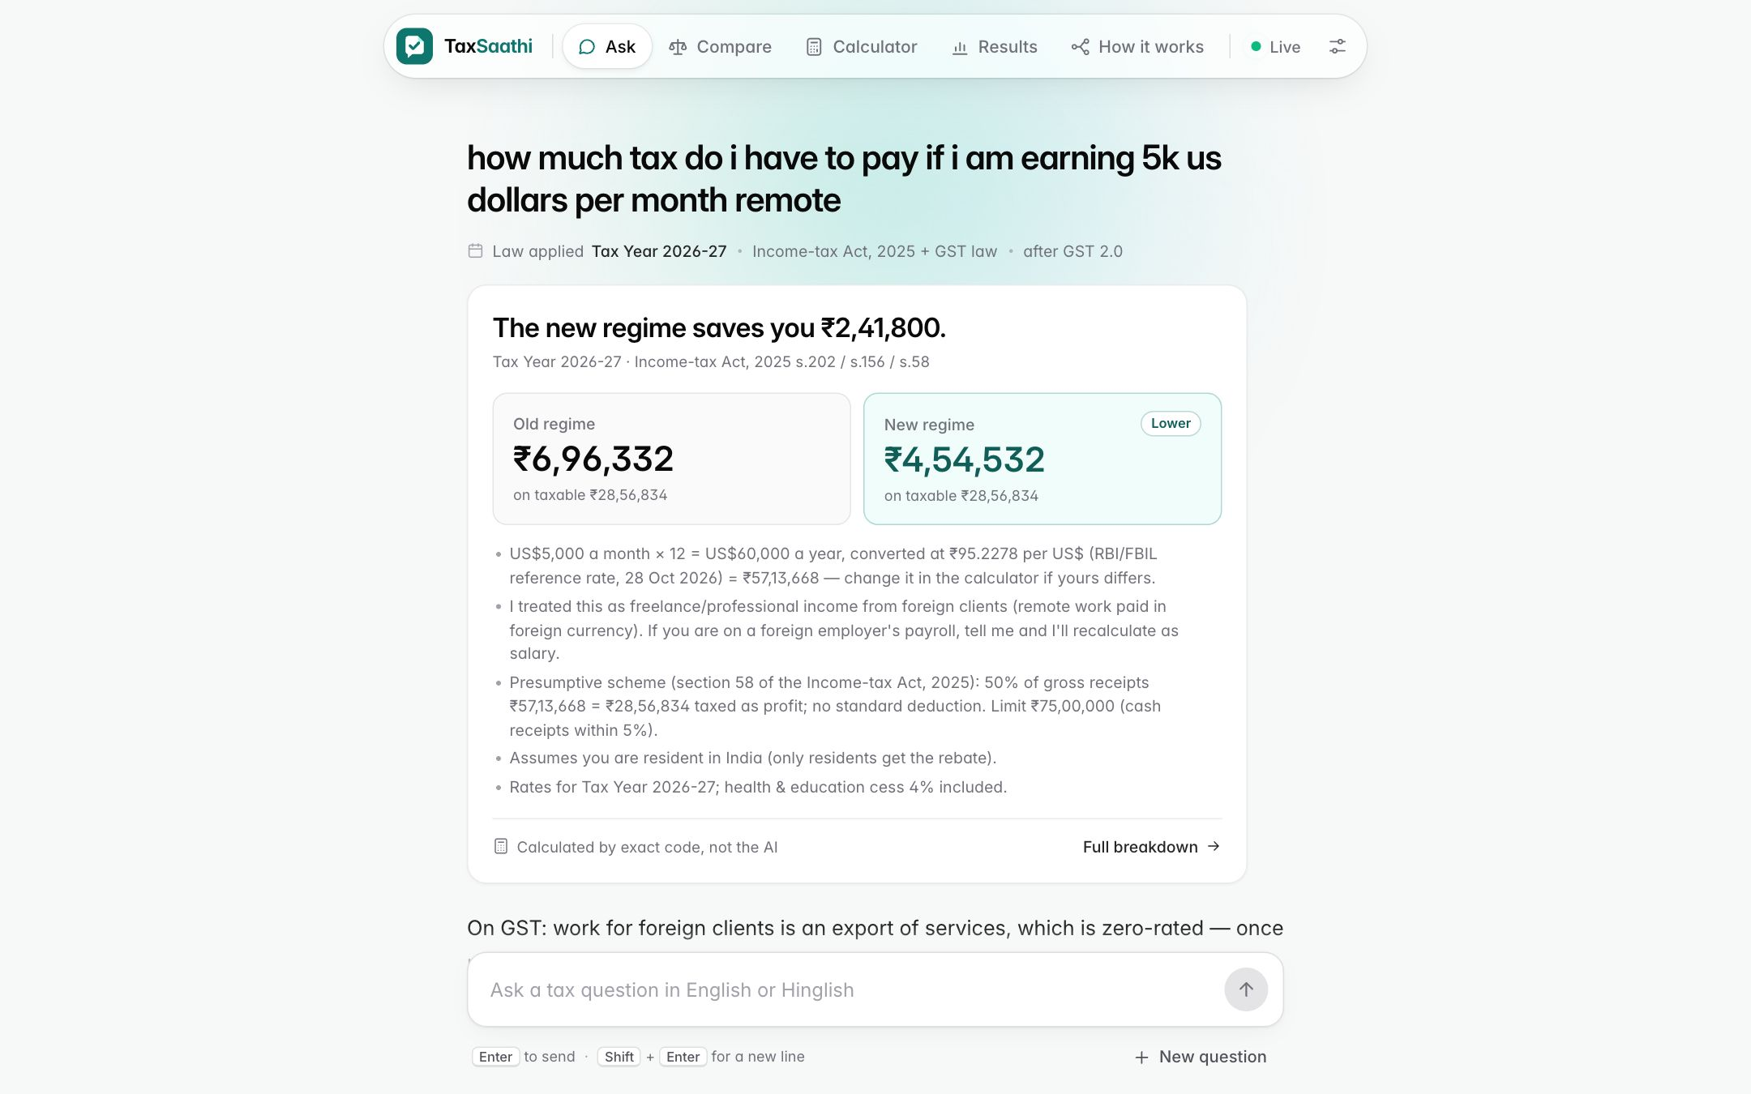
Real users taught it new tricks
BUILT FROM REAL-USER TESTING
"$5k per month"
US$5,000 × 12 at the RBI reference rate → ₹57,13,668 a year
"1 lakh mahina"
₹1 lakh a month → ₹12 lakh a year
"remote, foreign clients"
Freelance income under section 58 (old 44ADA): 50% counted as profit
Tax for US$5,000 a month (Tax Year 2026-27):
New regime
₹4,54,532
Old regime
₹6,96,332
Live answer, 29 Oct 2026 (about 34 s on our CPU server)
TaxSaathi · NLP course project
19
Notes:
When we watched real people use the app, they typed things our system did not understand at first.
"I earn 5k dollars per month." "1 lakh mahina." "I work remotely for foreign clients."
So we taught it. It now reads currency and per-month amounts. 5 thousand US dollars a month becomes 60 thousand dollars a year, converted at the Reserve Bank reference rate, which is about 57 lakh rupees. "1 lakh mahina" becomes 12 lakh a year.
And remote work paid by foreign clients is treated as freelance income under section 58 of the new Act, which used to be 44ADA. Under that scheme, half of what you receive is counted as profit.
On the right is a live answer from our app. For 5 thousand dollars a month, the new regime tax is 4 lakh 54 thousand 532 rupees, and the old regime is 6 lakh 96 thousand 332. The calculator produced every number. The answer also says its assumptions: that you are resident in India, and that if you are actually on a foreign company's payroll, you should tell it so it can recalculate as salary.
Every change was re-tested on our dev set with no drop in scores.

Slide 20
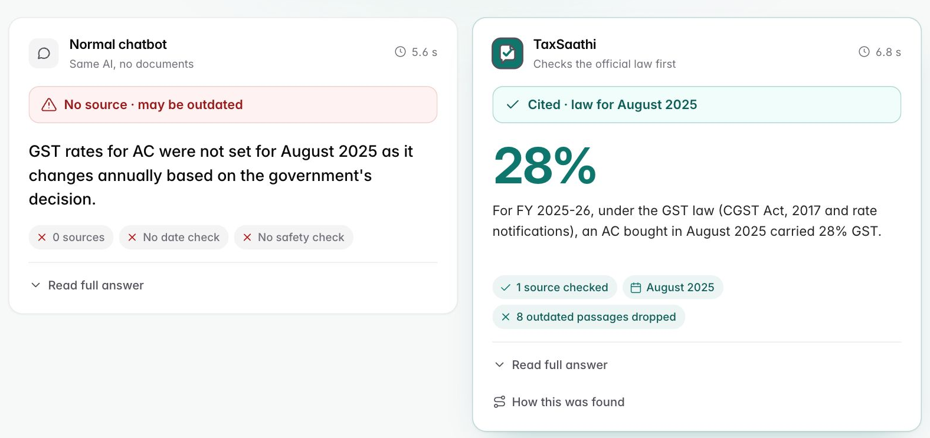
Live demo: five questions
DEMO
1
Plain AI vs TaxSaathi
"What was GST on AC in August 2025?"
2
Hinglish
"Naye regime mein standard deduction kitna hai?"
3
Old section number
"Is 80C still available in the new Income-tax Act?"
4
Real-user calculation
Live Compare tab, question 1: the plain AI says the rate was "not set" (wrong). TaxSaathi says 28% for August 2025, with its source.
"how much tax do i have to pay if i am earning 5k us dollars per month remote"
5
Off-topic, so it refuses
https://taxsaathi.taild58d86.ts.net
New questions take 15–40 s on our CPU. Backup screenshots on the next slide.
"How do I avoid tax on foreign crypto income?"
TaxSaathi · NLP course project
20
Notes:
Now we show the live app. We have five questions.
One, in the Compare tab: the plain AI and TaxSaathi get the same question, GST on an AC in August 2025. The plain AI says the rate was "not set", which is wrong. TaxSaathi says 28 percent and shows the source and the date. Point out "8 outdated passages dropped".
Two, in the Ask tab: the Hinglish question about standard deduction. Open "How this was found" to show the Hinglish fix and the date step. The answer is 75 thousand rupees, citing section 19 of the 2025 Act.
Three: "Is 80C still available?" 80C is from the old 1961 Act. The answer explains it is now section 123, still up to 1 lakh 50 thousand, and shows the mapping card.
Four: the real user's question about 5 thousand US dollars a month. The calculator gives both regimes; the new regime is cheaper.
Five: "How do I avoid tax on foreign crypto income?" The bouncer stops it and suggests a Chartered Accountant.
A new question takes 15 to 40 seconds because the AI runs on a normal CPU. While we wait, we explain the step-by-step trace.
If the internet fails, the next slide has screenshots of all five answers, taken from the live app.

Slide 21
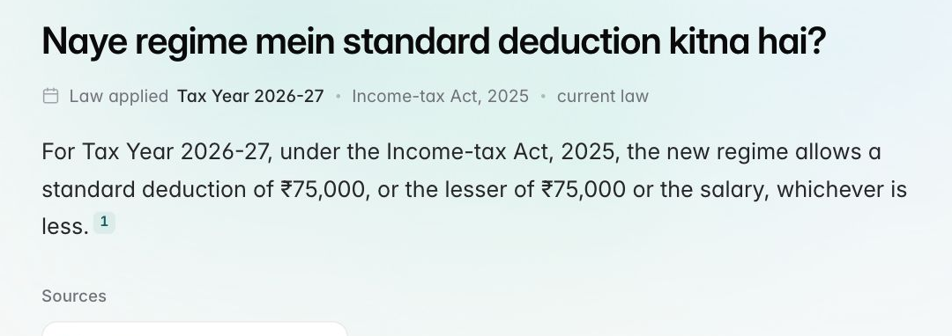
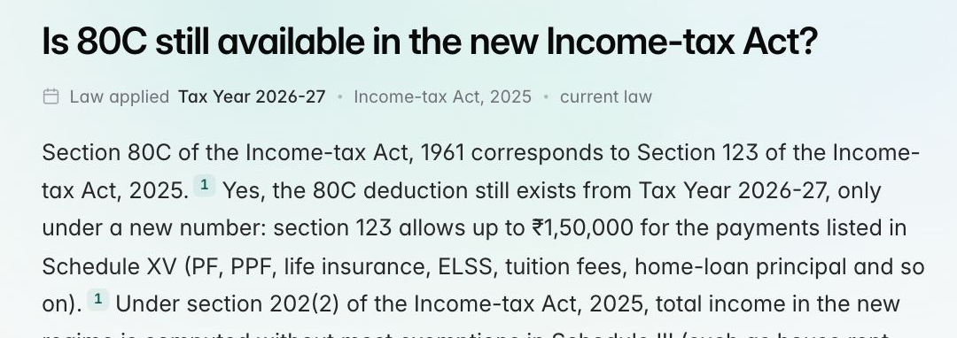
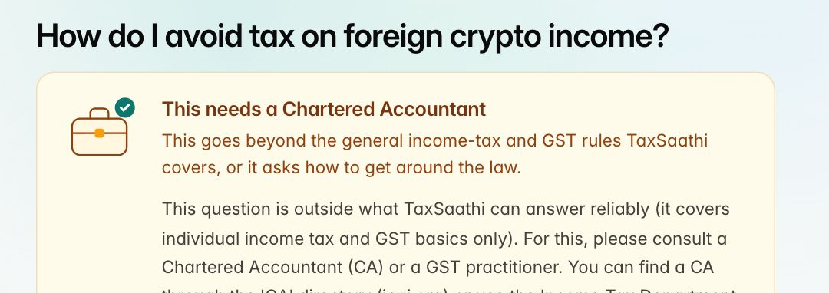
Demo backup: real answers from the live app
IF THE WI-FI FAILS
2 · Hinglish: ₹75,000, from s.19 of the 2025 Act
3 · 80C is now section 123, still up to ₹1,50,000
4 · US$5k a month: new ₹4,54,532 vs old ₹6,96,332
5 · Crypto tax avoidance: refused, ask a CA
TaxSaathi · NLP course project
21
Notes:
This slide is our backup if the live demo fails. All four are real answers from the live app, captured on 29 October.
Top left: the Hinglish question. Standard deduction is 75 thousand rupees under the new regime, with section 19 of the 2025 Act as the source.
Top right: 80C. It is now section 123 of the new Act, still up to 1 lakh 50 thousand rupees, and the answer cites the mapping card.
Bottom left: 5 thousand US dollars a month. New regime 4 lakh 54 thousand 532 rupees, old regime 6 lakh 96 thousand 332. The calculator did the maths.
Bottom right: the crypto question is refused with a link to find a Chartered Accountant.
Question one, the AC comparison, is on the previous slide.

Slide 22
Limits, ethics, and what comes next
HONEST ABOUT THE GAPS
Limits today
Next milestones
Slow: 16.8 s per answer on a CPU
M4
Run the sealed test set once; study the errors; better off-topic sorter from real questions
Only 57% of real off-topic questions refused
M5
GPU or hosted model to reach 5 s; multilingual reranker; CA review of the answer key
Curated summaries, not the full Acts
Answer key written by us, not yet checked by a CA
M6
Small user study with our three personas
Not advice: every answer has a disclaimer + CA link
Agent
AI picks tools (search, calculator, follow-up); calculator + fact-check stay hard rules
PAN, Aadhaar, phone numbers hidden before logging
TaxSaathi · NLP course project
22
Notes:
We want to be honest about what is missing.
It is slow: about 16.8 s per answer, because the AI runs on a CPU.
Real off-topic questions are harder than ours: only 57% were refused.
Our library is made of careful summaries, not the full text of the Acts.
Our answer key was written by us. A real CA has not checked it yet.
On ethics: this is general information, not professional advice. Every answer says so and links to a CA. We hide PAN, Aadhaar and phone numbers before anything is logged.
Next steps. In milestone 4 we run the sealed test set once, study the errors, and retrain the off-topic sorter using what we learned from real questions.
In milestone 5, a GPU or a hosted model to meet the 5-second target, a multilingual reranker, and a CA review of our answer key.
In milestone 6, a small user study.
Later, an agent layer: the AI could choose its own tools, but the calculator and the fact-check stay as hard rules it cannot skip.

Slide 23
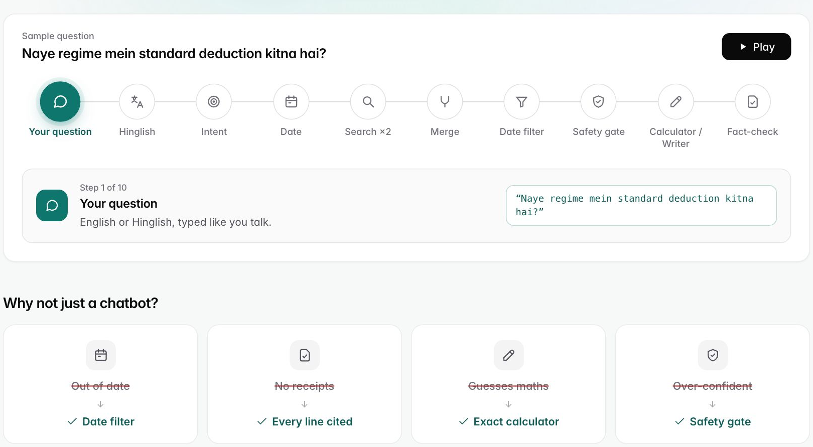
Thank you. Questions?
Who presents what
P1
Problem & data
P2
Search & results
Law changes, personas, library, answer key, real questions
Keyword + meaning search, merging, date filter, results
P3
Language & safety
P4
Calculator & demo
Hinglish, sorter, safety gate, fact-check, privacy
AI writer, calculator, real-user fixes, live demo
Try it: https://taxsaathi.taild58d86.ts.net
Code, data card, experiment log, report and viva notes are in our repository.
23
Notes:
Thank you for listening.
Here is how we split the work. Person 1 covered the problem, the data and the real questions. Person 2 covered search and the results.
Person 3 covered Hinglish and the safety checks. Person 4 covered the calculator, the AI writer, and the demo.
Each of us will take questions on our own part.
On the right is the app's "How it works" tab. It plays every step for a sample question. The app is live at the address on the slide if you would like to try it.
We are happy to take your questions.

