Slide 1
CMSC 432 – Operating Systems
Instructor: Dr. Nathan Backman
Location: ESSC 126
Time: Tuesday & Thursdays
12:00pm – 1:15pm

Slide 2







Desktop Operating Systems (the big 3)
Market:
87.56%
9.54%
2.35%
http://www.netmarketshare.com/operating-system-market-share.aspx
Mobile Operating Systems (the big 4)
Market:
0.01%
0.00%
28.26%
71.24%
http://www.netmarketshare.com/operating-system-market-share.aspx?qprid=8&qpcustomd=1

Slide 3
What is an Operating System?
Provides abstractions to utilize underlying hardware facilities
Manages shared resources
Processors
RAM
Disks
Network interfaces
User IO peripherals
Displays, keyboards, mice, etc.

Slide 4
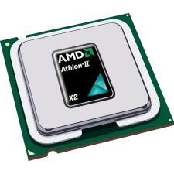
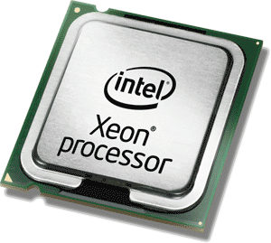
Managing Processors
Q: Why is this important?
A: Because only one thing can happen at a time! (per processor/core)
Who gets to decide what work is done and when?
Multitasking is somewhat of an illusion thanks to multiplexing at the processor

Slide 5
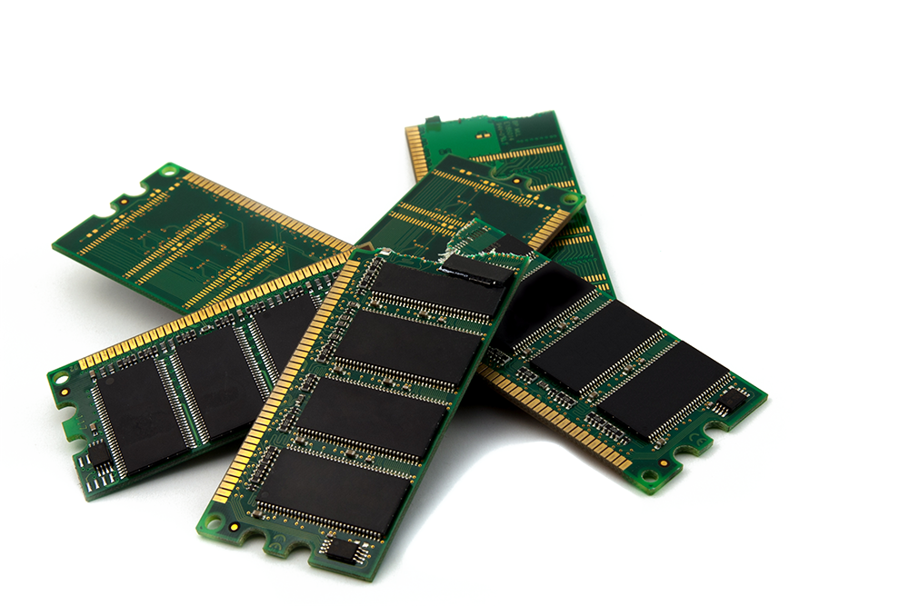
Managing RAM
Q: Why is this important?
A: Because someone needs to decide where we can read/write data to/from and load instructions!
Programs/programmers need to be encapsulated (sandboxed) and protected from each other.
Someone needs to keep track of how much (and which) memory has been claimed.

Slide 6
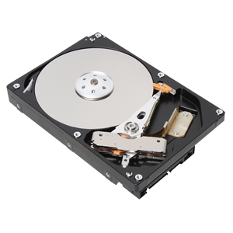
Managing Disks
Q: Why is this important?
A: Because we can’t function without some kind of order and disks are just collections of blocks!
Can’t expect programmers to know what blocks are or are not free.
Don’t want programmers to have to remember where they left their data.

Slide 7
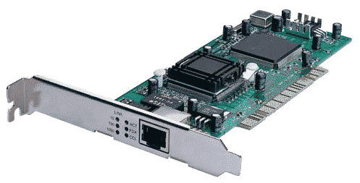
Managing Network Interfaces
Q: Why is this important?
A: Because a dozen processes can’t “talk on the phone” at the same time!
There needs to be a mediator when multiple programs want to use a bus.
Likewise for receiving data – we need to decide which program will get it.

Slide 8
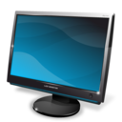
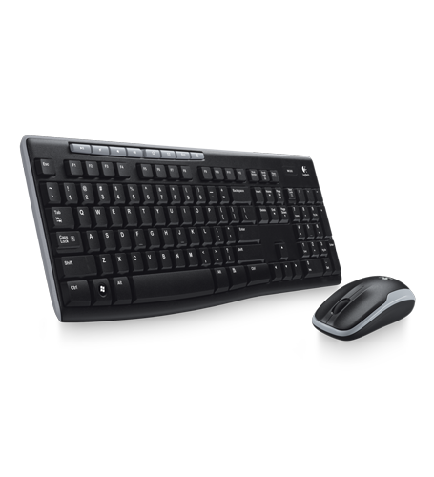
Managing User IO Peripherals
Q: Why is this important?
A: Because we need to facilitate interaction between users and programs!
Everyone can’t control these devices at once.
Need to tie the interactions of the user to a particular program.

Slide 9
The Process Abstraction
It encapsulates everything we need to know about executing the program at hand.
What does a program normally keep track of when executing?
Data
Global/static variables
Local variables
Dynamically allocated memory
Call stack information (stack frames)
Code

Slide 10
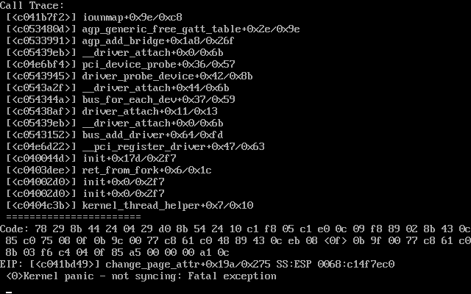
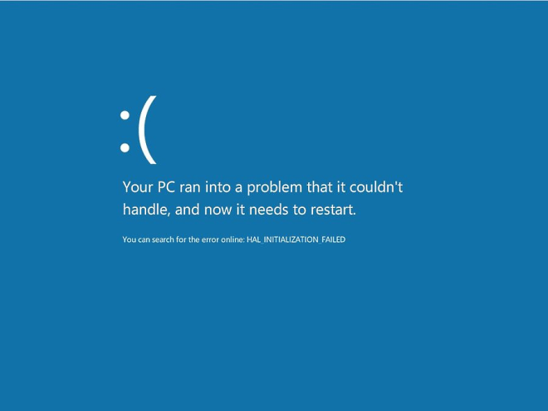
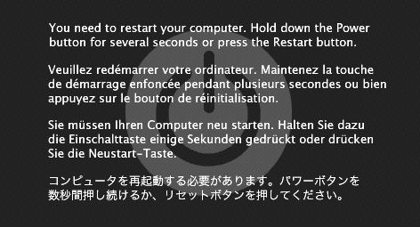
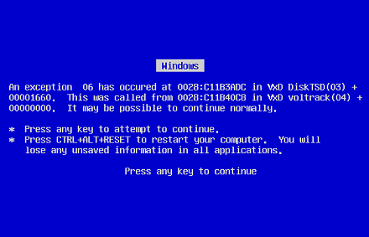
What’s left to be done?
Q: Are operating systems perfect?
Do you have any complaints?
Issues still common today
Crashes
Security / vulnerabilities
Corruption / data loss
Performance

Slide 11
A Brief History of Operating Systems

Slide 12
Prior to Operating Systems
Early computers didn’t have them
You would completely and explicitly program them. You provided the very first/last instruction.
No resource sharing – it’s all yours!
Feed in your tape / punch card and let it run

Slide 13
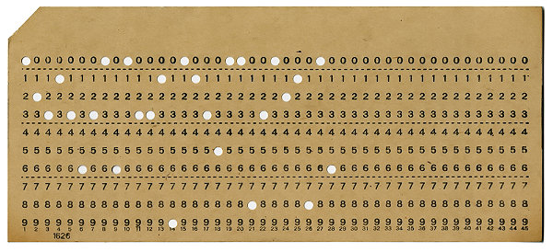
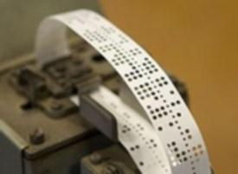
The First Operating Systems (late 50’s)
They were written to streamline sequential jobs
(batch processing)
Prior to this, you had to load up your tape/cards by yourself (this ate into reserved computing time)

Slide 14
Next Operating Systems (the 60’s)
They added pipelining to the process (sort of)
Loaded another program while the current program executes
Generally applicable to any type of IO
Used the notion of interrupts to check for completion
This was the start of multiprogramming
Two things happening at once (although one being IO)
Not yet concurrent computations

Slide 15
Modern Operating Systems Introducing revolutionary concepts
Virtual Memory
Since programs couldn’t always fit into memory they had to be shuffled around. Virtual memory gave the illusion of lots of space and the OS shuffled as needed.
Time Sharing
Concept of allowing multiple users to interact with programs running on the computer.

Slide 16
Modern Operating Systems
Multics (1964)
Scalable terminal access
Reliable internal file system with access control
Provided a variety of programming environments
Perhaps the first OS written in a high-level language
Virtual memory; files could be mapped into memory
Not commercially successful (highly targeted hardware)
Incredible list of features and very influential

Slide 17
Modern Operating Systems
OS/360 (1966)
More successful than Multics
Designed to work on many families of computers
Failed at being universally deployable
The task was just way over their head and would have taken too much time/effort/organization to pull off
Resorted to specialized instances for targeted machines
Lessons learned featured in the book: “The Mythical Man Month” by project leader Fred Brooks

Slide 18
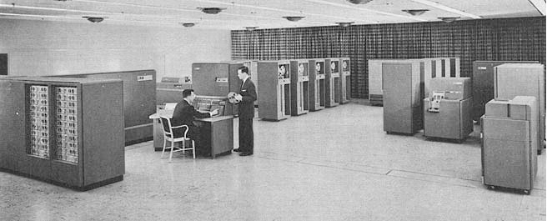
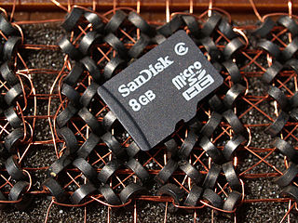
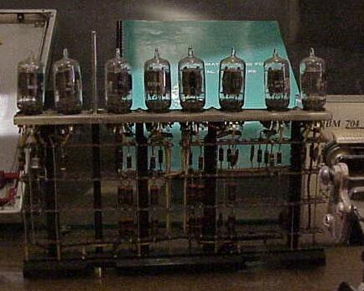
From Mainframes to Minicomputers
Mainframe Computers (big iron)
IBM 704 pictured Super expensive
Filled rooms
Vacuum Tubes
Core Memory

Slide 19
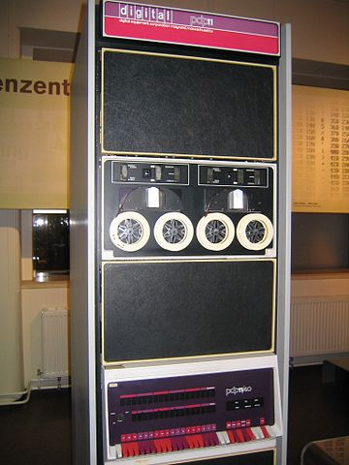
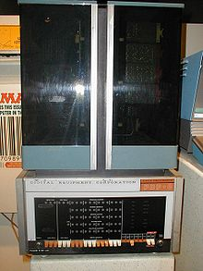
From Mainframes to Minicomputers
Minicomputers (1965 – early 80’s)
Cheap enough for universities
Still to expensive for hobbyists
Refrigerator size
Great time for OSs
Lots of progress
DEC PDP-11
DEC PDP-8

Slide 20
Unix (from Bell Labs at AT&T, early 70’s)
Created by some of the people behind Multics
Ken Thompson
Dennis Ritchie
They left the Multics project because it was just too big to pull off right
Less grand than Multics, therefore named Unix
Similar principles but smaller scale / less ambitious
Very popular and relatively cheap for universities
Few hundred $, and you got the (trade secret) code

Slide 21
BSD (from UC Berkeley, late 70’s)
Berkeley Software Distribution (lead by Bill Joy)
1BSD: Unix add-on that contained a pascal compiler and the ex editor
2BSD: Updates to 1BSD programs and included vi and csh
3BSD: Augmented Unix to support virtual memory on the VAX 11 Largely re-written Unix
4.2 BSD: Included support for networking – an implementation of TCP/IP
Still licensed Unix code so royalties went to AT&T

Slide 22
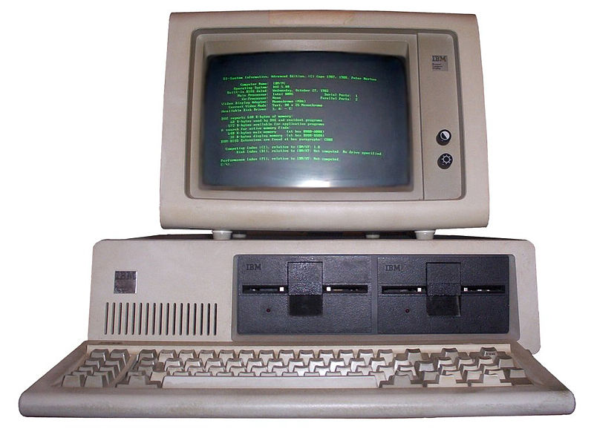
Microcomputers (PCs) (mid 70’s – early 90’s)
Computers for hobbyists / mass market
Suddenly a need for more polished operating systems
Computers shipped with operating systems
CP/M (1974)
Console command processor (CPM)
Basic disk operating system (BDOS)
Basic input/output system (BIOS)
Apple DOS & Apple SOS

Slide 23
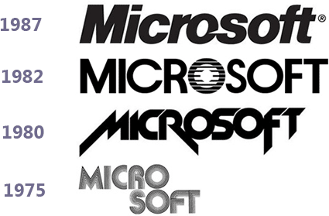
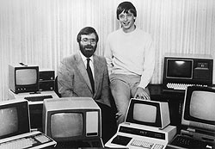
Humble beginnings
Software company with a Basic interpreter
Jumped into operating systems
Licensed Unix, converted it to 16-bit, sold it as Xenix
IBM creates the IBM PC and wants an OS bundled
IBM wanted CP/M but couldn’t reach an agreement
IBM calls MS and asks them if they will supply the OS
But, MS doesn’t want to pay AT&T royalties for Xenix
MS tells IBM they have an OS for them (they don’t) and IBM agrees to use it
MS quickly buys QDOS from SCP and slips it to IBM
(1975)
(1980)
(1980)

Slide 24
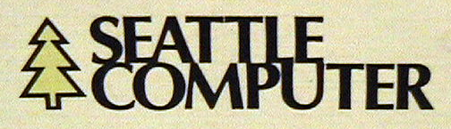

QDOS
86-DOS
PC DOS
(Aug, 1980)
(Dec, 1980)
(July, 1981)
(Aug, 1981)
Everyone Else
MS DOS
PC DOS / MS DOS Features
Virtual Memory
Multitasking (cooperative, not pre-emptive)
Access control for the file system

Slide 25

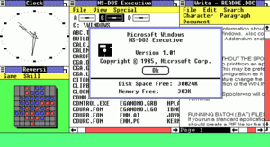
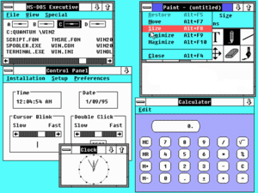
Windows 1.0
Not an operating system
Provided graphical windows for MS DOS
Windows 2.0
Still not an operating system
Provided improvements
(1985)
(1987)

Slide 26
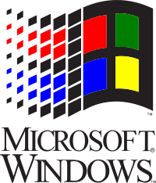
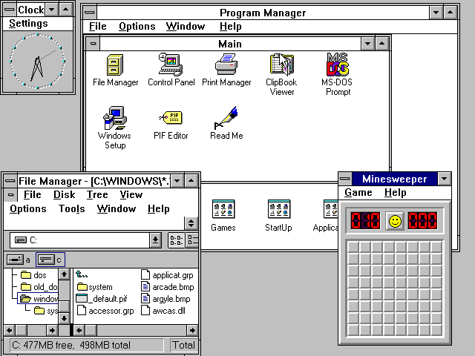
Windows 3.0 and 3.1
More improvements, still not an OS
No memory protection yet either
Apps could write over each other
(1990)
(1992)

Slide 27
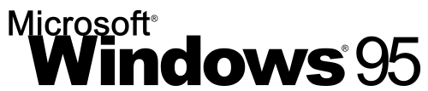
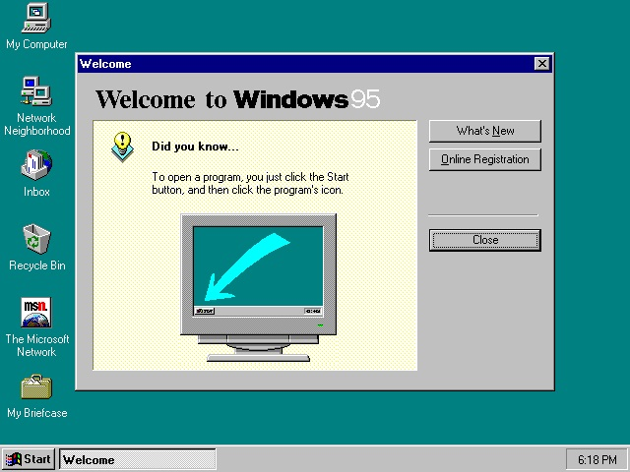
Still running on MS DOS although much OS functionality moved from MS DOS to Win95
Better memory protection
Although the OS could still be clobbered
Supported pre-emptive multitasking

Slide 28
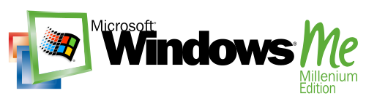
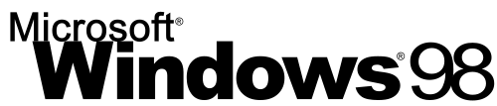
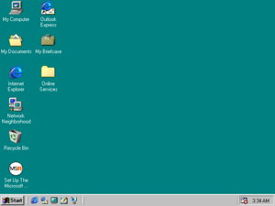
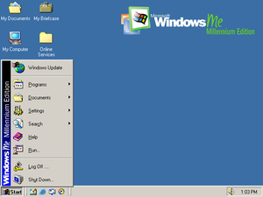
More improvements but same fundamental model

Slide 29
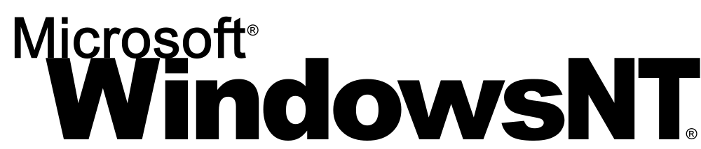






(1993)
“New Technology”
Fully 32-bit and then
64-bit support
NTFS journaling file system
(2001)
(2007)
(2009)
(2012)
(2015)

Slide 30
Unix Continues…
Unix is in widespread use in academia and industry, but it’s not free
Andrew Tanenbaum, in 1987, created Minix, a free and small/toy clone of Unix meant for education.
In 1991, Linus Torvalds bought an Intel 386 PC
MS DOS didn’t support all of its features
He ported Minix to it and then added features
Released as Linux 0.12 in January 1992
Became POSIX compliant

Slide 31
Unix Continues…
Linux received overwhelming support
IBM and Compaq supported it by 1998
Overwhelming industry support by 2000
NetBSD / FreeBSD also developed in the early 90’s
Free Unix clones, but didn’t reach success of Linux
MacOS X (released in 2000)
Built from NetBSD/FreeBSD
Macs finally support VM, multitasking, protected FS

Slide 32
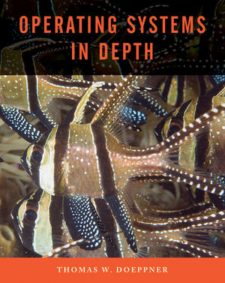
Reading for Thursday
Sections 1.1 & 1.2
(pages 1-12)
There will be a quiz!

