Slide 1
A. “Event” definition
Window 1 blast query
5000 bp
Window 2 blast query
5000 bp
Reference Sp. Contig
Blast hits >= 2500 bp
Hit on contig A in target sp
Hit on contig B in target sp
Δ matches >= 7
Δ matches >= 7
Hit on contig B in target sp
Hit on contig A in target sp
...
...
Hit on contig N in target sp
Hit on contig N in target sp
B. “Cross over event” definition

Slide 2
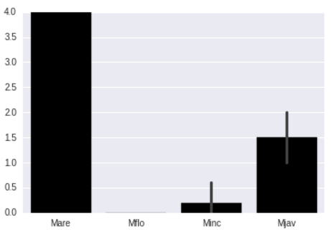
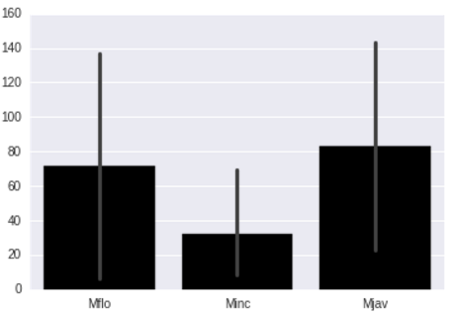
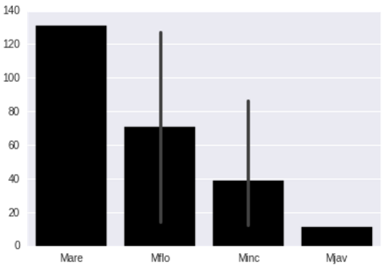
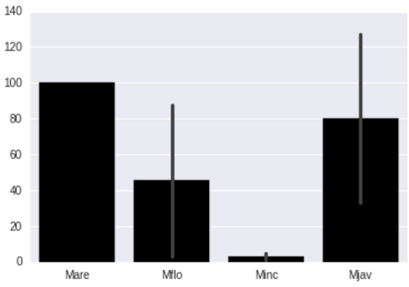
Events between and within species
A. M. floridensis vs. other species
B. M. arenaira vs. other species
# Events
Minc
Mjav
Mflo
Minc
Mjav
Mare
Mflo
C. M. javanica vs. other species
D. M. incognita vs. other species
Mare
Mflo
Minc
Mjav
Mare
Mflo
Minc
Mjav
Species

Slide 3
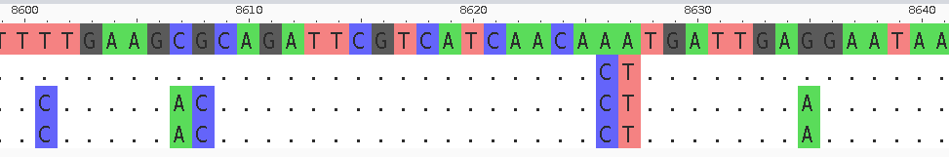
Events between M. incognita and M. javanica
27 events detected reciprocally
All of them appear to be gene conversion and not cross over
MincW1-1
MjavVW4-1
MincW1-2
MjavVW4-2

