Slide 1
Project: SunShine -BY TEAM RA Challenge: You Are My Sunshine
TEAM MEMBERS : Ronit Kumar
-SRM IST KATTANKULATHUR
: Dhruv S. Pathak
-MANIPAL UNIVERSITY JAIPUR
: Arin Johari
-MANIPAL INSTITUTE OF TECHNOLOGY
: Divyapratap Singh Chauhan
-SRM IST KATTANKULATHUR

Slide 2
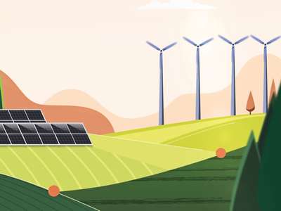
CONTENT
Our mission
Our vision
About project
Project-Till now
Our scope for future

Slide 3
OUR MISSION
The energy sector is the major contributor to economic and industrial accomplishments as well as a pre-requisite for providing the basic human needs.
Up till now countries have been relying on non-renewable sources to power up their homes, industries ,transportation and other day-to-day machineries. But with time passing we have started to see the consciences of using them extensively which may be unusual rainfall pattern , bush fires, floods in major cities and unexpected cyclone and damage to bio-diversity.
The solution to these problem are renewable energy which are clean and can generate enough clean energy required for our daily work.
Our mission is to ultimately bring easily accessible knowledge about such energy sources among masses and make their transition from non-renewable to renewable energy sources easy

Slide 4
OUR VISION
Addressing the problem of impact on climate due to non-renewable energy consumption and development in renewable energy sector people have started to move from fuel based generators to solar panels for clean energy.
But these are still early days and the information regarding solar panels are scarce and tough to find online.
Our vision to address this problem is to create a mobile application which helps people who are enthusiastic about solar panel or are current users of it to learn more.

Slide 5
ABOUT PROJECT
We are building our mobile application using Flutter framework and dart programming language, this will help us to make the application available for people using different platforms like ios , windows & android.
We have established 2 login methods one for an anonymous user and one for google user. This will help track and address different problem and also make our application more secure.
The objectives which we will be achieving in hackathon and for later includes:
1)To get average KW-hr/m^2/days data for their current location and also shows historic data of different parameters related to climate and energy in user’s region.
2)Shows the working and information regarding solar panels which will help people who want to know about solar panels or are planning to install one.
3) To make available files containing historic data for download.
4)Features to help them calculate total energy consumption of their homes and financial incentives for installing a solar panel. This will help them in deciding on solar panels and how much area of it.

Slide 6
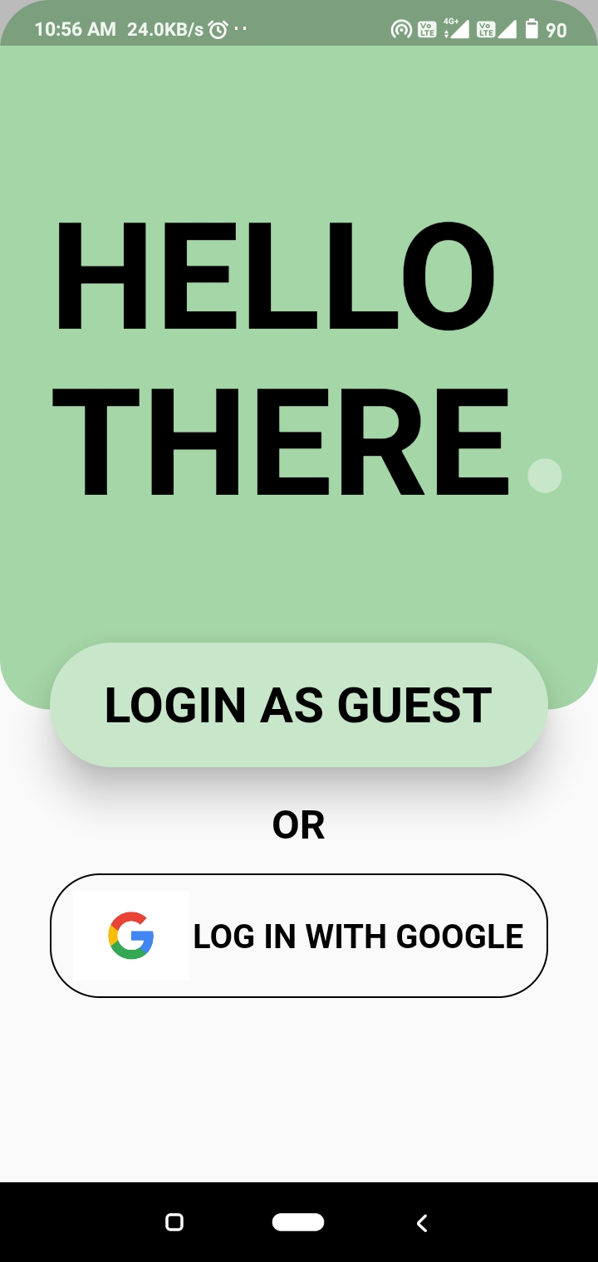
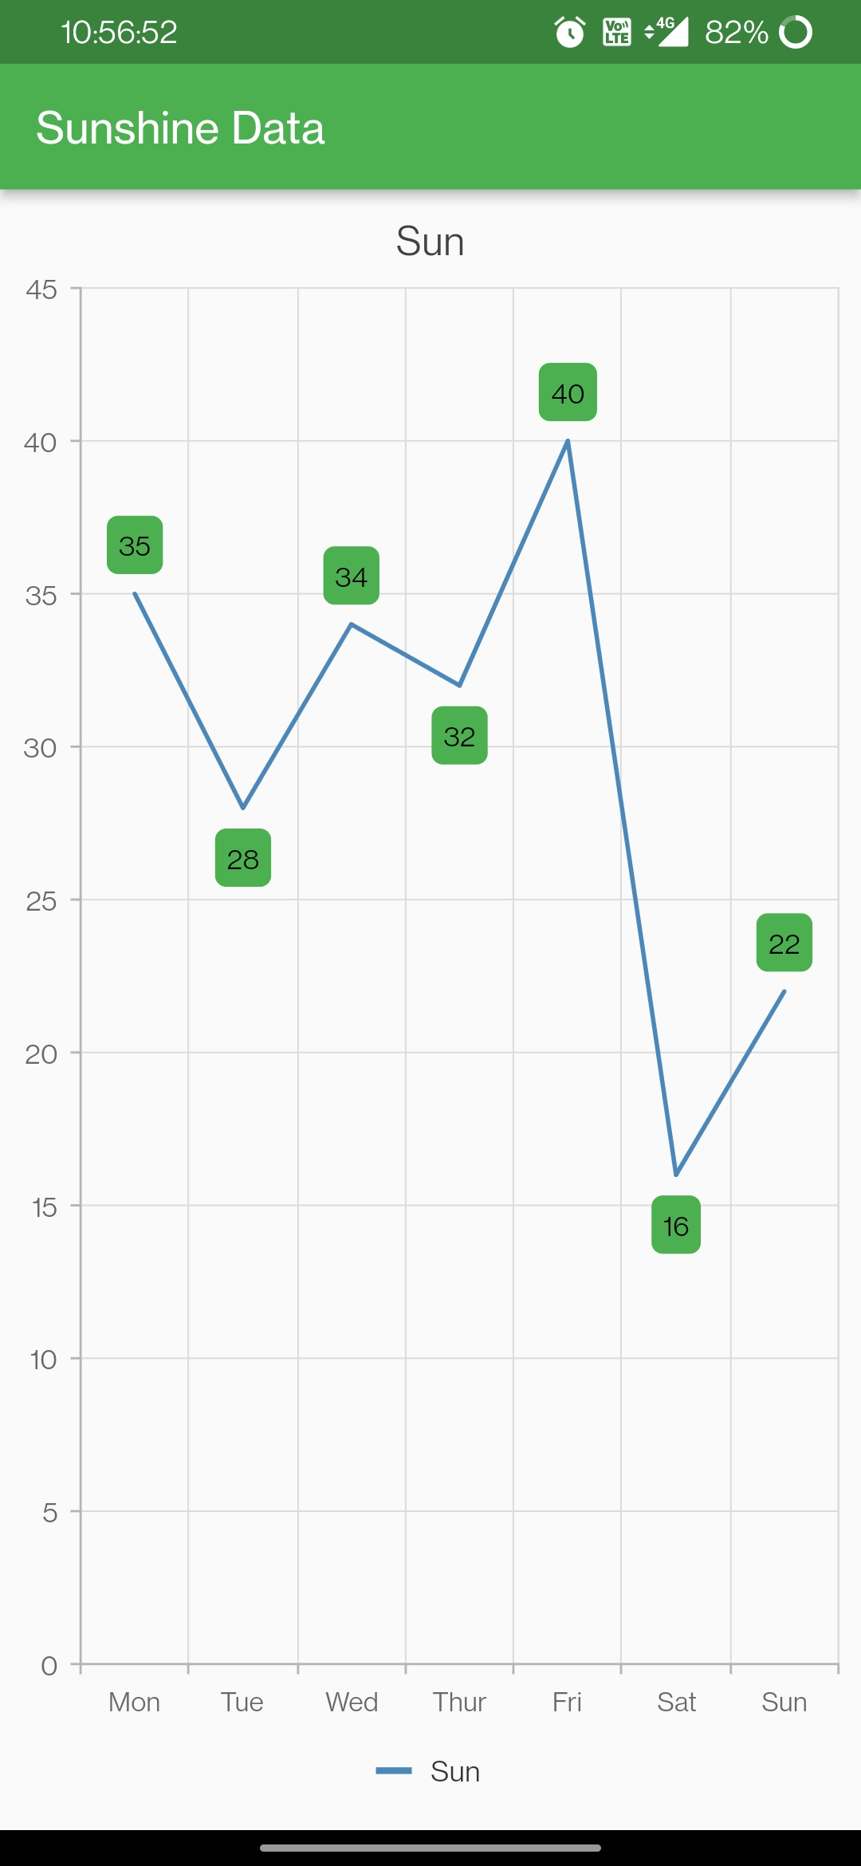
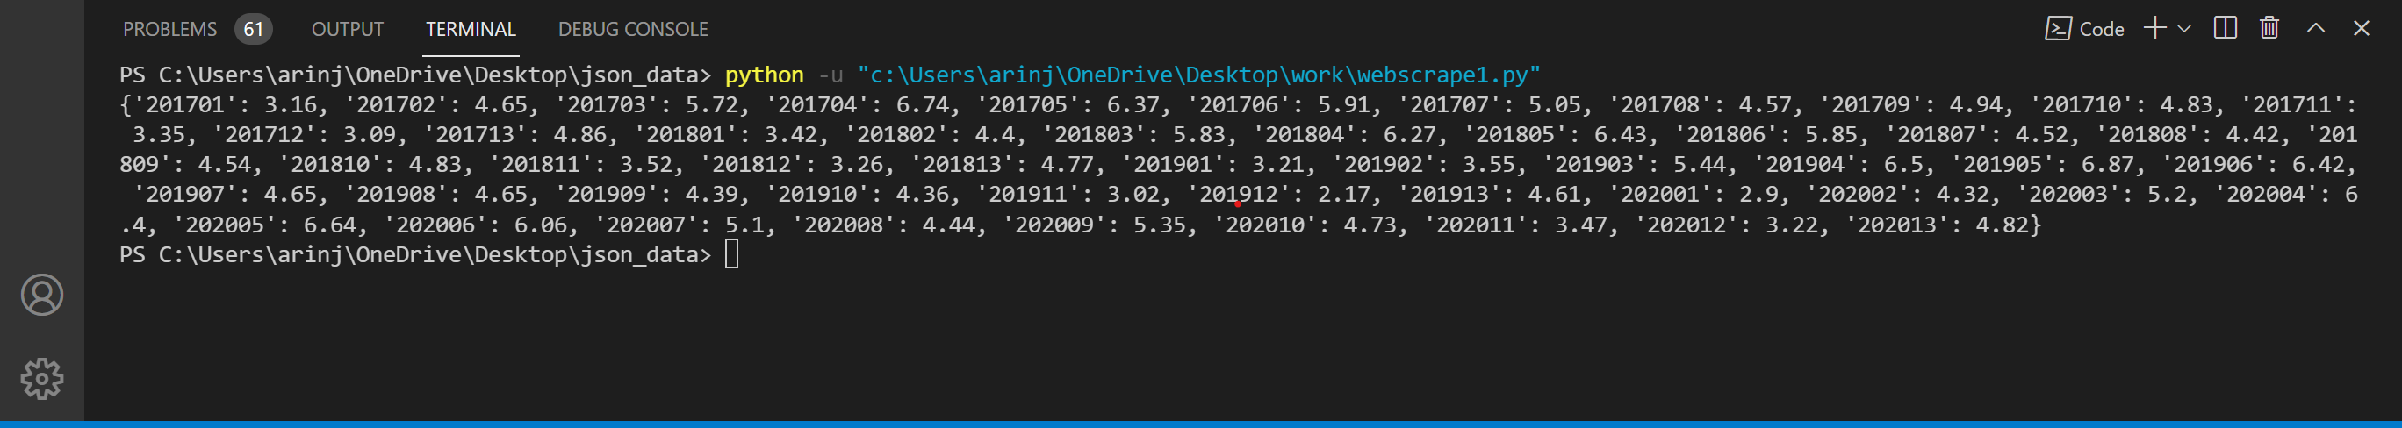
PROJECT TILL NOW

Slide 7
OUR SCOPE FOR FUTURE
With this project we really want to impact and give back to our community. We are aiming to get this application to rural India where it can really help people. And will contribute in making a self-reliant ecosystem in villages like in agriculture fields, schools, homes etc. which can be an example and building block & example for renewable energy sector in India, furthering the cause.
THANK YOU !

