Slide 1
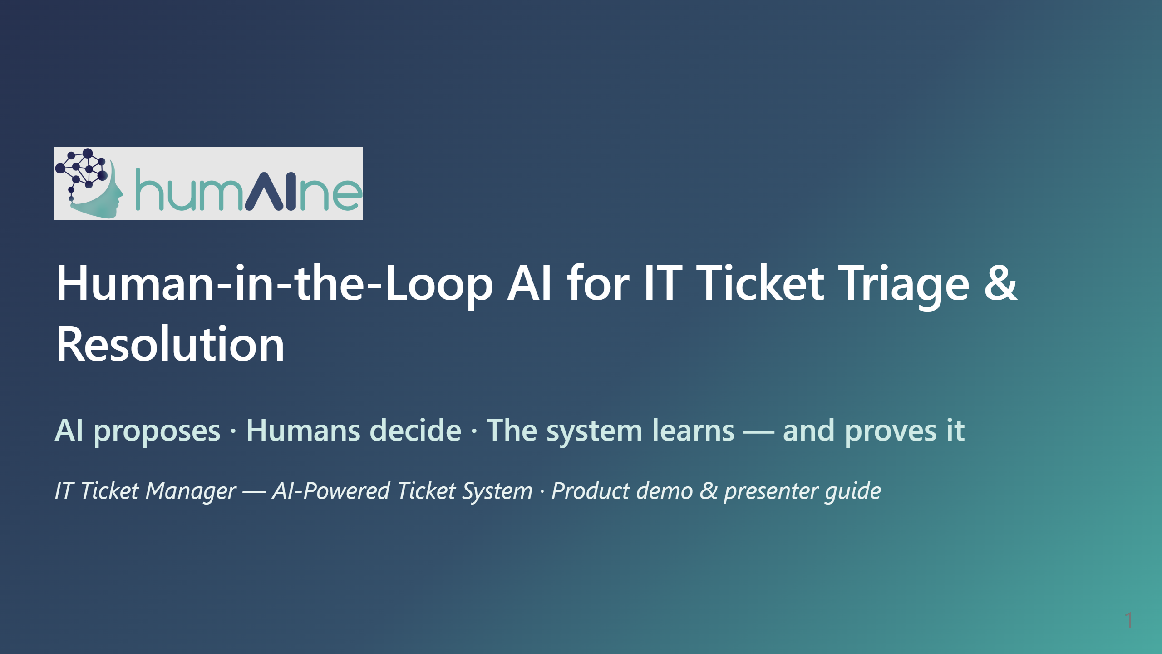
Notes:
PRESENTER SCRIPT — Opening (30s) "Hi everyone. Today I'll show humAIne — an AI-powered IT ticket system built around one principle: the AI does the heavy lifting, but a human always stays in control, and every decision is measured." - Say the tagline out loud: AI proposes, humans decide, the system learns and proves it. - Tell them the plan: a short story, then a live walkthrough of the app, then the numbers. - Housekeeping: "I'll take questions at the end, but stop me anytime."

Slide 2
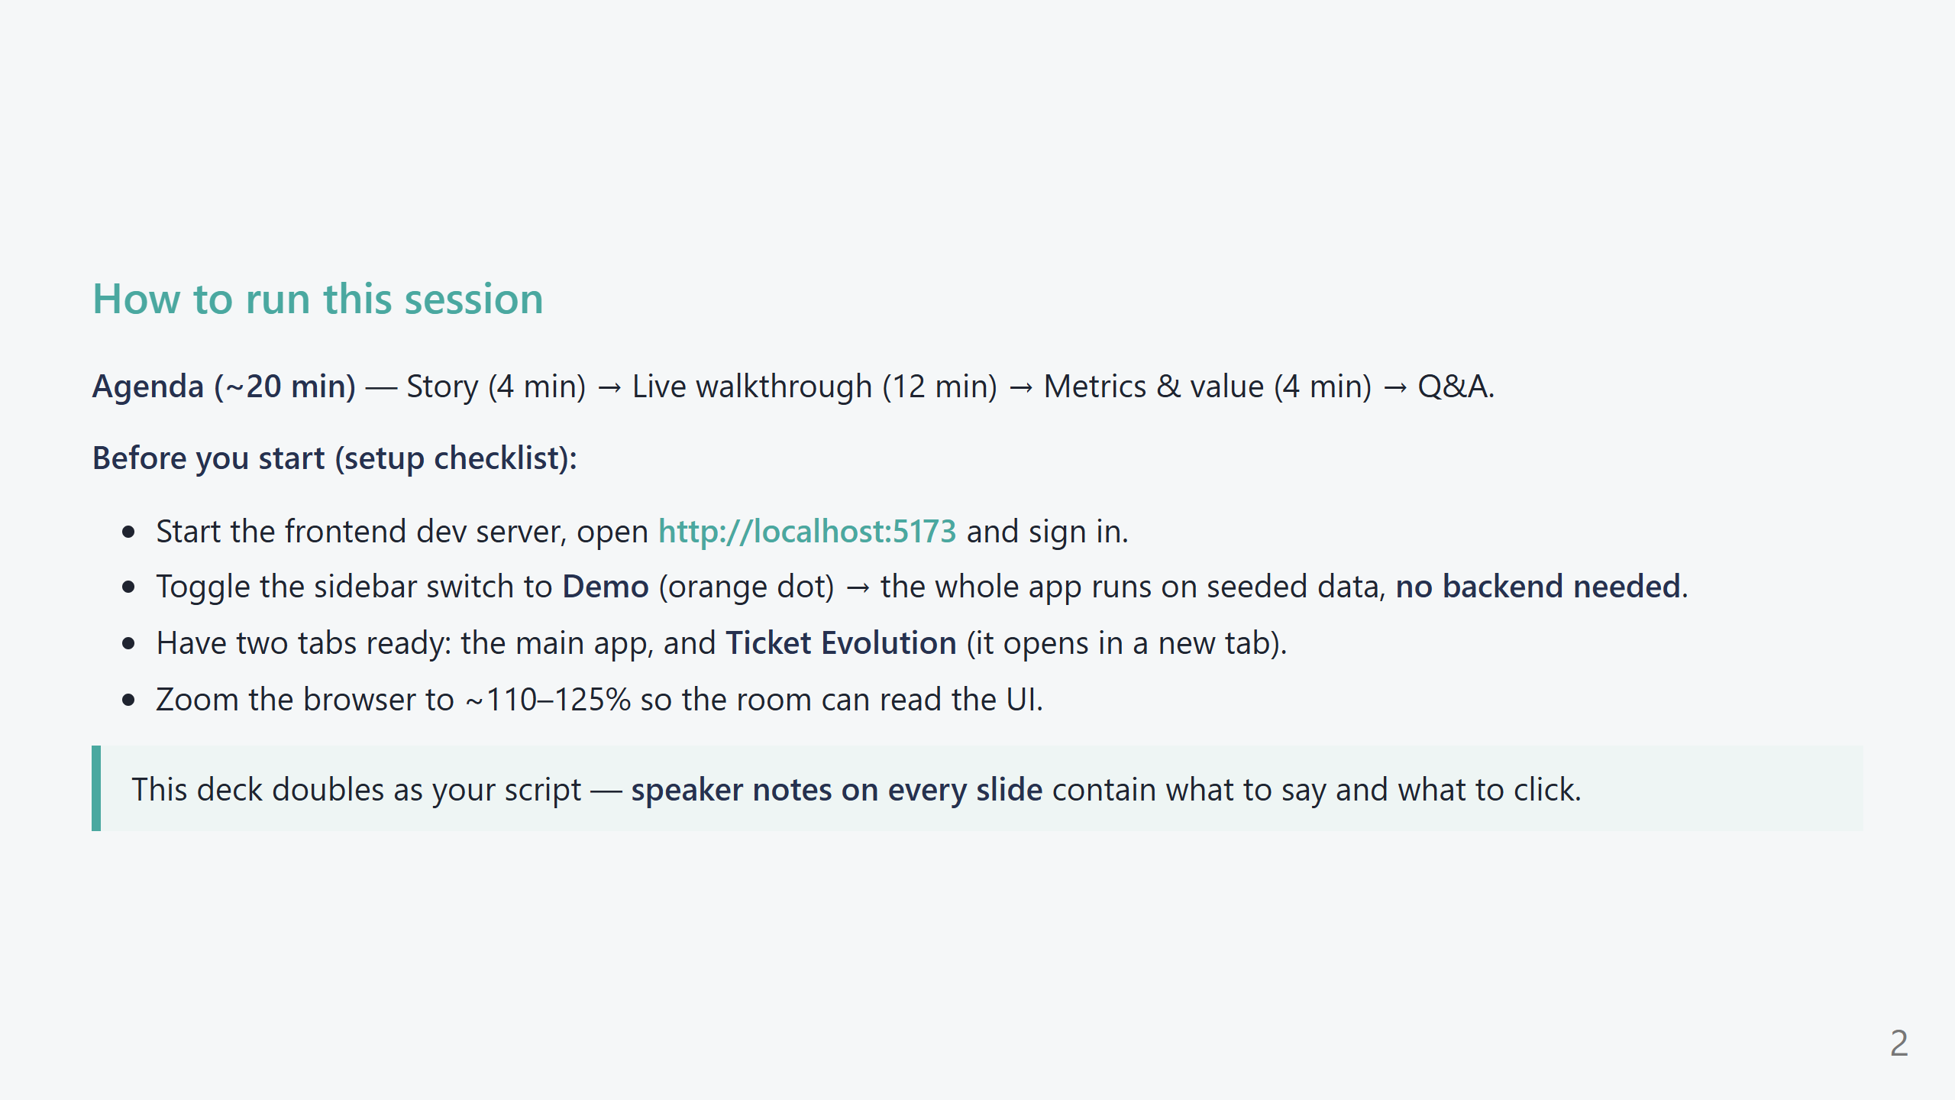
Notes:
PRESENTER SCRIPT — Setup (45s) - Emphasize Demo mode: "Everything you'll see runs on realistic seeded data, so the demo never depends on a live model or network." - The green/orange dot in the sidebar is the Live/Demo toggle. Orange = Demo. - Ticket Evolution opens in its own tab by design (it's the Tier-2 tool) — pre-open it to avoid fumbling. - Tell the audience these are real screens from the product, not mockups. - If presenting slides only (no live app), the screenshots carry the full story.

Slide 3
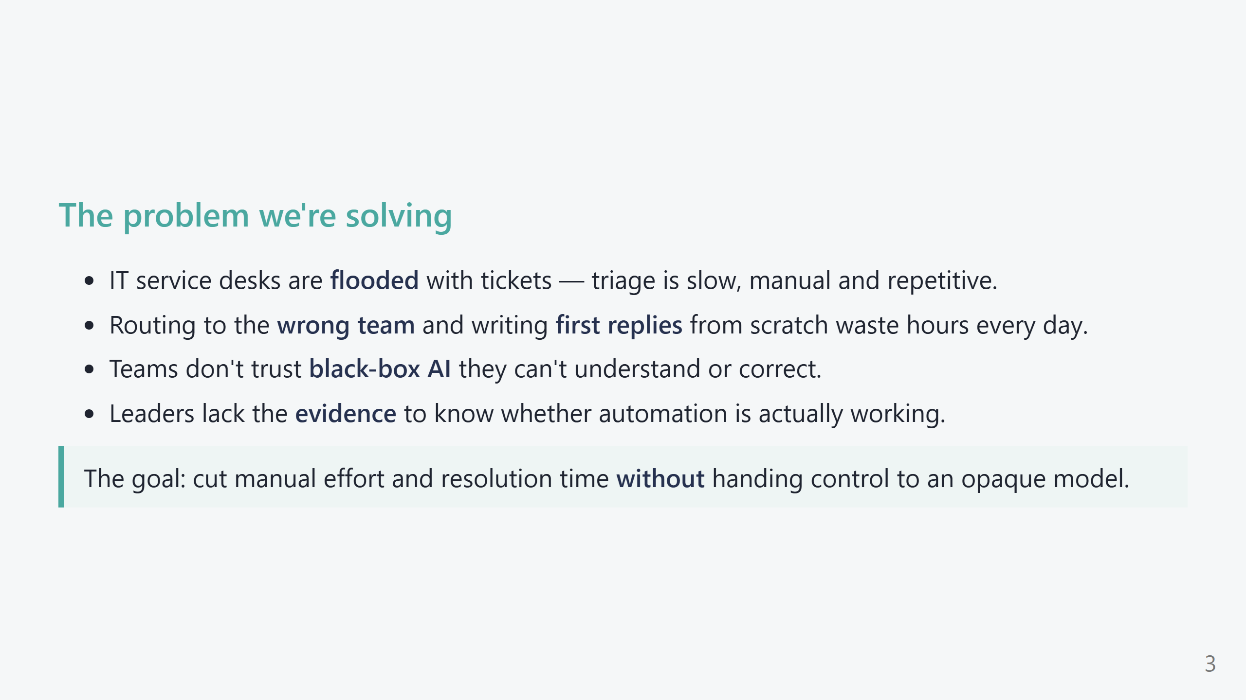
Notes:
PRESENTER SCRIPT — Problem (1 min) - Land the pain: "Every mis-routed ticket bounces between teams for hours. Every first reply is written from a blank page." - Name the two blockers to AI adoption: trust ("is it a black box?") and proof ("is it actually helping?"). - Transition: "So we built the system around solving all four of these at once." - If you know the audience's numbers (ticket volume, avg handling time), quote them here.

Slide 4
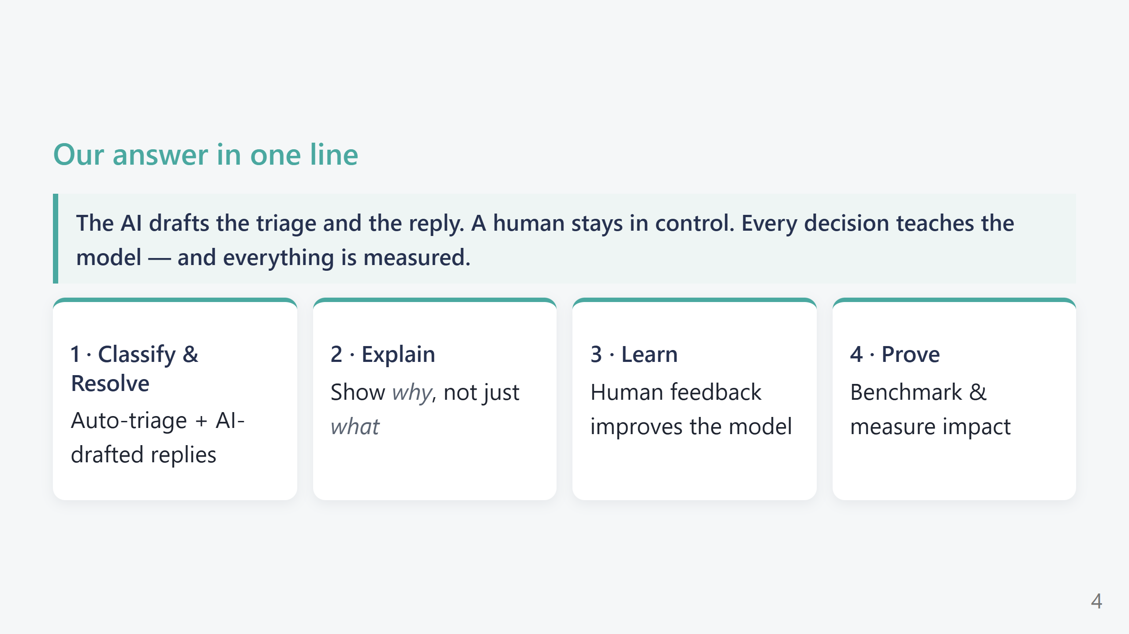
Notes:
PRESENTER SCRIPT — Four pillars (45s) - Read the one-liner slowly; it's the thesis of the whole talk. - Point to each pillar: Classify & Resolve (the work), Explain (trust), Learn (it gets better), Prove (the numbers). - Tell them: "The rest of the demo is just these four pillars, shown live."

Slide 5
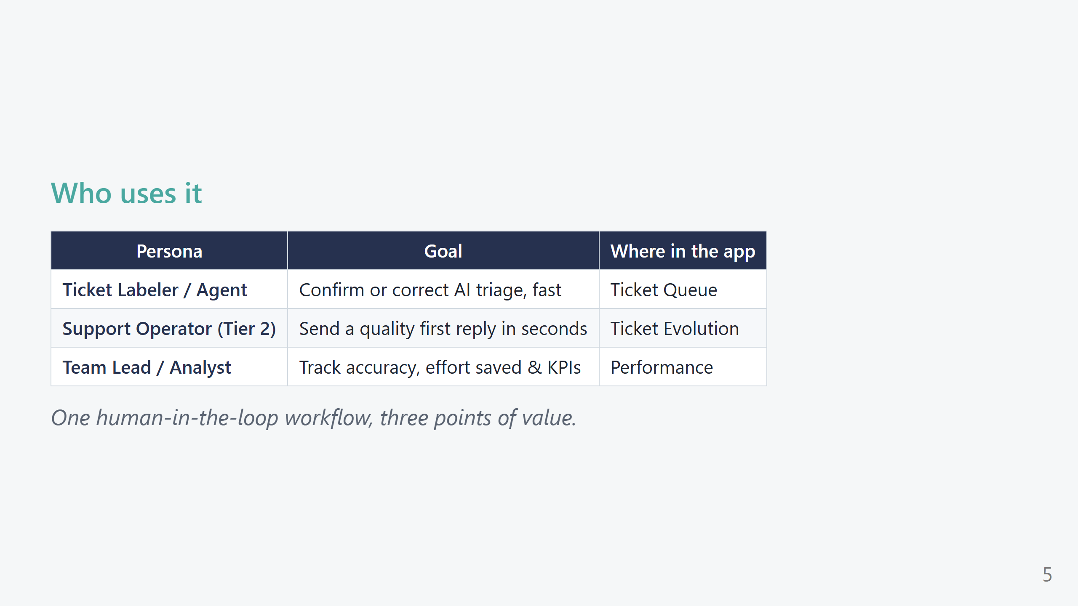
Notes:
PRESENTER SCRIPT — Personas (30s) - Anchor each persona to a screen so the audience knows who they are "playing" during the demo. - "I'll walk you through the app as all three: first the labeler, then the Tier-2 operator, then the team lead."

Slide 6
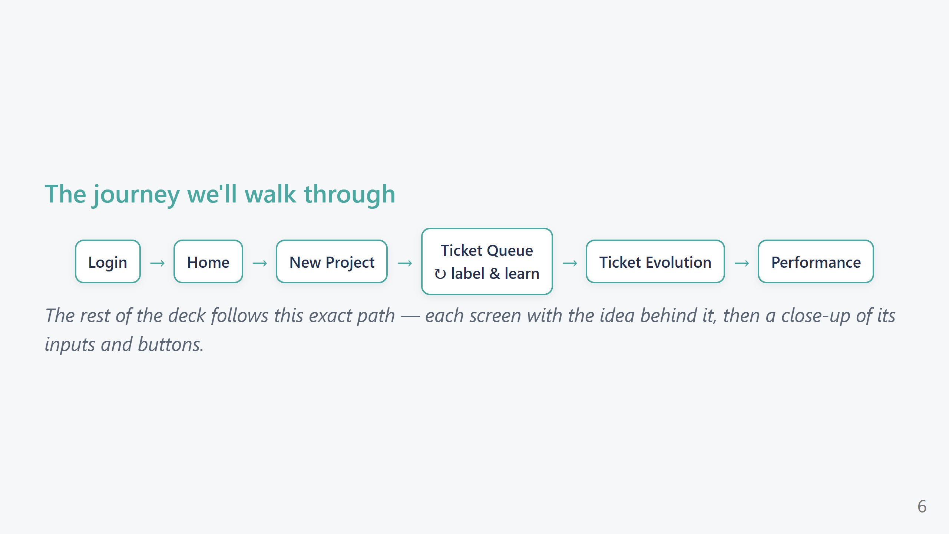
Notes:
PRESENTER SCRIPT — Journey map (30s) - Trace the arrows with your cursor/pointer: this is literally the click-path you'll follow live. - Note the loop on Ticket Queue: labeling feeds back into the model continuously. - "Every screen has two slides: the big picture, then a close-up of the controls."

Slide 7
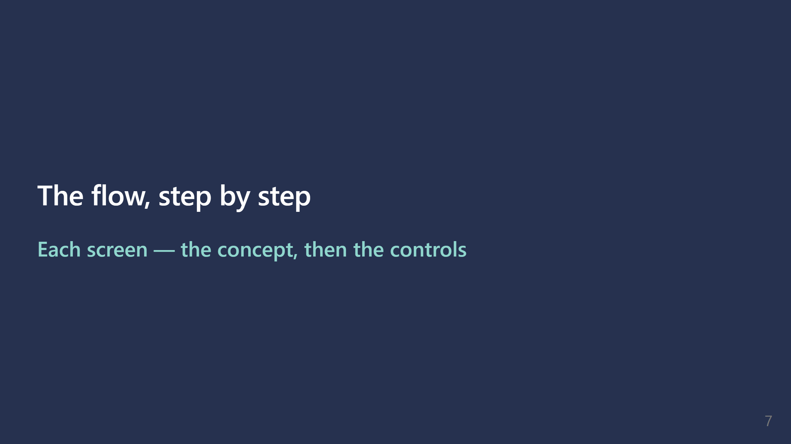

Slide 8
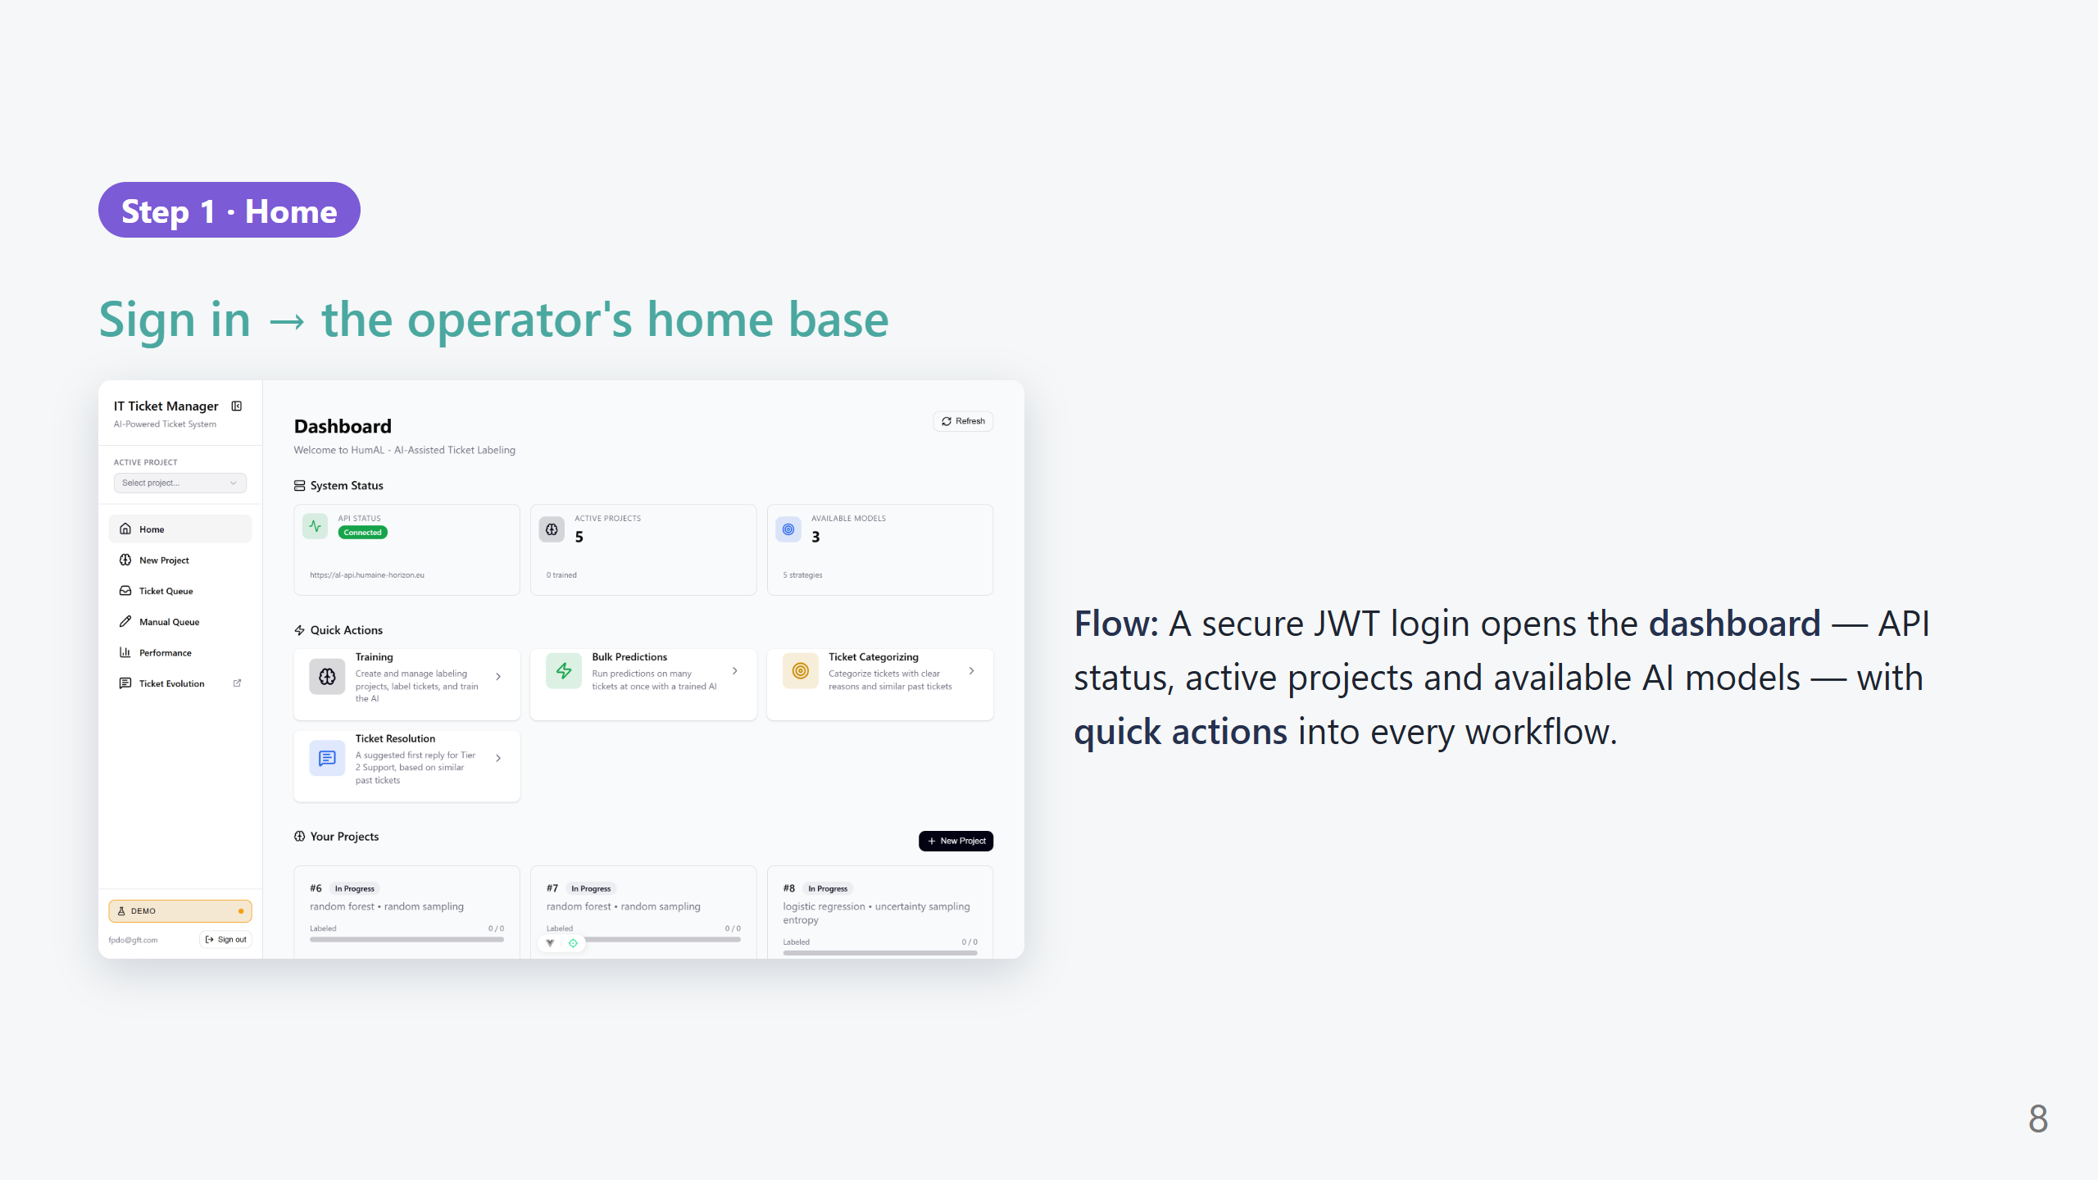
Notes:
PRESENTER SCRIPT — Home (1 min) What to say: "After signing in, the operator lands on a control tower for the whole system." What to click / point at: - Top-left: 'System Status' — API Status badge (Connected), Active Projects count, Available Models count. "Green means the backend is healthy." - 'Quick Actions' cards jump straight into each workflow. - 'Your Projects' lists labeling projects with a Trained / In Progress badge and an Open button. - The Refresh button re-checks system status. Transition: "Let's create a project — that's where we choose the AI and how it learns."

Slide 9
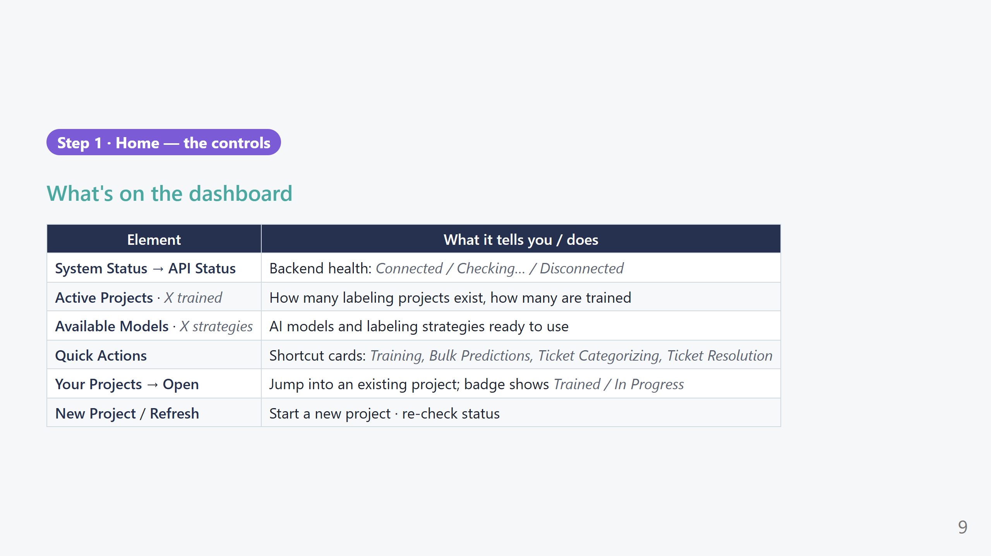
Notes:
PRESENTER SCRIPT — Home controls (30s) - Use this slide only if the audience is hands-on/technical or asks "what does each part do?" - For a business audience, skim it: "Status up top, shortcuts in the middle, your projects at the bottom."

Slide 10
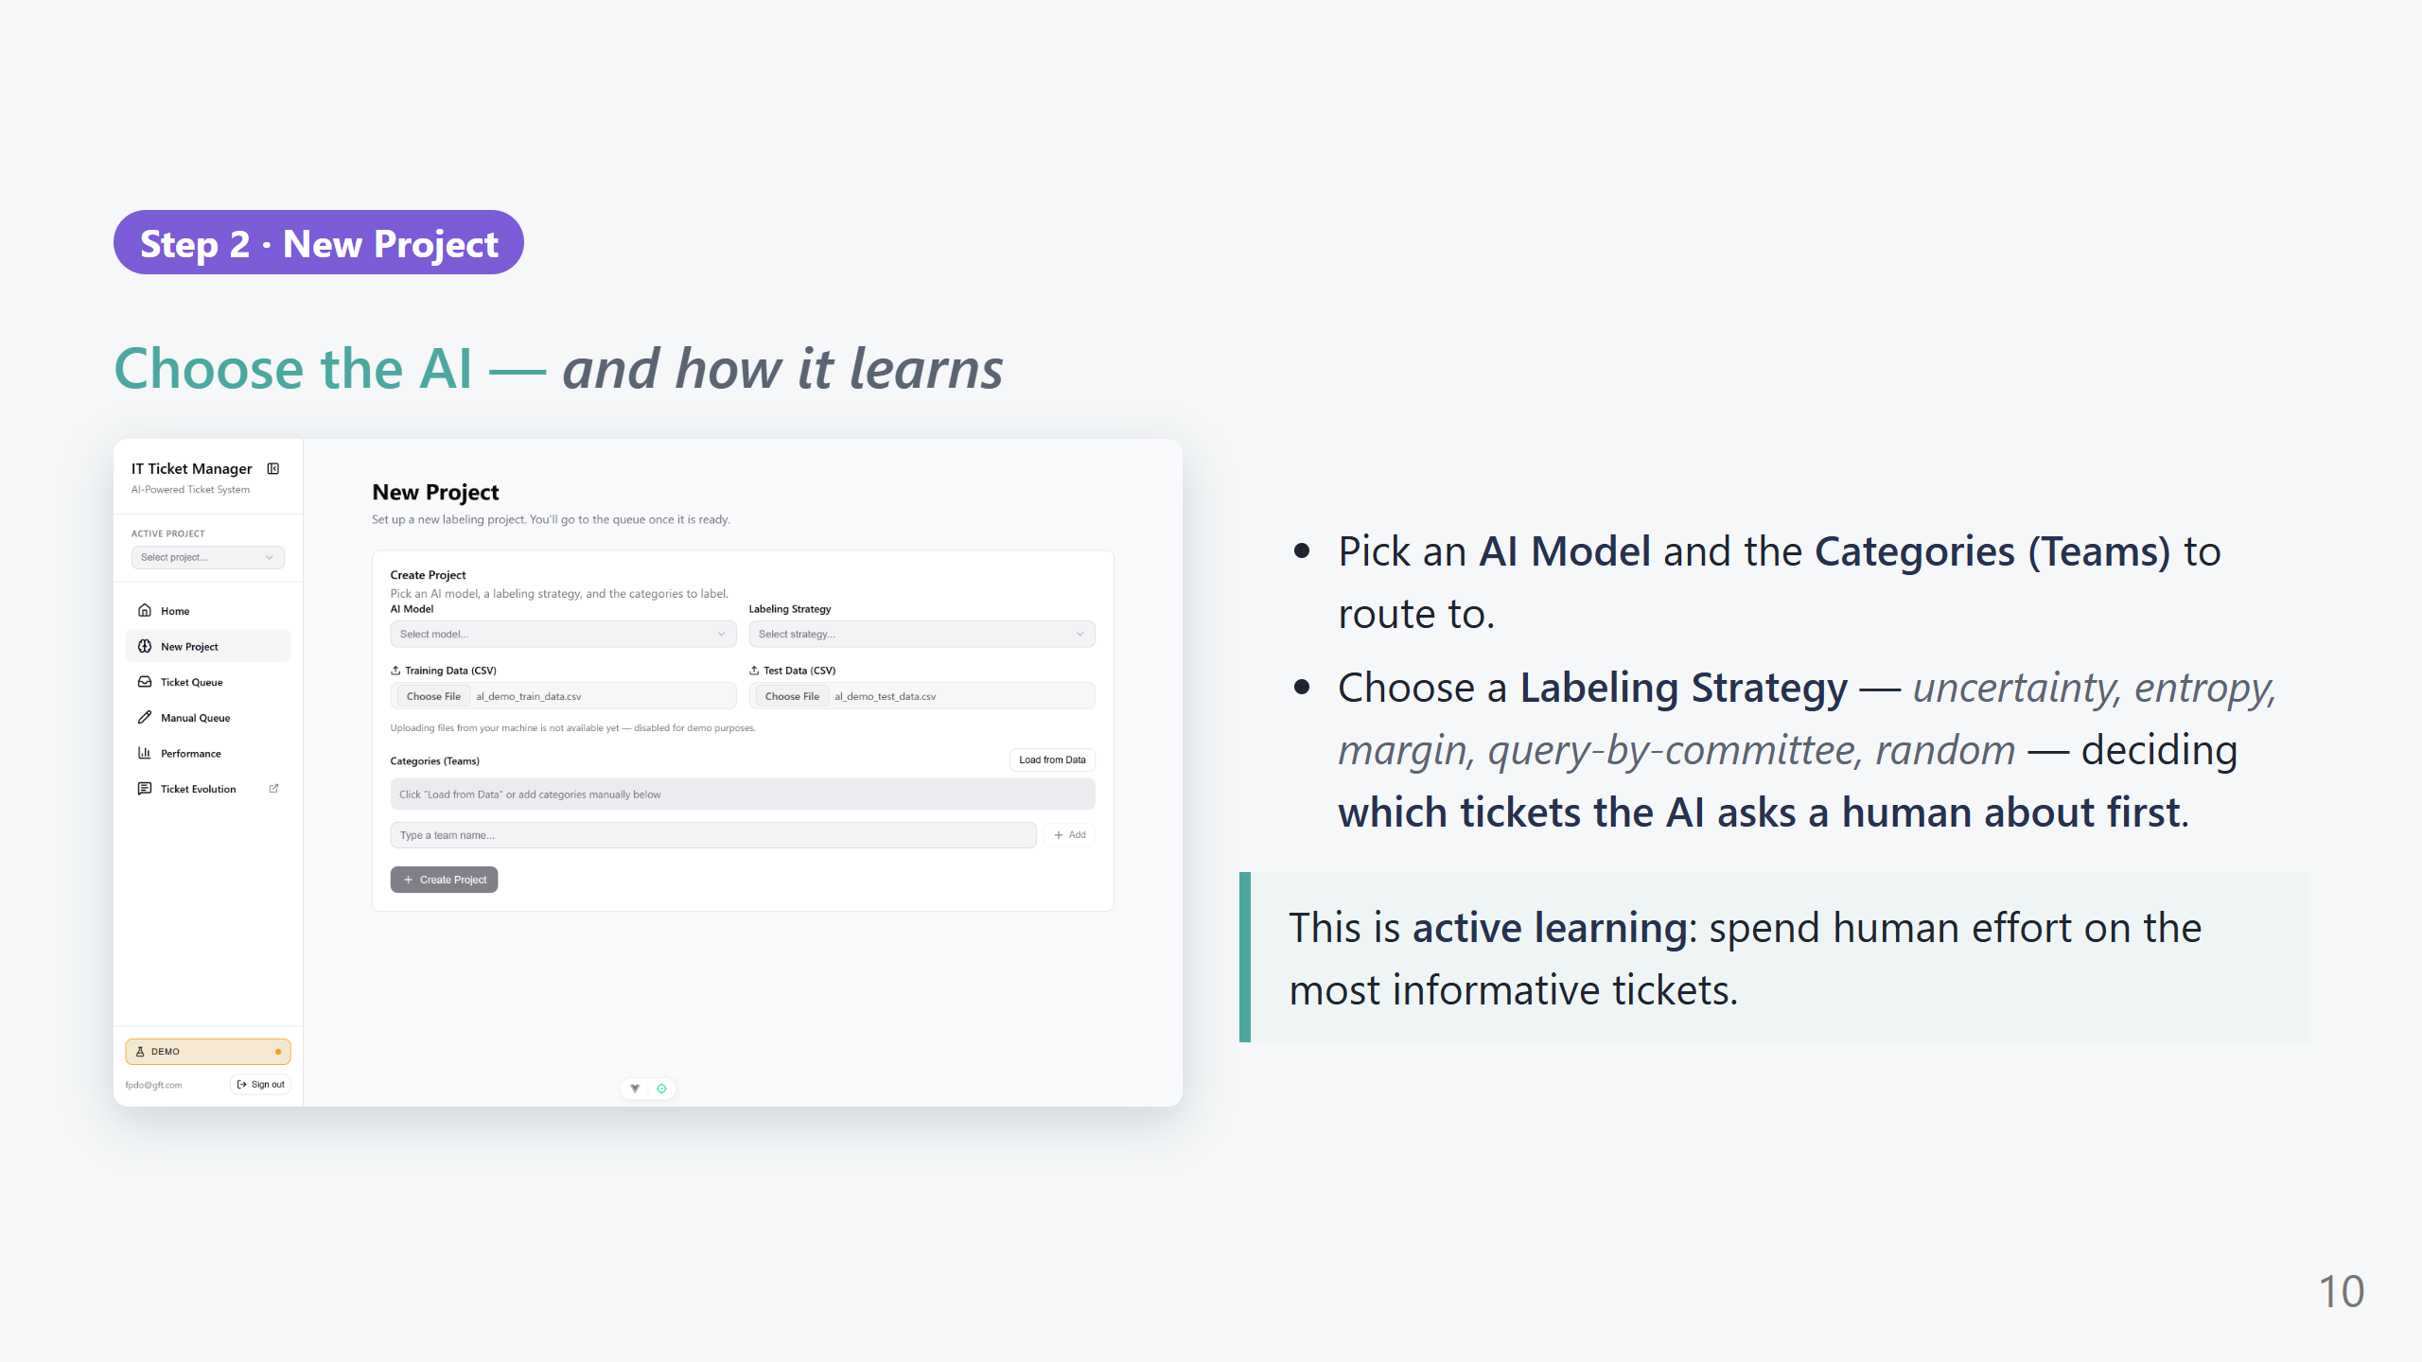
Notes:
PRESENTER SCRIPT — New Project (1 min) What to say: "Setting up a project takes under a minute and it's where the 'human-in-the-loop' magic is configured." What to click: - 'AI Model' dropdown → pick a model (e.g., SVM / Logistic Regression). "This is the classifier that will learn to route tickets." - 'Labeling Strategy' dropdown → pick 'Uncertainty'. KEY POINT: "This decides which tickets we ask the human to label first — the ones the AI is least sure about, so every label teaches it the most." - 'Categories (Teams)' → click 'Load from Data' to auto-fill the teams from the dataset, or type one and 'Add'. - Click 'Create Project' → it takes you to the queue. Note: file upload is disabled in the demo (fixed dataset) — mention if asked.

Slide 11
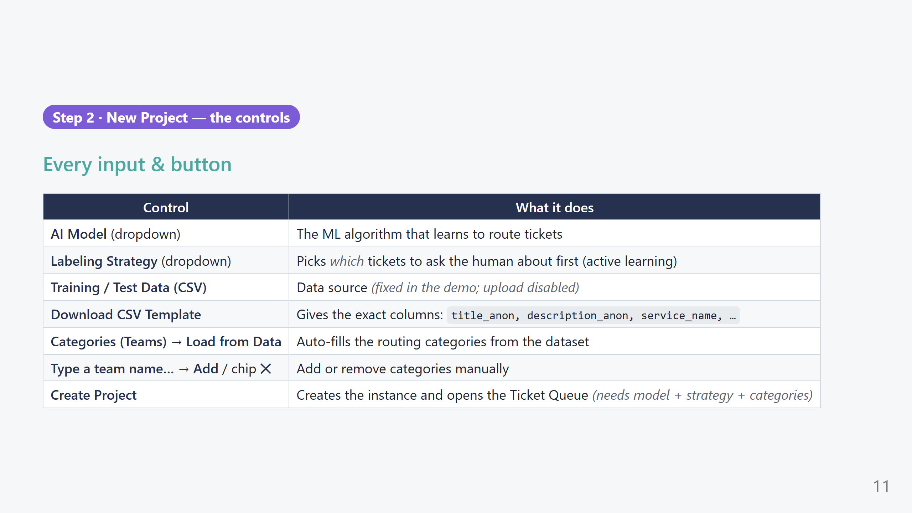
Notes:
PRESENTER SCRIPT — New Project controls (40s) - 'Load from Data' is the fast path — one click fills all the teams. - The 'Create Project' button stays disabled until model + strategy + at least one category are set — a good moment to explain the minimum recipe. - If asked about real data onboarding: "In production you upload your own CSV; the template button shows the exact format."

Slide 12
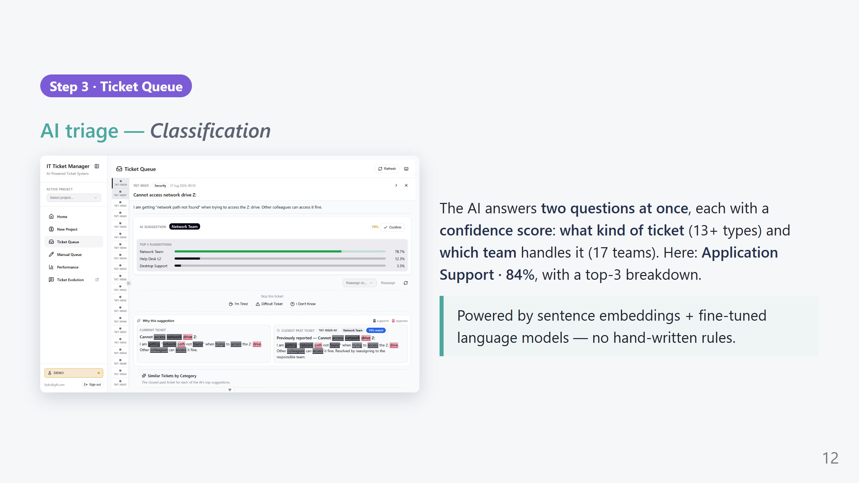
Notes:
PRESENTER SCRIPT — Ticket Queue (1.5 min) What to say: "This is where a labeler spends their day — and where the AI earns its trust." What to click: - Select the first ticket in the list. The right panel shows the ticket, then the AI's suggestion. - Point at the big prediction: 'Application Support · 84%' and the top-3 bars. "The AI is 84% confident, and here are its next two guesses." - 'Get AI Suggestion' re-runs the model if needed; 'Confirm' accepts it (keyboard: c); 'Reassign to…' lets you override. - Confidence colour-codes: green ≥80%, amber ≥50%, red below — the labeler instantly sees when to look closer. Transition: "But would you trust 84% without knowing why? That's the next screen."

Slide 13
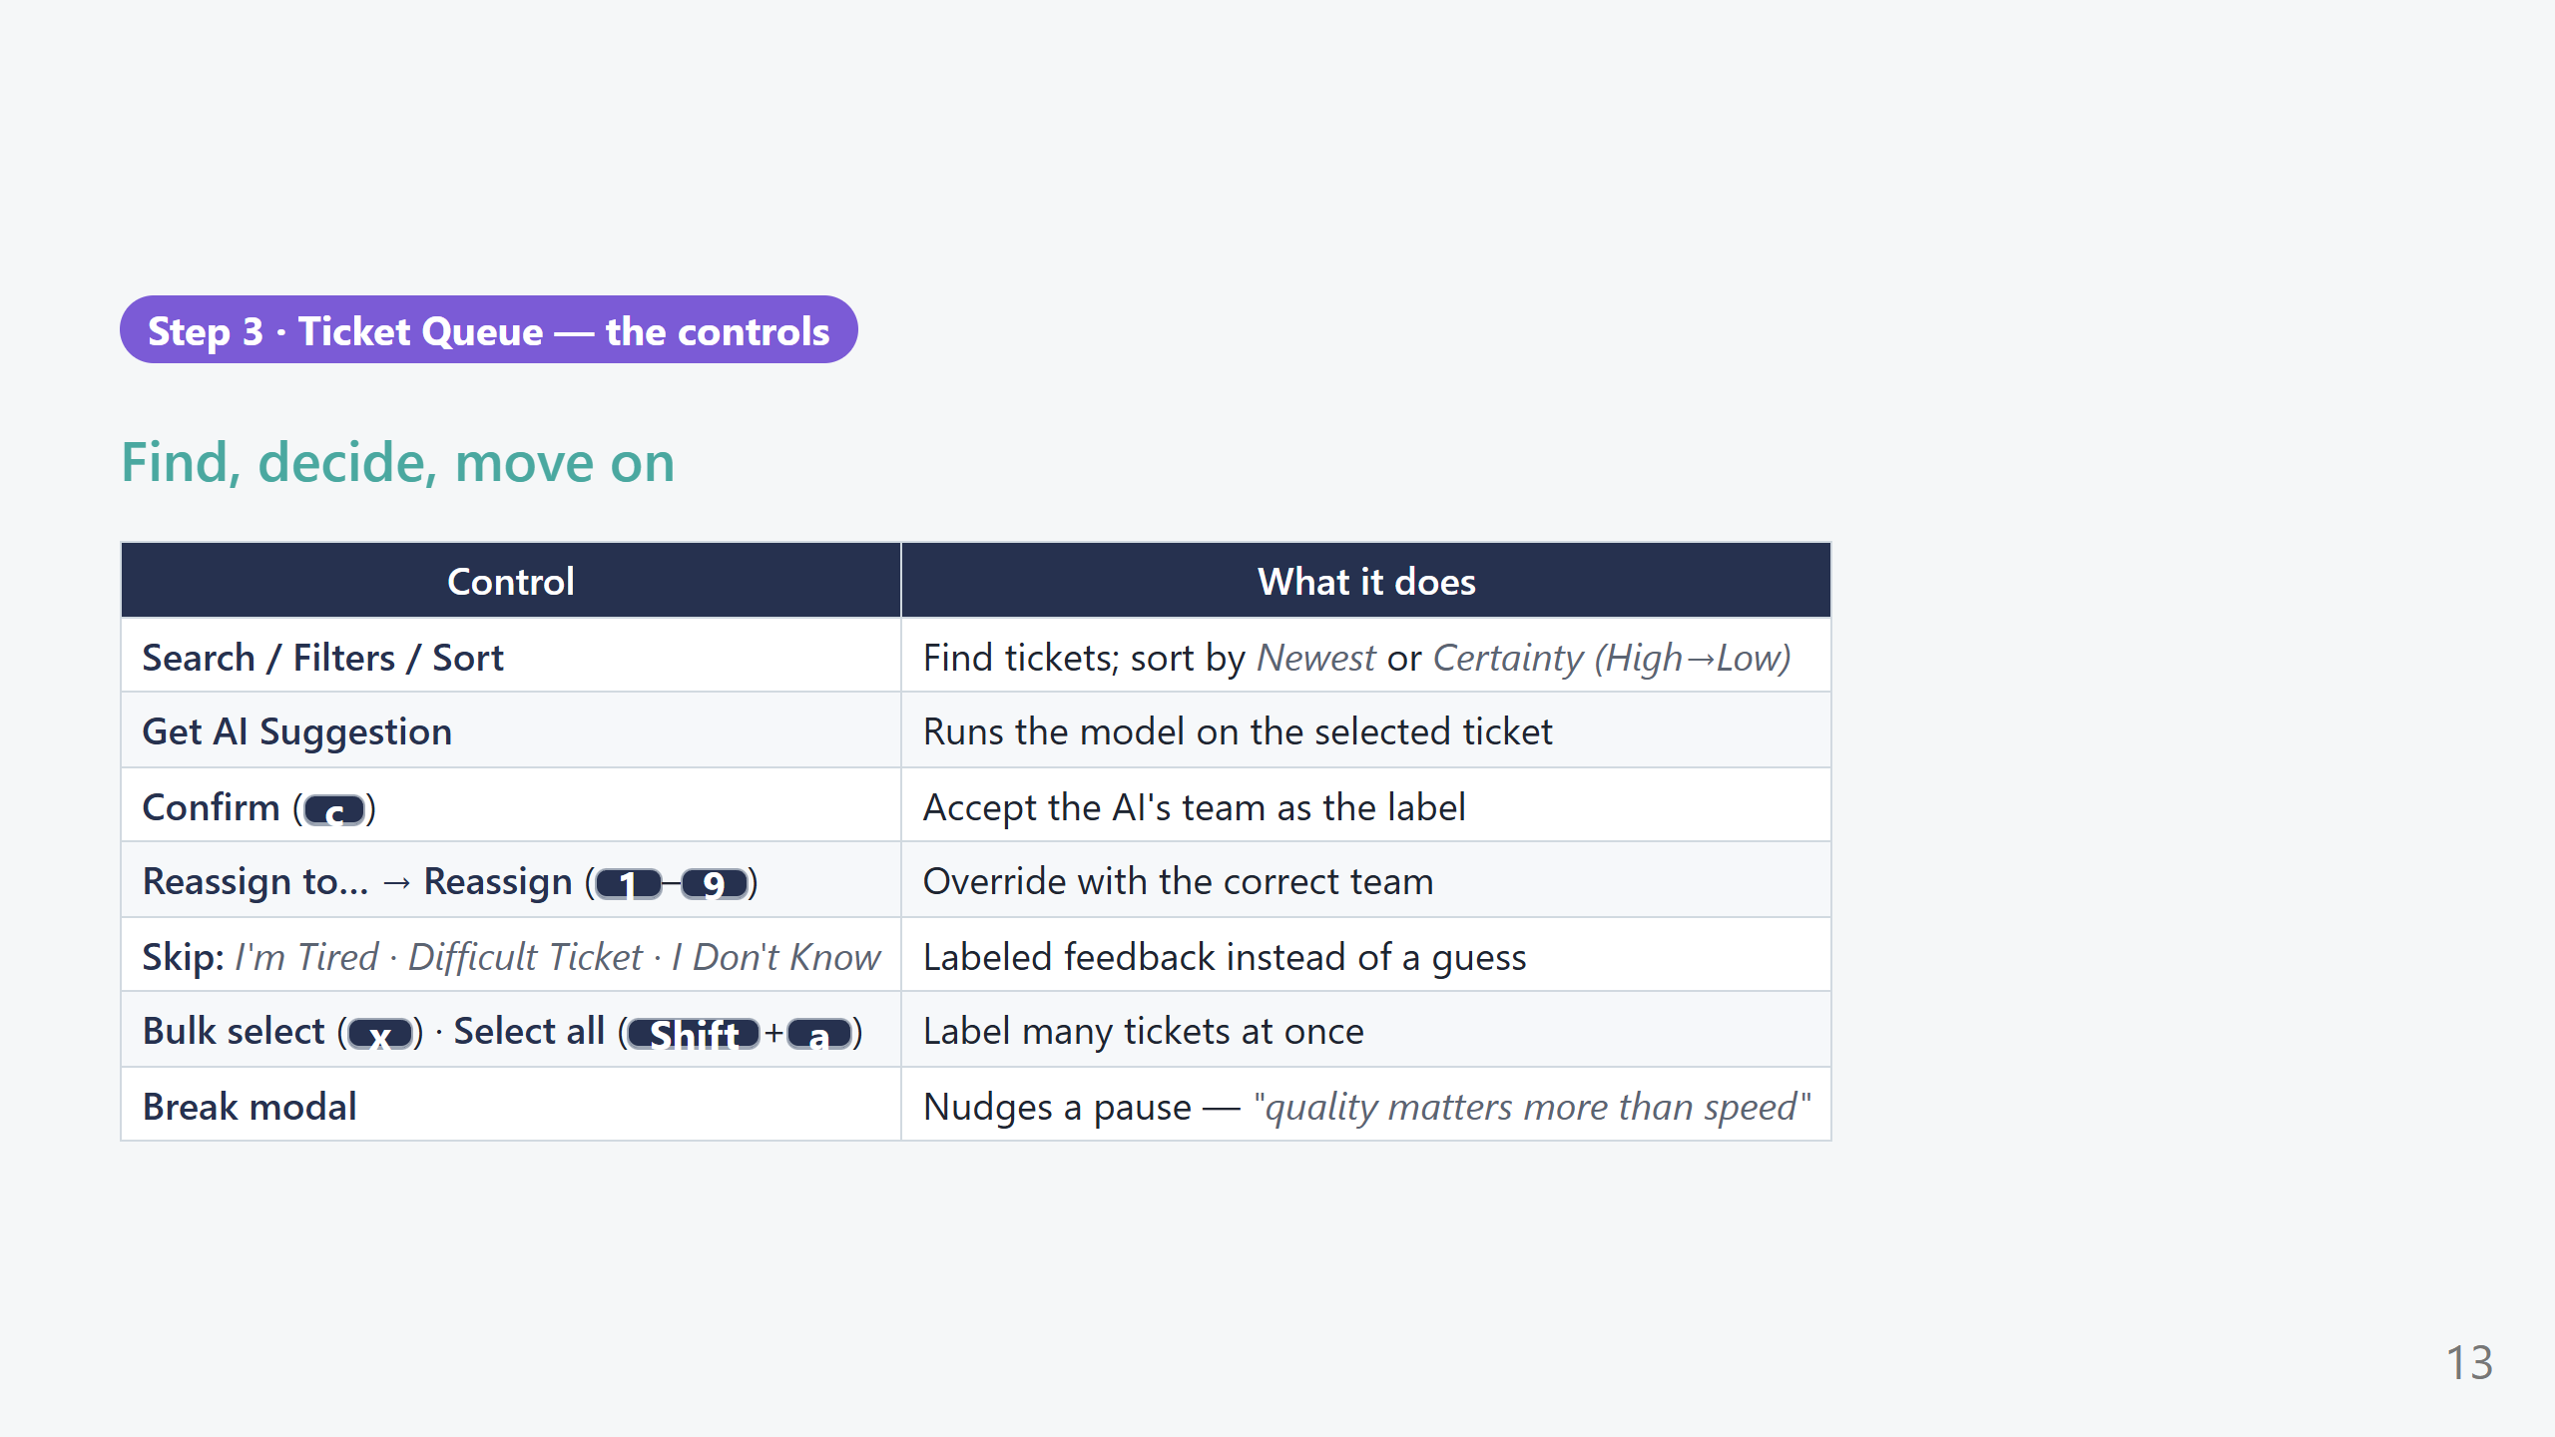
Notes:
PRESENTER SCRIPT — Queue controls (45s) - The 'Skip with a reason' buttons are a highlight: instead of a bad guess, the labeler tells us *why* they skipped (tired / too hard / unsure) — that's honest signal for the model and for wellbeing analytics. - Bulk actions + number keys make high-volume labeling fast — show 'x' then a number if time allows. - The Break modal shows we care about labeler wellbeing and label quality, not just throughput.

Slide 14
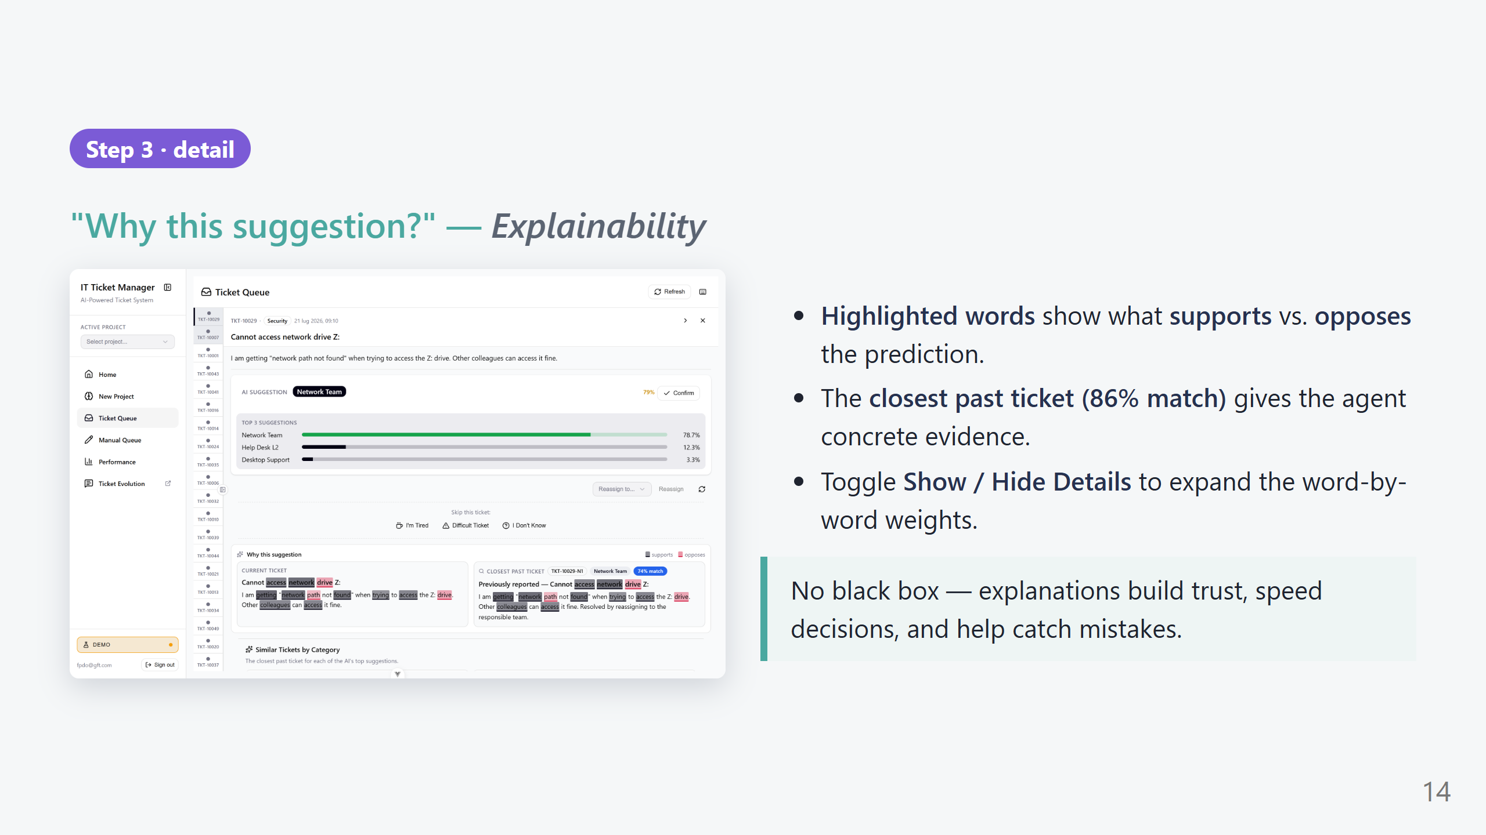
Notes:
PRESENTER SCRIPT — Explainability (1 min) What to say: "This is the trust layer — the difference between 'the AI said so' and 'here's why.'" What to click / point at: - 'Why this suggestion?' panel — the highlighted words are what drove the prediction (LIME). Green supports, red opposes. - 'Similar Tickets by Category' — the closest resolved ticket for each top guess, with a match %. "The labeler can open a real precedent." - Toggle 'Show Details' for the ranked word weights. Key line: "When the AI is wrong, the explanation makes it obvious — the labeler catches it in seconds instead of trusting blindly."

Slide 15
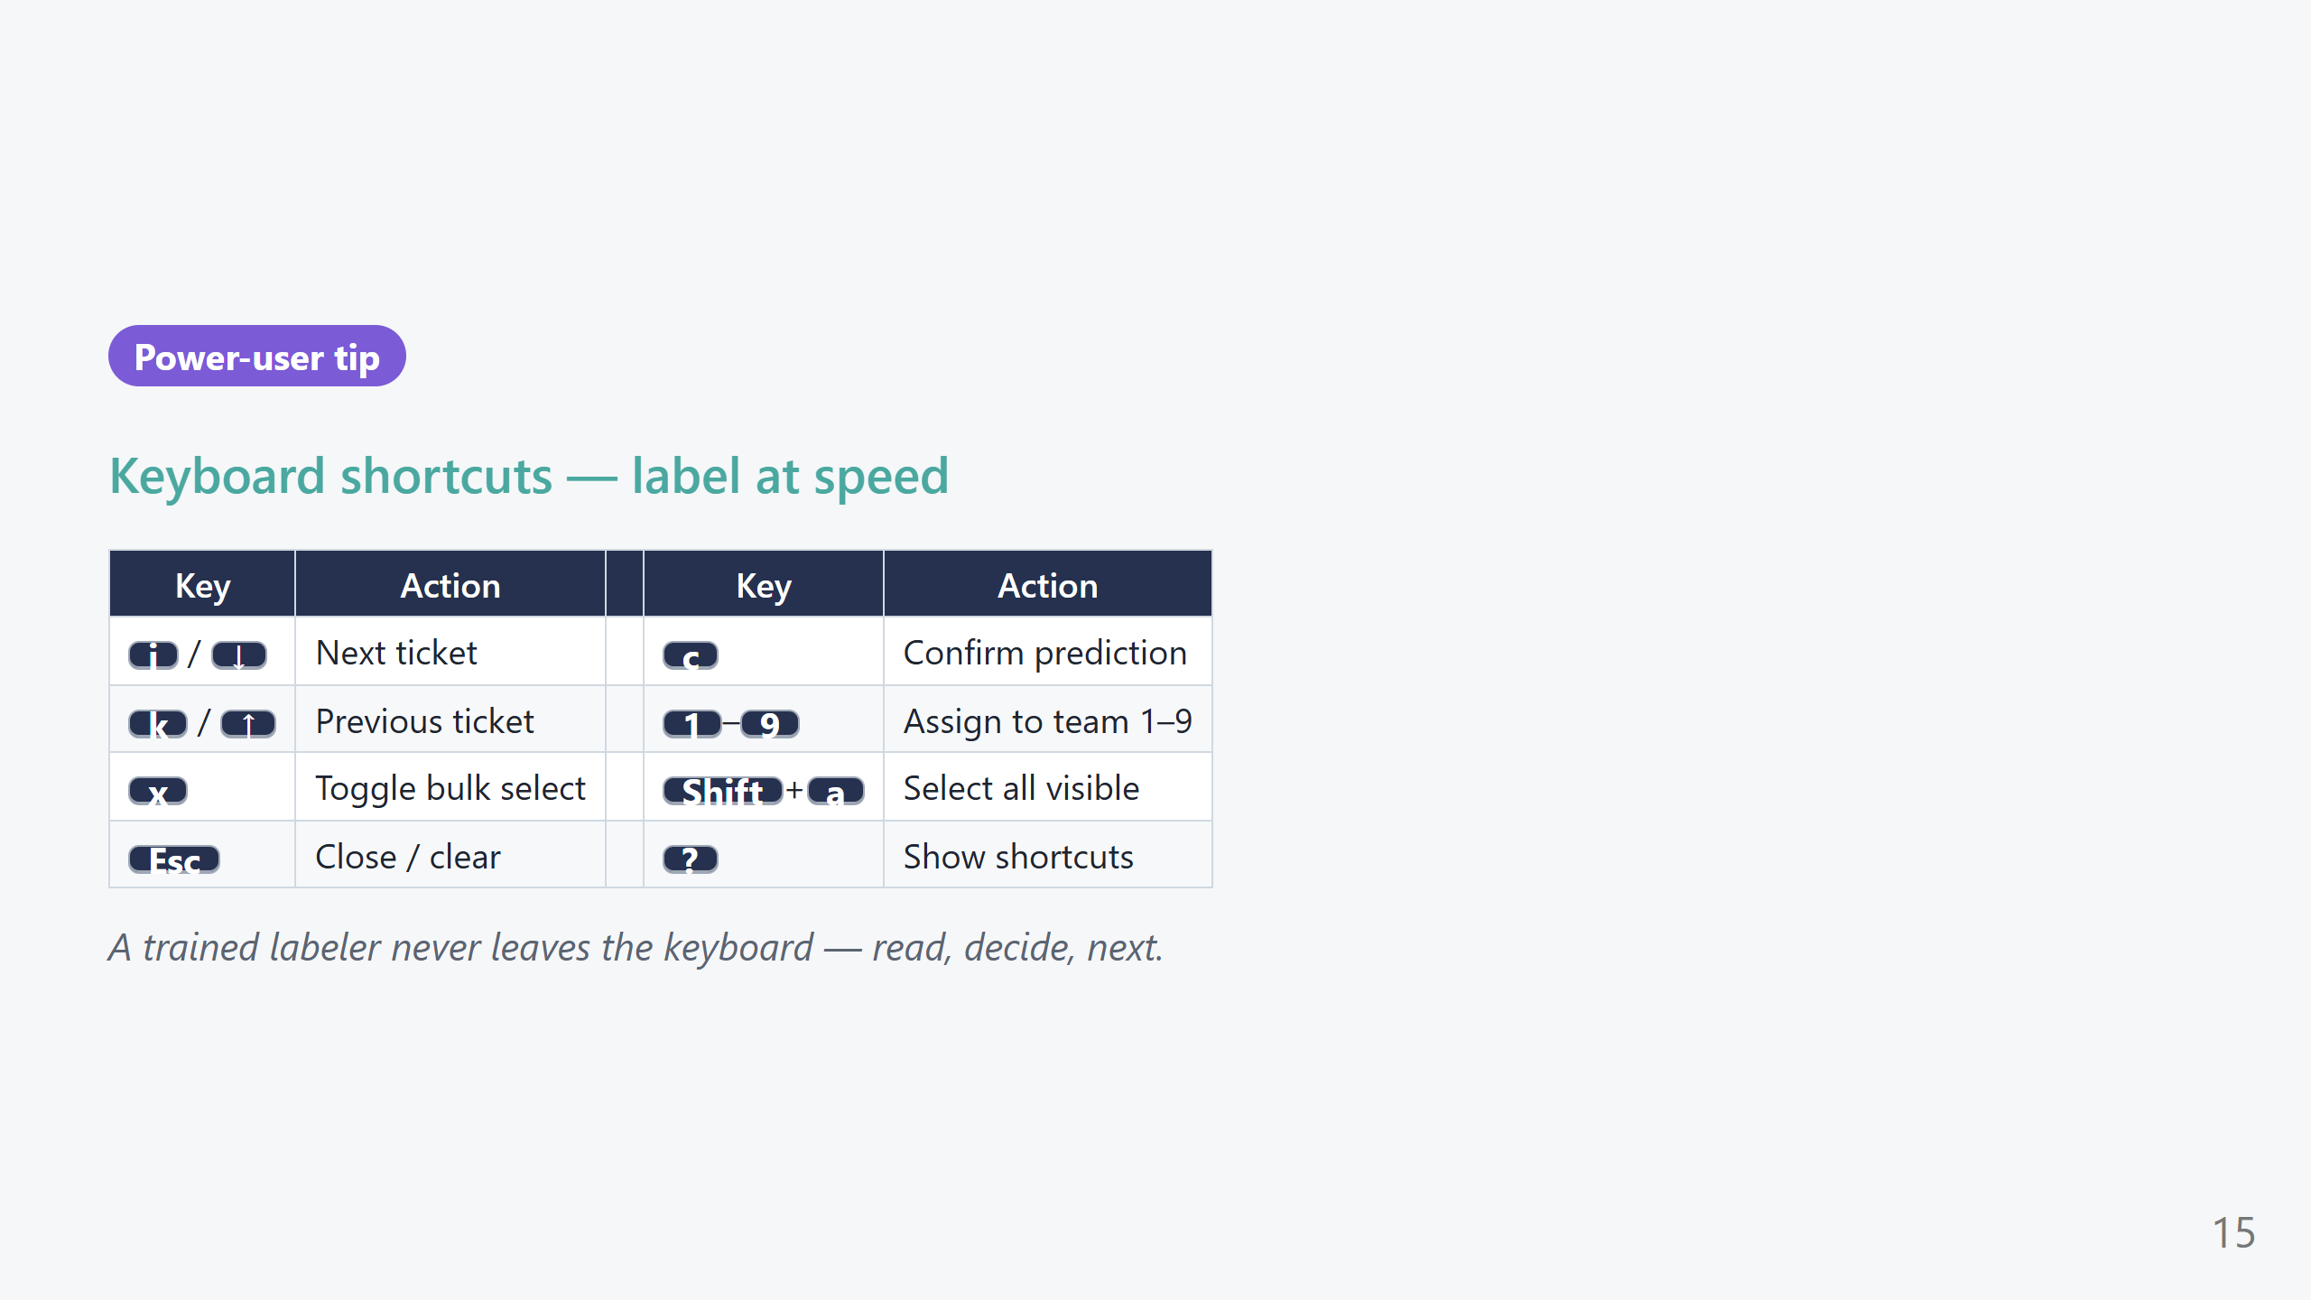
Notes:
PRESENTER SCRIPT — Shortcuts (20s) - Optional slide; great for an operations audience worried about speed. - "Confirm-and-next is a single keystroke; the whole queue can be cleared without touching the mouse."

Slide 16
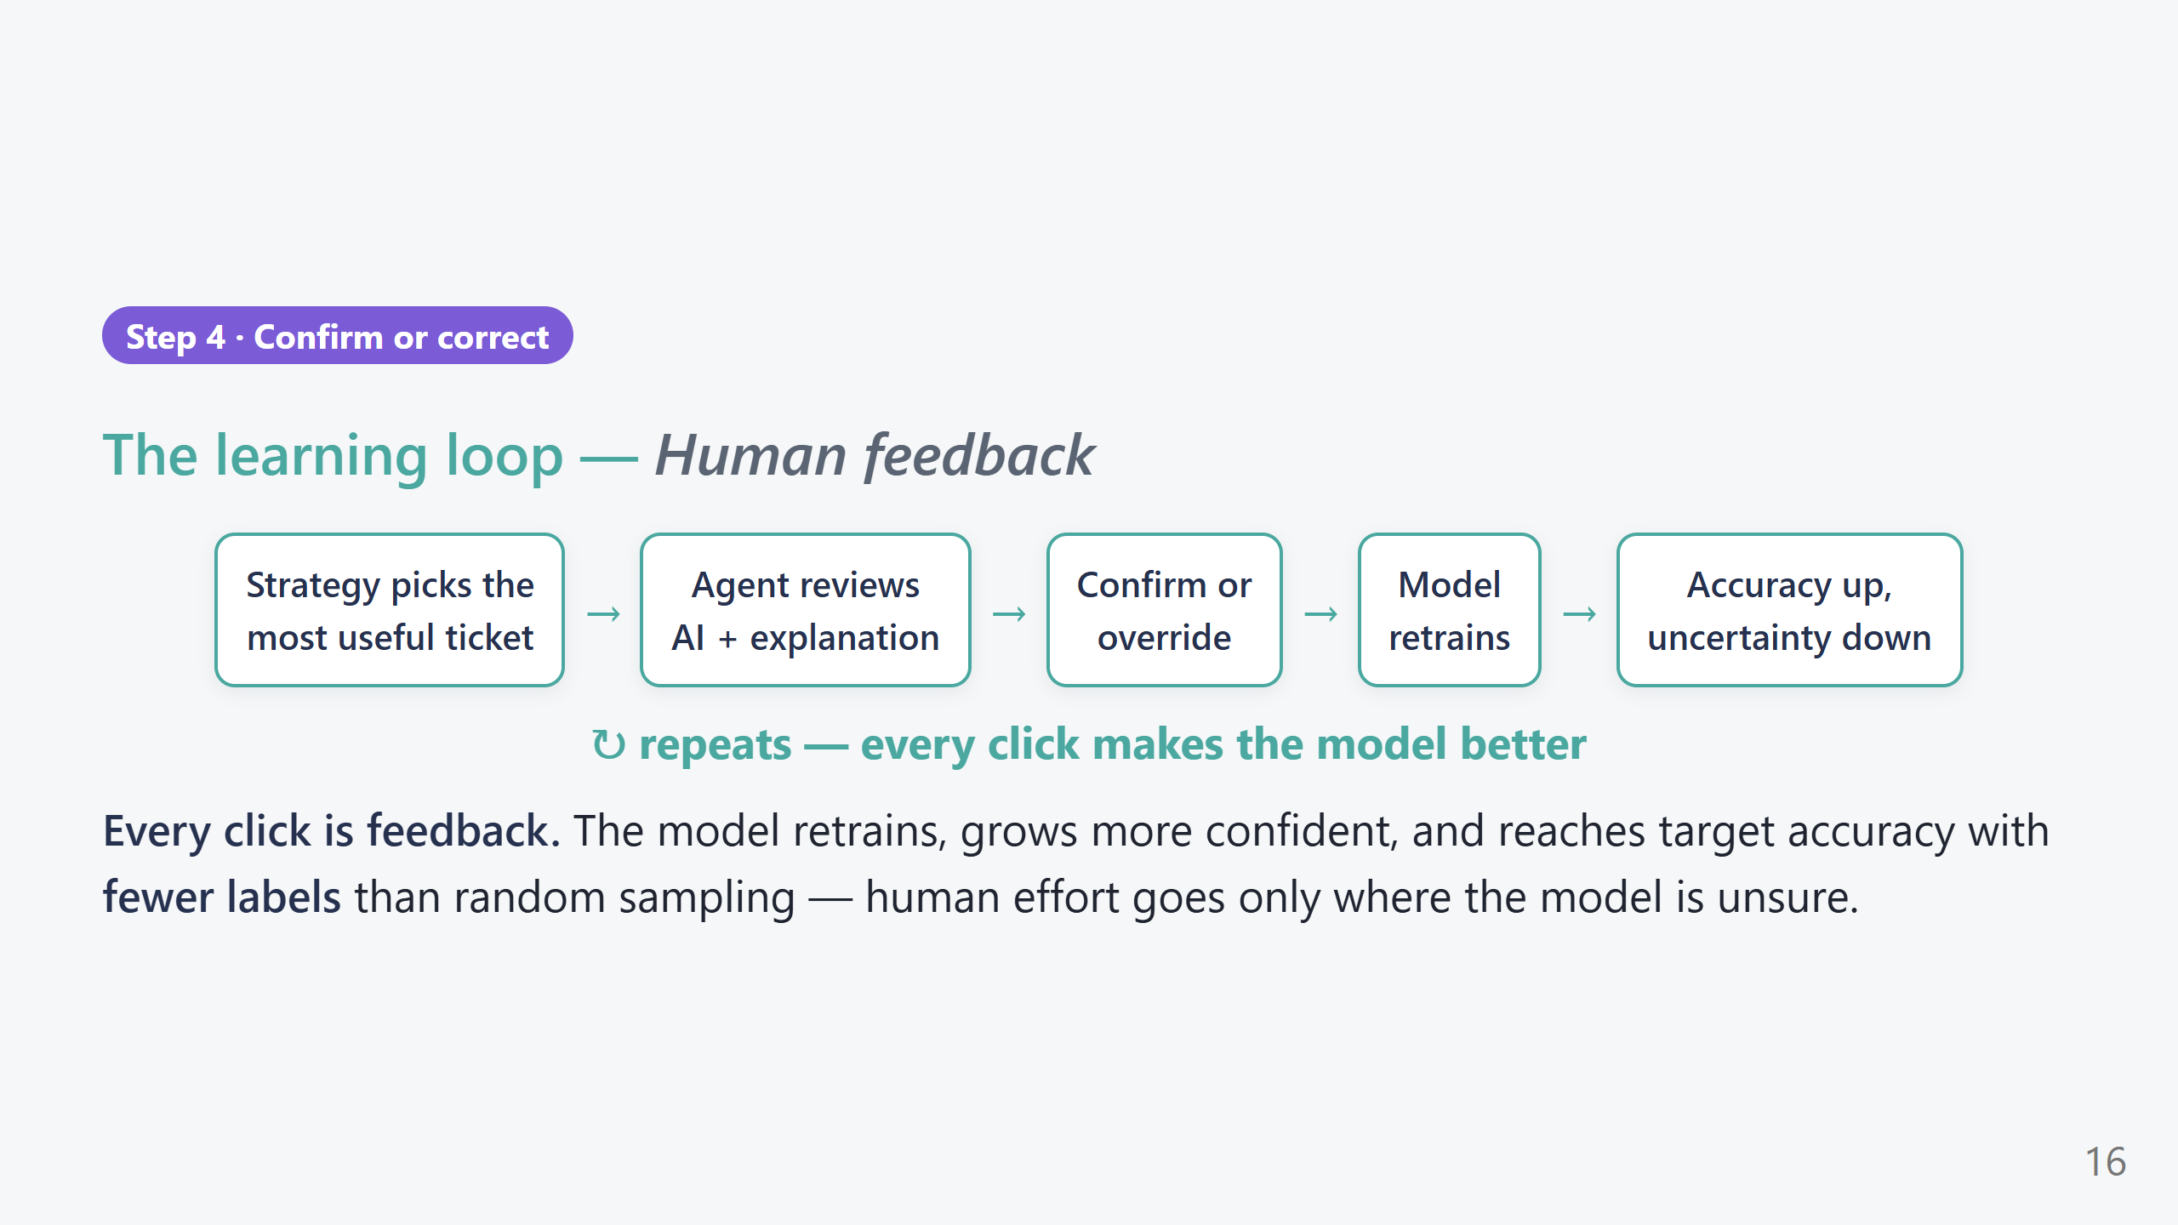
Notes:
PRESENTER SCRIPT — Learning loop (45s) - This is the "Learn" pillar. Walk the arrows. - The punchline: because the strategy picks the *most informative* tickets, we hit target accuracy with far fewer labels than labeling at random — that's real human time saved. - "Confirm teaches it it's right; override teaches it it's wrong. Both are gold."

Slide 17
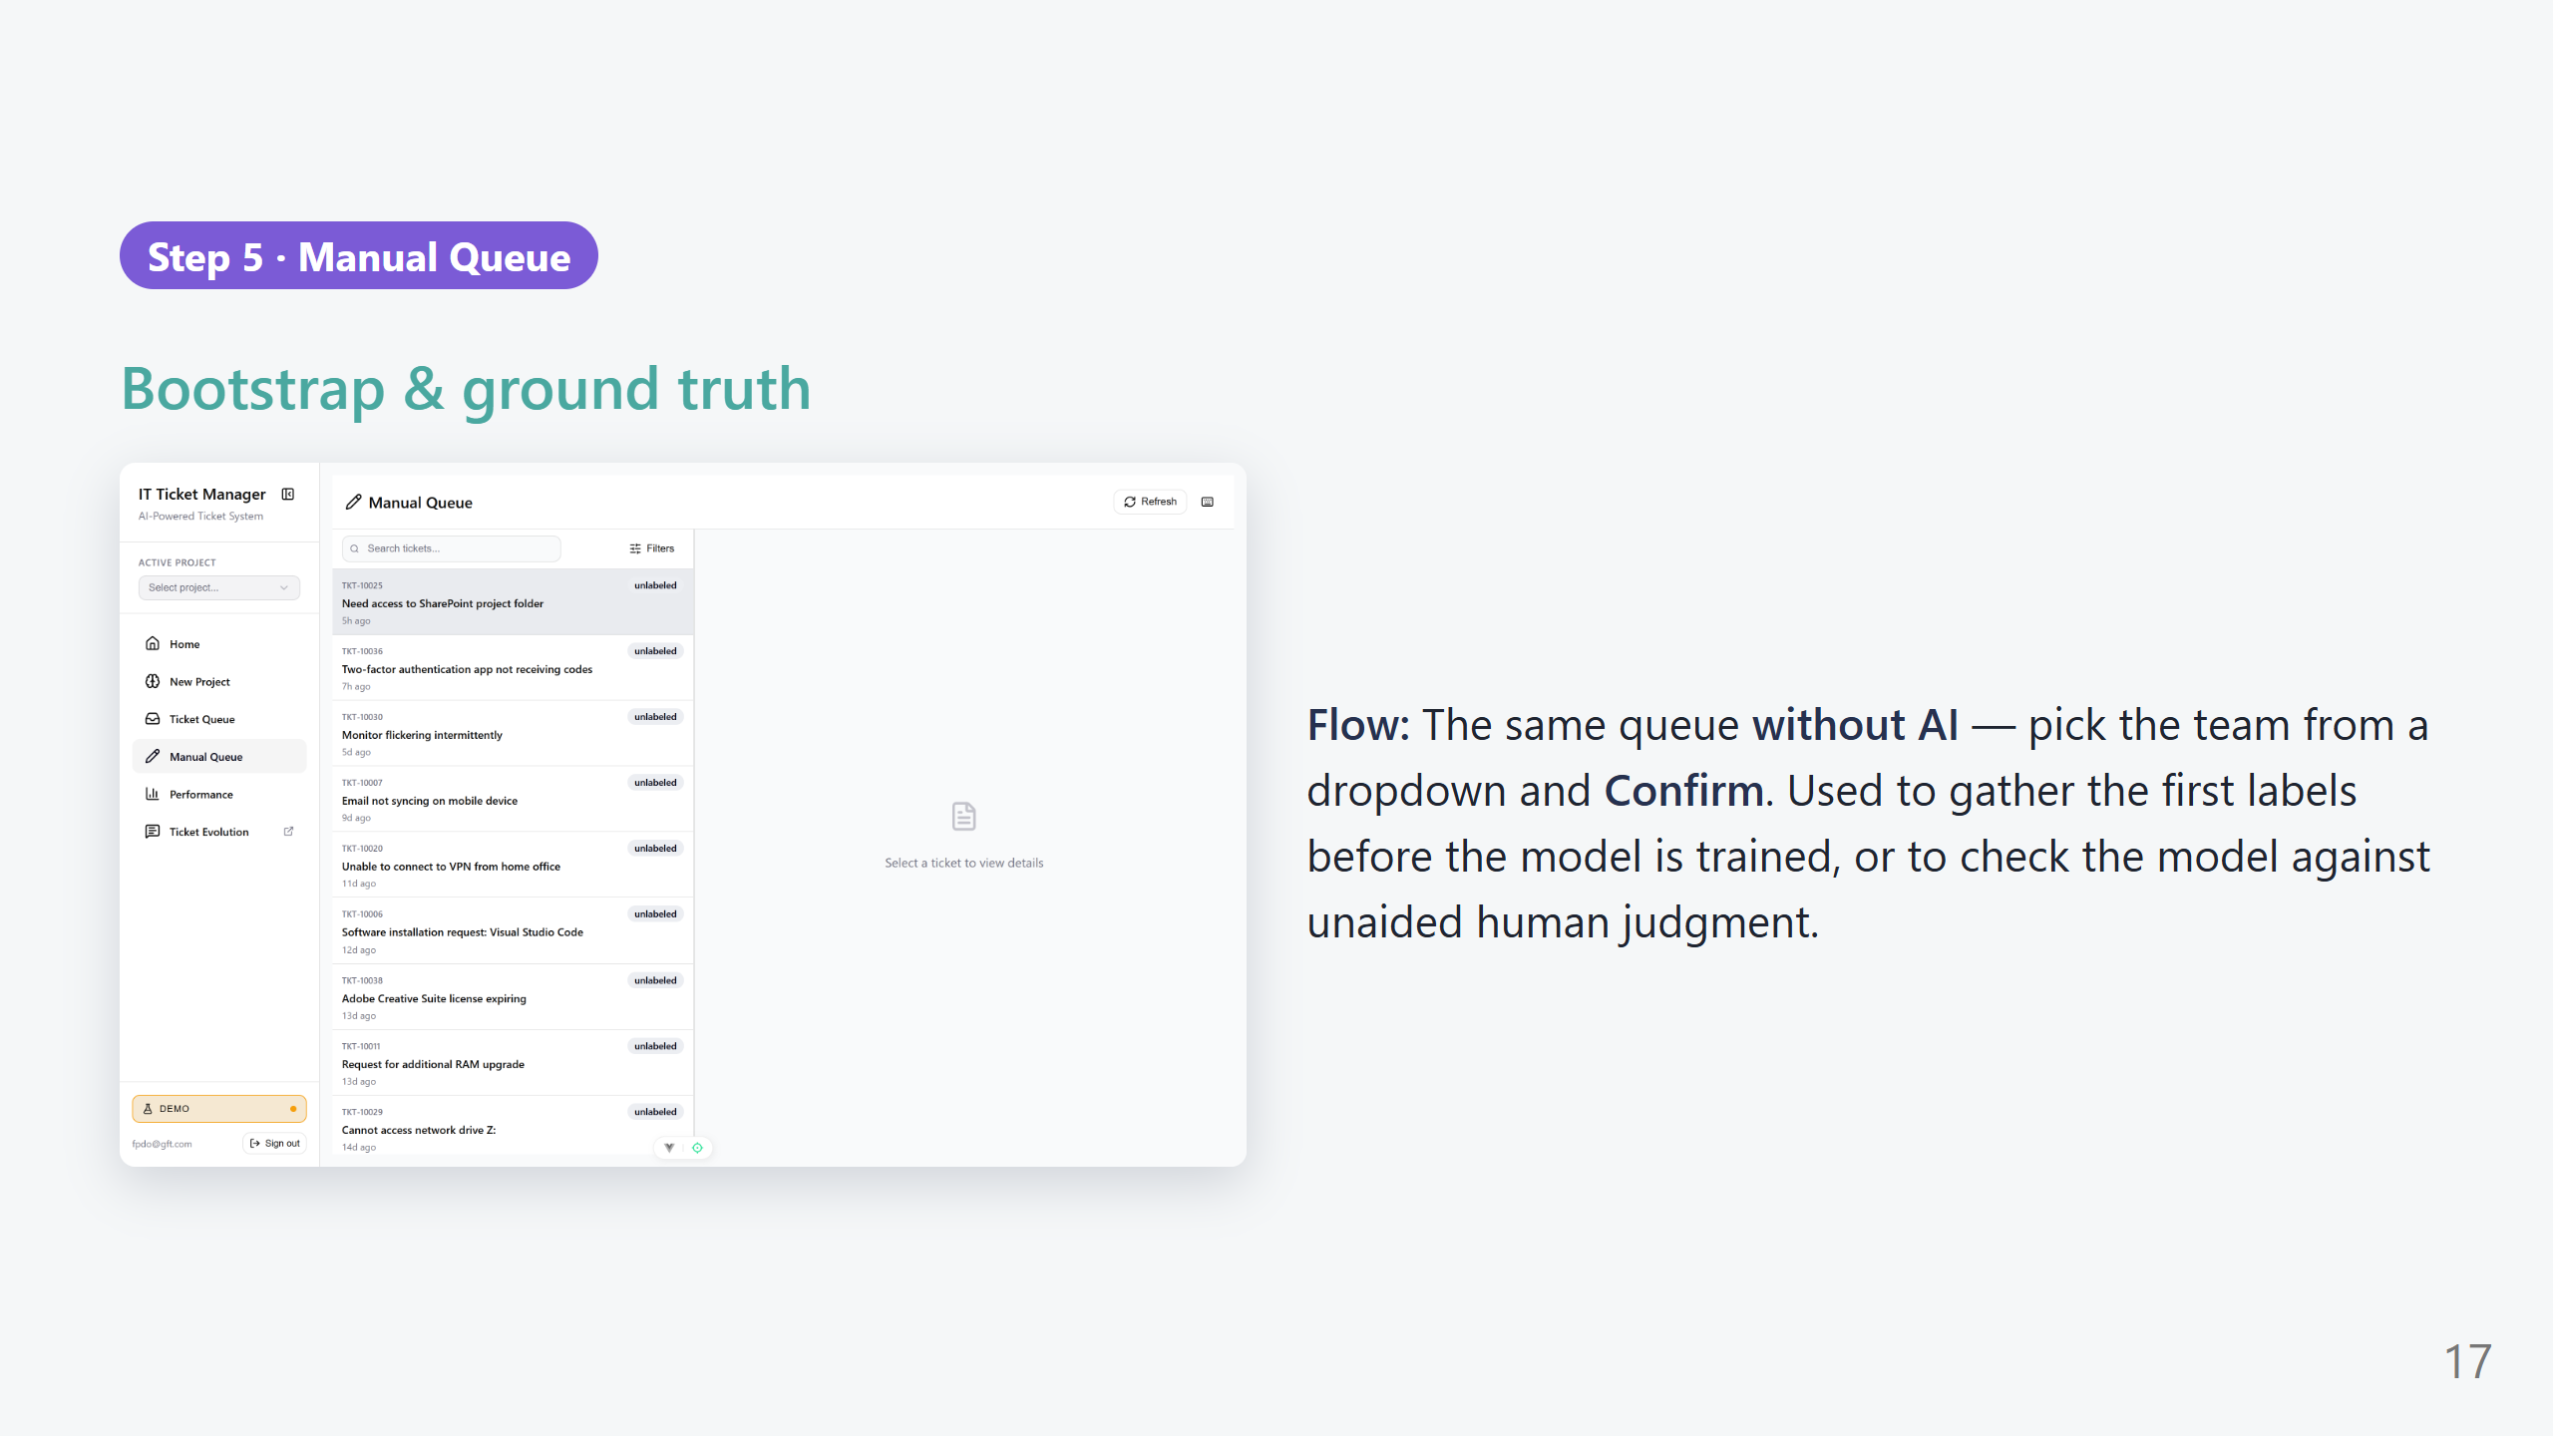
Notes:
PRESENTER SCRIPT — Manual Queue (40s) What to say: "Before the AI knows anything, we need a few honest human labels — that's the Manual Queue." - No predictions, no explanations — just the ticket, a 'Select team…' dropdown, and 'Confirm'. - Two uses: (1) bootstrap the very first training data, (2) audit — hide the AI to measure unaided human accuracy as a baseline. - Same keyboard shortcuts as the AI queue.

Slide 18
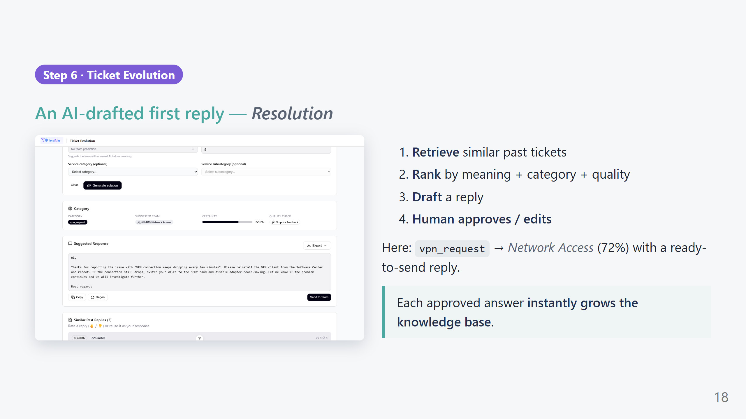
Notes:
PRESENTER SCRIPT — Ticket Evolution (1.5 min) What to say: "Now the Tier-2 operator's tool — turning a routed ticket into a sent reply in seconds." What to click: - Type a Title + Description (or use 'Pick a ticket' to pull one you just labeled). - Click 'Generate solution'. - Walk the result: 'Category' = vpn_request, 'Suggested Team' = Network Access, 'Certainty' 72%, and a 'Quality check' badge showing whether past feedback was applied. - Scroll to 'Suggested Response' — a ready-to-send draft the operator can edit. - Below: 'Similar Past Replies' with match % and 👍/👎 votes — real precedents. Key line: "Approve it and it joins the knowledge base — the next similar ticket gets an even better draft. No retraining wait."

Slide 19
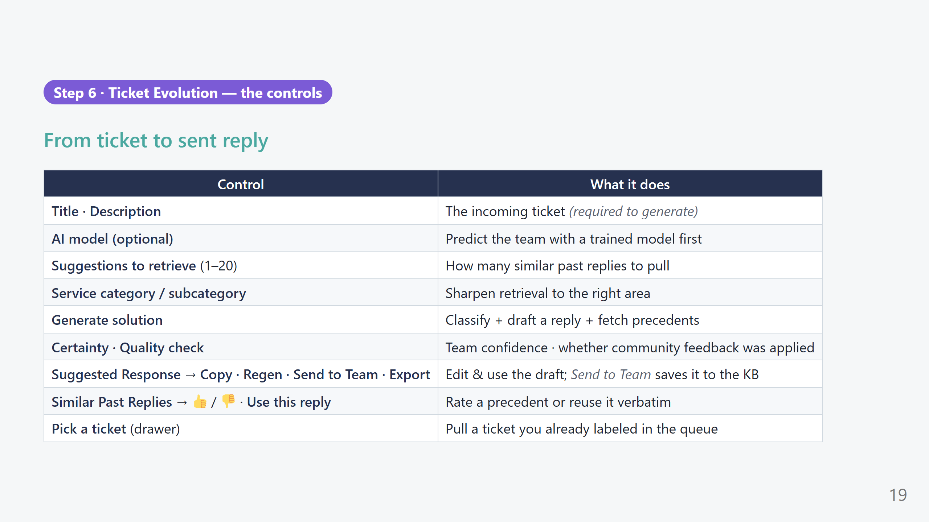
Notes:
PRESENTER SCRIPT — Resolution controls (45s) - 'Suggestions to retrieve' = the top-K knob for the RAG search; more = more precedents, slower. - 'Send to Team' is the money button: it saves the approved reply and grows the knowledge base incrementally. - 👍/👎 on precedents feed the 'Quality check' — the community teaches the retrieval what's actually helpful.

Slide 20
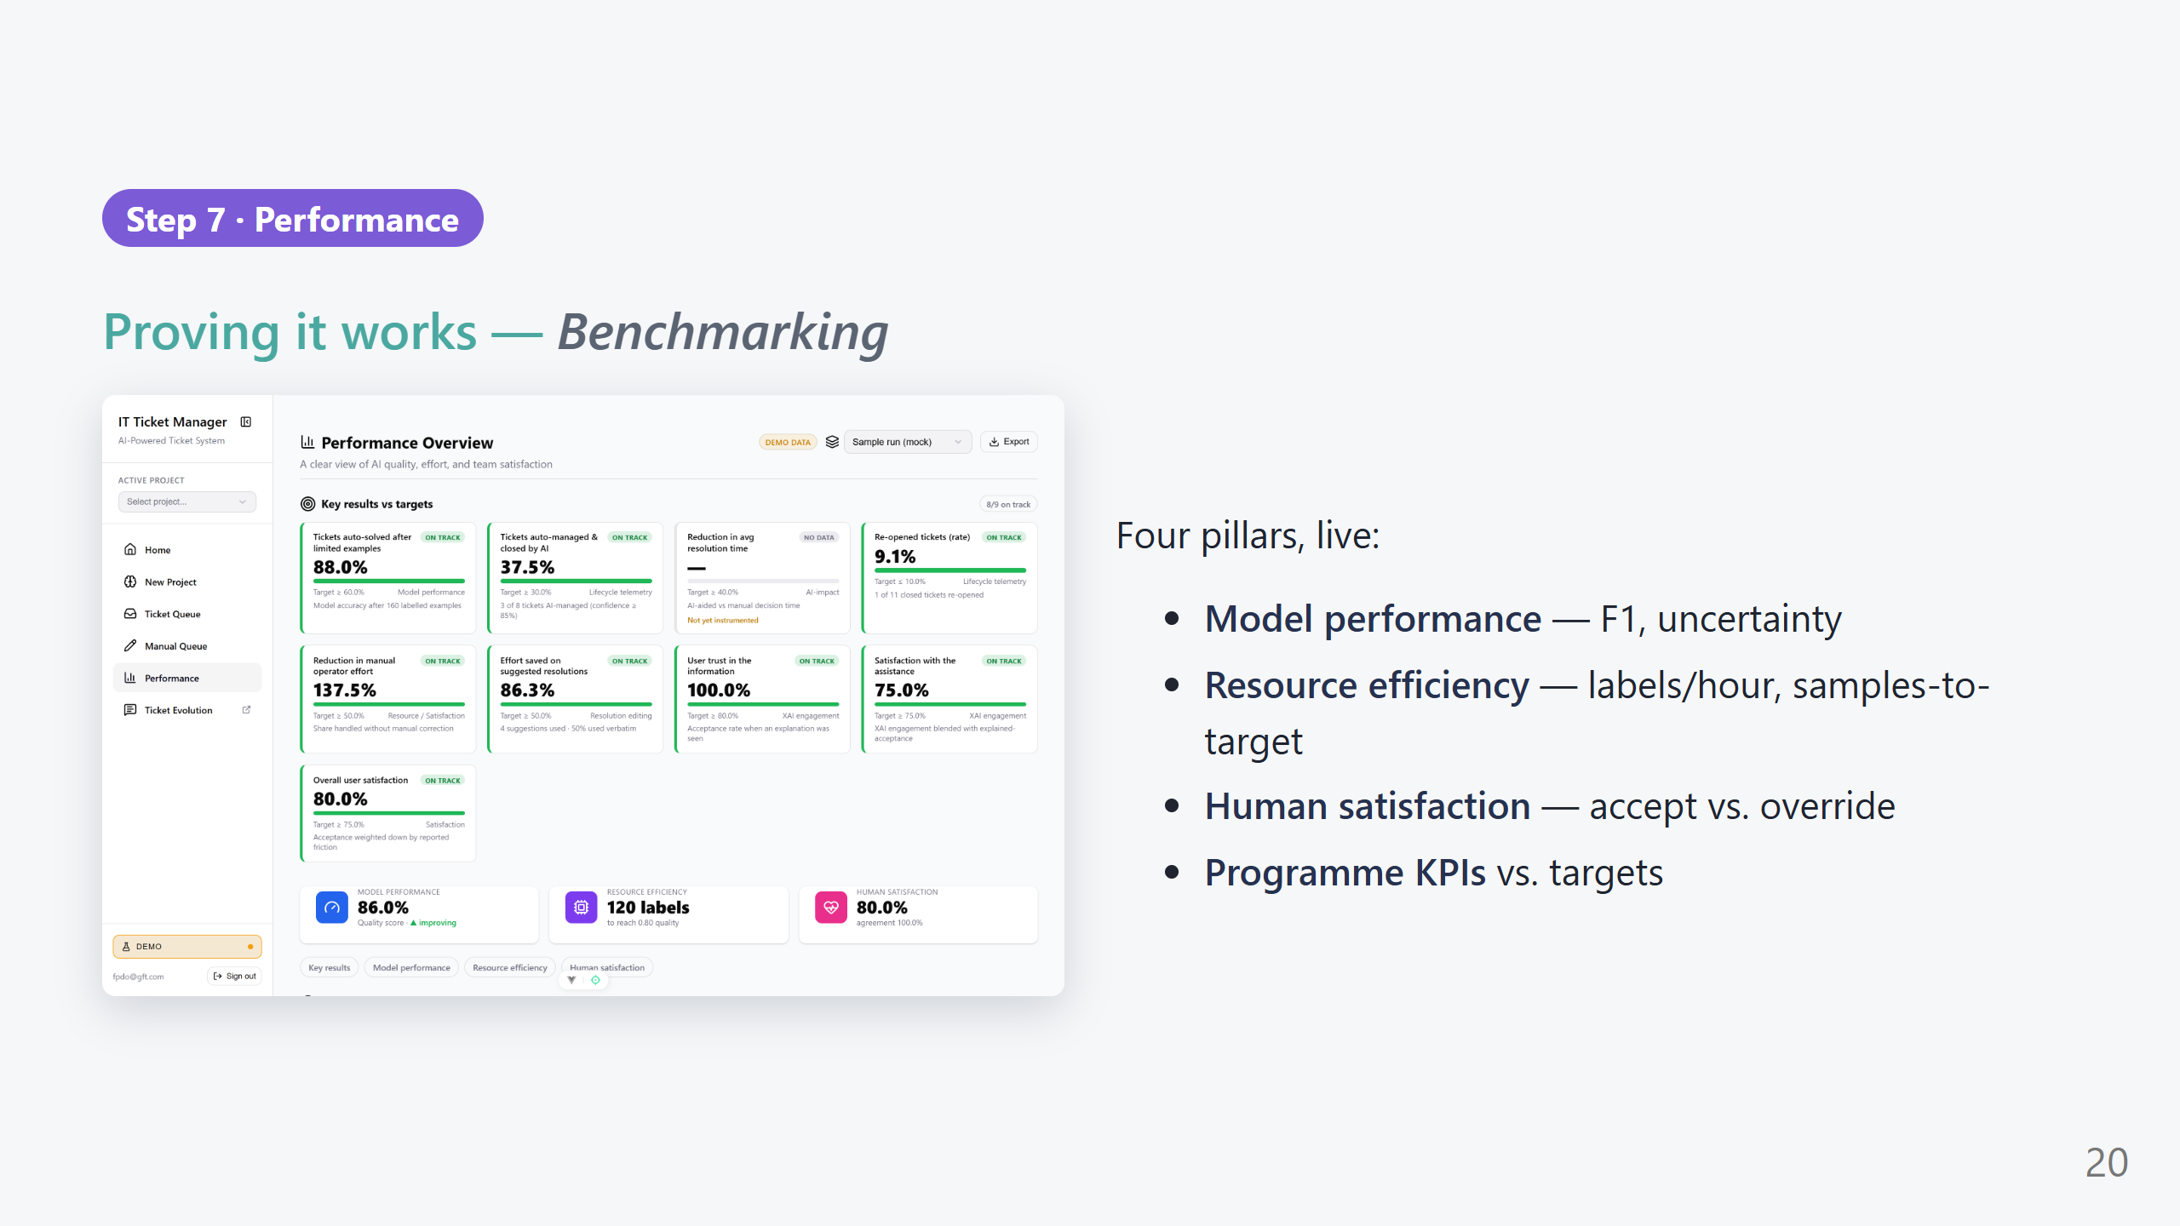
Notes:
PRESENTER SCRIPT — Performance (1 min) What to say: "Every click in the demo is instrumented — this page turns it into evidence." What to point at: - Top: 'Key results vs targets' scorecards with On track / At risk badges. - Three pillar cards: Model performance (F1 + trend), Resource efficiency (labels to reach quality), Human satisfaction (agreement %). - 'Export' saves a JSON snapshot for reporting. - Note the Demo/Live badge — here it's demo data; in production it reads from the live analytics API.

Slide 21
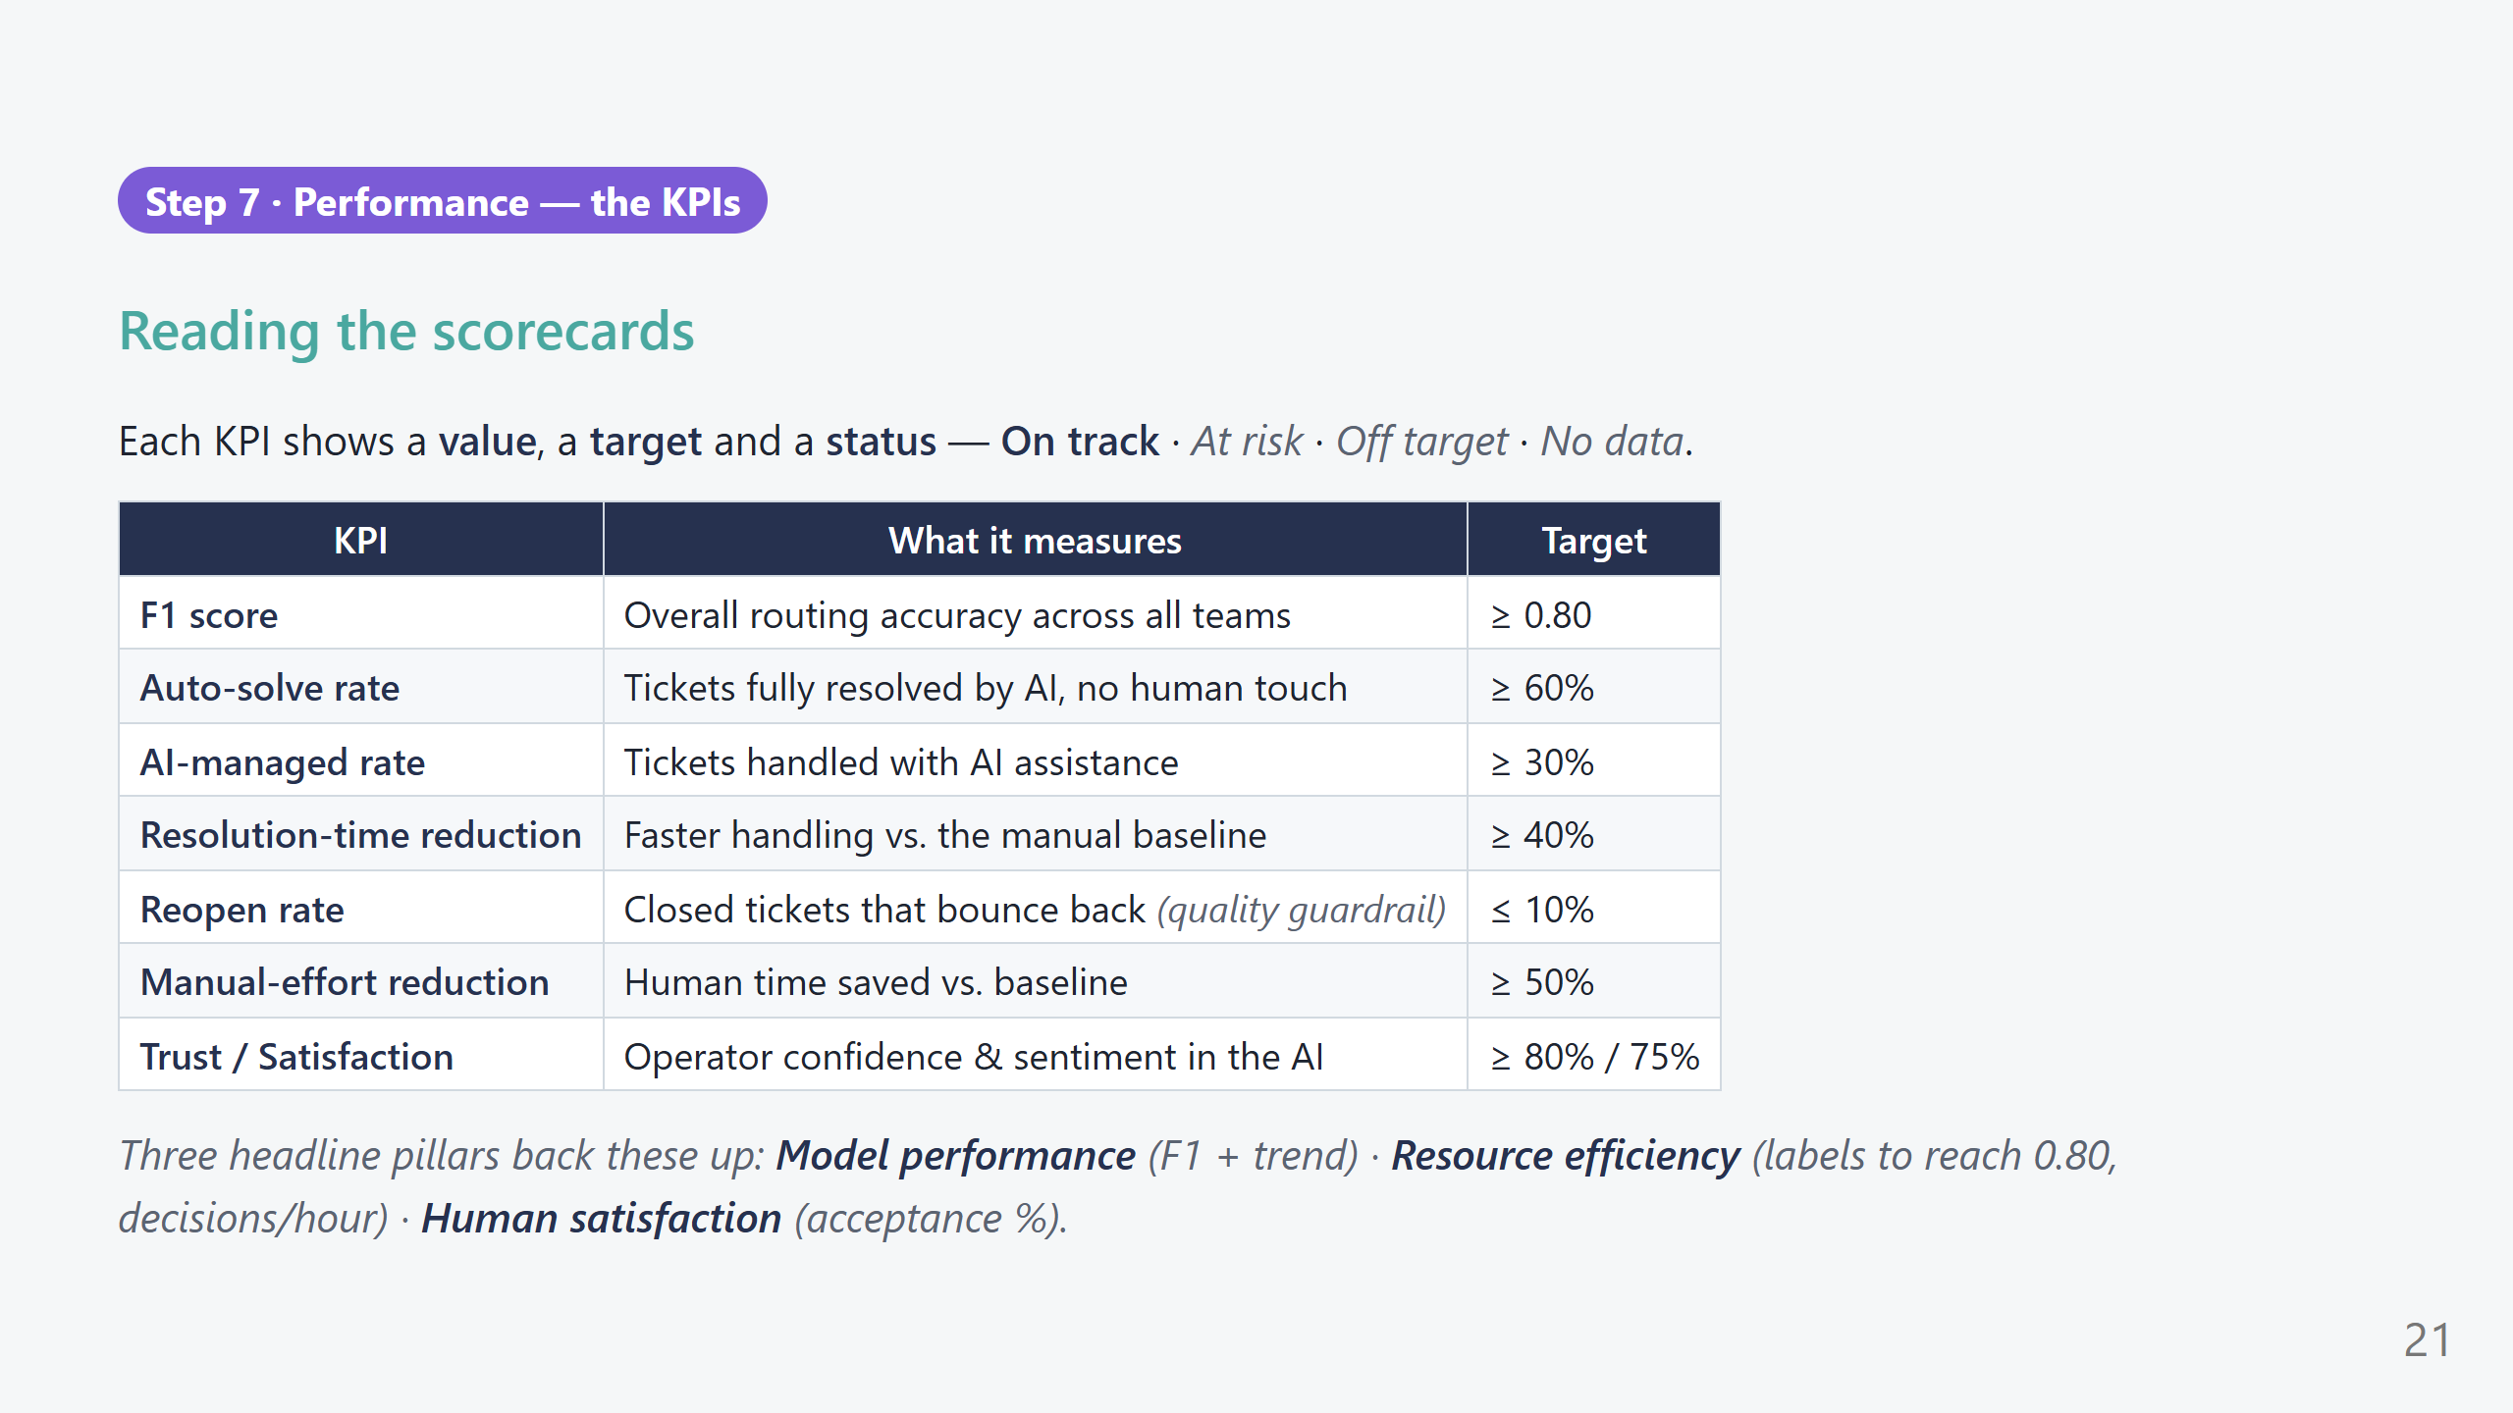
Notes:
PRESENTER SCRIPT — KPI detail (1 min) What to say: "Each card is a promise with a number and a target — green when we're on track, amber when at risk." Walk a few: - 'F1 score' is the single best measure of routing accuracy; target 0.80. - 'Auto-solve' and 'AI-managed' show how much work the AI takes off the team's plate (60% / 30% targets). - 'Reopen rate' is the safety guardrail — if auto-solved tickets bounce back above 10%, we pull back automation. - 'Manual-effort reduction' and 'Trust/Satisfaction' close the loop: less work, and people actually trust it. Key line: "Every one of these is computed from the clicks you saw earlier — nothing here is hand-entered." Reminder: these are programme TARGETS; swap in live values from a real run when you have them.

Slide 22
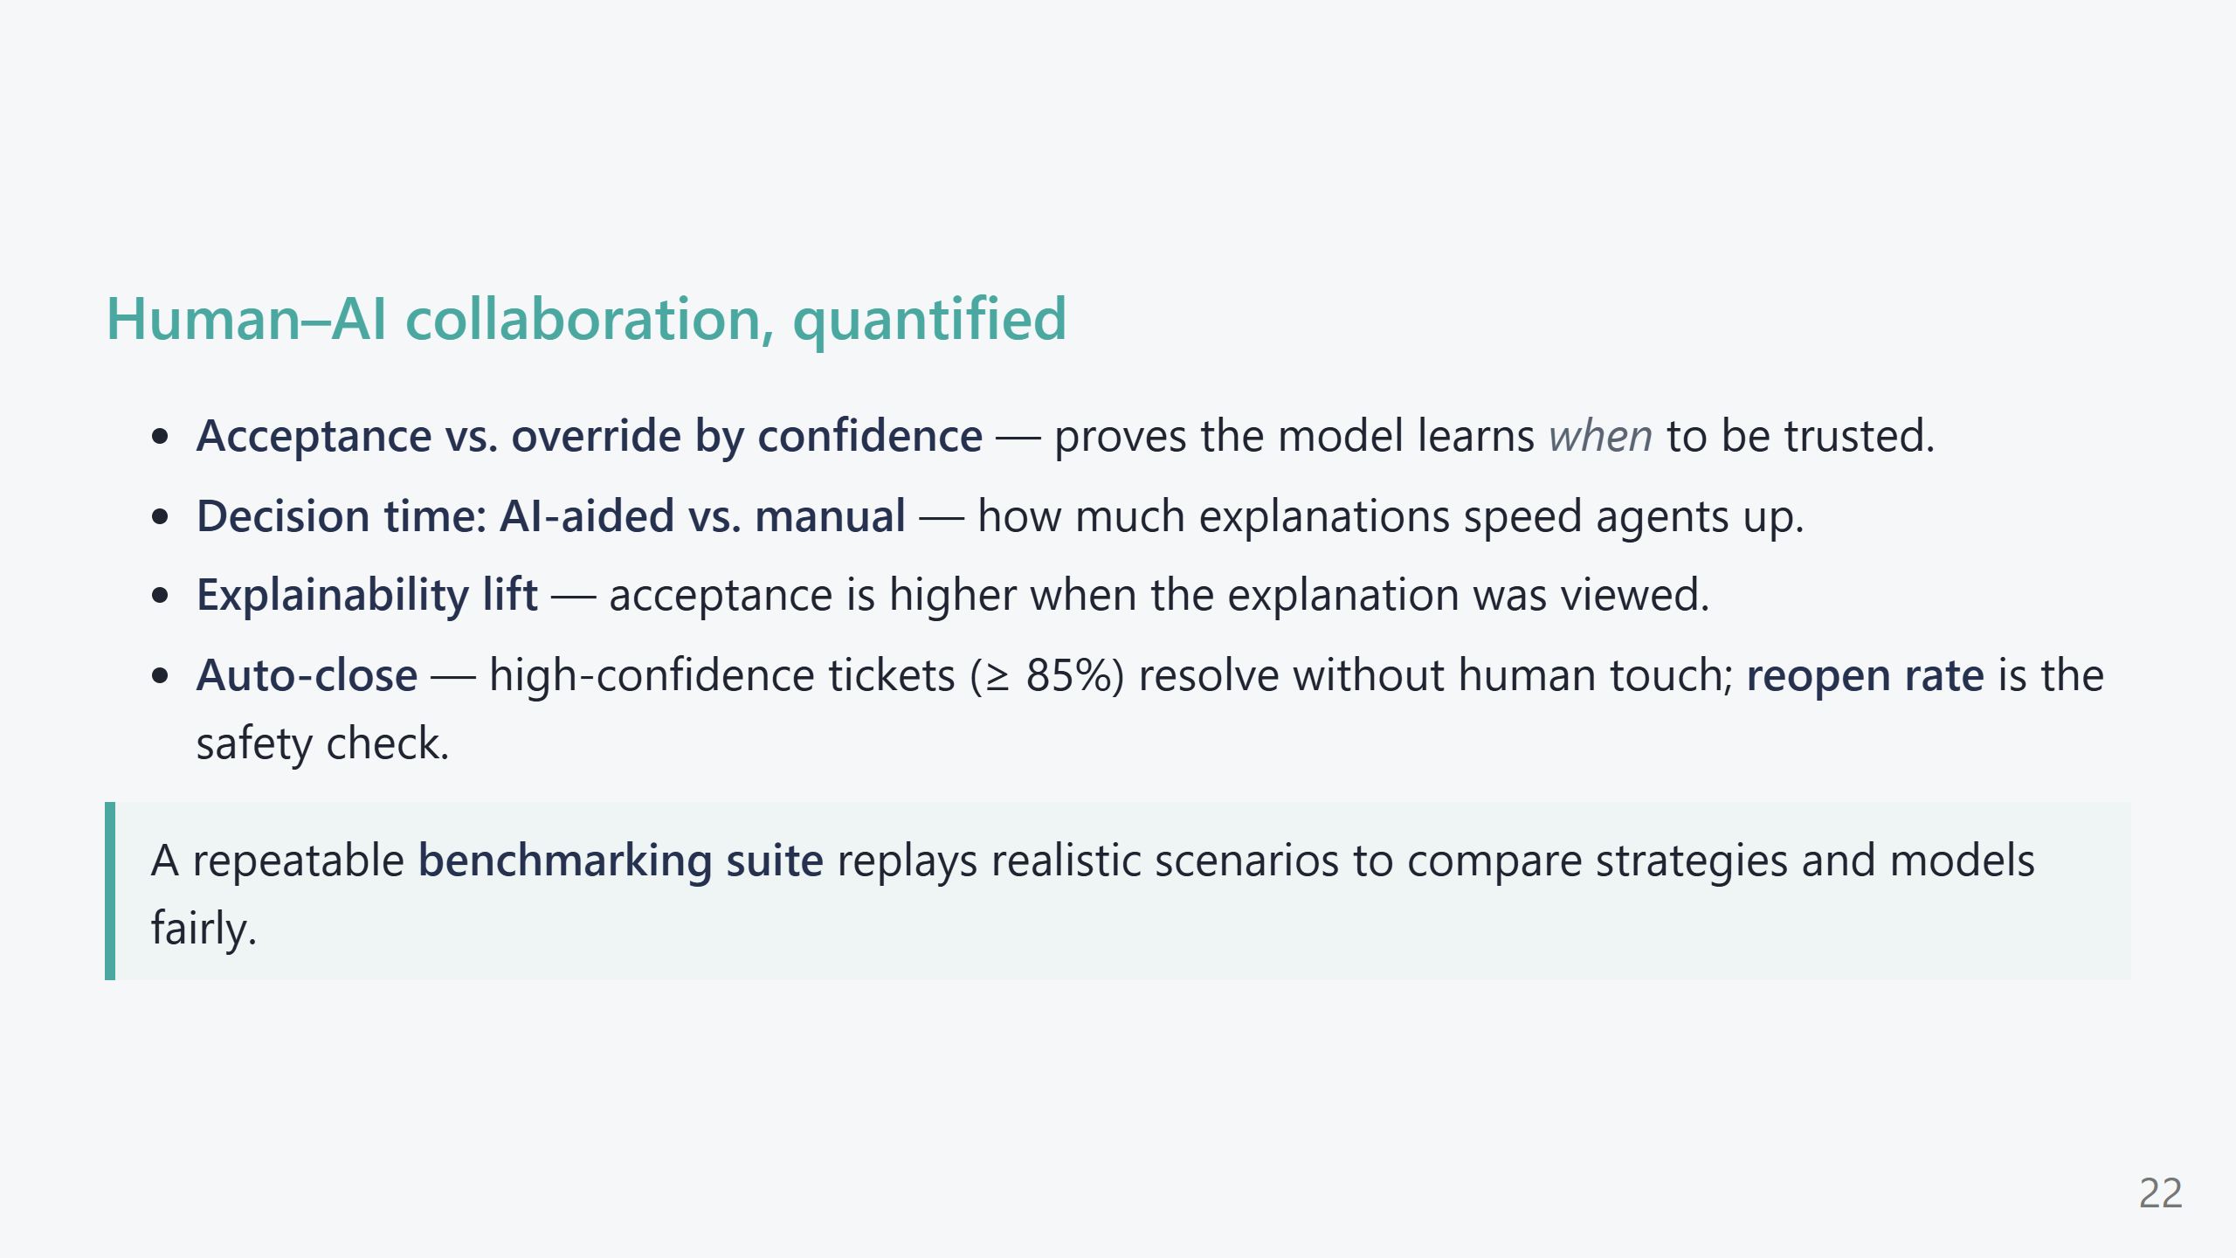
Notes:
PRESENTER SCRIPT — Collaboration metrics (45s) - These are the metrics that make leadership comfortable: not just "is the model accurate" but "is the human+AI team working well?" - Auto-close with a reopen-rate guardrail is the safe path to automation: only very confident tickets, and we watch how many come back. - The benchmarking suite means we can A/B strategies and models on the same scenarios — fair, repeatable comparisons.

Slide 23
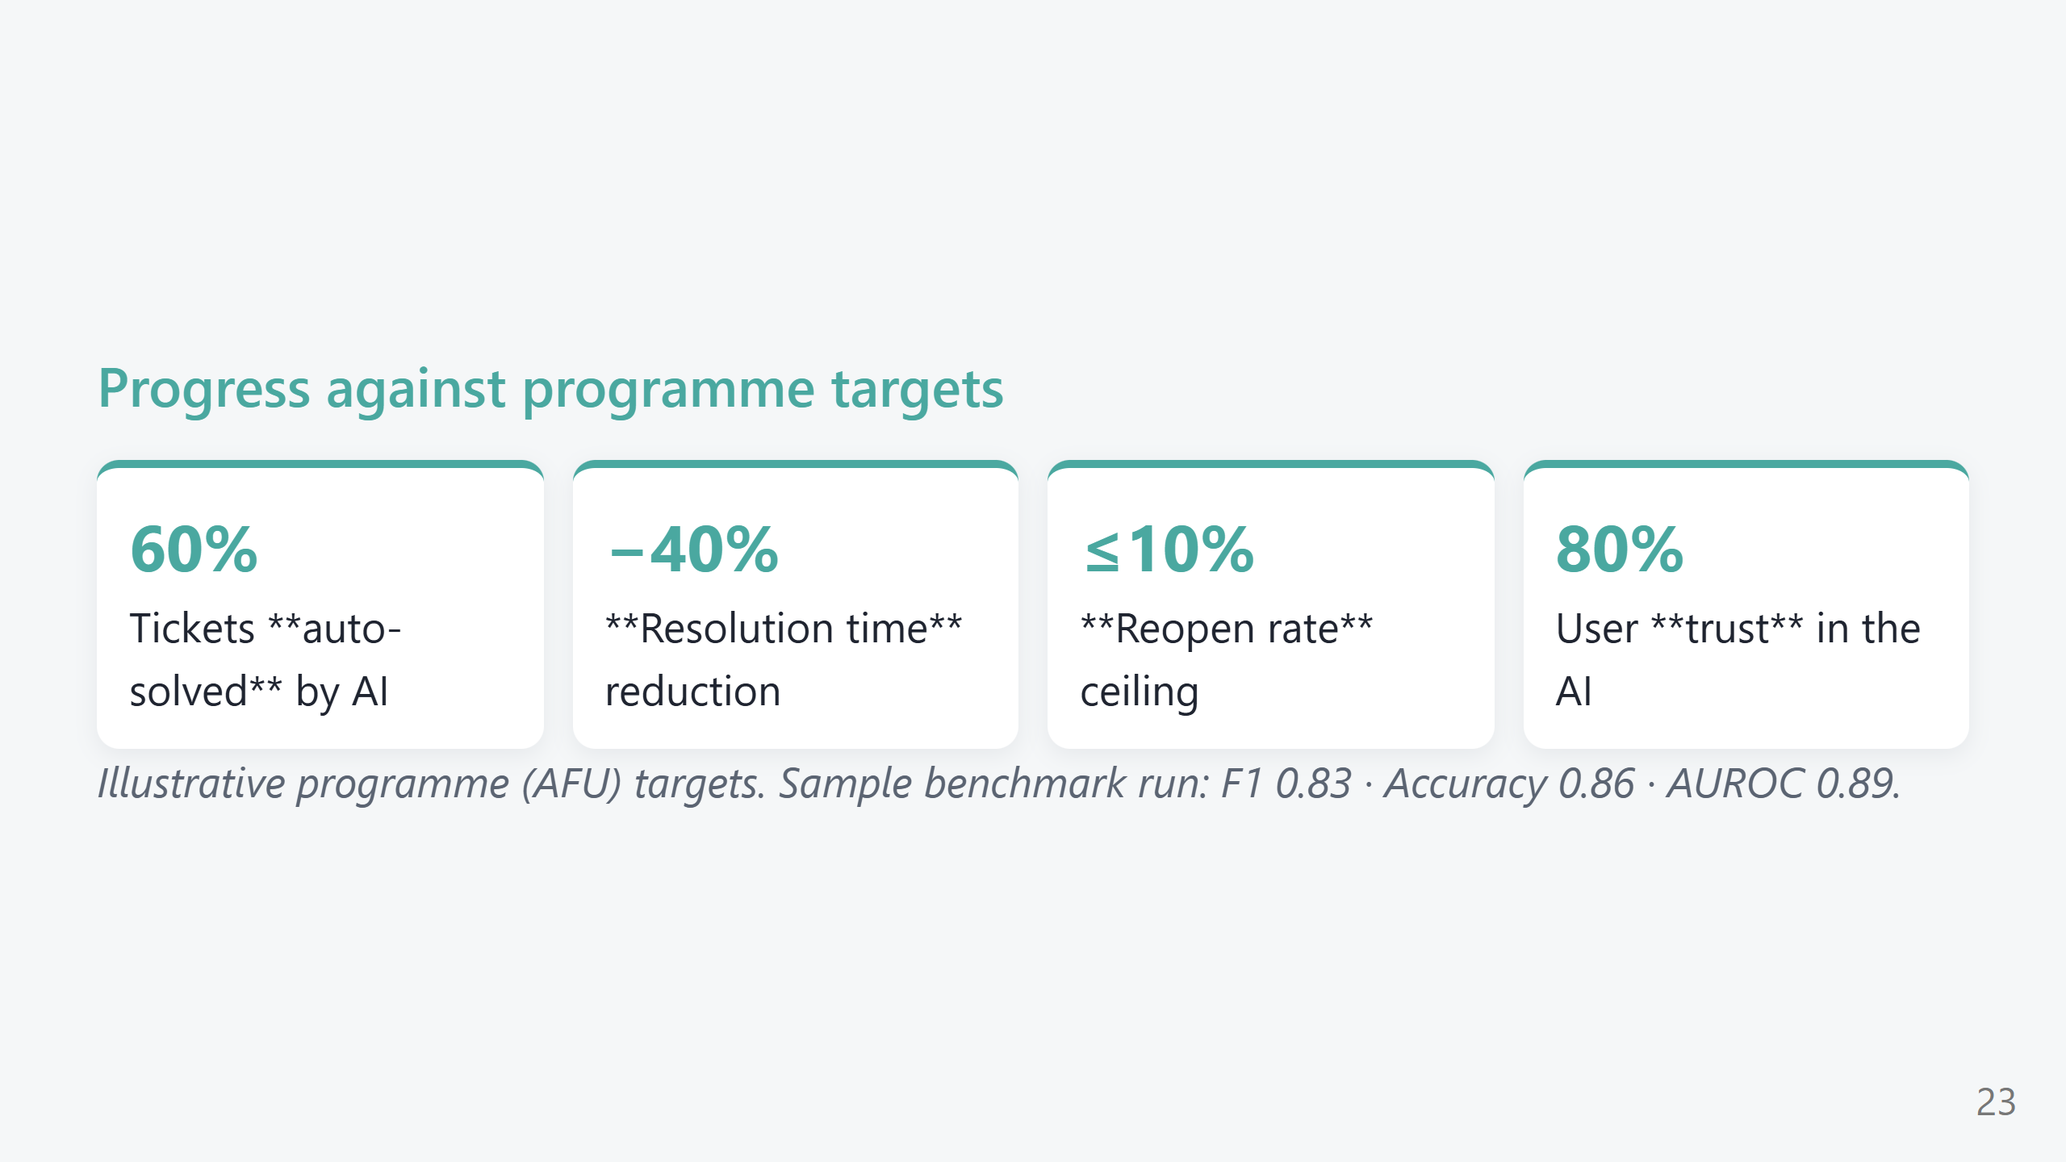
Notes:
PRESENTER SCRIPT — Targets (30s) - Be explicit these are programme TARGETS, not claims — swap in your real numbers if you have a run. - The sample benchmark (F1 0.83 / Acc 0.86 / AUROC 0.89) is illustrative of a mid-training checkpoint. - Frame: "This is how we'll know the programme succeeded."

Slide 24
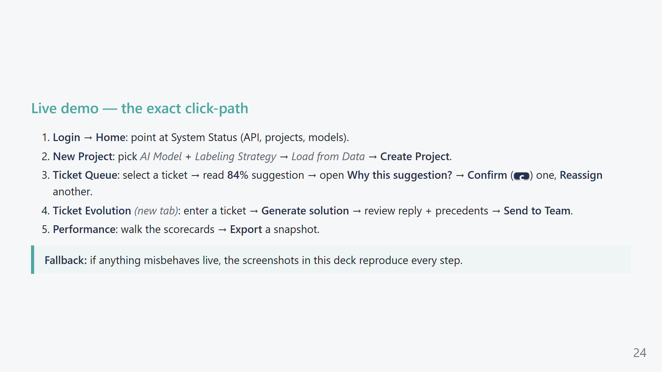
Notes:
PRESENTER SCRIPT — Click-path cheat sheet (keep visible while demoing) - This is your safety net — glance here if you lose your place. - Keep Demo mode ON the whole time so nothing depends on the backend. - Budget ~12 minutes for the live walkthrough; don't rabbit-hole on any one screen.

Slide 25
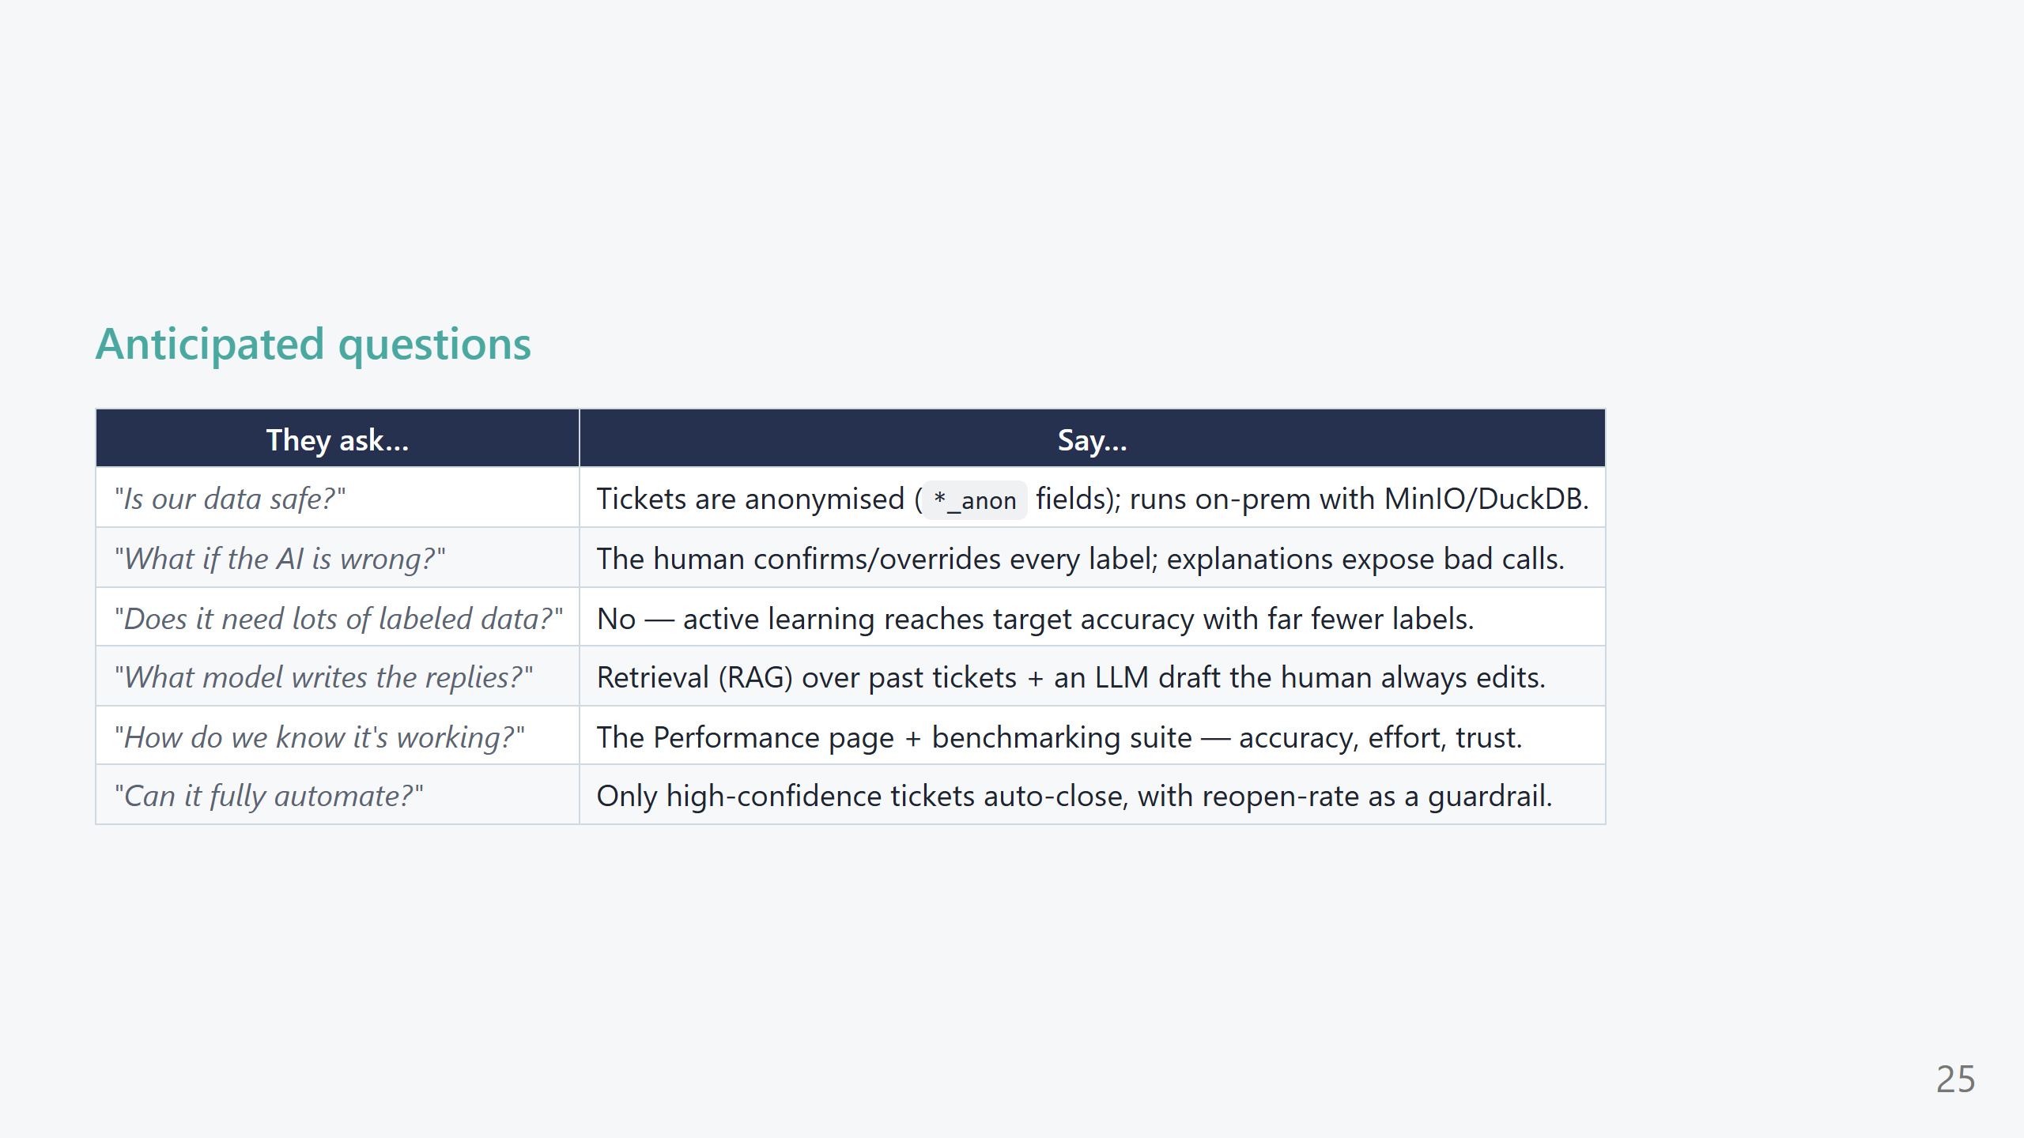
Notes:
PRESENTER SCRIPT — FAQ (use as needed) - Keep answers short and route back to a screen you already showed. - Privacy and "what if it's wrong" are the two most common; lead with those.

Slide 26
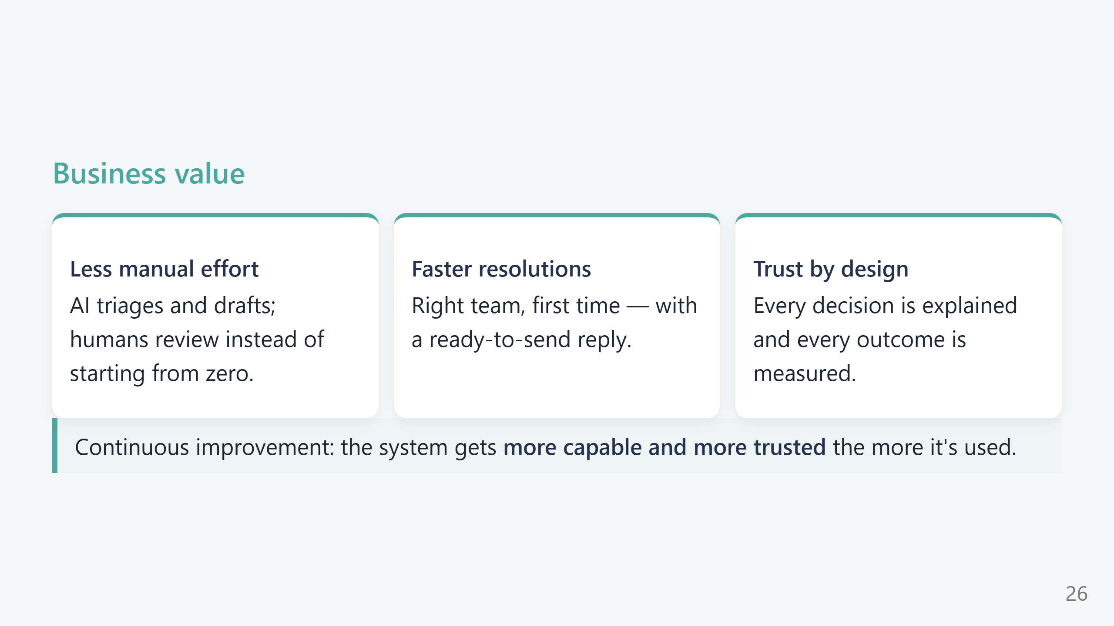
Notes:
PRESENTER SCRIPT — Business value (30s) - Tie back to the four pillars and the opening pain points. - One sentence per tile; don't over-explain — the demo already proved it.

Slide 27
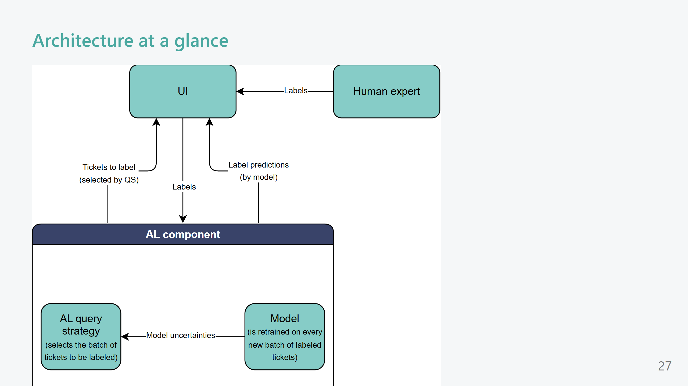
Notes:
PRESENTER SCRIPT — Architecture (30s, optional) - Only linger here for a technical audience. - Keep it one breath: Vue front end, FastAPI back end, FAISS for similarity, DistilBERT for classification, an LLM for drafting, and MinIO/DuckDB/RabbitMQ for storage and async jobs.

Slide 28
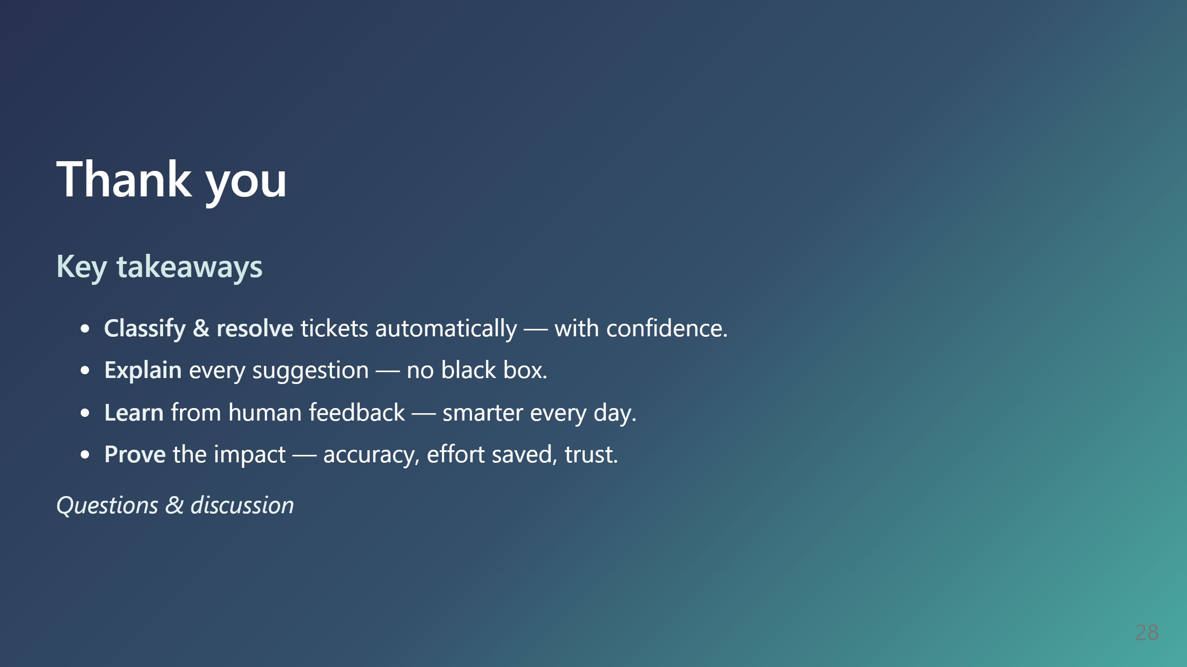
Notes:
PRESENTER SCRIPT — Close (30s) - Recap the four pillars in one line each. - Clear call to action: propose next step (pilot on a real team / dataset). - "Happy to dive into any screen again — what would you like to see?"

