Slide 1
Evaluation of Machine learning algorithms for delineating site-specific Management Units
Huma and Wub

Slide 2
Library
raster
rgdal
pls

Slide 3
1. Principal component analysis
Objective
To choose the best predictors to delineate management zone

Slide 4
Data structure
Soil_data_WithG = read.csv("Data_4_machine learning_with_G.csv", quote="'") colnames(Soil_data_WithG)
## [1] "ID" "POINT_X" "POINT_Y" "PH" "OM" "Nitrate_N" ## [7] "Olsen_P" "K" "Ca" "Mg" "Sand" "Silt" ## [13] "Clay"
#head(Soil_data_WithG) #str(Soil_data_WithG)

Slide 5
Scaled dataset | PCA
Soil_data_WithG.scaled = scale(as.matrix(Soil_data_WithG[4:13])) pca = princomp(Soil_data_WithG.scaled,cor=F,scores=T) summary(pca)
## Importance of components: ## Comp.1 Comp.2 Comp.3 Comp.4 Comp.5 ## Standard deviation 1.9900167 1.8262924 0.97834414 0.83271757 0.61705921 ## Proportion of Variance 0.3966016 0.3340271 0.09585711 0.06944428 0.03813245 ## Cumulative Proportion 0.3966016 0.7306287 0.82648579 0.89593007 0.93406252 ## Comp.6 Comp.7 Comp.8 Comp.9 Comp.10 ## Standard deviation 0.50891603 0.49540268 0.33120391 0.19820513 0.0707221028 ## Proportion of Variance 0.02593781 0.02457863 0.01098581 0.00393433 0.0005009004 ## Cumulative Proportion 0.96000033 0.98457896 0.99556477 0.99949910 1.0000000000

Slide 6
PCA Outputs
#attributes(pca) pca$loadings
## ## Loadings: ## Comp.1 Comp.2 Comp.3 Comp.4 Comp.5 Comp.6 Comp.7 Comp.8 Comp.9 ## PH 0.339 0.300 0.247 0.287 0.477 0.577 0.279 ## OM -0.123 -0.449 0.244 -0.346 0.630 0.434 ## Nitrate_N -0.320 -0.300 -0.183 0.412 -0.197 -0.249 0.658 0.263 ## Olsen_P 0.196 -0.366 0.524 0.286 0.345 0.185 -0.419 -0.371 ## K -0.507 0.159 -0.205 -0.301 -0.123 -0.121 0.735 ## Ca 0.208 -0.278 -0.651 0.308 0.316 0.449 -0.186 0.131 ## Mg 0.372 -0.306 -0.609 0.283 -0.265 0.441 -0.217 ## Sand -0.481 -0.110 0.396 ## Silt 0.424 0.195 0.127 -0.457 0.283 0.375 -0.246 0.166 ## Clay 0.355 -0.329 -0.108 0.161 -0.251 -0.308 -0.406 0.340 -0.372 ## Comp.10 ## PH ## OM ## Nitrate_N ## Olsen_P ## K ## Ca ## Mg ## Sand 0.765 ## Silt 0.498 ## Clay 0.389 ## ## Comp.1 Comp.2 Comp.3 Comp.4 Comp.5 Comp.6 Comp.7 Comp.8 Comp.9 ## SS loadings 1.0 1.0 1.0 1.0 1.0 1.0 1.0 1.0 1.0 ## Proportion Var 0.1 0.1 0.1 0.1 0.1 0.1 0.1 0.1 0.1 ## Cumulative Var 0.1 0.2 0.3 0.4 0.5 0.6 0.7 0.8 0.9 ## Comp.10 ## SS loadings 1.0 ## Proportion Var 0.1 ## Cumulative Var 1.0

Slide 7
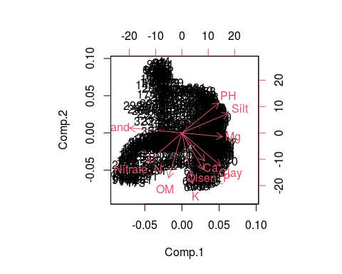
PCA plot

Slide 8
Study Area
library(rgdal) Study_area= readOGR("Study_area.shp")
## OGR data source with driver: ESRI Shapefile ## Source: "/cloud/project/Study_area.shp", layer: "Study_area" ## with 1 features ## It has 0 fields
plot(Study_area, asp=1,type='l',xaxt='n',yaxt='n',xlab='',ylab='',bty='n',col='grey')

Slide 9
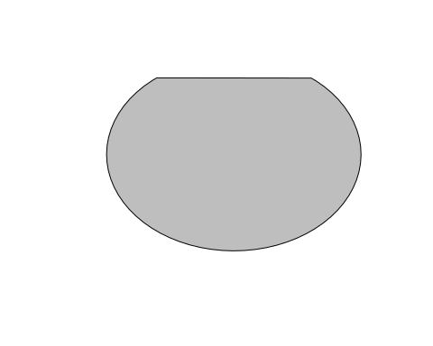

Slide 10
backdrop = function() plot(Study_area,asp=1,type='l',xaxt='n',yaxt='n',xlab='',ylab='',bty='n',col='grey')

Slide 11
PC1
pc1 = pca$scores[,1] backdrop() points(Soil_data_WithG$POINT_X[pc1>0],Soil_data_WithG$POINT_Y[pc1>0],pch=16,col='yellow') points(Soil_data_WithG$POINT_X[pc1<0],Soil_data_WithG$POINT_Y[pc1<0],pch=16,col='brown')

Slide 12
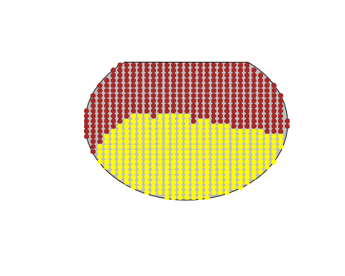

Slide 13
PC2
pc2 = pca$scores[,2] backdrop() points(Soil_data_WithG$POINT_X[pc2>0],Soil_data_WithG$POINT_Y[pc2>0],pch=16,col='yellow') points(Soil_data_WithG$POINT_X[pc2<0],Soil_data_WithG$POINT_Y[pc2<0],pch=16,col='brown')

Slide 14
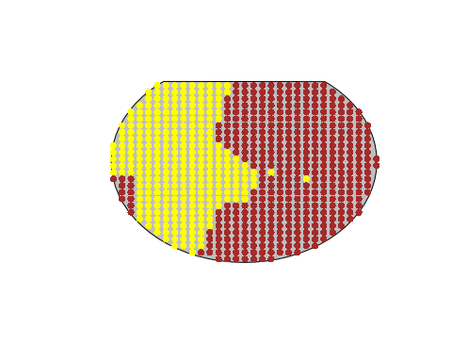

Slide 15
2. K-means clustering to delineate in-season management zone
#Data NDVI_Data_4_Kmeans = read.csv("Data_4_machine learning_bare_NDVI_SAVI.csv", quote="'") #Prepare Data NDVI_K_means_cluster = kmeans(NDVI_Data_4_Kmeans[,4:7], centers = 3, iter.max = 500, nstart = 3, algorithm="Lloyd")

Slide 16
Clustering
#attributes(NDVI_K_means_cluster) #str(NDVI_K_means_cluster) cluster_4_NDVI_plot = NDVI_K_means_cluster$cluster

Slide 17
Plot clustering
#plot plot(Study_area, asp=1,type='l',xaxt='n',yaxt='n',xlab='',ylab='',bty='n',col='grey') backdrop_1 = function() plot(Study_area, asp=1,type='l',xaxt='n',yaxt='n',xlab='',ylab='',bty='n',col='grey') points(NDVI_Data_4_Kmeans$POINT_X[cluster_4_NDVI_plot==1], NDVI_Data_4_Kmeans$POINT_Y[cluster_4_NDVI_plot==1], pch=16, col='green') points(NDVI_Data_4_Kmeans$POINT_X[cluster_4_NDVI_plot==2], NDVI_Data_4_Kmeans$POINT_Y[cluster_4_NDVI_plot==2], pch=16, col='blue') points(NDVI_Data_4_Kmeans$POINT_X[cluster_4_NDVI_plot==3], NDVI_Data_4_Kmeans$POINT_Y[cluster_4_NDVI_plot==3], pch=16, col='red')

Slide 18
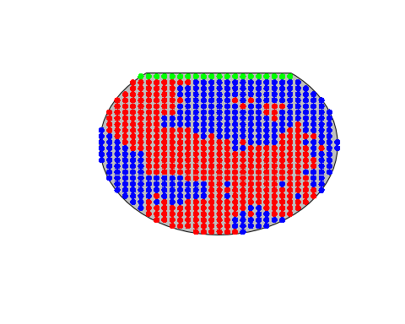

Slide 19
3. Nitrogen prediction based on ECa and VI based
## 'data.frame': 678 obs. of 10 variables: ## $ OBJECTID_1 : int 1 2 3 4 5 6 7 8 9 10 ... ## $ POINT_X : num -105 -105 -105 -105 -105 ... ## $ POINT_Y : num 40.7 40.7 40.7 40.7 40.7 ... ## $ OM : num 1.15 1.15 1.17 1.21 1.26 ... ## $ Nitrate_N : num 6.88 7.31 8.37 8.92 9.58 ... ## $ Eca_deep : num 40.5 40.2 40.3 40.8 41.5 ... ## $ Eca_shallow: num 14.1 14.2 14.4 14.7 14.8 ... ## $ Bare_SAVI : num 0.109 0.11 0.108 0.113 0.109 ... ## $ Bare_NDVI : num 0.152 0.153 0.15 0.156 0.153 ... ## $ DEM : int 1563 1563 1563 1563 1563 1563 1563 1563 1563 1562 ...

Slide 20
Linear regression summary
## ## Call: ## lm(formula = Nitrate_N ~ Eca_deep + Eca_shallow + Bare_SAVI + ## Bare_NDVI + DEM, data = N_prediction) ## ## Residuals: ## Min 1Q Median 3Q Max ## -4.9755 -1.5251 -0.0132 1.4344 5.3443 ## ## Coefficients: ## Estimate Std. Error t value Pr(>|t|) ## (Intercept) 1782.99391 136.24179 13.087 < 2e-16 *** ## Eca_deep 0.10784 0.09972 1.081 0.279891 ## Eca_shallow 0.52108 0.13691 3.806 0.000154 *** ## Bare_SAVI -723.01386 32.36161 -22.342 < 2e-16 *** ## Bare_NDVI 544.72083 22.63566 24.065 < 2e-16 *** ## DEM -1.14749 0.08624 -13.306 < 2e-16 *** ## --- ## Signif. codes: 0 '***' 0.001 '**' 0.01 '*' 0.05 '.' 0.1 ' ' 1 ## ## Residual standard error: 2.022 on 672 degrees of freedom ## Multiple R-squared: 0.7291, Adjusted R-squared: 0.7271 ## F-statistic: 361.8 on 5 and 672 DF, p-value: < 2.2e-16

Slide 21
Data Summary
## OBJECTID_1 POINT_X POINT_Y OM ## Min. : 1.0 Min. :-105 Min. :40.66 Min. :0.9322 ## 1st Qu.:170.2 1st Qu.:-105 1st Qu.:40.67 1st Qu.:1.2161 ## Median :339.5 Median :-105 Median :40.67 Median :1.3492 ## Mean :339.5 Mean :-105 Mean :40.67 Mean :1.3583 ## 3rd Qu.:508.8 3rd Qu.:-105 3rd Qu.:40.67 3rd Qu.:1.4856 ## Max. :678.0 Max. :-105 Max. :40.67 Max. :1.7893 ## Nitrate_N Eca_deep Eca_shallow Bare_SAVI ## Min. : 3.076 Min. :39.46 Min. :14.04 Min. :0.05885 ## 1st Qu.: 5.290 1st Qu.:42.20 1st Qu.:15.19 1st Qu.:0.07137 ## Median : 7.463 Median :43.10 Median :15.93 Median :0.07536 ## Mean : 8.496 Mean :43.59 Mean :16.27 Mean :0.07681 ## 3rd Qu.:11.593 3rd Qu.:44.57 3rd Qu.:16.98 3rd Qu.:0.07964 ## Max. :18.204 Max. :51.60 Max. :22.14 Max. :0.15603 ## Bare_NDVI DEM ## Min. :0.08476 Min. :1559 ## 1st Qu.:0.10078 1st Qu.:1561 ## Median :0.10790 Median :1562 ## Mean :0.11003 Mean :1562 ## 3rd Qu.:0.11478 3rd Qu.:1563 ## Max. :0.22755 Max. :1565

Slide 22
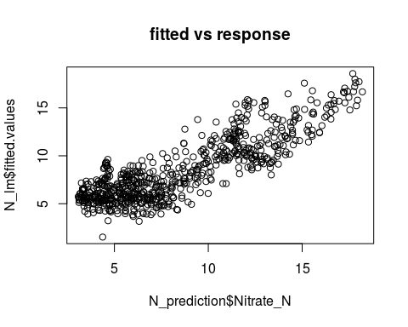
Fitted Vs response plot

Slide 23
Partial least square regression
#partial least square N_plsr = plsr(Nitrate_N ~ Eca_deep + Eca_shallow + Bare_SAVI + Bare_NDVI + DEM , data = N_prediction, scale = TRUE, ncomp =5, validation = "CV") #validation procedure - standard cross validation

Slide 24
Partial least square regression summary
## Data: X dimension: 678 5 ## Y dimension: 678 1 ## Fit method: kernelpls ## Number of components considered: 5 ## ## VALIDATION: RMSEP ## Cross-validated using 10 random segments. ## (Intercept) 1 comps 2 comps 3 comps 4 comps 5 comps ## CV 3.874 2.727 2.649 2.476 2.051 2.034 ## adjCV 3.874 2.726 2.642 2.355 2.049 2.033 ## ## TRAINING: % variance explained ## 1 comps 2 comps 3 comps 4 comps 5 comps ## X 49.11 58.87 82.25 98.55 100.00 ## Nitrate_N 50.84 54.59 62.46 72.65 72.91

Slide 25
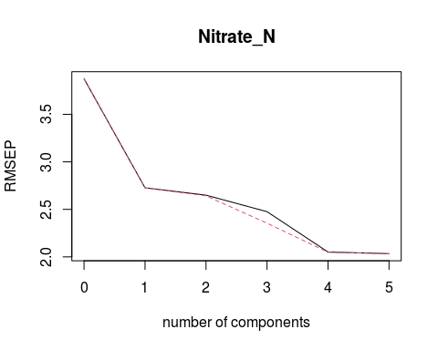
RMSP plot

Slide 26
Subsetting the dataset into training and testing data
#training and test data #Split the data into training (60%) and “test” (40%) set randomly. plsr_data = sample(nrow(N_prediction), nrow(N_prediction)*.6) plsr_training = N_prediction[plsr_data,] plsr_test = N_prediction[-plsr_data,]

Slide 27
Training the model
#number of component chosen is 4 #training N_plsr_training = plsr(Nitrate_N ~ Eca_deep + Eca_shallow + Bare_SAVI + Bare_NDVI + DEM , data = plsr_training, scale = TRUE, ncomp =4)

Slide 28
Training model summary
#validation procedure - standard cross validation summary(N_plsr_training)
## Data: X dimension: 406 5 ## Y dimension: 406 1 ## Fit method: kernelpls ## Number of components considered: 4 ## TRAINING: % variance explained ## 1 comps 2 comps 3 comps 4 comps ## X 48.08 60.09 92.64 98.25 ## Nitrate_N 47.74 52.44 56.13 71.76

Slide 29
Testing the trained model
#test >>> predict Predicted_N = predict(N_plsr_training, newdata=plsr_test) plsr_test$plsr_N_fitted = predict(N_plsr_training, newdata=plsr_test)

Slide 30
How well the nitrate nitrogen predicted accurately?
#R-square need to be calculated to compare the MSE of different models average_test = mean(plsr_test$Nitrate_N) 1- mean((Predicted_N - plsr_test$Nitrate_N)^2)/mean((average_test - plsr_test$Nitrate_N)^2)
## [1] 0.6197903

Slide 31
4. OM prediction based on ECa and VI based
## 'data.frame': 678 obs. of 10 variables: ## $ OBJECTID_1 : int 1 2 3 4 5 6 7 8 9 10 ... ## $ POINT_X : num -105 -105 -105 -105 -105 ... ## $ POINT_Y : num 40.7 40.7 40.7 40.7 40.7 ... ## $ OM : num 1.15 1.15 1.17 1.21 1.26 ... ## $ Nitrate_N : num 6.88 7.31 8.37 8.92 9.58 ... ## $ Eca_deep : num 40.5 40.2 40.3 40.8 41.5 ... ## $ Eca_shallow: num 14.1 14.2 14.4 14.7 14.8 ... ## $ Bare_SAVI : num 0.109 0.11 0.108 0.113 0.109 ... ## $ Bare_NDVI : num 0.152 0.153 0.15 0.156 0.153 ... ## $ DEM : int 1563 1563 1563 1563 1563 1563 1563 1563 1563 1562 ...

Slide 32
Linear regression summary
## ## Call: ## lm(formula = Nitrate_N ~ Eca_deep + Eca_shallow + Bare_SAVI + ## Bare_NDVI + DEM, data = OM_prediction) ## ## Residuals: ## Min 1Q Median 3Q Max ## -4.9755 -1.5251 -0.0132 1.4344 5.3443 ## ## Coefficients: ## Estimate Std. Error t value Pr(>|t|) ## (Intercept) 1782.99391 136.24179 13.087 < 2e-16 *** ## Eca_deep 0.10784 0.09972 1.081 0.279891 ## Eca_shallow 0.52108 0.13691 3.806 0.000154 *** ## Bare_SAVI -723.01386 32.36161 -22.342 < 2e-16 *** ## Bare_NDVI 544.72083 22.63566 24.065 < 2e-16 *** ## DEM -1.14749 0.08624 -13.306 < 2e-16 *** ## --- ## Signif. codes: 0 '***' 0.001 '**' 0.01 '*' 0.05 '.' 0.1 ' ' 1 ## ## Residual standard error: 2.022 on 672 degrees of freedom ## Multiple R-squared: 0.7291, Adjusted R-squared: 0.7271 ## F-statistic: 361.8 on 5 and 672 DF, p-value: < 2.2e-16

Slide 33
Data Summary
## OBJECTID_1 POINT_X POINT_Y OM ## Min. : 1.0 Min. :-105 Min. :40.66 Min. :0.9322 ## 1st Qu.:170.2 1st Qu.:-105 1st Qu.:40.67 1st Qu.:1.2161 ## Median :339.5 Median :-105 Median :40.67 Median :1.3492 ## Mean :339.5 Mean :-105 Mean :40.67 Mean :1.3583 ## 3rd Qu.:508.8 3rd Qu.:-105 3rd Qu.:40.67 3rd Qu.:1.4856 ## Max. :678.0 Max. :-105 Max. :40.67 Max. :1.7893 ## Nitrate_N Eca_deep Eca_shallow Bare_SAVI ## Min. : 3.076 Min. :39.46 Min. :14.04 Min. :0.05885 ## 1st Qu.: 5.290 1st Qu.:42.20 1st Qu.:15.19 1st Qu.:0.07137 ## Median : 7.463 Median :43.10 Median :15.93 Median :0.07536 ## Mean : 8.496 Mean :43.59 Mean :16.27 Mean :0.07681 ## 3rd Qu.:11.593 3rd Qu.:44.57 3rd Qu.:16.98 3rd Qu.:0.07964 ## Max. :18.204 Max. :51.60 Max. :22.14 Max. :0.15603 ## Bare_NDVI DEM ## Min. :0.08476 Min. :1559 ## 1st Qu.:0.10078 1st Qu.:1561 ## Median :0.10790 Median :1562 ## Mean :0.11003 Mean :1562 ## 3rd Qu.:0.11478 3rd Qu.:1563 ## Max. :0.22755 Max. :1565

Slide 34
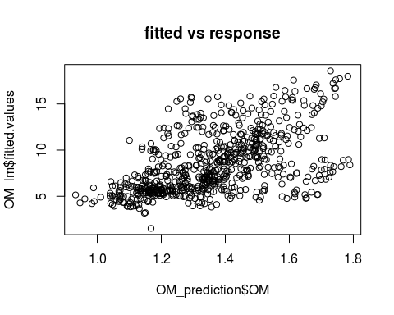
Fitted Vs response plot

Slide 35
Partial least square regression
#partial least square OM_plsr = plsr(OM ~ Eca_deep + Eca_shallow + Bare_SAVI + Bare_NDVI + DEM , data = OM_prediction, scale = TRUE, ncomp =5, validation = "CV") #validation procedure - standard cross validation

Slide 36
Partial least square regression summary
## Data: X dimension: 678 5 ## Y dimension: 678 1 ## Fit method: kernelpls ## Number of components considered: 5 ## ## VALIDATION: RMSEP ## Cross-validated using 10 random segments. ## (Intercept) 1 comps 2 comps 3 comps 4 comps 5 comps ## CV 0.1784 0.1391 0.1352 0.1314 0.1242 0.1242 ## adjCV 0.1784 0.1391 0.1351 0.1313 0.1241 0.1242 ## ## TRAINING: % variance explained ## 1 comps 2 comps 3 comps 4 comps 5 comps ## X 48.23 73.55 96.64 99.54 100.00 ## OM 39.85 43.69 46.66 52.62 52.68

Slide 37
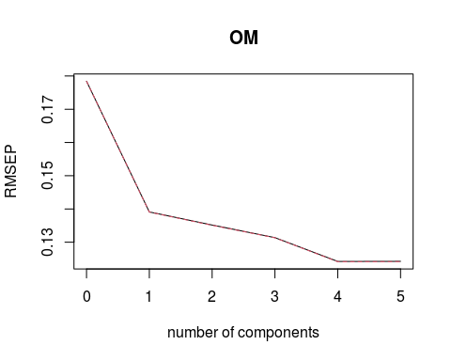
RMSP plot

Slide 38
Subsetting the dataset into training and testing data
#training and test data #Split the data into training (60%) and “test” (40%) set randomly. OM_plsr_data = sample(nrow(OM_prediction), nrow(OM_prediction)*.6) OM_plsr_training = OM_prediction[plsr_data,] OM_plsr_test = OM_prediction[-plsr_data,]

Slide 39
Training the model
#number of component chosen is 4 #training OM_plsr_training = plsr(OM ~ Eca_deep + Eca_shallow + Bare_SAVI + Bare_NDVI + DEM , data = OM_plsr_training, scale = TRUE, ncomp =4)

Slide 40
Training model summary
#validation procedure - standard cross validation summary(OM_plsr_training)
## Data: X dimension: 406 5 ## Y dimension: 406 1 ## Fit method: kernelpls ## Number of components considered: 4 ## TRAINING: % variance explained ## 1 comps 2 comps 3 comps 4 comps ## X 47.24 68.39 95.59 99.41 ## OM 38.19 43.59 46.58 52.58

Slide 41
Testing the trained model
#test >>> predict Predicted_OM = predict(OM_plsr_training, newdata=OM_plsr_test) OM_plsr_test$plsr_OM_fitted = predict(OM_plsr_training, newdata=OM_plsr_test)

Slide 42
How well the nitrate nitrogen predicted accurately?
#R-square need to be calculated to compare the MSE of different models average_test_OM = mean(OM_plsr_test$OM) 1- mean((Predicted_OM - OM_plsr_test$OM)^2)/mean((average_test_OM - OM_plsr_test$OM)^2)
## [1] 0.4633303

