Slide 1
SUPPLY CHAIN MANAGEMENT ANALYSIS
From late deliveries to a predictive operating system
Core story:
The business is profitable, but reliability is fragile. Most delays are small enough to fix before they become customer trust problems.
A stakeholder report built from Python-based order, delivery, profitability, regional, status, payment, and time-pattern analysis.
180,519
54.7%
80.6%
3 days
orders analyzed
late delivery rate
orders still profitable
90th percentile delay
Stakeholder-ready decision deck
Prepared for mixed business, operations, finance, and analytics audiences.
Source: Python SCM analysis | Generated stakeholder report
01
Notes:
This report translates exploratory Python analysis into a business decision narrative. The framing is not only what happened, but where leadership can act first. The key tension is clear: the company remains largely profitable, yet 54.7% of orders are late. This means the current operating model is still commercially viable, but customer experience and future margin are at risk if delivery consistency does not improve.

Slide 2
Executive summary
The data points to a reliability problem, not a demand problem.
DECISION NARRATIVE
The company handles strong order volume across regions, yet delivery timelines are inconsistent. More orders are late than on time, and the delay pattern is concentrated enough to be operationally manageable.
98,743
31.0%
late deliveries to reduce
orders delayed by 1 day
The highest total profit comes from 1-day delayed orders because this is the largest order group. That creates a dangerous illusion: delays look profitable in aggregate, but average profit weakens as delays grow longer.
18.7%
59.3%
orders losing money
delay rate in Central Africa
Main decision:
shift from reactive delay reporting to predictive delay prevention.
Recommended focus areas
1. Fix premium shipping reliability
2. Create regional delay control tower
3. Fast-track payment and fraud review
4. Deploy predictive delay scoring
5. Govern actions with weekly KPI reviews
Source: Python SCM analysis | Generated stakeholder report
02
Notes:
For executives, the short version is this: the company does not need to solve every delay equally. It needs to reduce preventable delays in the highest-risk operating lanes first. The strongest opportunities are premium shipping mode reliability, Central Africa, payment review and suspected fraud queues, and predictable calendar-hour spikes. These are specific enough to convert into a 90-day action plan.

Slide 3
The business problem in one frame
Customers experience delay as uncertainty; the company experiences it as cost, margin risk, and operational noise.
FROM SYMPTOM TO SYSTEM
Current state
Future state
Today, the operation sees late delivery after the fact. The stakeholder need is different: identify the orders likely to miss their promised timeline before they create customer impact.
Order placed
Shipping mode selected
Payment or review queue
Fulfillment starts
Delay discovered late
Order placed
Delay risk scored
Exception routed early
Promise adjusted or expedited
Customer trust protected
The analysis shows delays are not random. They cluster by shipping mode, region, order status, payment type, department, month, day, and hour.
Decision lens
A late order is the end of the story. A risk-scored order is where decision-making begins.
Which orders should receive operational attention before they turn into delay, loss, or customer dissatisfaction?
Source: Python SCM analysis | Generated stakeholder report
03
Notes:
This slide reframes the problem from a logistics metric to a management system problem. The company currently observes the outcome. The opportunity is to intervene earlier. The right analytical goal is not only measuring delay percentage. The right goal is to build an operating rhythm that flags risk and connects it to specific actions.

Slide 4
Performance baseline: late delivery is now the majority outcome
The first stakeholder decision is whether delivery reliability should become a core operating KPI.
45.3%
54.7%
3.0
7.8%
on-time delivery
late delivery
90% delay threshold in days
orders delayed 3 to 4 days
Interpretation
The operation is not failing because every order is severely delayed. It is underperforming because small delays are frequent. That makes the problem fixable through better forecasting, queue discipline, and shipping mode controls.
The biggest lever is not chasing every late order.
It is preventing the repeatable 1-day miss.
What stakeholders should watch weekly
Late delivery % | Severe delay % | On-time by shipping mode | Delayed profit exposure
Source: Python SCM analysis | Generated stakeholder report
04
Notes:
The operating baseline shows that delivery reliability is below the threshold expected for a trusted e-commerce fulfillment model. A 54.7% late rate means delivery variability is not isolated; it is systemic. However, the 90th percentile delay is 3 days. That suggests many delays are not extreme logistics failures. They are likely caused by scheduling, queue timing, payment holds, processing priority, carrier assignment, or service promise mismatch.

Slide 5
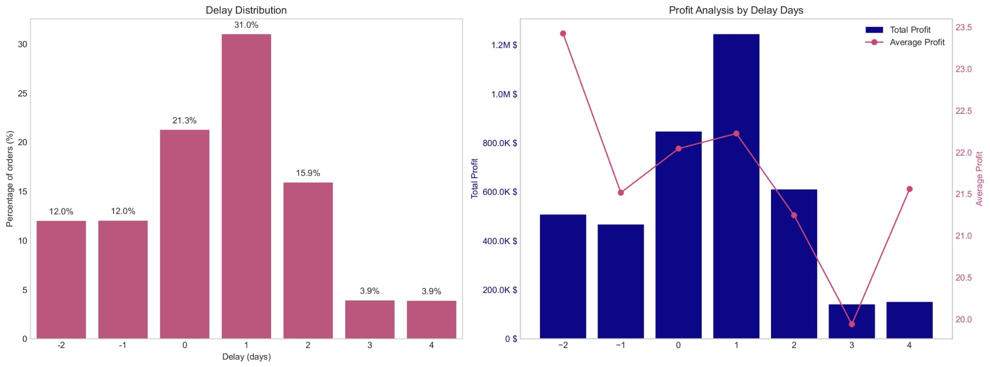
Delay and profit tell a more complex story
Volume makes short delays look commercially safe, but longer delays start hurting average profit.
31% of all orders are delayed by 1 day, creating the largest profit pool because of volume, not because delay improves operations.
Average profit falls to $19.94 at 3 days, making severe delays a margin protection issue.
Source: Python SCM analysis | Generated stakeholder report
05
Notes:
The left chart shows that the dominant delay state is a 1-day delay. This is not a small edge case; it is the largest slice of the order base. The right chart shows the profit paradox. The 1-day delayed group produces the highest total profit because it has the most orders. This should not be interpreted as delay being good. Once delays move to 3 days, average profit reaches the lowest point in the table. The company should protect the large 1-day group from becoming a 2- to 3-day group.

Slide 6
The profit paradox: delay volume is hiding risk
A large profitable late-delivery bucket can make the operation feel healthier than it really is.
PROFIT BY DELAY DAY
What this means
Delay
Orders
Avg profit
-2 days
21,666
$23.42
$507K
The 1-day delay group should be treated as the control point. It contains the biggest volume and the biggest preventable trust risk.
Total profit
-1 day
21,700
$21.52
$467K
0 day
38,410
$22.04
$847K
Severe delays should be treated as margin leakage. At 3 days, average profit is the weakest among all delay states.
1 day
55,990
$22.23
$1.24M
2 days
28,718
$21.25
$610K
3 days
7,052
$19.94
$141K
4 days
6,983
$21.56
$151K
Decision rule: prevent 1-day delays from becoming 2+ days, and escalate 3+ day risk before fulfillment handoff.
Source: Python SCM analysis | Generated stakeholder report
06
Notes:
The table separates total profit from average profit. Total profit follows volume; average profit reveals efficiency. Stakeholders should avoid celebrating profitable delay buckets without understanding their operational cost and customer experience cost. The recommended action is to create two management lanes. Lane one reduces the high-volume 1-day delay. Lane two escalates severe delay risk because average profit deteriorates sharply by day 3.

Slide 7
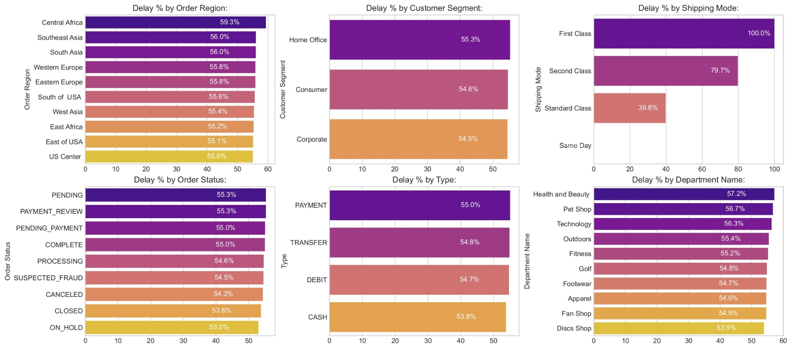
Where delays concentrate across the operation
The delay rate is broad across segments, but sharper in specific regions, modes, and departments.
Central Africa leads regional delay at 59.3%, while customer segments stay close around 54.5% to 55.3%. The problem is more operational than customer-type driven.
07
Notes:
The breakdown view is important because it prevents overfitting the story to a single dimension. Customer segments have very similar delay rates, so targeting customers alone will not solve the issue. Regions, shipping modes, order statuses, and departments show more useful variation. This supports an operational intervention plan rather than a broad customer-segment strategy.

Slide 8
Premium shipping is the biggest red flag
The modes that should signal speed are showing the highest delay rates.
100.0%
79.7%
39.8%
First Class delay rate
Second Class delay rate
Standard Class delay rate
Why this matters
Operational interpretation
If premium modes carry high delay rates, the company is likely overpromising, under-routing, or allocating premium capacity poorly. This creates a brand risk beyond the logistics metric.
Premium shipping should be audited by region, fulfillment node, carrier, cut-off time, and payment clearance status before any pricing or promise expansion.
Recommendation:
Pause expansion of First Class promises until SLA compliance improves in the highest-risk lanes.
08
Notes:
The strongest operational signal in the analysis is the shipping mode breakdown. First Class at 100% delay and Second Class at 79.7% delay should trigger immediate investigation. This does not mean the business should abandon premium shipping. It means premium promises need tighter eligibility rules, carrier-level review, fulfillment cut-off discipline, and a weekly SLA scorecard.

Slide 9
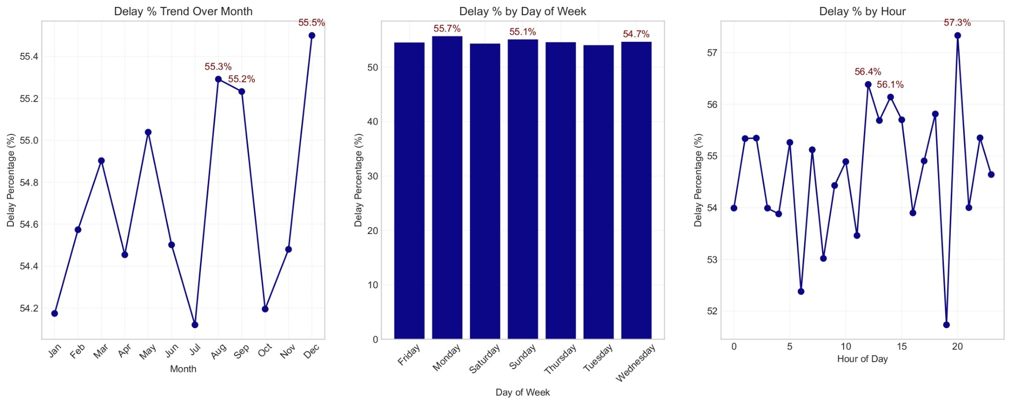
Time patterns reveal when the operation is weakest
Delay risk changes by month, day, and hour, which means staffing and queue timing matter.
December peaks at 55.5%, Monday at 55.7%, and hour 20 at 57.3%. These windows should drive capacity planning and exception review coverage.
09
Notes:
The time-based chart suggests delivery performance has predictable timing stress. December is a seasonal risk period, Monday is the highest day-of-week delay rate, and hour 20 is the highest hourly spike. These patterns should be converted into operational planning. For example, the business can increase review capacity before Monday peaks, monitor evening order cutoffs, and run pre-December capacity simulations.

Slide 10
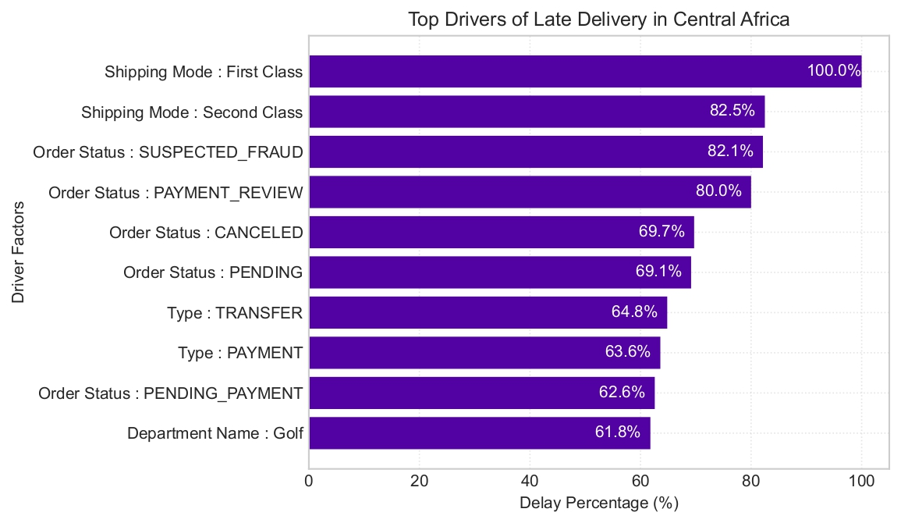
Central Africa deep dive: the clearest intervention zone
A focused regional pilot can prove whether delay prevention creates measurable improvement.
In Central Africa, First Class, Second Class, suspected fraud, payment review, canceled, and pending statuses dominate the late-delivery risk profile.
Source: Python SCM analysis | Generated stakeholder report
10
Notes:
Central Africa has the highest regional delay percentage in the overall breakdown. The driver chart shows that the issue is not just geography; it is tied to shipping mode and order-processing statuses. This makes Central Africa a strong pilot market for a control tower. The goal would be to identify at-risk orders early, clear payment and fraud queues faster, and audit premium shipping lanes with specific owners.

Slide 11
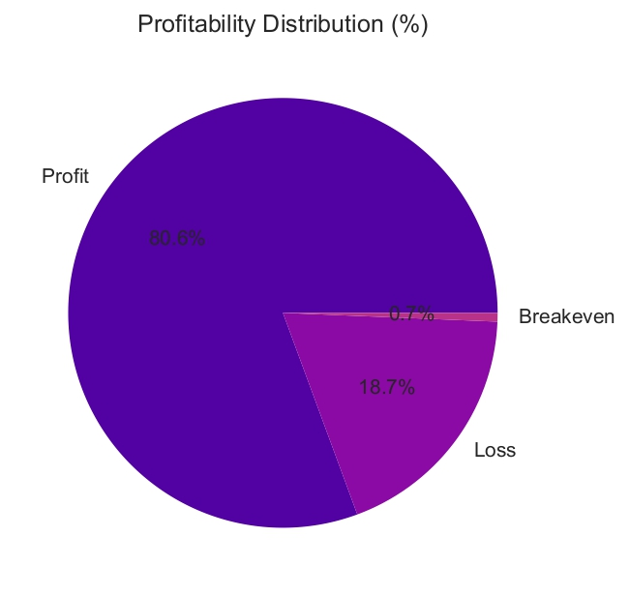
Profitability is strong, but the loss pool is too large to ignore
The company has a profitable base, yet nearly one in five orders is loss-making.
145,558
33,784
profitable orders
loss-making orders
1,177
breakeven orders
Management implication
Delay action should be linked to expected margin. Not every order deserves the same intervention cost.
Use predicted delay risk plus predicted margin to decide when to expedite, re-route, adjust promise, or hold for manual review.
Source: Python SCM analysis | Generated stakeholder report
11
Notes:
The profitability distribution is encouraging: 80.6% of orders are profitable. However, the 18.7% loss-making order share is operationally meaningful. The next level of decision-making is not simply reducing delays. It is reducing delays where they threaten profit and customer trust the most. A high-margin, high-risk order should get different treatment than a low-margin, high-risk order.

Slide 12
Action strategy: move from reporting to intervention
Recommendations are grouped by where the business can change outcomes fastest.
FIVE PRIORITY PLAYS
1
Premium shipping SLA audit
Review First Class and Second Class by region, carrier, fulfillment node, and cut-off time. Freeze risky promises until evidence improves.
2
Regional delay control tower
Start with Central Africa. Assign owners for high-risk lanes and track exception clearance daily.
3
Payment and fraud fast lane
Reduce delay caused by payment review, pending payment, suspected fraud, and transfer-heavy workflows.
4
Time-based capacity planning
Staff and monitor Monday, December, and hour-20 risk windows with proactive queue reviews.
5
Profit-aware intervention rules
Use margin and delay probability together to choose expedite, re-route, promise adjustment, or manual review.
Recommended operating principle: fewer, sharper interventions beat broad process change.
Source: Python SCM analysis | Generated stakeholder report
12
Notes:
These five priorities are selected because they are grounded in the patterns visible in the analysis: shipping mode, region, order status, payment type, time, and profitability. The recommendation is not to redesign the full supply chain immediately. The recommendation is to run focused interventions where the data shows concentrated risk and measurable upside.

Slide 13
Predictive system blueprint
The analytics system should recommend action, not only predict delay.
Data signals
Prediction layer
Decision layer
Feedback loop
Region
Shipping mode
Order status
Payment type
Department
Month, day, hour
Historical delay
Delay probability
Expected delay days
Expected profit / loss
Confidence band
Driver explanation
Expedite
Re-route
Adjust promise
Prioritize review
Escalate to control tower
Track outcome
Compare intervention cost
Update model
Review weekly KPIs
Model objective: flag the few orders where early action changes delivery outcome or protects margin.
Minimum viable model
Start with a binary delay classifier and add explainability by feature importance. Move next to predicted delay days and profit-aware routing.
Source: Python SCM analysis | Generated stakeholder report
13
Notes:
The predictive system should be designed for operations, not only analytics reporting. A useful model should connect risk to a specific next action. The first version can be simple. It can predict whether an order is likely to be delayed. The second version can predict delay days and expected profit exposure. The most valuable version adds decision rules that tell teams which intervention to take.

Slide 14
90-day execution roadmap
A practical plan to turn the analysis into business improvement.
Days 0-30
Days 31-60
Days 61-90
Stabilize measurement
Pilot interventions
Scale predictive action
Create KPI definitions, validate data quality, audit First Class and Second Class, and build daily delay dashboard.
Launch Central Africa control tower, payment-review fast lane, and Monday / evening capacity checks.
Deploy delay risk score, run A/B intervention tests, and set review cadence for shipping promises and margin impact.
Success target: reduce late delivery percentage, reduce 3+ day severe delays, and lower loss-making order exposure without damaging profitable volume.
Owner model
Operations owns intervention. Analytics owns scoring. Finance owns profit guardrails. Customer teams own customer promise impact.
Source: Python SCM analysis | Generated stakeholder report
14
Notes:
The roadmap is designed to avoid a long analytics project with no business action. The first 30 days standardize measurement. The next 30 days test specific interventions. The final 30 days scale the predictive workflow. Stakeholders should align on ownership early. Without named owners, a predictive model becomes another dashboard. With owners, it becomes an operating system.

Slide 15
KPI governance for stakeholders
The reporting rhythm should move from monthly explanation to weekly operational control.
Primary KPIs
Driver KPIs
Decision KPIs
Late delivery %
On-time delivery %
3+ day severe delay %
Orders delayed by 1 day
Average profit by delay day
Delay by region
Delay by shipping mode
Payment review cycle time
Fraud review cycle time
Delay by hour and day
Intervention rate
Prevented delay rate
Expedite cost per saved order
Promise adjustment rate
Profit protected
Governance cadence
Daily: exception queue review
Weekly: cross-functional KPI review
Monthly: lane, carrier, and promise strategy
Quarterly: model retraining and policy refresh
Decision ask: approve a 90-day pilot focused on premium shipping, Central Africa, payment review, and delay risk scoring.
Source: Python SCM analysis | Generated stakeholder report
15
Notes:
A stakeholder-ready system needs a governance layer. The KPIs should reflect both business outcomes and operational actions. The decision ask is intentionally focused. Rather than asking for a full transformation program, this deck recommends a 90-day pilot with clear targets and ownership.

Slide 16
Final takeaway
The company has enough signal to act now.
Late delivery is not evenly distributed. It is concentrated by delay day, shipping mode, region, status, payment flow, department, and time window.
Stakeholder decision: approve the 90-day pilot and use weekly governance to convert insights into measurable operational improvement.
The best next step is a focused operating pilot, not more generic reporting. Start with the lanes where the data is clearest, connect risk scoring to action, and measure whether interventions protect delivery trust and margin.
Predict
Prioritize
Prevent
risk before delay
orders worth action
margin and trust loss
Source: Python SCM analysis | Generated stakeholder report
16
Notes:
The final takeaway is simple: the data is mature enough for action. The analysis has identified patterns with enough specificity to run a business pilot. The recommended management behavior is to predict, prioritize, and prevent. Predict delay risk before it happens. Prioritize orders based on profit exposure and customer impact. Prevent the delay with operational interventions.

