Slide 1


Hybrid Mobile Application Development using Flutter
Online Food Delivery - FeastFi
Presenting at Ardent Computech Pvt. Ltd.
Project Member : Humaira Sadia
FeastFi is a hybrid food delivery app built with Flutter and Firebase. It allows users to easily browse restaurants, place orders, and track deliveries in real-time. Key features include secure login, menu exploration, and convenient payment options, all designed to provide a seamless food delivery experience.
by Humaira Sadia

Slide 2
Problem Statement
In the rapidly growing food delivery industry, users often face challenges with fragmented ordering experiences, limited restaurant options, and inefficient tracking systems. Many existing apps lack intuitive interfaces, real-time updates, and seamless payment integrations, leading to customer frustration and a less satisfying overall experience.
Solution
FeastFi addresses these issues by offering a unified platform that simplifies food ordering, provides extensive restaurant choices, and ensures real-time tracking and secure payments, thereby enhancing user convenience and satisfaction.

Slide 3


Flutter was chosen for FeastFi due to its cross-platform support, enabling a single codebase for both iOS and Android. Its fast development features, like hot reload and rich widgets, allow for quick, beautiful UI creation. Flutter also offers native-like performance and strong community support, making it perfect for a high-quality food delivery app.
Firebase supports FeastFi by handling authentication, real-time data syncing with Realtime Database and Firestore, serverless functions for backend logic, push notifications with Cloud Messaging, and user tracking via Analytics. It also ensures data security and provides fast hosting for static content, making it a comprehensive and scalable backend solution.

Slide 4
Specifications..
Software Requirements
Hardware Requirements
Platform: Flutter for cross-platform mobile development.
Development Machine:
Backend: Firebase for authentication, database, and storage.
Processor: Intel i5 or equivalent (quad-core) or higher.
Design: Tailwind CSS for styling (if applicable in web version).
RAM: Minimum 8 GB (16 GB recommended for smoother performance).
APIs: Integration with third-party APIs for payment processing and location services.
Storage: At least 256 GB SSD for faster build and load times.
Database: Firebase Firestore for real-time data management.
Operating System: Windows 10/11, macOS, or Linux (latest stable versions).
Version Control: Git for code versioning and collaboration.
Testing: Tools like Flutter's built-in testing framework for unit and integration tests.
Mobile Devices (for Testing):
Android: Devices running Android 8.0 (Oreo) or higher.
iOS: Devices running iOS 12 or higher.
Screen Sizes: Various screen sizes to ensure responsive design.

Slide 5
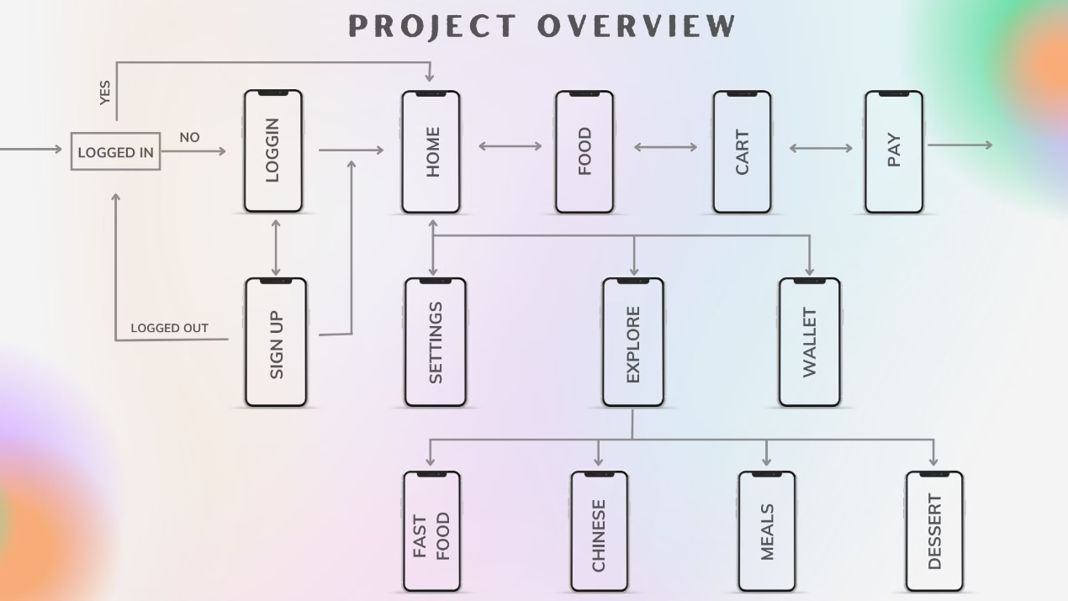
Project Overview

Slide 6
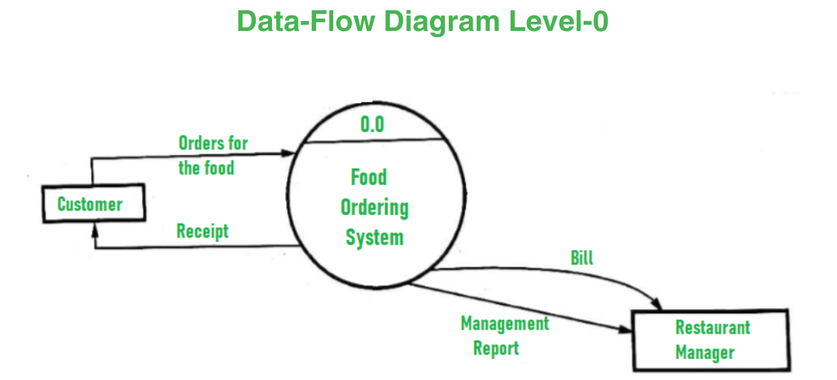
Data-Flow Diagram

Slide 7
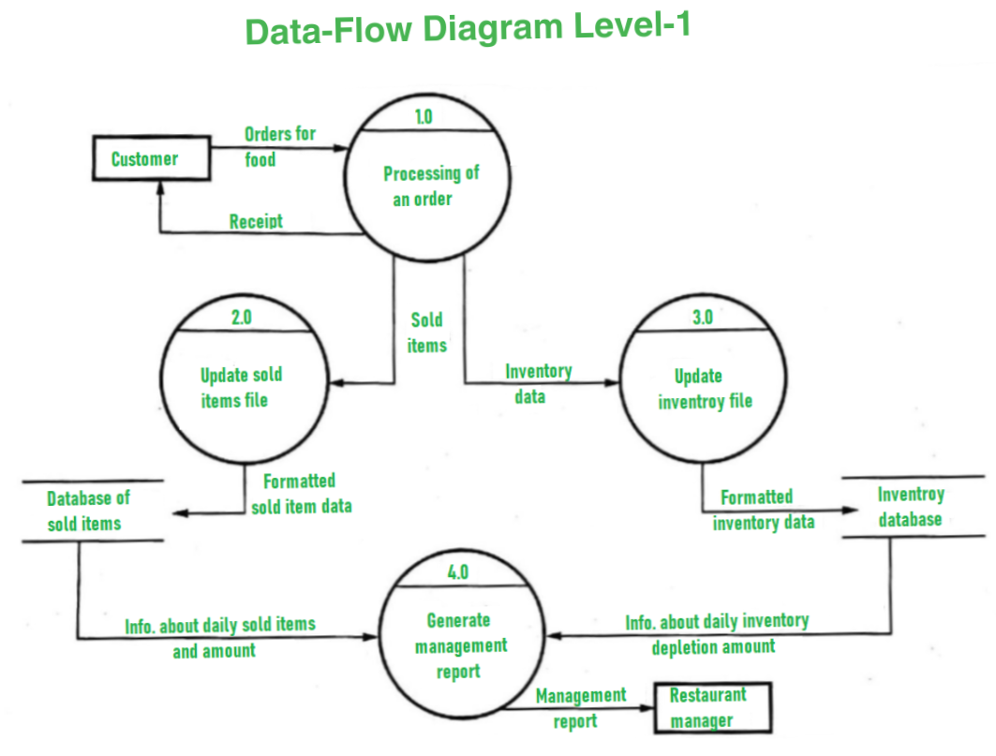

Slide 8
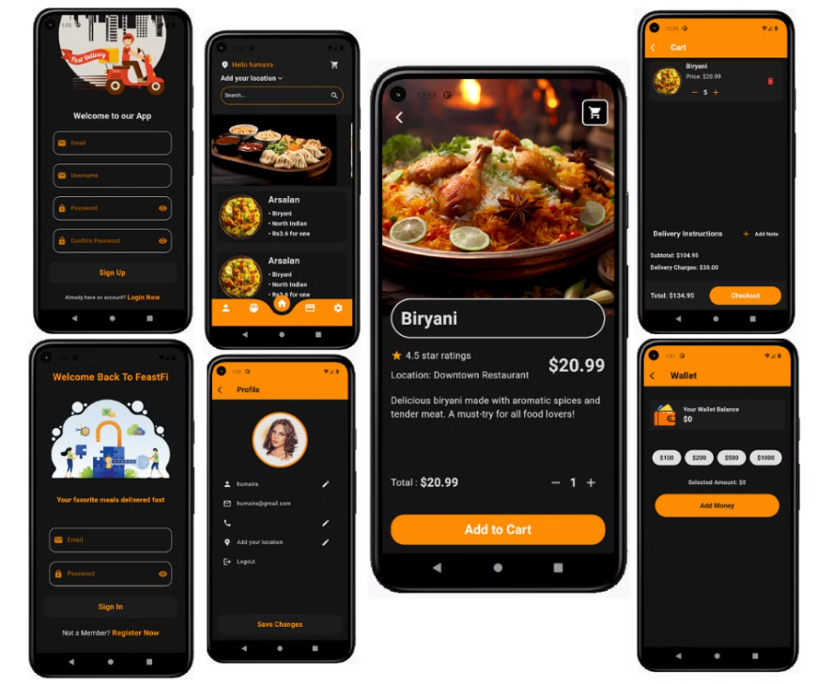
Features Demonstration

Slide 9
Conclusion
The FeastFi Flutter app has been successfully developed and tested, ensuring it meets both technical standards and user needs. White box testing secured code integrity, while black box testing confirmed seamless functionality. System and output testing verified performance and accuracy, and continuous user feedback guided design refinements. The project concludes with a robust and user-friendly food delivery app, ready for deployment.
Thank You…

