Slide 1

Digital System Design Lab
Solution
Project: Design, Simulation & Implementation of Arithmetic & Logic Unit
Team
Circuit
Design
Equation
Question

Slide 2
Design a 4 bit ALU using 4 bit full adder and also implement the “Carry”, “Overflow”, “Sign” and “Zero” flags. The ALU has two control signals (S₁ & S₀ ), two 4 bit input (A & B), a single bit Carry in ( C_{in}) and should output a 4 bit result and 4 flags. The ALU should perform according to the following:
Team
Design
Solution
S₁ | S₀ | C_{in} | Output | Explanation
0 | 0 | X | A⊕B | Logical “XOR” of A & B
0 | 1 | X | A’ | Logical “NOT” of A & B
1 | 0 | 0 | A+1 | Increment A
1 | 0 | 1 | A | Transfer A
1 | 1 | 0 | A+B+1 | Sum A & B with Carry
1 | 1 | 1 | A+B | Sum A & B
Circuit
Equation
Question

Slide 3
Solution Table
S₁ | S₀ | C_{in} | Output | Explanation | X | Y | Z
0 | 0 | X | A⊕B | Logical “XOR” of A & B | A⊕B | 0 | 0
0 | 1 | X | A’ | Logical “NOT” of A & B | A’ | 0 | 0
1 | 0 | 0 | A+1 | Increment A | A | 0 | 1
1 | 0 | 1 | A | Transfer A | A | 0 | 0
1 | 1 | 0 | A+B+1 | Sum A & B with Carry | A | B | 1
1 | 1 | 1 | A+B | Sum A & B | A | B | 0
Team
Solution
Circuit
Design
Equation
Question

Slide 4
The following equations are derived from the table which will help us design & implement the ALU.
Team
Solution
Circuit
Design
Equation
Question
X= S₁ A + S₁ ‘ ( S₀ ‘ (A⊕B)+ S₀ A’)
Y= S₁ S₀ B
Z= S₁ C_{in} C_{in}

Slide 5
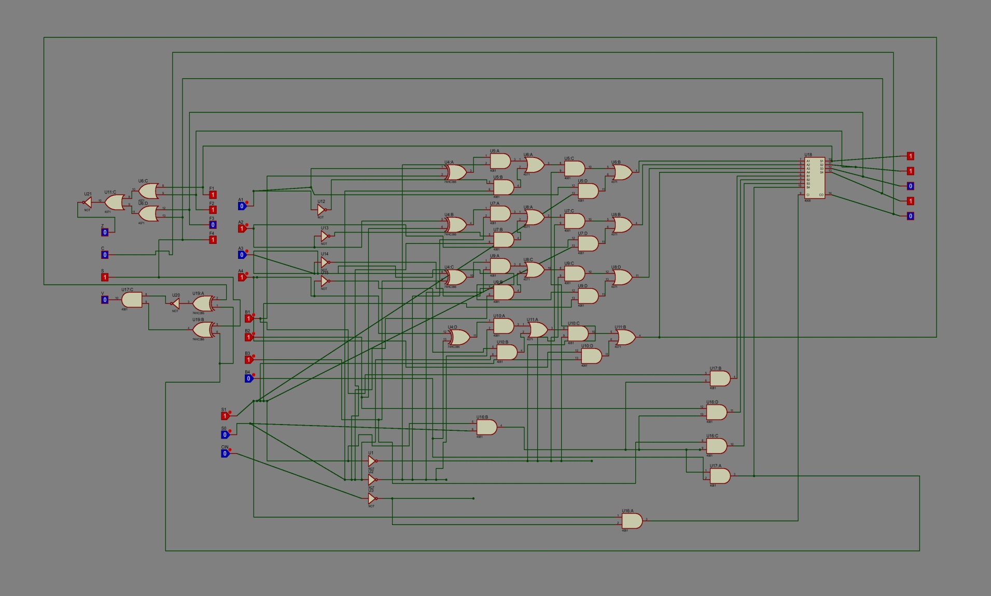
Design and Simulation on Proteus
Team
Solution
Circuit
Design
Equation
Question

Slide 6
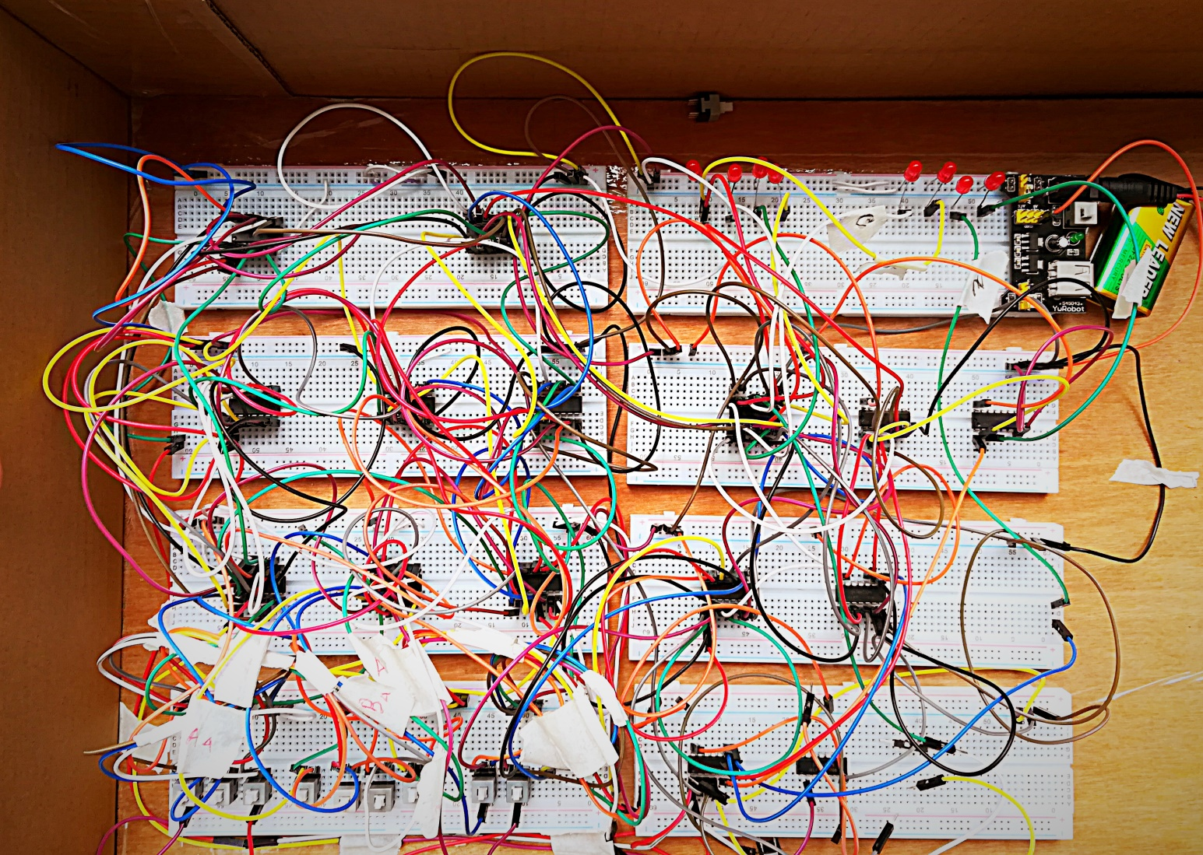
The implemented circuit
Team
Circuit
Solution
Design
Equation
Question

Slide 7




Team
Solution
Circuit
Design
Equation
Question
Humaira Ferdous Shifa
Ridwan Masud Khan
Raihan Tanvir

