Slide 1
Diabetes Prediction
Complex Problem
Humaiz jawaid

Slide 2
Assignment
Select a dataset.
Data Preprocessing.
Train and test the prediction.
Fine-tune its performance (by adjusting hyperparameters).
Analyze the model's performance.

Slide 3
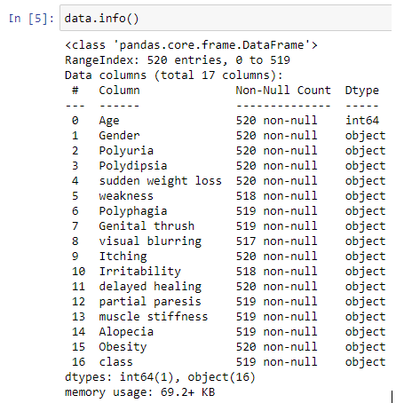
Select a dataset
Understanding the dataset:
Selected dataset: Diabetes data
17 features
520 entries
Data types:
  Integer
  Object

Slide 4
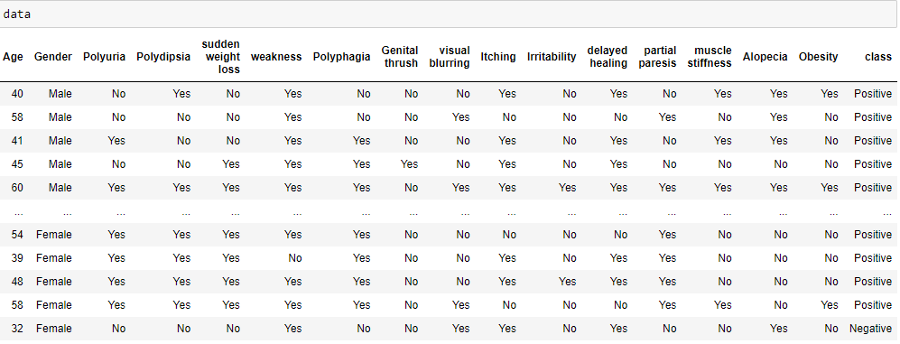
Select a dataset
Overview of the dataset:

Slide 5
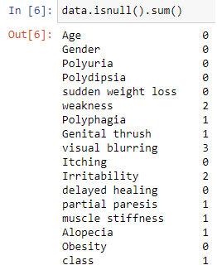


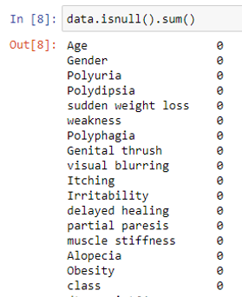

Data Preprocessing
Detecting missing values:
Handling missing values:
The above screenshot shows that there are no missing values in any feature and therefore the size of the dataset have been reduced:

Slide 6


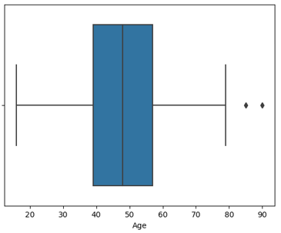


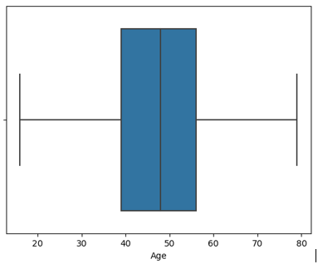
Data Preprocessing
Detecting Outliers:
Handling Outliers:
This boxplot clearly shows that there are two outliers in the age feature as two the data points are beyond the whiskers.
Note: Outliers are just for numeric and continuous data, not for categorical data.

Slide 7


Data Preprocessing
❗
The data['Age'].mean() part is a float value, and when we use it to replace elements in an integer array, NumPy automatically converts the entire array to a float type to maintain consistency.
How to avoid it?
We can fix this issue by converting the 'Age' column into integer type after the replacement, ensuring that the non-outlier values remain whole numbers.

Slide 8

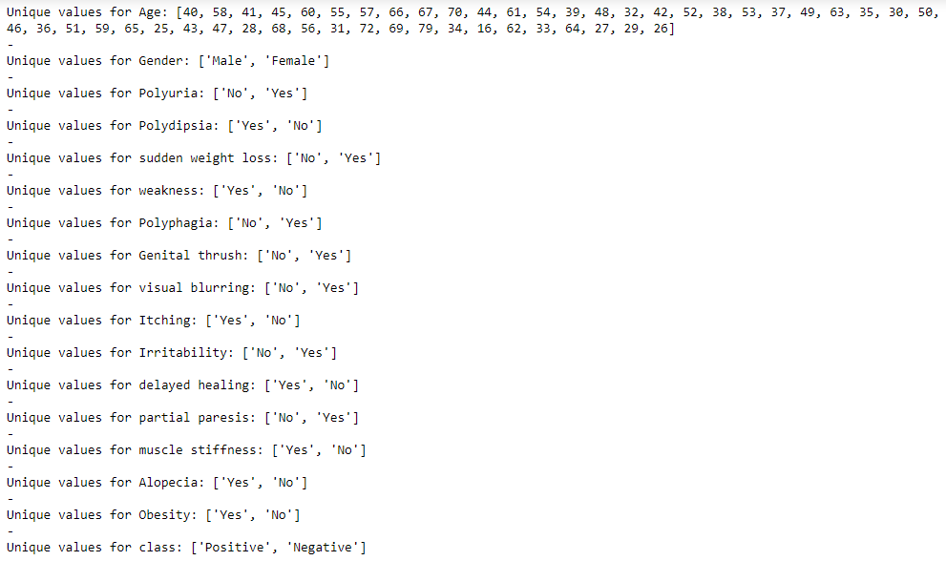
Data Preprocessing
Detecting Noisy data:
To detect the noisy data, we simply displayed all the unique values of every feature through which if there was any noisy data in the dataset, the unique variables would easily display it.
The output did not displayed any irrelevant values which shows that the dataset does not have noisy data.

Slide 9


Data Preprocessing
Feature scaling:
Feature scaling is a preprocessing step that is typically applied to numeric data and not categorical data. The purpose of feature scaling is to standardize or normalize the range of independent variables or features of a dataset.
In common usage, normalization (Min-Max scaling) typically refers to scaling to the range [0, 1]. The goal is to ensure that all features contribute equally to the modeling process, prevent certain features from dominating due to their larger scale, and make the optimization process more stable.
Note: The model would predict based on relationships and pattern, not based on the absolute values.

Slide 10
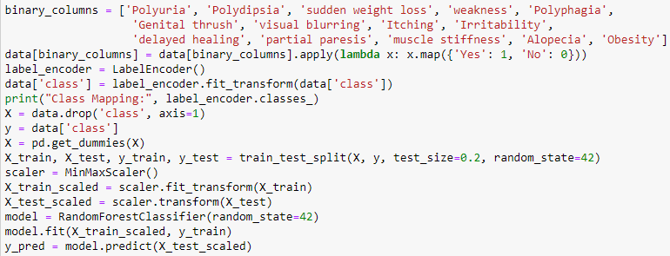
Train and test the prediction
Selected Algorithm: Random Forest
Random forest is a commonly-used machine learning algorithm, which combines the output of multiple decision trees to reach a single result. Its ease of use and flexibility have fueled its adoption, as it handles both classification and regression problems.
Binary Columns Mapping:
  Applies a lambda function to map 'Yes' to 1 and 'No' to 0.
Label Encoding (for class feature):
  Negative becomes 0 and Positive becomes 1.
Feature-Target Separation:
  X = Input features.
  Y = Target variable.
Train-Test Split:
  Split into training and testing sets.
Feature Scaling:
  Scales features to a specified range, usually [0, 1].
[Training a Random Forest Classifier for a binary classification problem]
Random forest classifier have the ability to work on categorical variables! Then why did we convert the data into binary form?
The decision to convert to binary may have been made for simplicity or based on the assumption that binary encoding might be more straightforward for certain machine learning algorithms. However, for Random Forests, it's not strictly necessary.

Slide 11

Train and test the prediction
Why random_state = 42?
The number simply has been made popular by a comic science fiction called "The Hitchhiker's Guide to the Galaxy" authored by Douglas Adams in 1978.
In this novel, a supercomputer called Deep Thought takes seven and a half million years to compute the answer to the ultimate question of Life, The Universe and Everything. The answer turns out to be 42.

Slide 12
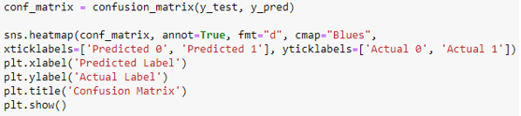
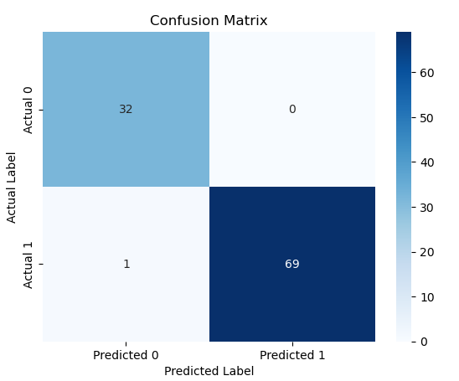
Train and test the prediction
Confusion Matrix:
The confusion matrix helps evaluate the performance of a classification model by providing a summary of the model's predictions compared to the actual outcomes.
This code generates a confusion matrix and a heatmap visualization to evaluate the performance of a machine learning model. The model has been trained on a dataset, and predictions have been made on a test set (X_test_scaled).
• The (32) represents the number of true negatives (TN), which are instances correctly predicted as "Negative."
• The (0) represents the number of false positives (FP), which are instances predicted as "Positive" but are actually "Negative."
• The (1) represents the number of false negatives (FN), which are instances predicted as "Negative" but are actually "Positive."
• The (69) represents the number of true positives (TP), which are instances correctly predicted as "Positive."

Slide 13


Analyze the model's performance
Is 99% accuracy considered overfitting?
    Answer is no.
[Machine Learning: Theory to Applications | p. 107]

Slide 14
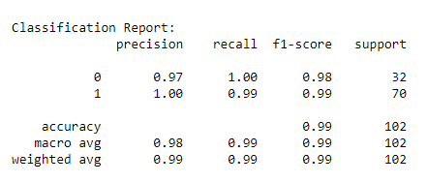
Train and test the prediction
Classification Report:
The classification report is a summary of various classification metrics that provide insights into the performance of a machine learning model, particularly in a classification task. It includes several key metrics:
Precision: Precision is the ratio of correctly predicted positive observations to the total predicted positives. In this case, it's high for both "Negative" and "Positive," indicating that the model has low false positive rates.
Recall (Sensitivity or True Positive Rate): Recall is the ratio of correctly predicted positive observations to the all observations in the actual class. It's high for both "Negative" and "Positive," indicating that the model captures a high percentage of actual positives
F1-Score: The F1-score is the weighted average of precision and recall. It provides a balance between precision and recall.
Support: The number of actual occurrences of the class in the specified dataset.
Accuracy: Overall accuracy of the model on the test set.
Macro Avg: The macro average calculates metrics independently for each class and then takes the average. In this case, the macro-averaged precision, recall, and F1-score are all 99%.
Weighted Avg: The weighted average calculates metrics for each class and weights them by the number of instances in each class. In this case, the weighted-averaged precision, recall, and F1-score are all 99%, taking into account the support (number of instances) for each class.

Slide 15
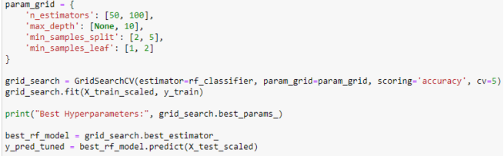
Fine-tune its performance (by adjusting hyperparameters)
GridSearchCV:
GridSearchCV is a technique that performs an exhaustive search over a specified parameter grid to find the best set of hyperparameters for a machine learning model.
It considers all possible combinations of hyperparameter values within the specified grid and evaluates the model's performance using cross-validation.
n_estimators:
  Number of trees in the forest.
  Typically tried in a range, e.g., [50, 100, 150].
max_depth:
  Maximum depth of individual trees.
  Include None (unlimited depth) and reasonable values, e.g., [None, 10, 20, 30].
min_samples_split:
  Minimum samples required to split an internal node.
  Range of values explored, e.g., [2, 5, 10].
min_samples_leaf:
  Minimum samples required to be at a leaf node.
  Range of values explored, e.g., [1, 2, 4].
This code uses GridSearchCV to perform an exhaustive search over a specified hyperparameter grid, evaluating a Random Forest Classifier's performance with cross-validation, and identifying the best hyperparameters for maximizing accuracy on the training dataset.
The best combination of hyperparameters for the Random Forest Classifier was found to be {'max_depth': None, 'min_samples_leaf': 1, 'min_samples_split': 2, 'n_estimators': 100} based on their performance on the provided dataset. These hyperparameters were selected because they led to the highest accuracy in predicting the target variable (diabetes class) during the cross-validation process.

Slide 16
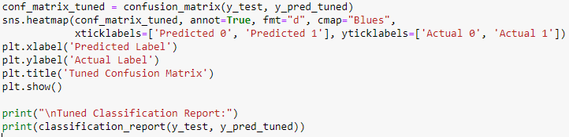
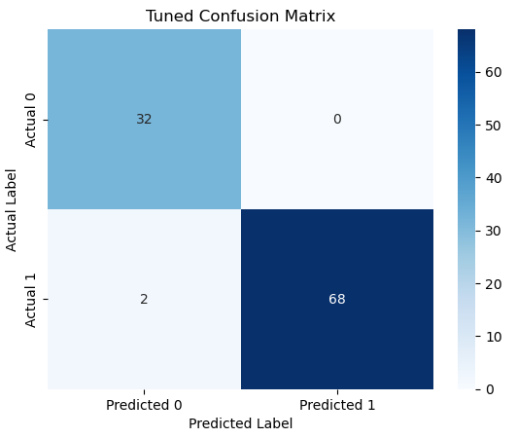
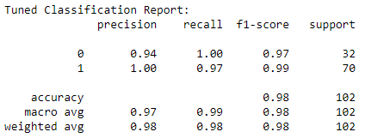
Fine-tune its performance (by adjusting hyperparameters)
Tuned Confusion Matrix and Classification Report:
The overall accuracy of the tuned model is 99%, which is a high level of accuracy.

Slide 17
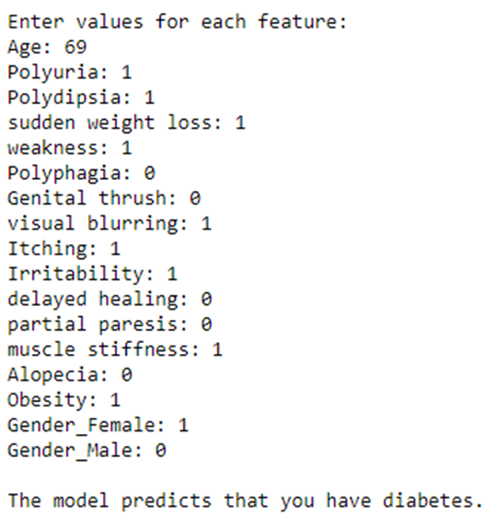
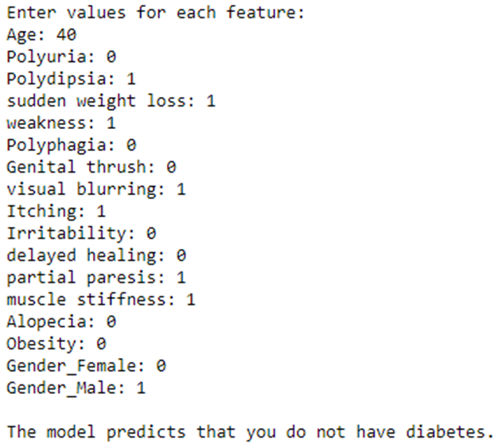
Analyze the model's performance
Testing on the dataset:
    Let us take two examples from the dataset

Slide 18
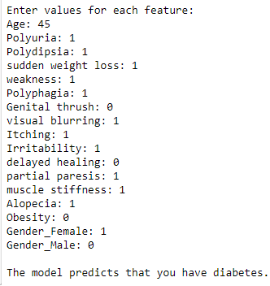

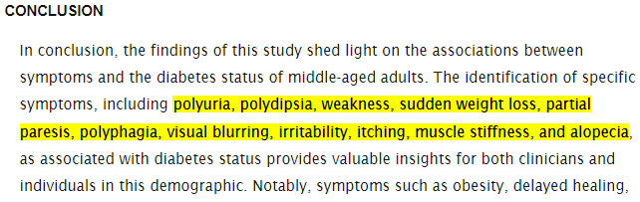

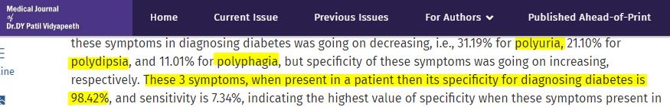
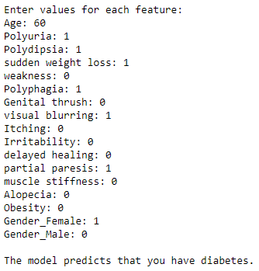
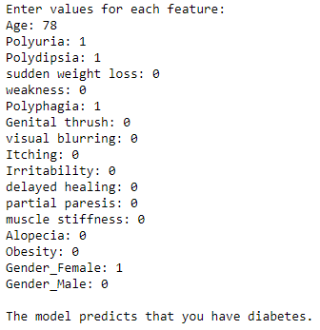
Analyze the model's performance
[https://www.medrxiv.org/content/10.1101/2023.11.26.23299025v1.full]

