Slide 1


Human-Centric
Machine Learning
Seminar
Winter Semester 2026

Slide 2




Who are we?
Ivi
Dimitrios
Ander
Manuel
more information about the seminar:
https://github.com/Networks-Learning/hcml-seminar-2025

Slide 3
Human-Centric Machine Learning
Human-Centric Machine Learning
seeks to
minimize the harm, risks & burdens
of machine learning systems
&
maximize their societal benefits

Slide 4
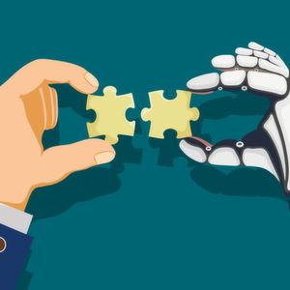

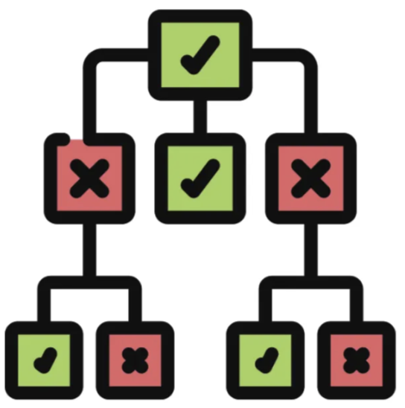


Developing Human-Centric Machine Learning
Human-Centric ML requires conceptual innovations and technical breakthroughs in multiple areas:
Human-AI
Collaboration
Uncertainty
Quantification
Interpretability
Bias &
Fairness
Algorithmic Auditing

Slide 5
What? When? Where?
What?
You will have to
present one paper in an area of human-centric ML
ask questions during the presentation of another paper in the same area
When?
Where?
One “test presentation” in January & one “final presentation” in Feb-March
MPI-SWS 111

Slide 6
Important dates
Oct 31
Nov 6
Nov 27
Dec 4
Jan 12
Jan 31
Feb 12
Mar 29
Registration
deadline
Acceptance notification
Deadline to
rank topics
Paper assignment &
Presentation dates
Practice presentations
Final presentations
Human-AI Collaboration
In front of the instructors
Bias & Fairness
Interpretability
Instructors provide feedback
Algorithmic Auditing
Uncertainty Quantification
In front of the instructors & students
Questions by students

