Slide 1
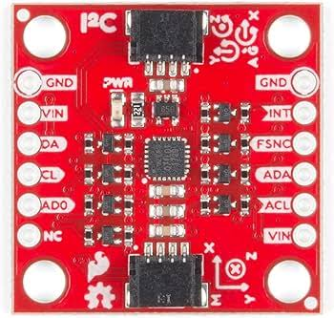
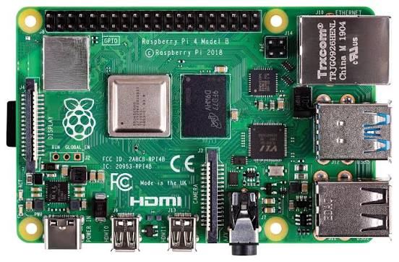
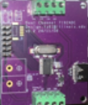
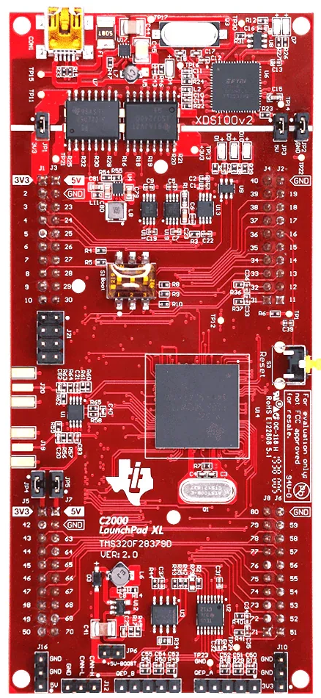
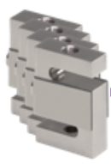
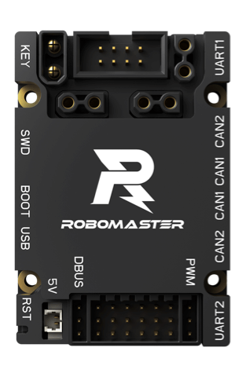
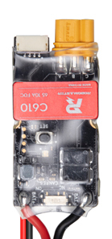
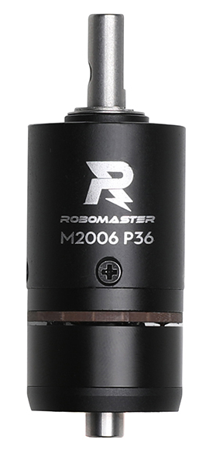
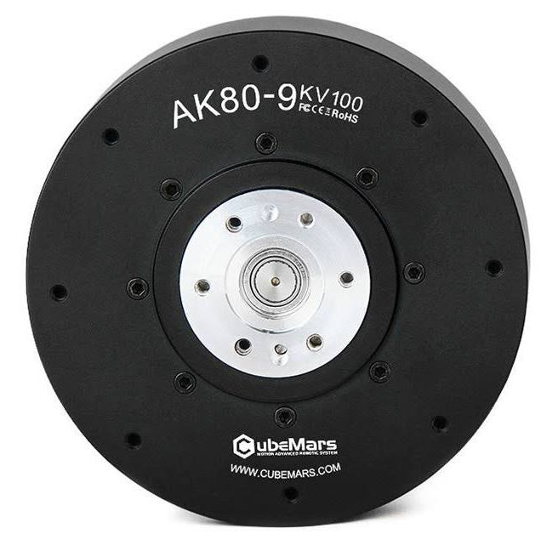
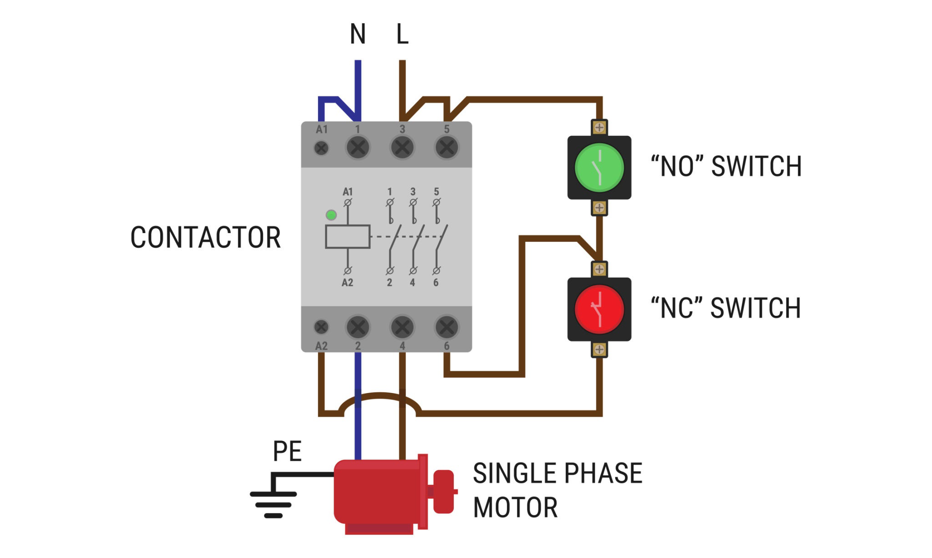
GND
5V
MOSI
CLK
MISO
CS
GND
3.3V
55
47
54
59
SPI-B
GND
9 (RX-D)
10 (TX-D)
43 (RX-C)
44 (TX-C)
Serial
-C&D
GND
TX1
RX1
TX2
RX2
IMU (ICM 20948)
Raspberry Pi 4
5V
GND
MOSI
SCLK
MISO
CS
5V
GND
17
13
18
12
5 V
GND
Analog 4pin
SPI-C
3
GND
4
15
14
CS | 1
GND | 2
CLK | 3
MOSI | 5
MISO | 7
Amplifier 1
SPI-A
CAN
36
5V
GND
MOSI
SCLK
MISO
CS
5V
GND
17
13
18
19
SPI-C
24 V
GND
DJI RM Board C
DJI C610 & M2006 x8
Load Cell x4
TI F28379D
Amplifier 2
35
5V
GND
SCITXDB | 74
SCIRXDB | 73
Seat Module
5 V
GND
Serial-B
CAN-H
CAN_L
CAN
CAN-H
CAN_L
5 V
GND
48 V
GND
E-stop
T-motor AK80-9 x4
6S LiPo
5 V
GND
CS 2 | 33
CS 3 | 34
CS 2 | 46
CS 3 | 42
5V
GND
SCL | 49
SDA | 50
6S LiPo
48 V
GND
Converter
5 V
GND
SPI-A
Reserve
SPI-B
Reserve
Contactor
I2C - B
5 V
GND
6S LiPo
24 V
GND

