Slide 1

Java Streams Dataprocessing with the Stream API
Akif Goge
18-11-2025

Slide 2
Introduction
Purpose of the presentation:
Explaining what Streams are in Java
Showing how Stsreams process data
Showing comparisons with traditional processing methods
Clarifying when Streams are useful (and when they aren't)
After this presentation, you will understand how Java Streams work, what the benefits are, and will be able to perform simple operations yourself with the Stream API.

Slide 3
Problem and Research Questions
Main Question
How can Java Streams contribute to more efficient and readable data processing within the Java Collection Framework?
Side questions
What is a stream in Java?
What sort of streams exist?
What is the difference between intermediate and terminal operations?
What are the positives and negatives of Stream?
Problem Definition
In many java projects, data is still processed with traditional loops
This makes code longer and less clear
Java Streams can make it simpler and more efficient
The challenge is knowing when to use Streams (and when not to)

Slide 4
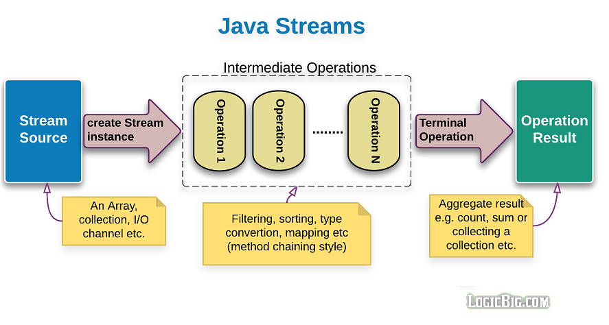
What is a stream?
A Stream is a data stream that performs operations on collections.
Introduced in Java
Streams do not change the original data but return a new result.
They use lambda expressions to make edits shorter and more readable.

Slide 5
Types of streams and how they work
Types:
Stream<T> objects
IntStream, LongStream DoubleStream – primitive data
ParallelStream Shares tasks with multiple cores
How they work:
Source
Intermediate operations
Terminal operation

Slide 6
Examples & Demo
Task | Traditional loop | Stream
Filter | for-loop with if-statement | .filter()
Transform | Fill a new list | .map()
Count | Keeping track with length | .count()

Slide 7
Positives & Negatives
Positives:
Shorter and more readable code
Combine operations simple
Supports parallel processing
Negatives
Harder to debug
Less useful for complex logic
Stream can only be used once

Slide 8
Java Streams make it possible to process data in a declarative, efficient way. They improve code readability and align with modern programming principles.
Oracle. (2024a). Java Platform, Standard Edition 21 API Specification: Stream. Retrieved from https://docs.oracle.com/en/java/javase/21/docs/api/java.base/java/util/stream/Stream.html
Oracle. (2024b). Processing Data with Java Streams. Retrieved from https://docs.oracle.com/javase/tutorial/collections/streams/index.html
W3Schools. (n.d.). Java Streams. Retrieved November 10, 2025, from https://www.w3schools.com/java/java_stream.asp
GeeksforGeeks. (2024). Stream in Java. Retrieved from https://www.geeksforgeeks.org/stream-in-java/

