Slide 1
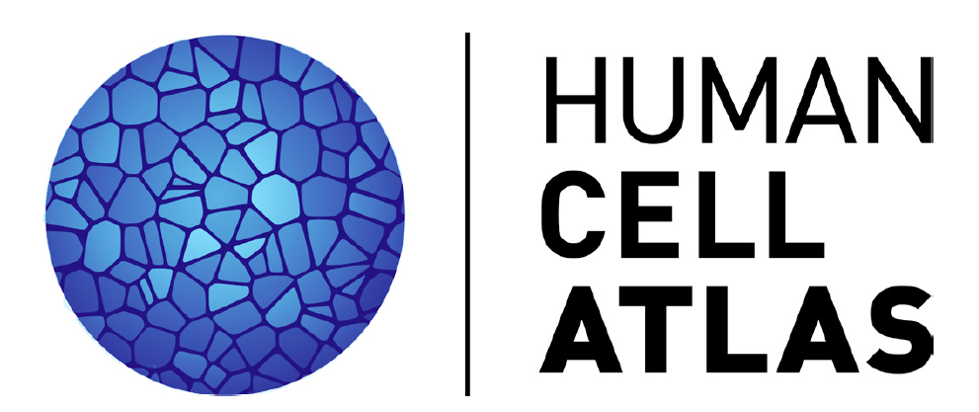
Identifying Low-Quality and Dying Cells
1st HCA Jamboree, August 2nd, 2017

Slide 2
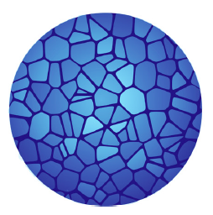
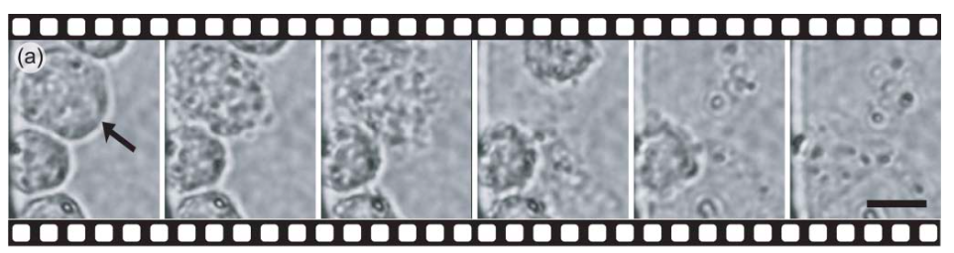
Recognizing Damaged Cells: Caveats
Nevin et al., Lab on a Chip’07
Many of the cells captured by single-cell methods are damaged
Completely dead cells may resemble empty droplets
Dying or damaged cells add their own expression signatures
Increased mitochondrial fraction
Damage signatures can depend on a cell type
Different types of stress can have different signatures

Slide 3
Recognizing Damaged Cells: Challenge
Nevin et al., Lab on a Chip’07
Task: Identify damaged or dying cells
Assign class labels, probabilities, scores
Alternatively: label/score “healthy” cells
Identify informative features
Characterize cell-type specificity
Can build on Task 1 …

Slide 4
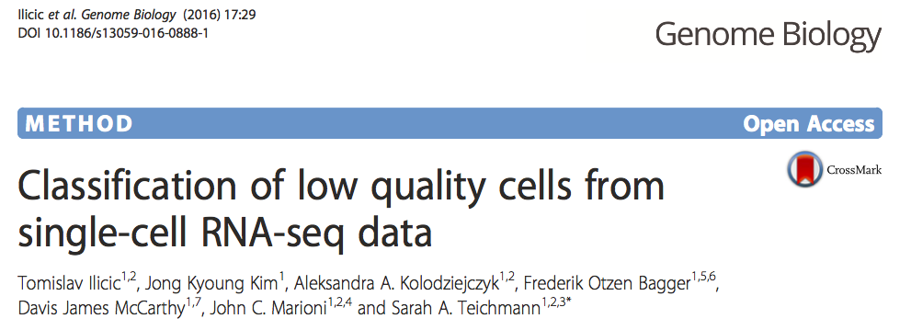
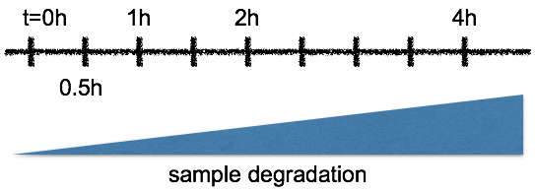
Recognizing Damaged Cells: Datasets
Imaging-based training set
Fluidigm C1
Count matrices
”Task 3” dataset from Haber/Regev
Mouse gut epithelial
10x data
Bam files
Count matrices

