Slide 1

Task 3: Identifying dead and damaged cells
Peter Kharchenko and Fabian Theis
1st HCA Jamboree, August 2nd, 2017

Slide 2
Task 3: Identifying dead and damaged cells
Problem statement: It is relatively simple to determine barcodes that are associated with real cells versus those that have debris and ambient RNA based on complexity, number of transcripts. However, dead and dying cells can appear to be "normal cells" and can obscure the correct biology. Physiological stress and tissue handling may influence this, and different types of stress can damage the cells and cell types in a different way.
Challenges
Identify and classify dead and damaged cells, and/or give probability thereof
Resolve types of stress or cell death prediction in a cell-type specific way

Slide 3
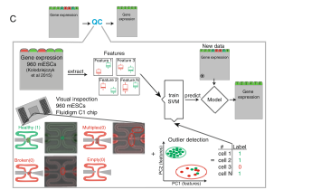
Task 3: Identifying dead and damaged cells
Ilicic et al, Genome Biology 2015

Slide 4
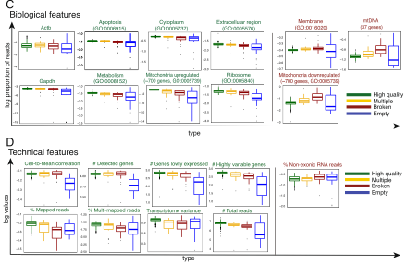
Task 3: Identifying dead and damaged cells
Ilicic et al, Genome Biology 2015

Slide 5
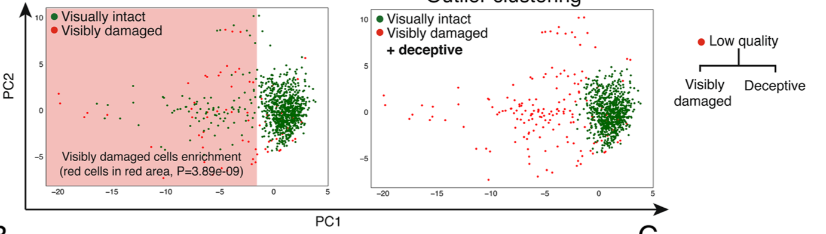
Task 3: Identifying dead and damaged cells
Ilicic et al, Genome Biology 2015

Slide 6
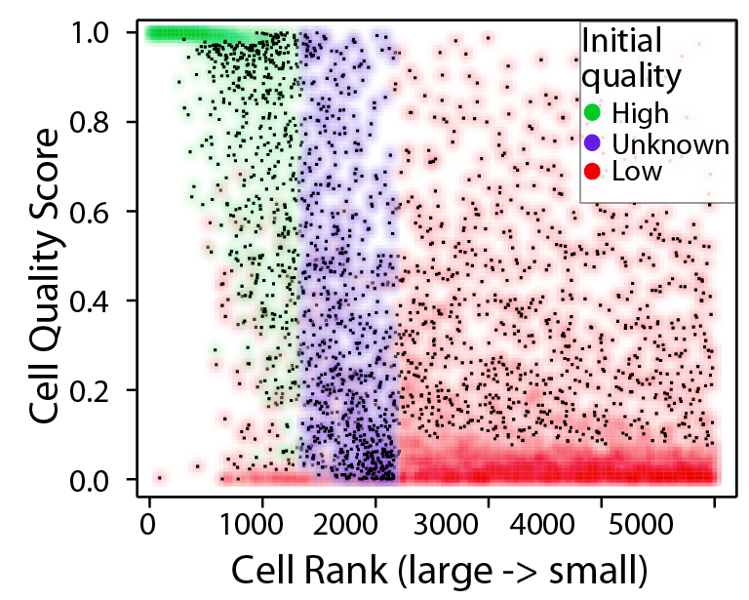

Cell quality and cell size
Most large cells are “good”
Most small cells are not
Imperfect correlations
Similarity to “real cells” problem

Slide 7

Task 3: Identifying dead and damaged cells
data (Regev lab): include cells put through alternative stress modes, such as high-pressure flow sorter or increased temperature (i.e. no ice). Data from Adam Haber/Aviv lab coming up; two conditions with more and less dead cell %; hackathon members will not see batch ID; we can define test score based on (hidden) batch ID
idea: simulate sample degradation by leaving sample on the bench for a fixed time period t
t=0h
1h
2h
4h
scRNAseq
0.5h
sample degradation

Slide 8
Task 3: Identifying dead and damaged cells
data (Regev lab): mouse intestinal epithelial cells.
experimental protocol used enriches for the intestinal crypts, so data is expected to be roughly composed of:
15% intestinal stem cells (expressing Lgr5)
30-50% enterocytes in various stages of maturation (Alpi)
1-2% tuft cells (Dclk1)
1-2% enteroendocrine cells (Chga)
5-10% goblet cells (Muc2)
goal: identify degradation in data set using unsupervised method, quantify using time-lapse a posteriori

