Slide 1
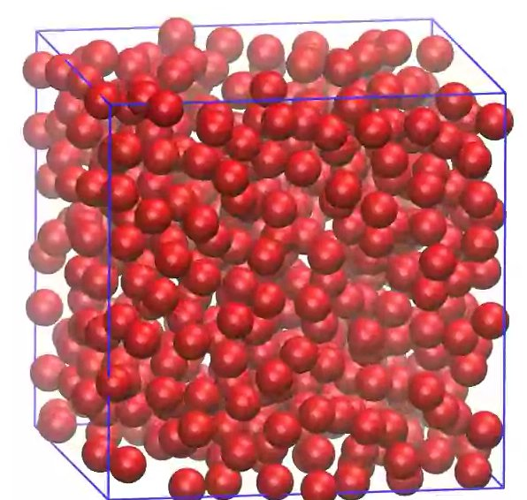
Molecular Dynamics Simulations

Slide 2
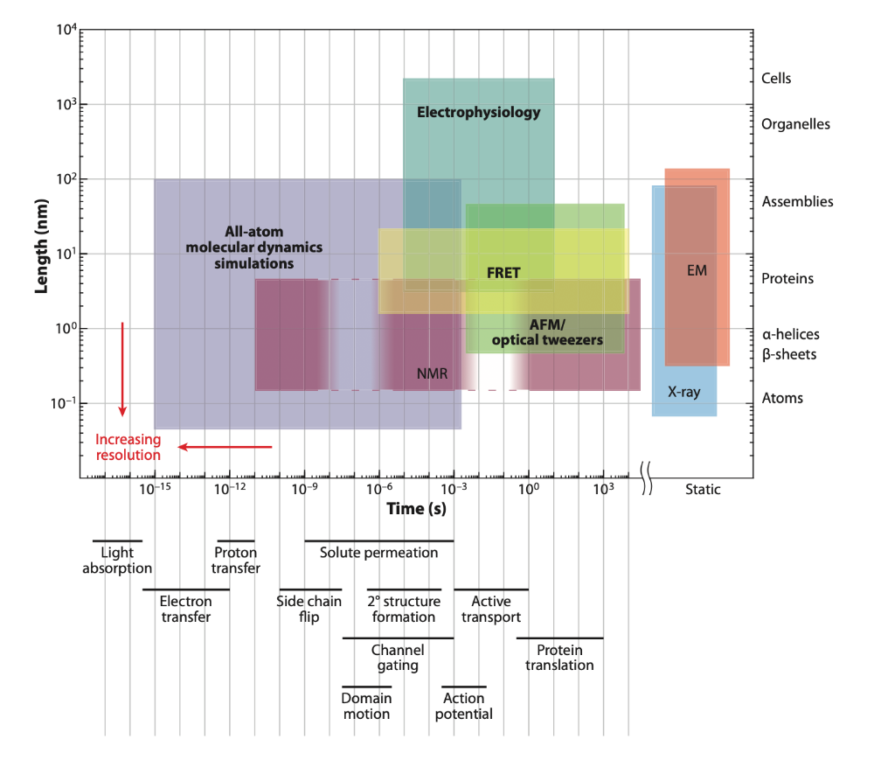
Different techniques focus on different time scales
Different experimental techniques can explore processes at different spatial and time resolution, there is a region that can only be covered by computational methods, only NMR can get close to it, but its results are hard to interpret

Slide 3
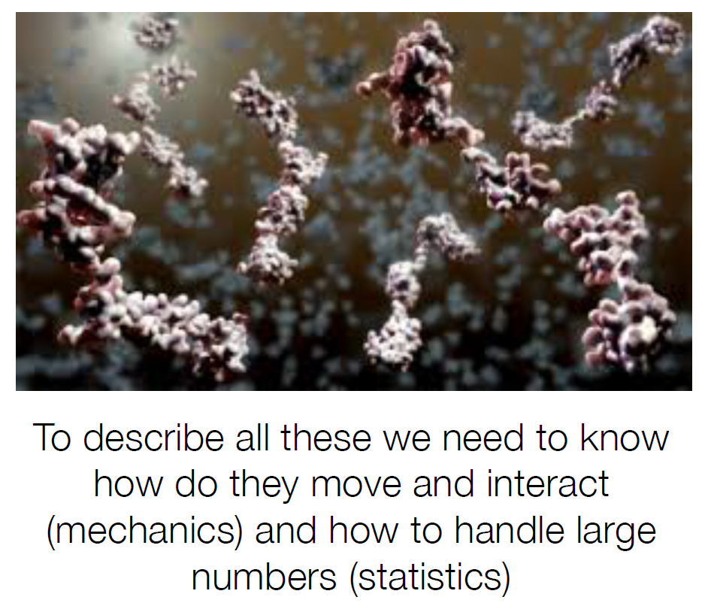
Why a Statical and Mechanical perspective
Our observations will handle with many molecules, generally many copies of the same molecule, that can:
  change their shape
  move in 3D
  have interactions

Slide 4
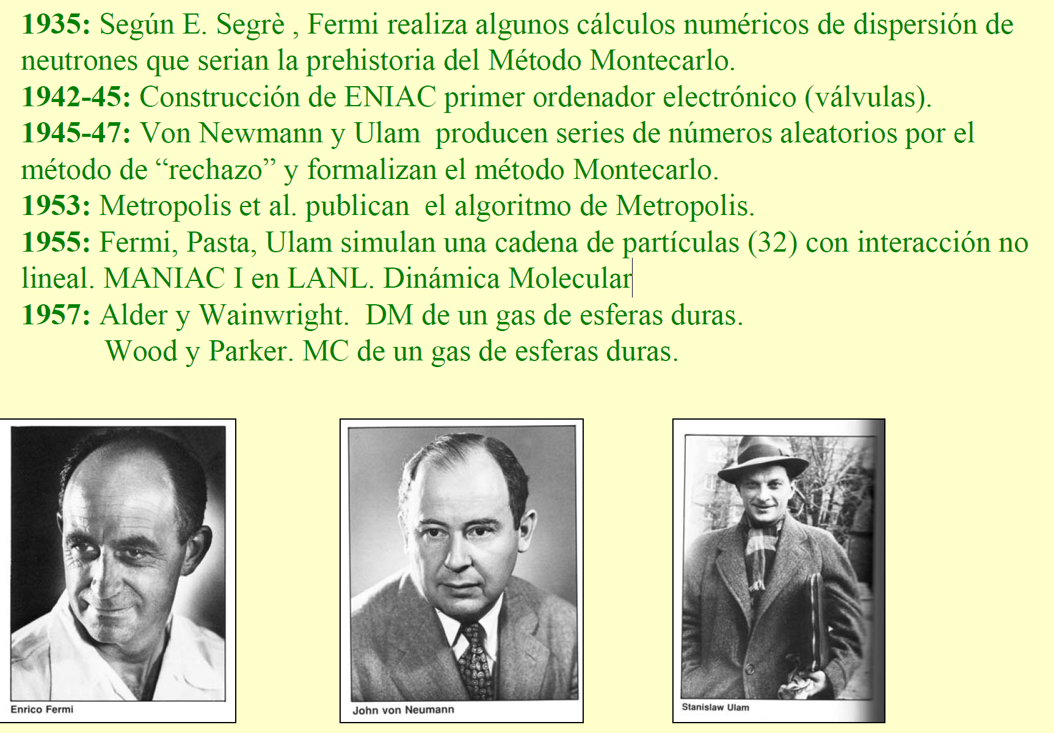
Un poco de (pre)historia de las Simulación

Slide 5
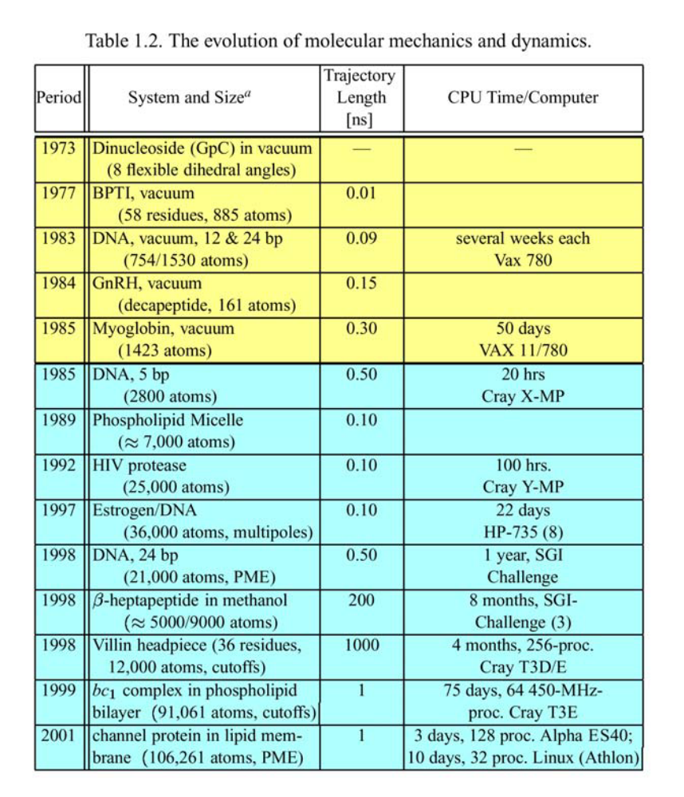
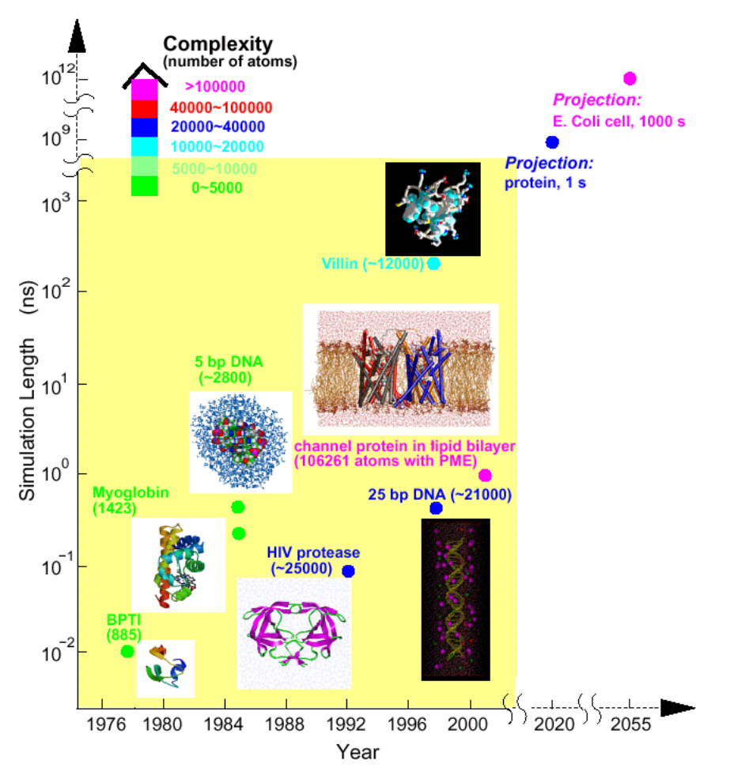
Un poco de (pre)historia de las Simulación

Slide 6
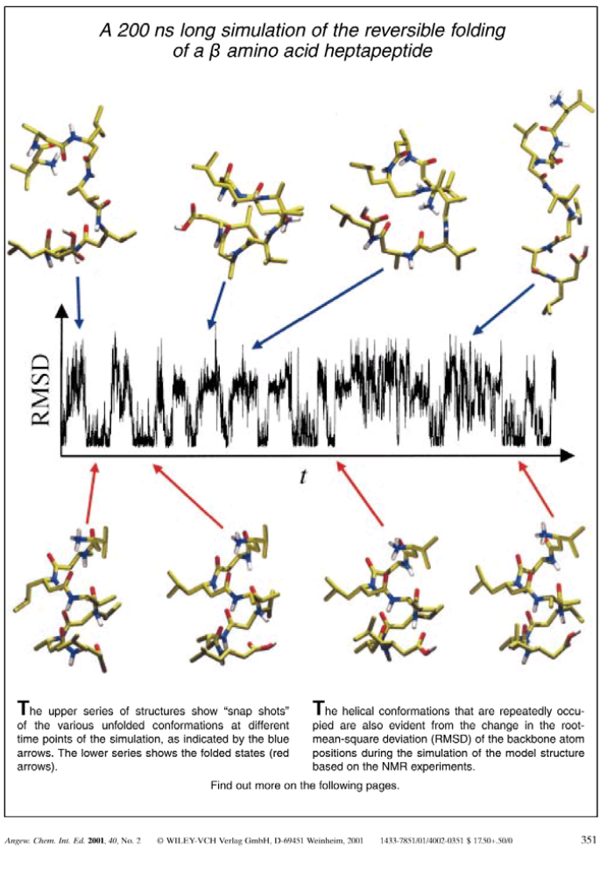
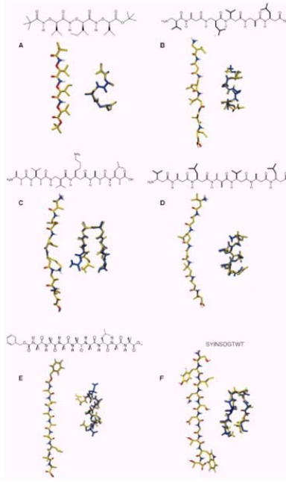
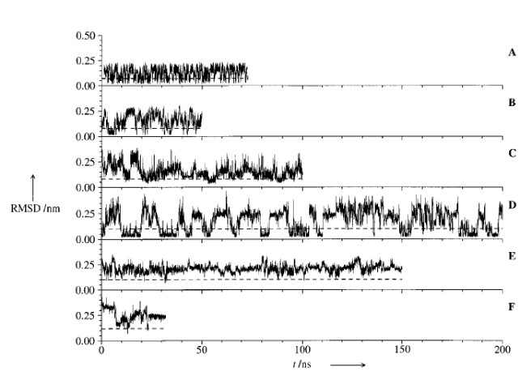
Un poco de (pre)historia de las Simulación

Slide 7
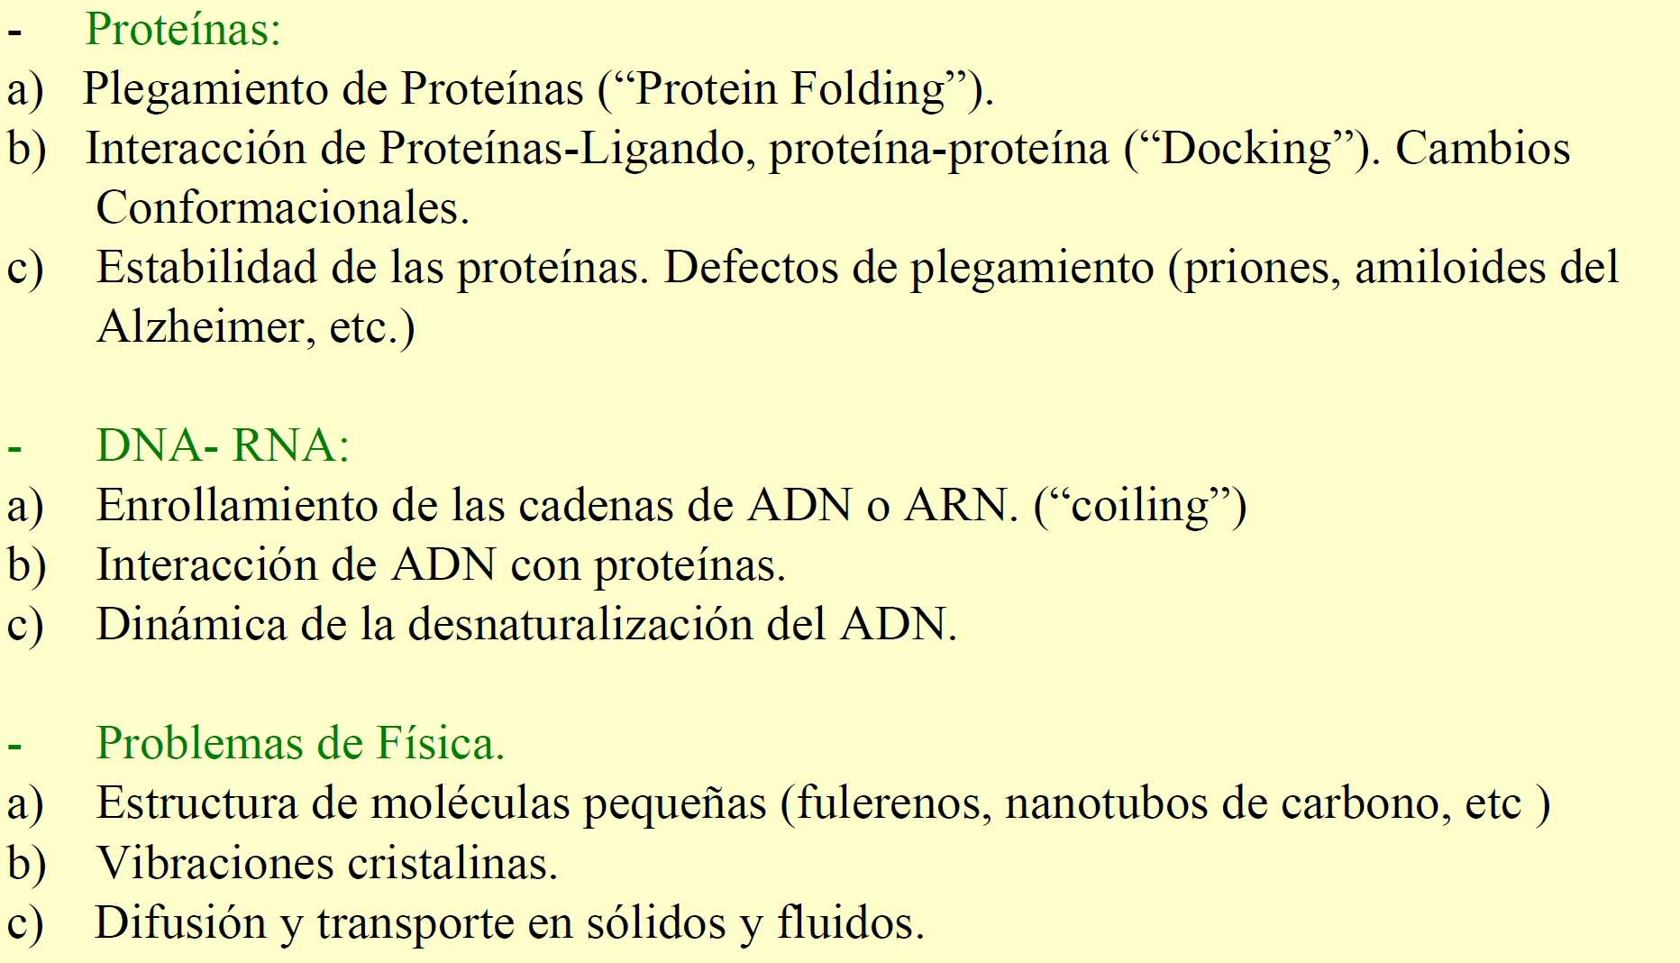
Problemas que podemos abordar

Slide 8
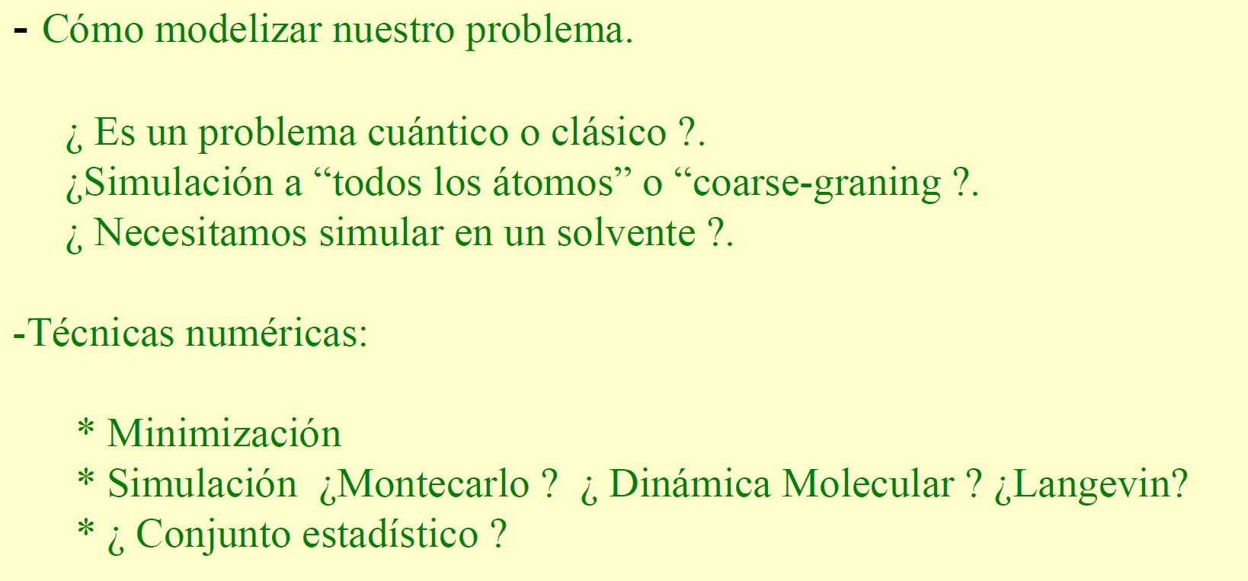
Que tenemos que aprender?

Slide 9
6.0 Overview
What is molecular dynamics (MD)?
Numerical method for studying many-particle systems such as molecules, clusters, and even macroscopic systems such as gases, liquids and solids
Used extensively in materials science, chemical physics, and biophysics/biochemistry
First reported MD simulation:
Alder + Wainwright (1957): Phase diagram of a hard-sphere gas

Slide 10
Basic idea of molecular dynamics:
Solution of Newton’s equations of motion for the individual particles (atoms, ions, …)
Example:
Molecular dynamics simulation of liquid argon

Slide 11
Advantages:
gives (in principle) complete knowledge of system; if all trajectories are known, everything can be calculated
easily accommodates non-equilibrium states and other complex situations beyond thermal equilibrium (by preparing appropriate initial conditions)
Disadvantages:
complete knowledge of all trajectories is often much more information than needed (e.g., equilibrium state of a fluid is characterized by just two variables, p and T)
Is this approach efficient?

Slide 12
Classical MD vs. ab-initio MD
Questions:
Is the classical description of the particles in terms of Newtonian mechanics justified?
What are the forces between the particles; how can we determine them?

Slide 13
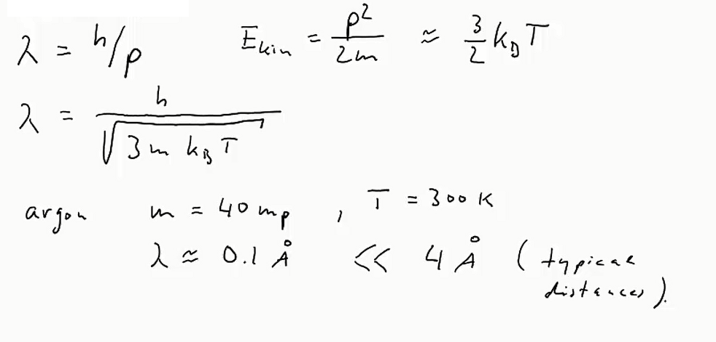
Classical vs. quantum description:
compare inter-particle distance to de-Broglie wavelength
→ Motion of atoms and ions is classical

Slide 14
Interaction potentials and forces:
interaction between atoms and molecules results from electronic structure: not a classical problem, requires quantum physics
two different ways to proceed, leading to two different classes of molecular dynamics simulations, classical MD and ab-initio MD

Slide 15
Classical molecular dynamics
Interactions are approximated by classical model potentials constructed by comparison with experiment (empirical potentials)
Leads to simulation of purely classical many-particle problem
Works well for simple particles (such as noble gases) that interact via isotropic pair potentials
Poor for covalent atoms (directional bonding) and metals (electrons form Fermi gas)
Simulations fast, permit large particle numbers

Slide 16
Ab-initio molecular dynamics
Performs a full quantum calculation of the electronic structure at every time step (for every configuration of the atomic nuclei),
ab-initio = from first principles
Forces are found the dependence of the energy on the particle positions
Much higher accuracy than classical MD, but much higher numerical effort (restricts number of particles and simulation time)

Slide 17
6.1 Basic Machinery

Slide 18
N particles at positions ${\vec{r}}_{i}$ (i=1…N), velocities $\dot{{\vec{r}}_{i}}=\frac{{\vec{p}}_{i}}{m}$
Kinetic energy:
Potential energy:
Forces:
Total energy:

Slide 19
The interaction potential
Simplest choice:
Interaction is sum over distance dependent pair potential
Implies:
No internal degrees of freedom (spherical particles) H₂O
No directional bonding (like in covalent materials, e.g. semiconductors, carbon)
→ works well for closed-shell atoms like the noble gases

Slide 20
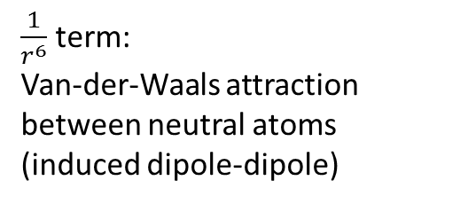
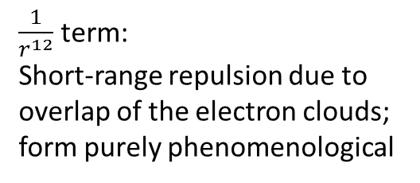
Popular model pair potential: Lennard-Jones Potential
$\frac{1}{r^{6}}$ term:
Van-der-Waals attraction between neutral atoms (induced dipole-dipole)
$\frac{1}{r^{12}}$ term:
Short-range repulsion due to overlap of the electron clouds;
form purely phenomenological

Slide 21
Truncation:
Lennard-Jones potential goes out to r→∞
One has to calculate a large number of small contributions
Sometimes V(r) will be truncated at R_{C} V(r)≡0 for r>R_{C}
To avoid potential jump at R_{C}: shift
Common truncation radii for the Lennard-Jones potential are 2.5σ or 3.2σ

Slide 22
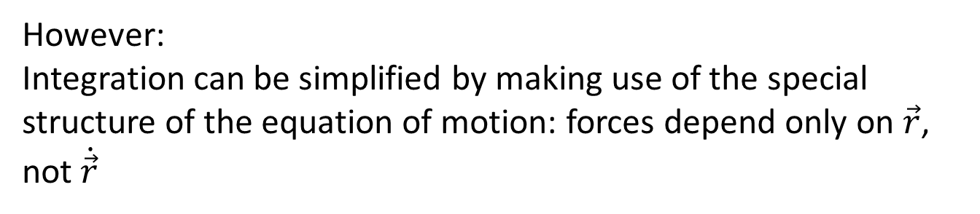
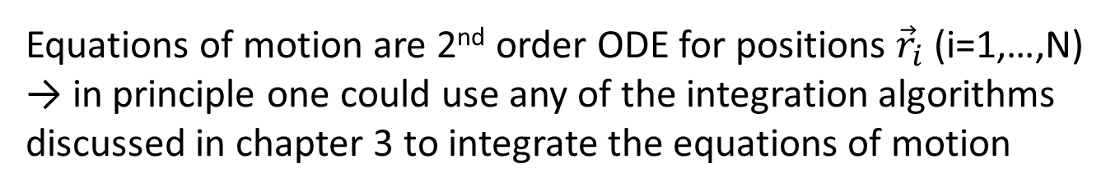
6.2 Time integration –Verlet algorithm
Equations of motion are 2nd order ODE for positions ${\vec{r}}_{i}$ (i=1,…,N)
→ in principle one could use any of the integration algorithms discussed in chapter 3 to integrate the equations of motion
However:
Integration can be simplified by making use of the special structure of the equation of motion: forces depend only on $\vec{r}$, not $\dot{\vec{r}}$

Slide 23
Verlet algorithm

Slide 24
Verlet algorithm
Position error is 4th order in τ (almost like Runge-Kutta, ch. 3)
Math simpler than two Runge-Kutta algorithms required
for a 2nd order ODE
Note: velocities do not show up! If velocities are desired:

Slide 25
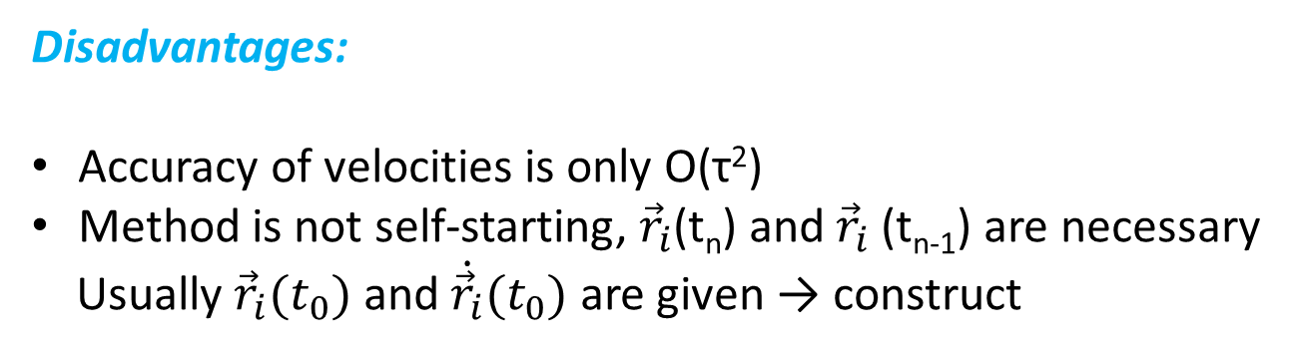
Advantages:
Very simple
High accuracy for the positions
If velocities are not needed, their calculation can be skipped
Disadvantages:
Accuracy of velocities is only O(τ²)
Method is not self-starting, ${\vec{r}}_{i}$(t_{n}) and ${\vec{r}}_{i}$(t_{n-1}) are necessary
Usually ${\vec{r}}_{i}(t_{0})$ and $\dot{{\vec{r}}_{i}}(t_{0})$ are given → construct
There are modifications of the Verlet algorithm that treat $\vec{r}$ and $\dot{\vec{r}}$ on equal footing.

Slide 26
6.3 Geometry and boundary conditions
Must distinguish simulation of finite objects like molecules and clusters from simulation of macroscopic systems
Finite systems: use open boundary conditions, i.e. no boundaries at all, just N particles in space
Macroscopic systems: real macroscopic systems have a much larger number of particles (∼10²³) than can be handled in a simulation
→ simulating a large cluster with open boundary conditions will greatly overestimate surface effects
Solution: periodic boundary conditions

Slide 27
Periodic boundary conditions
Consider box of size L, repeat box infinitely many times in all
directions
Basic box
copies

Slide 28
Periodic boundary conditions
Consider box of size L, repeat box infinitely many times in all directions
Each particle interacts (in principle) with all particles in all boxes
→ problems for long-range interactions (infinite resummation
necessary)
short-range interactions: minimum image convention:
consider box with size L>2R_{C} , at most the closest of all images
of a particle j can interact with a given particle i
→ great simplification: pick the closest image and use this to
calculate V(r_{ij})

Slide 29
Systems with surfaces
Two strategies:
Simulation of a slab
Periodic BC in 2 directions, open BC in remaining one
If the slab is thick enough, the inner part will look like a bulk system and we have two independent surfaces

Slide 30
2. For static questions:
Freeze a few layers of atoms in the known bulk configuration

Slide 31
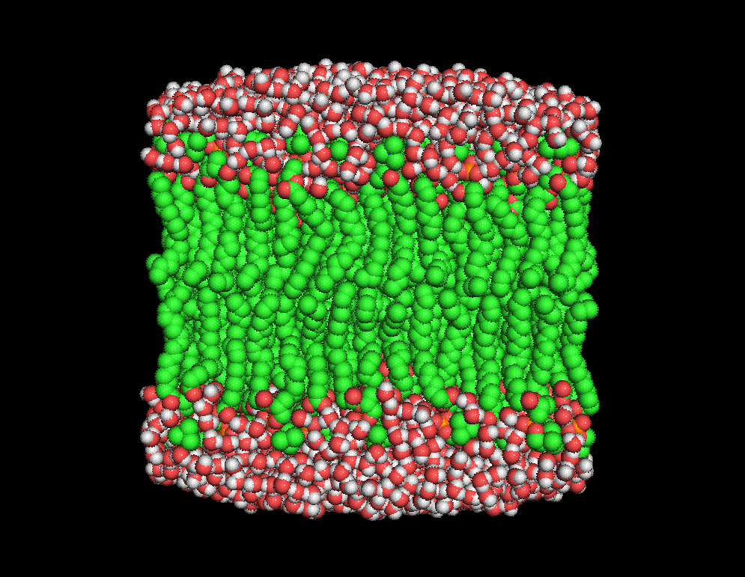
6.4 Starting and Controlling the Simulation
How to
Initialize positions and velocities
Equlibrate the system
Control simulation
H Heller, M Schaefer, & K Schulten, J. Phys. Chem. 97:8343, 1993

Slide 32
6.4.1 Starting the simulation
Create initial set of positions and velocities:
Positions usually defined on lattice or at random (if random avoid too short distances)
If knowledge about the structure exists, put it in!
Velocities are assigned random values, magnitudes reflect desired total energy or temperature
Average (center-of-mass) velocity should be zero
(otherwise you simulate translation of system as a whole)
→ This initial state is not the equilibrium state!
It will take the system some time to reach equilibrium.

Slide 33
Continuing a simulation:
Very often the best choice of initial conditions can be obtained from the previous run, if parameters have changed only slightly.
Particularly useful for large set of runs that systematically explore the parameter space.

Slide 34
6.4.2 Controlling the system
Thermodynamic system has a number of state variables which describe its macroscopic state such as
Particle number, volume, temperature, pressure, total energy
They are not all independent, but connected by equations of
state
Example: Ideal gas of non-interacting point particles

Slide 35
In MD simulation: some state variables are external parameters, others are observables to be calculated
Simplest setup: Microcanonical ensemble (NVE)
Particle number N
Volume V
Total energy E
Temperature T
Pressure P
External parameters
Observables to be calculated (see below)
Sometimes one wants to perform a simulation at constant T and/or constant p rather than constant E or constant V
→ modifications of molecular dynamics which change E and V on the go so that T and p are constant

Slide 36
Canonical ensemble (NVT)
Particle number N
Volume V
Temperature T
Total energy E
Pressure P
External parameters
Observables to be calculated
Requires a thermostat, an algorithm that adds and removes
energy to keep the temperature constant
Velocity rescaling based on equipartition theorem
Berendsen thermostat, Anderson thermostat

Slide 37
Isothermal–isobaric ensemble (NPT)
Particle number N
Pressure P
Temperature T
Total energy E
Volume V
Requires a barostat in addition to the thermostat, an algorithm that changes volume to keep the pressure constant
External parameters
Observables to be calculated

Slide 38
6.4.3 Equilibration
After initial setup or after change of parameters, system is out of equilibrium. i.e. its properties will not be stationary but drift, relax towards new equilibrium state
→ if we are interested in equilibrium, must wait for a number of
time steps to reach equilibrium before measuring observables
Normally, observable A(t) approaches equilibrium value A₀ as
A(t) short time average to eliminate fluctuations)
What is , i.e. how long do we have
to wait? Hard to know a priori.

Slide 39
Simple estimates:
Each particle should have had a few collisions (to exchange energy)
Particles should have moved at least a few typical interparticle distances to explore the potential
Best solution:
Watch a characteristic observable and monitor its approach to a constant value
If E, N and V are fixed external parameters, you could watch T and/or p
Compare runs with different initial conditions

Slide 40
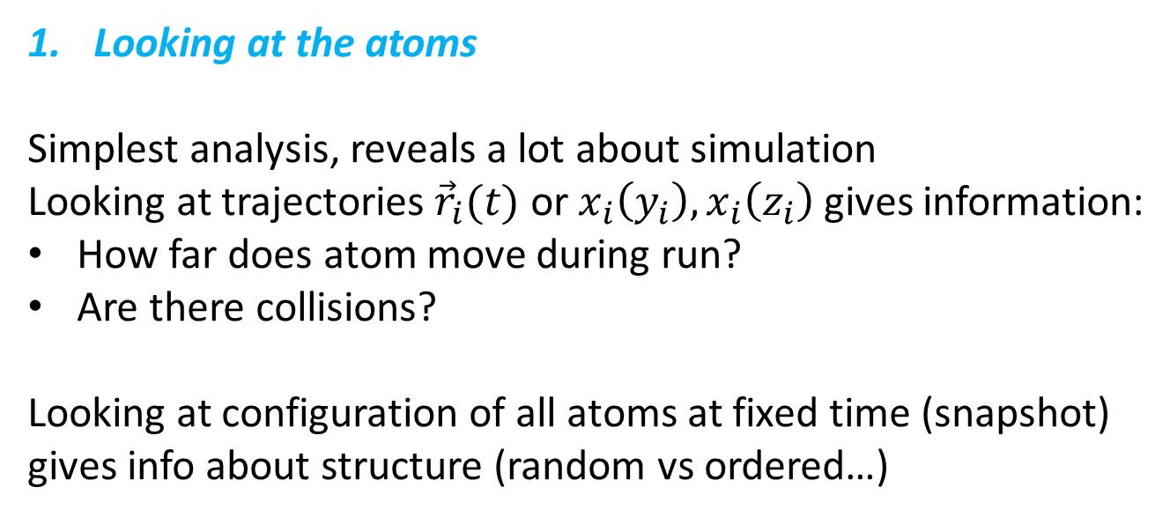
6.5 Simple Observables
Looking at the atoms
Simplest analysis, reveals a lot about simulation
Looking at trajectories ${\vec{r}}_{i}(t)$ or $x_{i}\left(y_{i}\right), x_{i}\left(z_{i}\right)$ gives information:
How far does atom move during run?
Are there collisions?
Looking at configuration of all atoms at fixed time (snapshot)
gives info about structure (random vs ordered…)

Slide 41
2. Statistical Quantities
A(t) will fluctuate with t. Fluctuations are the stronger the smaller the system
Thermodynamic behavior is represented by average:
Measurement can only be started after equilibration

Slide 42
a) Potential energy
b) Kinetic energy
c) Total energy
Should be conserved in Newton’s dynamics
Energy conservation is a good check of the time integration
Typically relative fluctuations of, say, ∼10⁻⁴ are OK
→ Choice of time step τ:
small enough to conserve energy to accuracy 10⁻⁴ ,
but large enough to allow for sufficiently long simulation time
→ compromise!

Slide 43
d) Temperature: derived quantity in MD simulation
in microcanonical (NVE) ensemble
Equipartition theorem: (statistical physics):
Every quadratic degree of freedom takes energy ½k_{B}T
Kinetic energy is quadratic in v_{i}

Slide 44
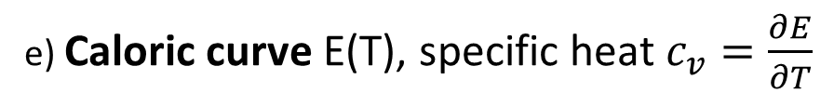
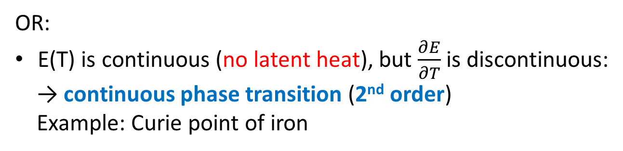
e) Caloric curve E(T), specific heat $c_{v}=\frac{∂E}{∂T}$
E(T) will have features at a phase transition
E(T) has jump
1st order phase transition
ΔE latent heat
Examples: melting of ice,
liquid water →vapor
OR:
E(T) is continuous (no latent heat), but $\frac{∂E}{∂T}$ is discontinuous:
→ continuous phase transition (2nd order)
Example: Curie point of iron

Slide 45
f) Mean-square displacement
Contains information about diffusivity, distinguishes phases
Solid: atoms remain at positions, undergo vibrations
→ 〈Δr²〉 will saturate at a value of the order of
(lattice constant)²
Fluid: atoms can move freely
→ 〈Δr²〉 will saturate at a value of the order of
(box size)²

Slide 46
Distinguish two regimes:
(i) “no collisions (small box, low density)
Mean free path λ (distance between collisions) λ>>L
Particles move ballistic, Δr∼t
〈Δr²〉∼t² before saturation
(ii) “many collisions (large box, high density)
Example: real gases at ambient conditions
λ<<L
Particles move diffusive
〈Δr²〉∼t before saturation

Slide 47
Question: Why do we observe 〈Δr²〉∼t in the collision dominated
regime?
Motion can be viewed as random walk

Slide 48
g) Pressure
Naïve idea: consider collisions of particles with walls of container,
calculate force from momentum change of particles
Not very efficient, only particles close to surface contribute

Slide 49
Better: use Clausius’ virial function:
MD average:

Slide 50
Container: box of dimensions L_{x}, L_{y}, L_{z} sitting at the origin
Virial
equation
No internal forces ➔ ideal gas law

Slide 51
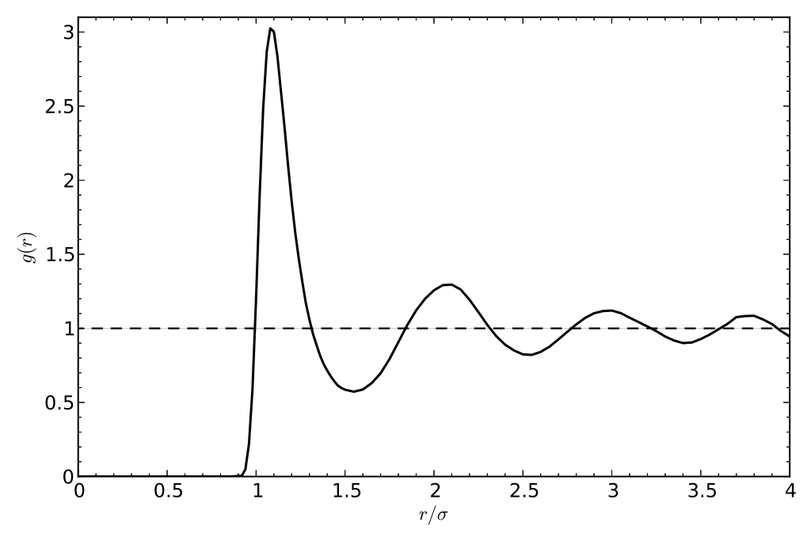
6.6 Real and momentum space
correlations
Correlation functions:
Relate the particle positions to each other
Important quantities conceptually
Directly related to scattering experiments (see chapter 5)

Slide 52
Pair correlation function g(r)
Describes probability for finding particle at position if
another particle is at 0 (relative to uniform distribution).
Particles independent, uniformly distributed:
Any deviation from 1 describes correlations between particles!

Slide 53
Relation between pair correlations and structure factor
Can be understood as density-density correlation function
Fourier transform of pair correlation function:

Slide 54
Measuring structure factor gives direct access to pair correlations

Slide 55
6.7 Molecular dynamics as an
optimization tool
So far, we have viewed molecular dynamics as a tool to simulate thermodynamic equilibrium
Equilibration needs to be finished before measurements can begin
Now:
Look at equilibration for its own sake
Can be used as an optimization algorithm

Slide 56
At low temperatures, equilibration means finding states with the lowest energies
Nontrivial problem, even for small particle numbers (see project 5)
Why?
Energy landscape in complicated, with many local minima
Conventional methods (e.g., steepest descent) get stuck in side minimum

Slide 57
How does nature find the optimal configuration?
System is prepared at high energy (high temperature)
System cools down slowly = annealing
At high temperatures, system easily overcomes barriers
As temperature decreases, system will spend more time in wider and deeper minima

Slide 58
Simulated annealing:
Computational algorithm that mimics annealing of a system
Start from a random configuration of particles and a kinetic energy larger than the typical barriers
Perform MD simulation, but slightly reduce kinetic energy after each time step (multiply velocities by factor a < 1)
Repeat until kinetic energy (temperature) is below some threshold
The resulting configuration is (close to) the minimum energy configuration

Slide 59
Remarks:
Finding the global minimum is not guaranteed
You need to cool very slowly to give the system time to explore the configuration space and find the deepest and broadest minima
If you cool too quickly, system will end up in the closest local minimum rather than the global one
velocity scaling factor a needs to be close to unity, e.g., a=0.999

Slide 60
Generalization: Minimum of arbitrary function F(x₁, …, x_{N})
Interpret F(x₁, …, x_{N}) as a potential energy
Add kinetic energy
(masses can be chosen arbitrarily)
Perform simulated annealing as above

