Slide 1

Phoenix AI &
Machine Learning
(Coffee & Bagels in the back!)

Slide 2

PayPal Inc.
“Powering the People Economy”
WiFi: PayPalGuest
Pass: safepayments

Slide 3

Cloud Systems Engineer
Python
GoLang
Machine Learning
PayPal Smart Cloud
LSTM, RL & ANN
Asymptotic Approach to Learning
About Me

Slide 4

“Transforming Computational Research and Engineering”
PayPal
Facebook
Google
IBM
Microsoft
Caffe
Cuda-covnet
Theano
Torch7
cuBLAS
MATLAB
Mocha.jl

Slide 5
Solving MNIST 1/3:
A simple neural network

Slide 6
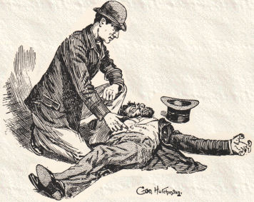
Inductive Reasoning
“Elementary”
Inductive:
specific instances ->
generalized conclusion
(True?)
Deductive:
general principles ->
specific conclusion
(True)

Slide 7
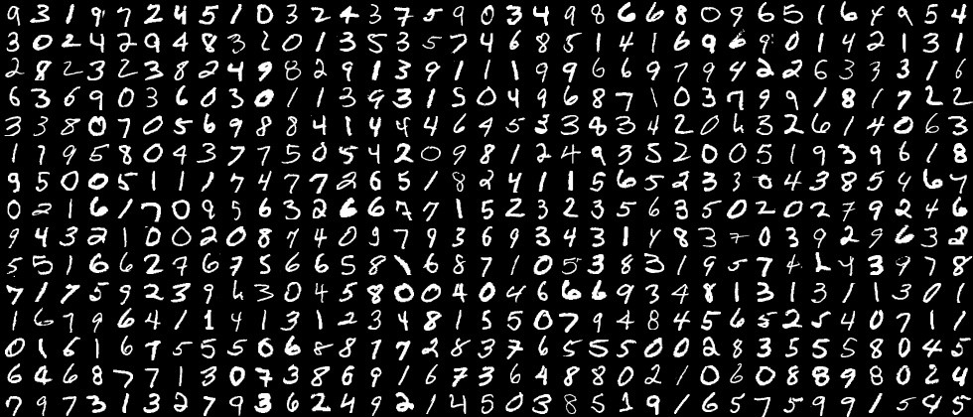
MNIST Dataset
(Mixed) National Institute of Standards & Technology

Slide 8
MNIST Dataset
(Mixed) National Institute of Standards & Technology
Mixed from previously collected NIST dataset
Normalized (20x20 pixel) and anti-aliased
American Census Bureau employees
American High School students
60,000 training images
10,000 testing images.
Goal: 98.30%+ Accuracy
Error: +/- 0.70%

Slide 9
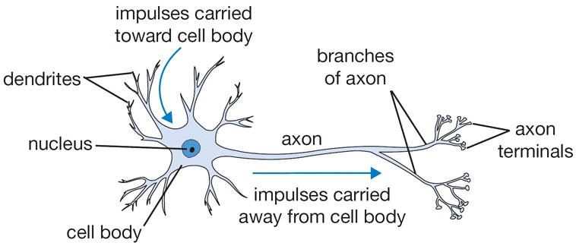
A Real Neuron
Spike Train -------------------------> Choo choo!
x 100,000,000,000

Slide 10
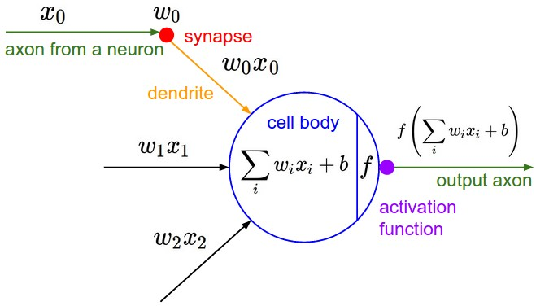
An Artificial Neural Network (ANN)

Slide 11
ANN Terminology
Cheatsheat
Input Layer
Data input -> to be fed into the network.
Hidden Layers
Any layer between the input and output layers
Output Layer
The final output of the network.
Backpropagation
Errors fed back into the network -> training!
Weight
Excitatory + [or] Inhibitory -
Activation Function
Threshold for Neuron Firing
Gradient
‘Derivative’
Stochastic
‘Randomly Determined’

Slide 12
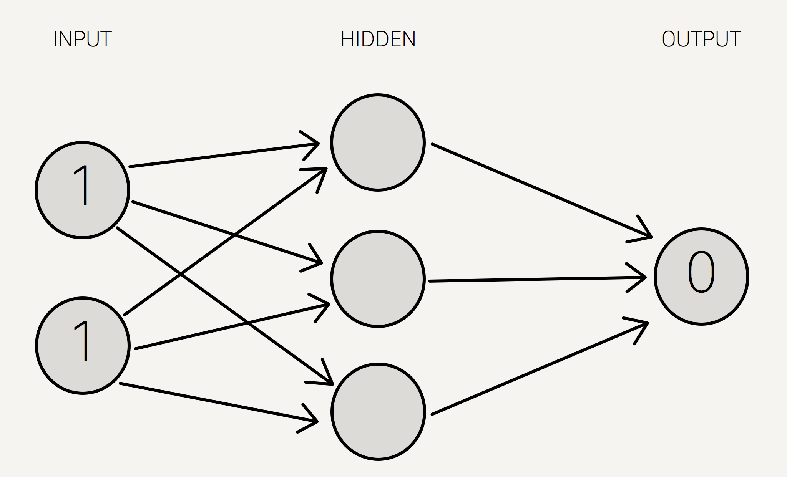
An Artificial Neural Network (ANN)

Slide 13
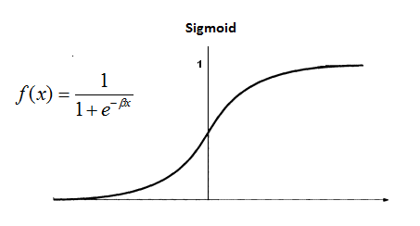
An Activation Function
(Squashing Function)
Describes the output behavior of a neuron

Slide 14
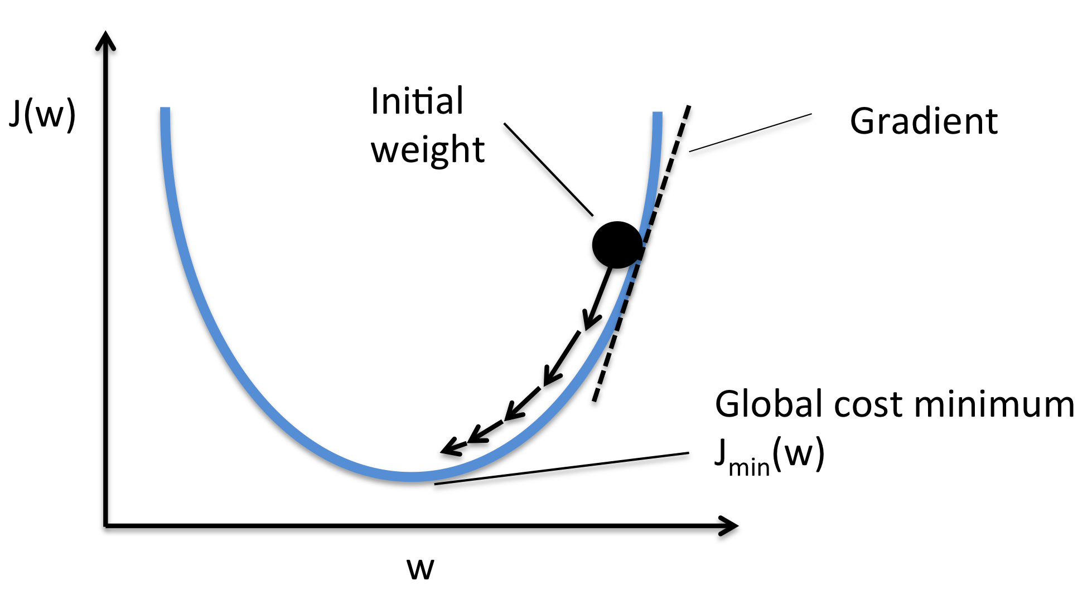
Gradient Descent
Mapping errors is fun!

Slide 15
Phoenix AI &
Machine Learning
THANK YOU FOR ATTENDING!

