Slide 1
Project
Presentation
on
BRAIN TUMOR CLASSIFICATION USING MR IMAGES AND TRANSFER LEARNING
Brlide Ankitha (700758855)
Srikanth Reddy Sagili (700759937)
Humani Korem (700743926)
Revathi Atchi (700742168)

Slide 2
Roles/Responsibilites
Methodology: Srikanth reddy Sagili did methodogy. Conduct literature reviews to identify relevant research papers, methodologies, and state-of-the-art techniques in brain tumor classification.
Preprocessing Data: Preprocessing of data was done by Ankitha . Develop scripts or pipelines for data preprocessing, including image cropping, normalization, and augmentation. Ensure the quality and consistency of the MRI image dataset for training and testing purposes.
Deep Learning Techniques: Humani and Revathi came up with Design and develop the deep learning model architecture for brain tumor classification using Convolutional Neural Networks (CNNs).Preprocess and augment the MRI image dataset to improve the model's accuracy and robustness.Implement transfer learning techniques using pre-trained models such as VGG16 and InceptionV3 to extract deep features from MRI images.

Slide 3
OBJECTIVE
Our objective is to build a system that works with Convolution Neural Network using Transfer Learning Techniques. The model is trained with augmentation methods and generate good accuracy among all the transfer learning and predefined architectures. In transfer learning algorithms based on highly complex neural network that mimic the human brain works to detect patterns in large unstructured data set. Transfer Learning can analyze images, videos, and unstructured data in which machine learning can’t easily do. The model is able to achieve high accuracy on the target dataset, while still being computationally efficient.

Slide 4
MOTIVATION
Detection of brain tumors in real-time can be achieved through various imaging techniques such as magnetic resonance imaging (MRI), computed tomography (CT), and positron emission tomography (PET) scans.
MRI is the most commonly used imaging technique for detecting brain tumors. It uses a magnetic field and radio waves to create detailed images of the brain. CT scans use X-rays to create images of the brain, and PET scans use a radioactive tracer to show how the brain is functioning.
Real-time detection of brain tumors can be helpful for doctors in several ways. It allows them to quickly identify the location and size of the tumor, which can help guide treatment decisions. Real-time imaging can also be used during surgery to help surgeons precisely remove the tumor while minimizing damage to healthy brain tissue.
In addition, real-time monitoring of the tumor during and after treatment can help doctors evaluate the effectiveness of the treatment and make any necessary adjustments. Overall, real-time detection of brain tumors is a valuable tool in the diagnosis and treatment of brain tumors.

Slide 5
LITERATURE
Title of the paper | Methods used | Accuracy | Advantages | Disadvantages
[1] Detection of tumors on brain MRI images using the hybrid convolutional neural network architecture Year : 2020 | Resnet50 model | It is 97.01% accurate. | Improved accuracy compared to other architecturesand utilizes the strong feature extraction capabilities of ResNet50. | The model used in this paper has limited evaluation metrics.
[2]Detection of brain abnormality by a novel Lu-Net deep neural CNN model from MR images Year : 2020 | Novel CNN model(LU-Net) | It has an accuracy rate of98%. | This system has highaccuracyand outperforms other models. | There is a limited scope for the model used
[3]Brain tumor detection in MR image using superpixels, principal component analysis and template based K-means clustering algorithm Year : 2021 | Super pixels and Principal Component Analysis (PCA),TK-means clustering | It has an accuracy rate of95% | Here,the system has superior Performance. | The main disadvantage is lack of Deep Learning Integration: Although the study suggests incorporating a deep learning system, it was not utilized in the proposed scheme

Slide 6
Title of thepaper | Methods used | Accuracy | Advantages | Disadvantages
[5]Early tumor diagnosis in brain MR images via deep convolutional neural network model Year : 2021 | Deep-CNN based model | It is 98% accurate | The proposed system has Higher accuracy and it Overcomes overfitting | The system is limited to classification of normal and abnormal tumor and has more computational time
[6]BrainMRNet: Brain tumor detection using magnetic resonance images with a novel convolutional neural network model Year : 2020 | BrainMRNet model | The study reports a classification success rate of 96.05% | Superior classification accuracy and has Residual blocks which Minimizes the negative effects of depth on model performance improves the overall accuracy. | The system has lack of further classification and limited dataset
[7]Brain tumor identification and classification of MRI images using deep learning techniques Year : 2020 | Fully Automatic Heterogeneous Segmentation using Support Vector Machine (FAHS-SVM) method | The has an accuracyrate of 98.51% | Promising results on multi-parametric Magnetic Resonance image. | The system used has limited evaluation and limited generalizability to different datasets or imaging techniques.

Slide 7
EXISTING METHODOLOGY
Traditionally,Convolutional neural network (CNN) model using a large dataset involves a significant level of computational complexity.
Reusing the model weights from previously trained models might therefore streamline this learning process.
Disadvantages:
Poorer output
Significant degree of computational complexity.

Slide 8
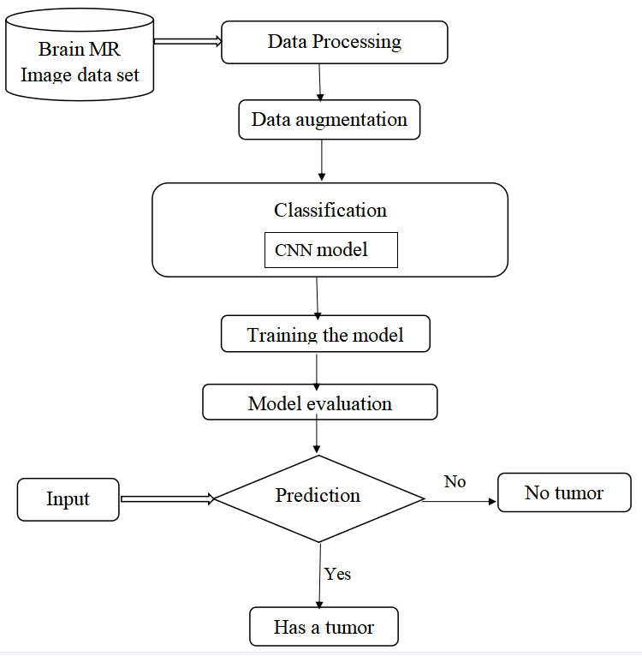
Existing model Block diagram

Slide 9
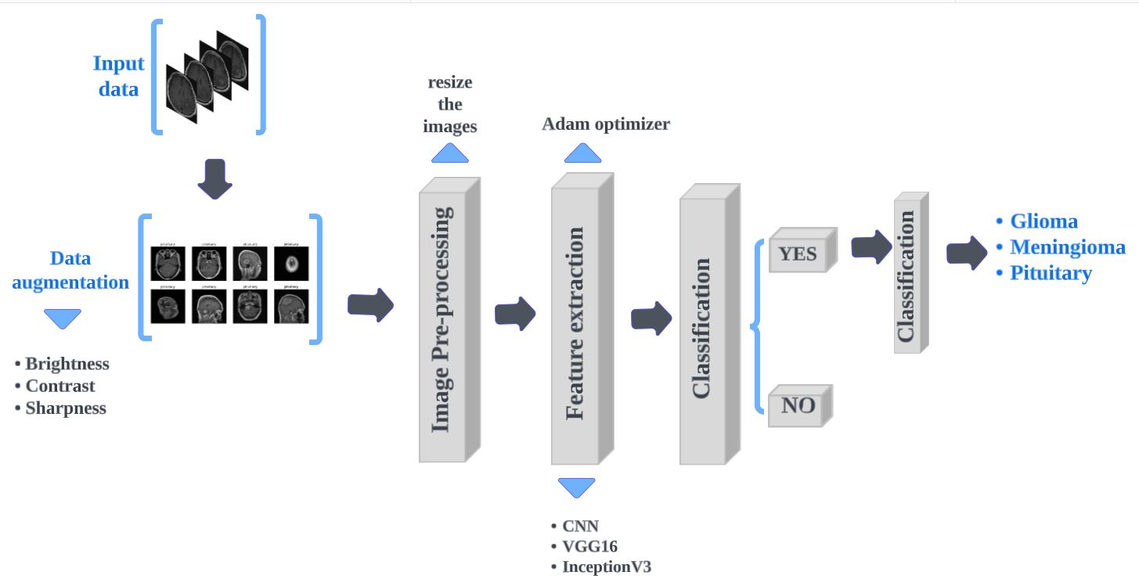
Proposed System
Block diagram

Slide 10
Model Implementation
Loading the dataset: The first step is to load the dataset into memory. This can be done using Python libraries such as NumPy or Pandas. The dataset should be divided into training and test sets.
Augmentation and image pre-procesing: Data augmentation techniques such as and cropping can be used to artificially increase the size of the dataset and reduce overfitting. This step can be done using Python libraries such as Keras or OpenCV.
Feature extraction: Feature extraction involves extracting important features from the images that can help in distinguishing between different types of tumors. This can be done using pre-trained models such as VGG16 or InceptionV3, which have been trained on large datasets of images and can extract meaningful features from the input images.
Classification: Once the features have been extracted, a classification model can be trained to classify the images into different tumor types.
Further classification of tumor type: After the images have been classified into different tumor types, further classification can be done to identify the specific type of tumor.
Overall, this process involves loading the dataset, augmenting the data, extracting important features, classifying the images to identify if there is a tumor or not, and further classifying the specific types of tumor if there is a tumor. This process requires a combination of image processing, machine learning, and deep learning techniques and can be computationally intensive.

Slide 11
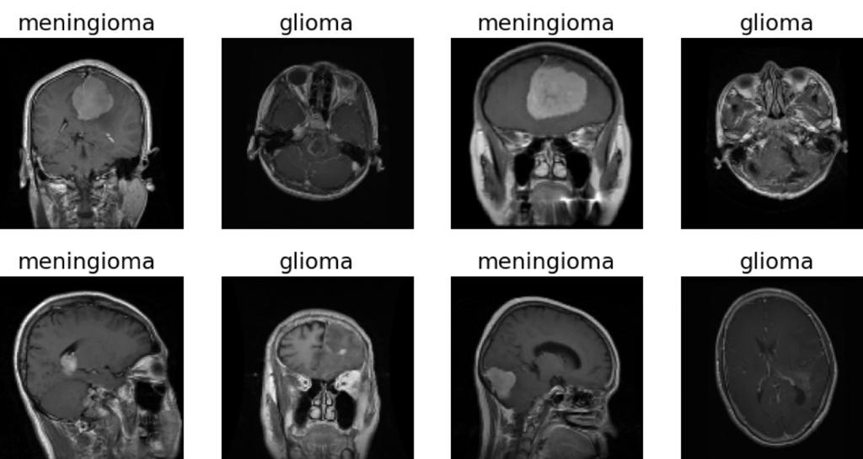
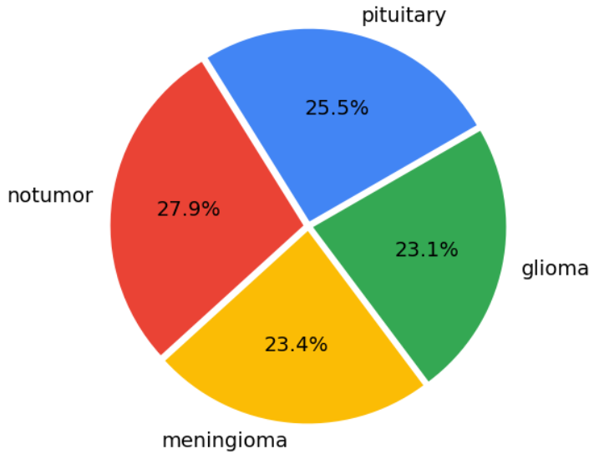
Data Description
There were 4 distinct classes in the dataset — Glioma, Meningioma, Pituitary Tumor, and a baseline case of No Tumor. The dataset consists of 5,712 images in the training set and 1,311 images in the test set.
Sample Images:

Slide 12
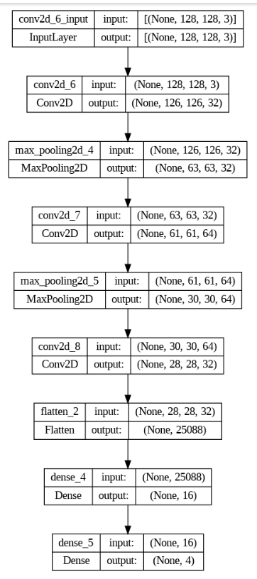
CNN Model
Convolutional Neural Network consists of multiple layers of interconnected neurons.
Each layer of the network contains multiple neurons.The connections between neurons are represented by weights.
The network is trained using the backpropagation algorithm, which adjusts the weights and baises.
CNN Architechture

Slide 13
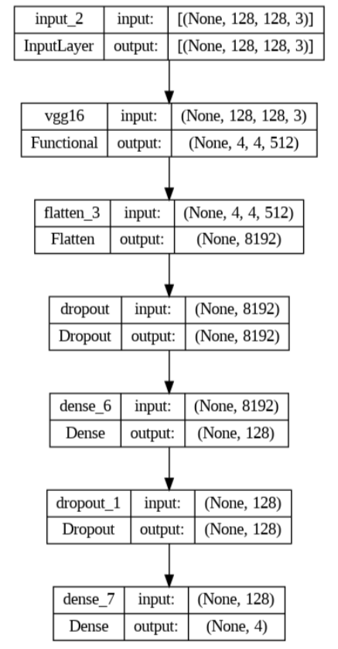
VGG16 Model
VGG16 has 16 layers, including 13 convolution layers and 3 fully connected layers.
The convolution layers in VGG16 have a small receptive field of 3x3 pixels.
VGG16 uses max pooling with 2x2 filters size and a stride of 2 to downsample the features maps and reduce the dimensionally of input.
Input image size is 224x224 in RGB format.
Vgg16 architechture

Slide 14
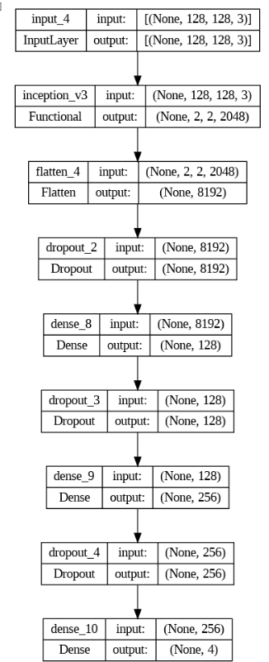
InveptionV3 Model
It has 48 layers.Input images of size 229x229 pixels.
Uses auxiliary classifiers at intermediate layers of the network to encourage to learn more discriminating features.
Batch normalization is used to normalize the inputs to each layer.
InceptionV3 Architechture

Slide 15
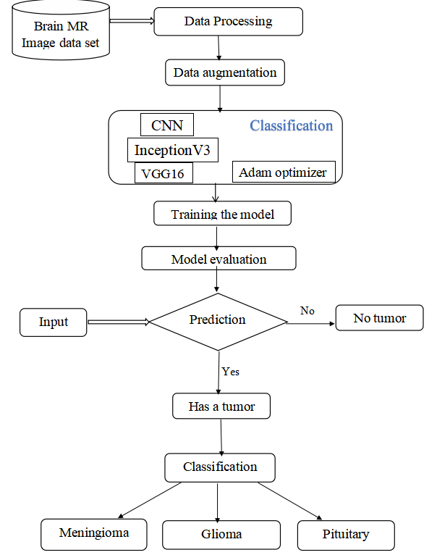
System Workflow

Slide 16
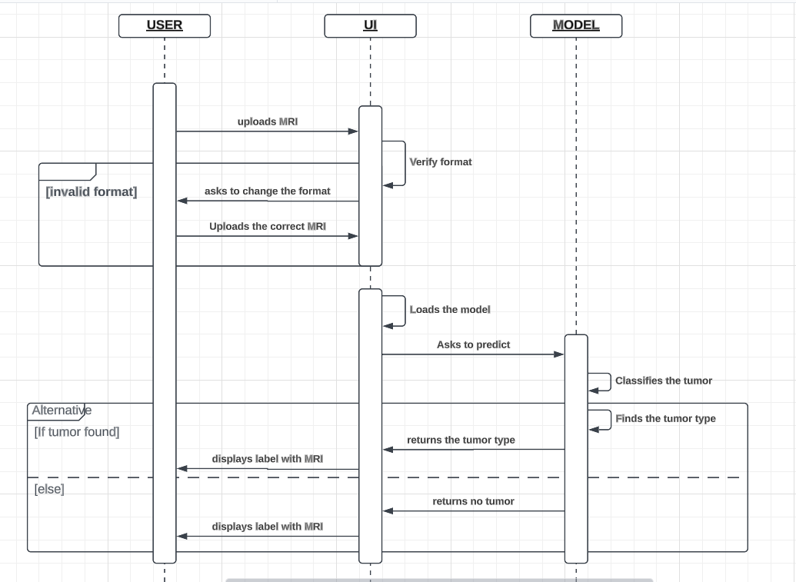
SEQUENCE DIAGRAM

Slide 17
Performance metrics
The metrics we have used for the evaluation of our model are:
Accuracy= (TN+TP)/ (TN+FP+FN+TP) (1)
Precision=TP/ (FP+TP) (2)
Recall=TP/ (TP+FN) (3)
F1 score= TP/ (TP+1/2(FP+FN)) (4)
Where,
TP = True-positive,
TN = True-negative,
FP = False- positive,
FN = False-negative

Slide 18
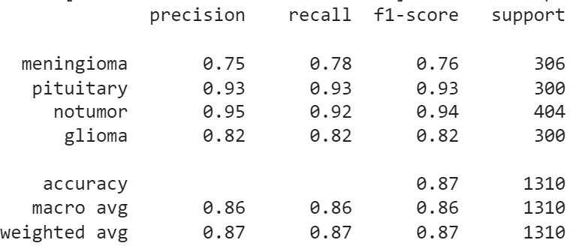
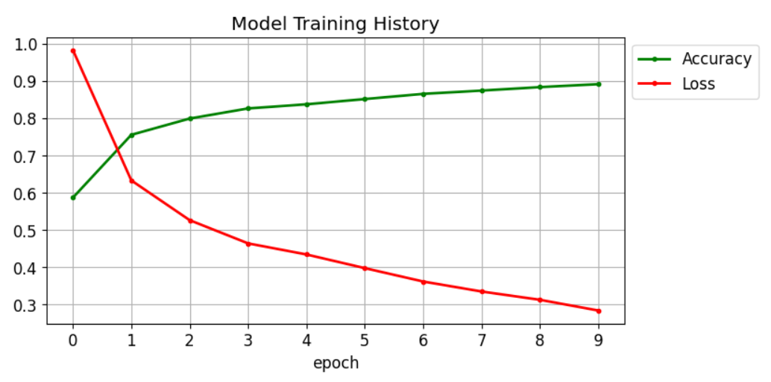
CNN Model Performance
These metrics are calculated during the training and evaluation of the model using the model.compile() and model.fit() functions, and are displayed in the output during the training and evaluation phases.
CNN Model Training History
CNN classification report

Slide 19
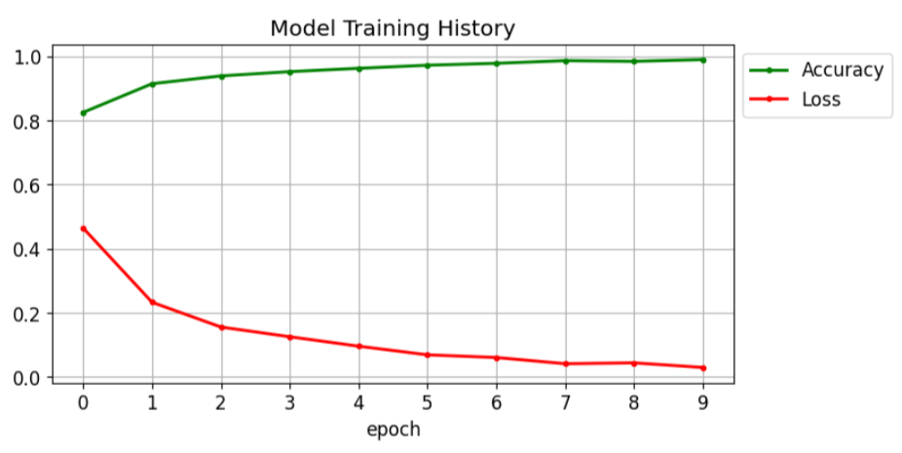
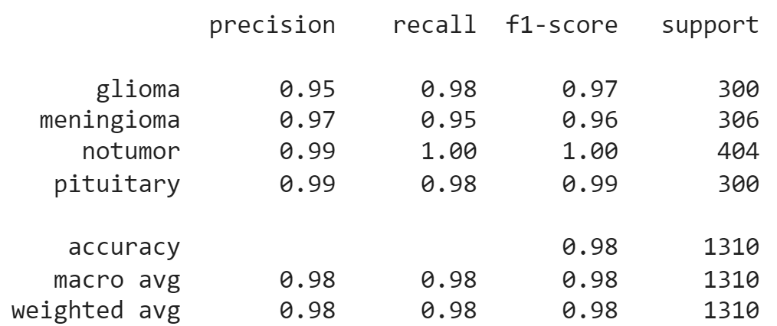
VGG16 Model Performance
VGG16 Training history
VGG16 Classification report

Slide 20
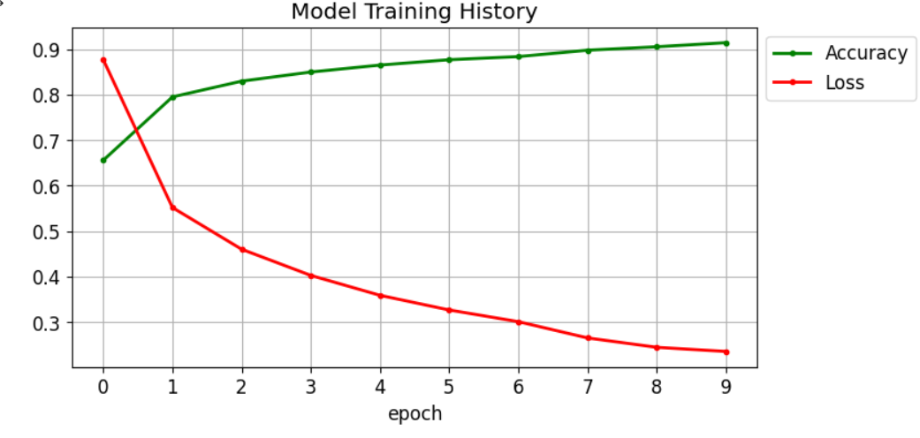
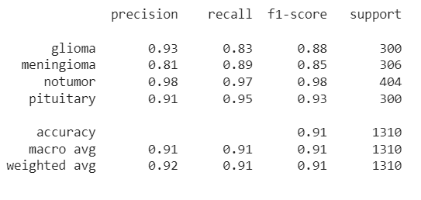
InceptionV3
InceptionV3 Training history
InceptionV3 Classification report

Slide 21
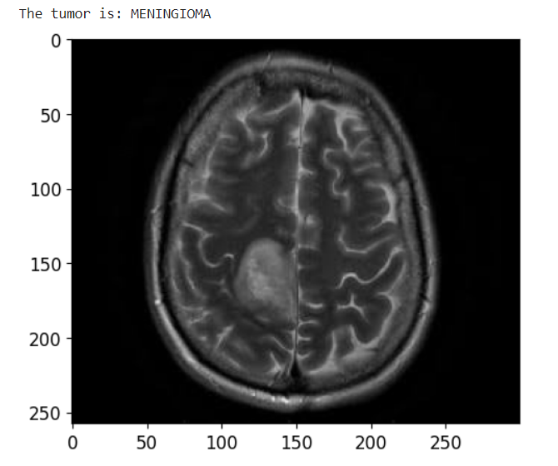
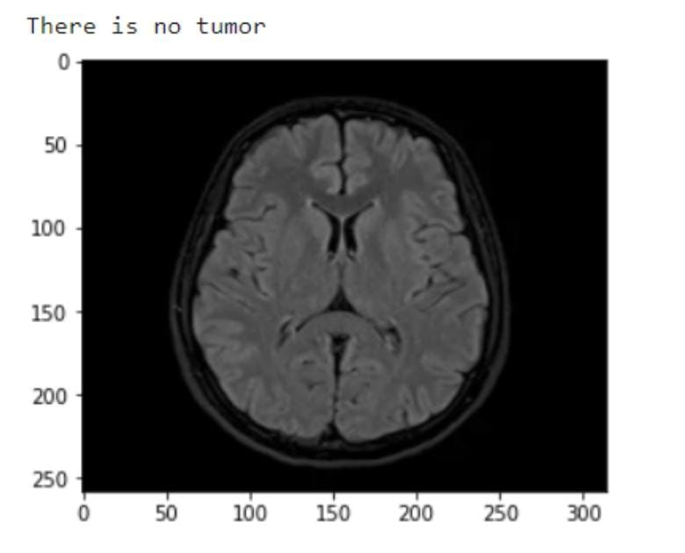
RESULTS
The MR image is predicted correctly as expected. The image is displayed after the prediction with the label on the top of the image as result.

Slide 22
Comparision of Results
Epochs | Three |  | Five |  | Seven |  | Ten
 | Time | Accuracy | Time | Accuracy | Time | Accuracy | Time | Accuracy
CNN | 165 | 75% | 175 | 80% | 179 | 80% | 171 | 86%
VGG-16 | 181 | 90% | 179 | 97% | 181 | 97% | 176 | 98%
InceptionV3 | 184 | 83% | 173 | 87% | 221 | 87% | 183 | 90%

Slide 23
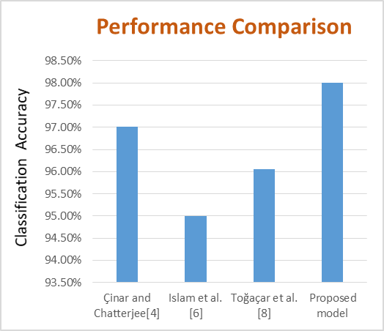

Slide 24
CONCLUSION
Within the proposed work, a model for brain tumor classification is displayed utilizing CNN and transfer learning procedures.
The outcomes proposed that VGG16 model gives way better comes about in comparison to CNN and InceptionV3 with accuracy of 98% on the test dataset.
This show is computationally successful, less time expending and gives strong design for classification of brain tumors.
In future scope, the tumor discovery can be performed utilizing multimodal MRI pictures for moved forward execution.

Slide 25
REFERENCES
[1] A. Çinar and M. Yildirim, ‘‘Detection of tumors on brain MRI images using the hybrid convolutional neural network architecture,’’ Med. Hypotheses, vol. 139, Jun. 2020, Art. no. 109684.
[2] H. M. Rai and K. Chatterjee, ‘‘Detection of brain abnormality by a novel Lu-Net deep neural CNN model from MR images,’’ Mach. Learn. Appl., vol. 2, Dec. 2020, Art. no. 100004.
[3] M. K. Islam, M. S. Ali, M. S. Miah, M. M. Rahman, M. S. Alam, and M. A. Hossain, “Brain tumor detection in MR image using superpixels, principal component analysis and template based K-means clustering algorithm,’’ Mach. Learn. Appl., vol. 5, Sep. 2021, Art. no. 100044
[4] R. Mehrotra, M. A. Ansari, R. Agrawal and R. S.Anand, “A Transfer Learning approach for AIbased classification of brain tumors,” Mach. Learn. Appl. 2020, 2, 10–19.
[5] T. K. Das, P. K. Roy, M. Uddin, K. Srinivasan, C.-Y. Chang, and S. Syed-Abdul, ‘‘Early tumor diagnosis in brain MR images via deep convolutional neural network model,’’ Comput., Mater. Continua, vol. 68, no. 2, pp. 2413–2429, 2021.
[6] M. Toğaçar, B. Ergen, and Z. Cömert, ‘‘BrainMRNet: Brain tumor detection using magnetic resonance images with a novel convolutional neural network model,’’ Med. Hypotheses, vol. 134, Jan. 2020, Art. no. 109531.
[7] Z. Jia and D. Chen, ‘‘Brain tumor identification and classification of MRI images using deep learning techniques,’’ IEEE Access, early access, Aug. 13, 2020, doi: 10.1109/ACCESS.2020.3016319.

Slide 26
REFERENCES
[8]N. Abiwinanda, M. Hanif, S. Hesaputra, A. Handayani, T. R. Mengko, “Brain tumor classification using convolutional neural network, “World Congress on Medical Physics and Biomedical Engineering, Springer, Singapore, 2019.
[9]S. Basheera, M. S. S. Ram, “Classification of brain tumors using deep features extracted using CNN,” J. Phys., 1172 (2019), 012016.
[10] M. Talo, U. B. Baloglu, O. Yldrm, U. R. Acharya, “Application of deep transfer learning for automated brain abnormality classification using MRI images, “Cognitive Systems Research, 54 (2019), 176–188.
[11] A. Rehman, S. Naz, M. I. Razzak, F. Akram, M. Imran, “A Deep Learning-Based Framework for Automatic Brain Tumors Classification Using Transfer Learning,” Circuits Syst. Signal Process., 39 (2020), 757–775.
[12] S. Preethi and P. Aishwarya, “Combining Wavelet Texture Features and Deep Neural Network for Tumor Detection and Segmentation Over MRI,”. J. Intell. Syst. 2019, 28, 571–588.
[13] Taher F, Shoaib MR, Emara HM, Abdelwahab KM, Abd El-Samie FE, Haweel MT,“ Efficient framework for brain tumor detection using different deep learning techniques”, Front Public Health. 2022 Dec 1.

