Slide 1

Behavrix
Human Risk Intelligence Platform
80% of breaches are caused by people, not firewalls. We surface exactly who's at risk.
Satwika Maddukuri
INFO 7375 — Branding with AI • Northeastern University
August 2026
behavrix.framer.app · Behavrix · Streamlit
1 / 14

Slide 2
Behavrix
THE PROBLEM
The $9.5 Trillion Blind Spot.
80%
$9.5T
$25K
6 wks
of breaches caused by human behavior
annual global cybercrime cost
avg. consulting engagement cost
to get one vendor risk assessment
“Six weeks and $25,000 later, you get a report. The human risk stayed invisible the entire time you waited..”
2 / 14

Slide 3

Behavrix
WHO WE SERVE
Two People Who Need an Answer, Not a Compliance Artifact
Priya
Harry
Security Analyst · Primary
CISO · Secondary
Mid-size financial institution, no dedicated research team
Mid-size regulated organization, reports to the board
NEEDS
NEEDS
To include human behavioral risk findings in a vendor report without adding days to her timeline.
To communicate human risk exposure to the board in plain English, without translating it himself.
“I can show this to a CISO and they immediately know where to focus.”
“Transparency around how the score is calculated would significantly improve credibility.”
3 / 14

Slide 4
Behavrix
We Teach AI to Think Like an Attacker.
Select organization type → AI analyzes 270 records → Human Risk Report in 90 seconds
The Clicker
Password Recycler
Shadow IT User
Over-Trusted Insider
Falls for urgency and fear-based phishing
Reuses credentials across systems
Routes around approved tools
Extends trust based on social pressure
MITRE T1566
MITRE T1078
MITRE T1072
MITRE T1134
“Behavrix helps security analysts at regulated organizations identify which human behavior patterns make their teams most vulnerable — so they can run data-backed tabletop exercises and communicate human risk to leadership without waiting weeks or paying thousands for a consultant.”
4 / 14

Slide 5
Behavrix
BRAND STRATEGY
What Behavrix Won't Compromise On.
01
02
03
04
05
Transparency
Accessibility
Honesty
Human-Centered
Evidence-Based
Every score shows its reasoning
Enterprise intelligence, no enterprise contract
Advisory framing, not false confidence
Built around how people behave
Every output traces to real data
Every brand touchpoint — the tool, the site, the article — gets checked against these five before it ships.
5 / 14

Slide 6
Behavrix
COMPETITIVE POSITIONING
Everyone Measures Controls. Nobody Measures Humans.
Behavrix
KnowBe4
Prevalent
Drata/Sprinto
Behavioral archetypes
✔ 4 personas
✖
✖
✖
Data-attributed scoring
✔
✖
✖
✖
Time to first report
90 sec
Weeks
Weeks
Weeks
Cost per report
$0.002
$2.79–3.75/user/mo
Enterprise
Enterprise
Contract required
None
25-seat min
✔
✔
MITRE ATT&CK mapped
✔
✖
✖
✖
6 / 14

Slide 7
Behavrix
COMPETITIVE ADVANTAGE
The Space Nobody Else Occupies.
THE GAP THEY ALL SHARE
OUR UNFAIR ADVANTAGE
✖
KnowBe4 trains on phishing — never generates a vendor risk report
✔
Behavioral archetypes, not compliance checkboxes — 4 personas mapped to MITRE ATT&CK
✖
Prevalent scores questionnaires — a vendor can score 95/100 while employing 500 password recyclers
✔
Data-attributed scoring — shows exactly which pattern drove the risk score
✖
Drata/Sprinto automate compliance evidence — never touch behavioral risk
✔
$0.002 per report, 90 seconds, zero contract — structurally impossible for enterprise GRC pricing to match
“Behavrix is the only security intelligence tool that models human vulnerability as behavioral archetypes — using data-attributed scoring that shows analysts exactly what pattern drove the risk score, without a per-seat subscription, enterprise contract, or implementation timeline.”
7 / 14

Slide 8


Behavrix
VISUAL IDENTITY
Visual Identity System
Deep Navy
Teal
Blue
#0D1F35
#1D9E75
#378ADD
Frost
Soft Teal
Amber
#EAF4FB
#E1F5EE
#FAEEDA
Primary Mark · Reversed Variation
IBM Plex Sans headings, risk scores Roboto body text, labels IBM Plex Mono MITRE codes, data values
No shields or padlocks. Amber reserved for medium risk only. Always specific numbers, never vague claims.
8 / 14

Slide 9
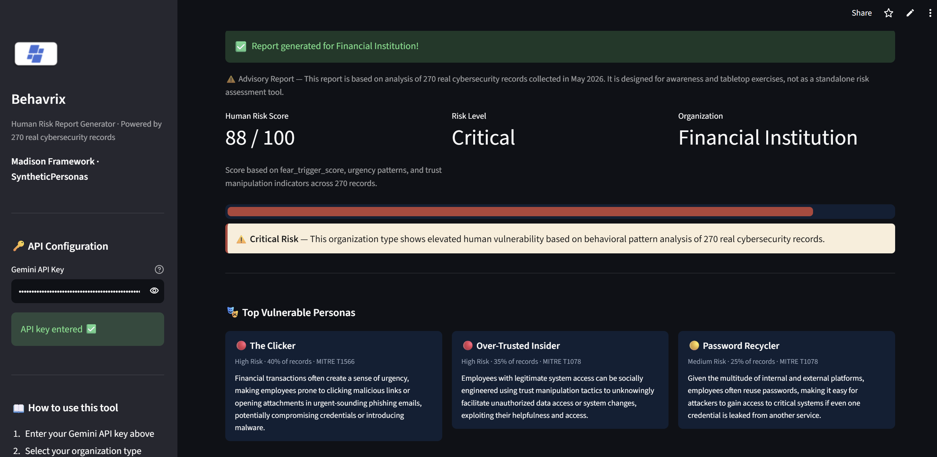
Behavrix
VISUAL IDENTITY
One Palette. Every Surface.
TYPOGRAPHY
IBM Plex Sans
PRIMARY — Headings & Interface
Aa Bb Cc 0123456789
IBM Plex Mono
SECONDARY — Data, Codes & Scores
T1566 90 sec $0.002 82/100
H1 32pt Bold • H2 20pt • Body 13pt • Data 12pt Mono
Live report — Financial Institution, 88/100 Critical Risk
9 / 14

Slide 10

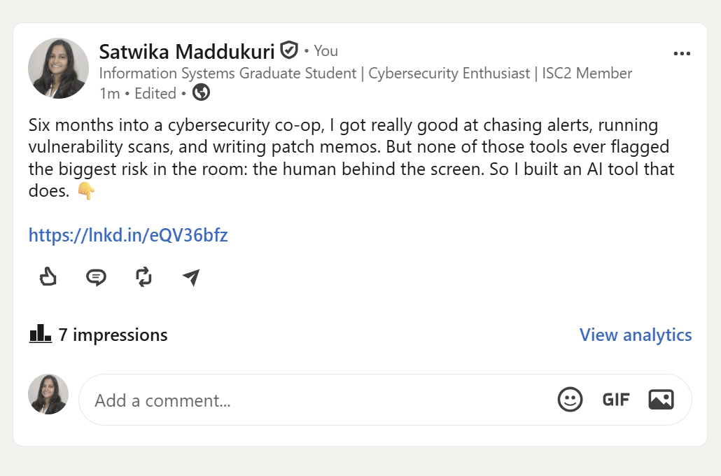
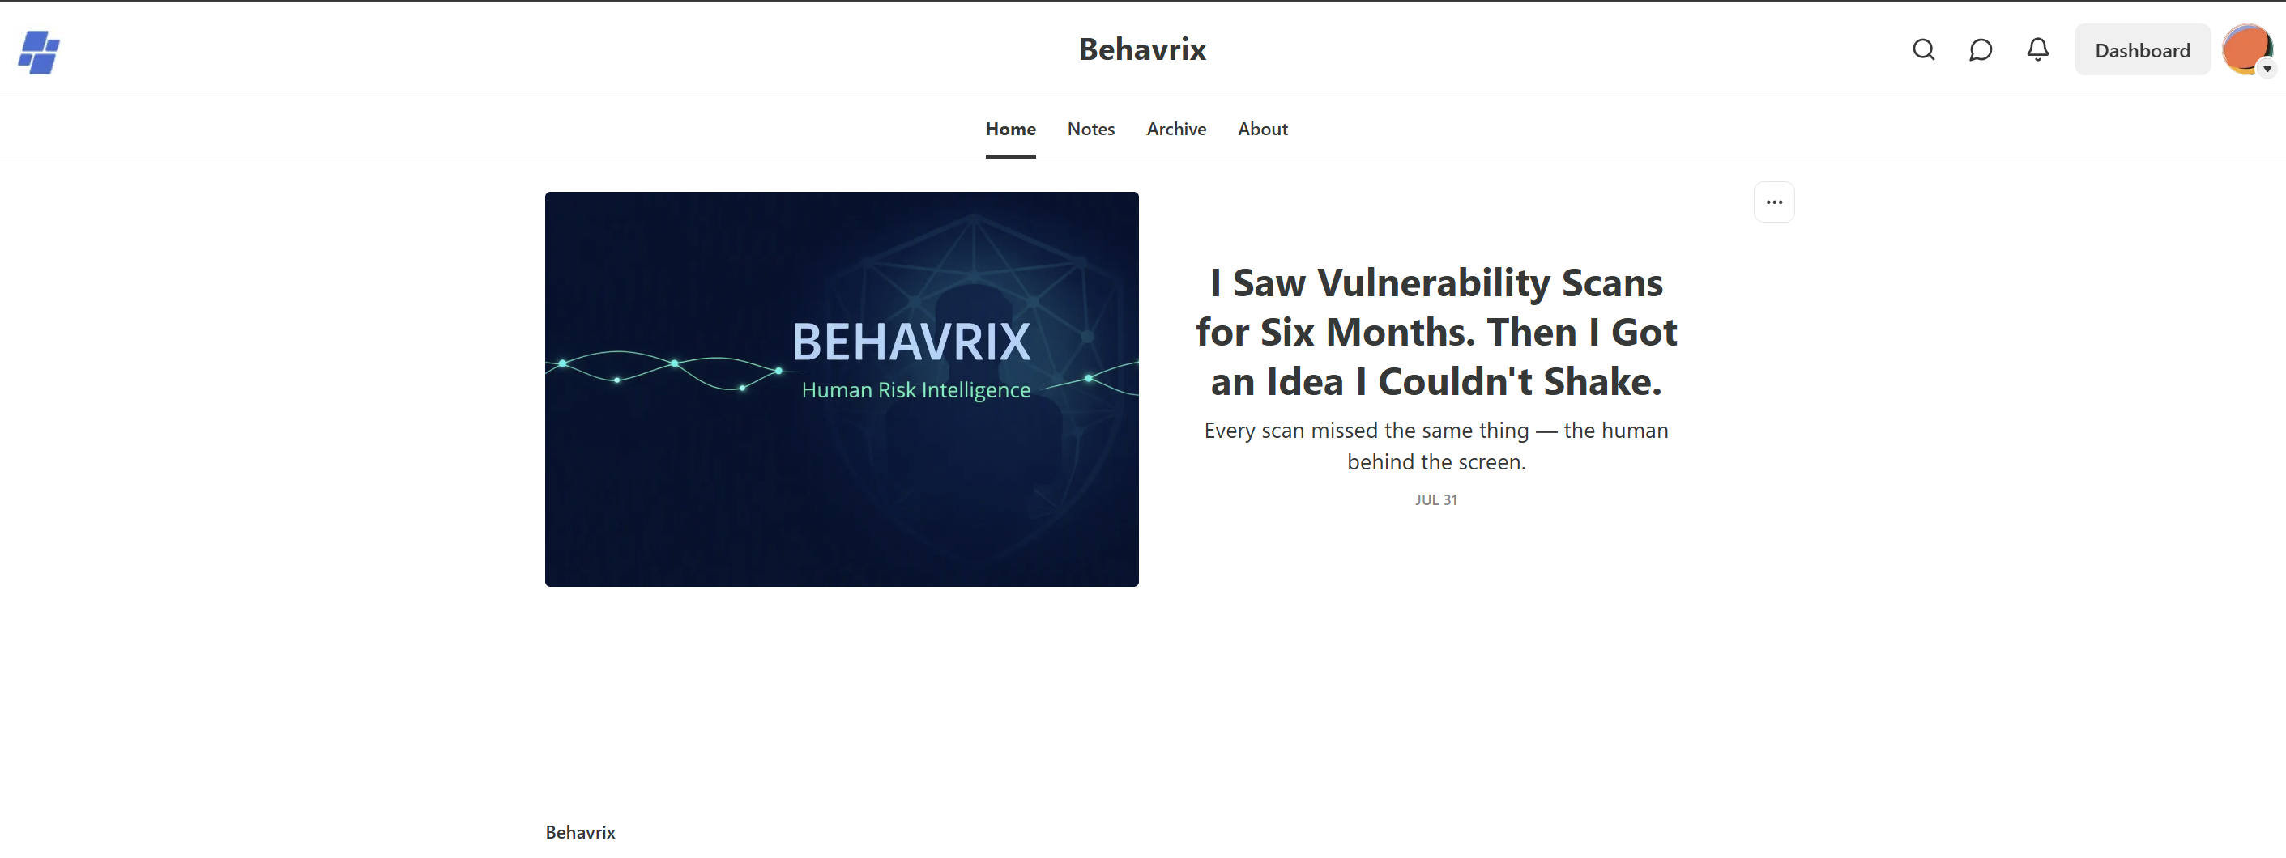
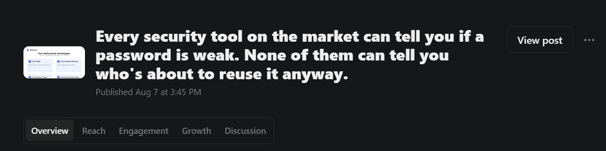
Behavrix
VISUAL IDENTITY
Already Live. Already Public.
LINKEDIN
SUBSTACK
SUBSTACK POST
Short, immediate, stat-first — built for a scroll, not a read.
Long-form credibility — the origin story and the framework, owned not borrowed.
Published Aug 7 — the framework article, live and public.
10 / 14

Slide 11

Behavrix
Origin Story — Voyage and Return
01
02
03
04
The Setup
A year and a half into my MS in Information Systems, I took a cybersecurity co-op in Braintree.
The Pattern
Six months in Tenable, Splunk, Defender — taught me security is really about people: who ignores a ticket, who reuses a password.
The Question
AI was the one thing everyone was talking about. Could it measure the human risk every other tool skipped?
The Build
That question became Behavrix — 270 real records, a Human Risk Score, in 90 seconds.
Framework: Voyage and Return — departure into the unfamiliar, trials faced, return transformed.
11 / 14

Slide 12
Behavrix
BRAND STORYTELLING
What Changes When the Pattern Is Visible
BEFORE BEHAVRIX
AFTER BEHAVRIX
A vendor questionnaire scores 95/100 while employing 500 password recyclers
A Human Risk Score shows exactly which behavioral pattern drove it — defensible, not just a number
A security analyst's only options: $25,000 and six weeks, or a checklist that says nothing useful
A complete report in 90 seconds for $0.002 — no contract, no consultant
A CISO gets a risk score with no explanation — nothing to defend to the board
A CISO walks into the board meeting with personas, MITRE mapping, and a number they can explain
12 / 14

Slide 13
Behavrix
MADISON AI TOOL — LIVE DEMO
See What $25,000 and Six Weeks Get Replaced By
● LIVE DEMO
Streamlit
01
02
03
SELECT
GENERATE
ACT
Choose an organization type from 10 options
AI analyzes 270 real records in ~90 seconds
Risk score, personas, MITRE mapping, ready to present
270
90 sec
$0.002
3
records analyzed
avg report time
cost per run
real user test sessions
13 / 14

Slide 14
The Human Risk Gap Is Real.
The human risk gap is real. The product is live.
$150,000 seed · 15% equity · Advisory board seat
90 days: 10 paying customers · 12 months: $25K MRR · 18 months: Enterprise API
PRODUCT
LIVE TOOL
SUBSTACK
behavrix.framer.app
...streamlit.app
behavrix.substack.com
Are you in?
14 / 14

