Slide 1
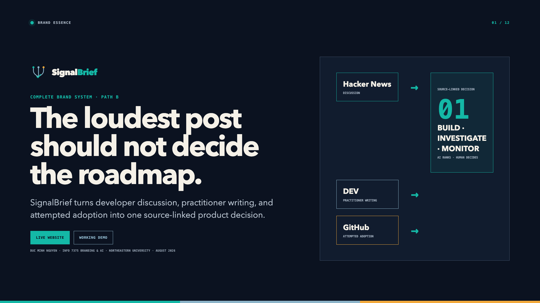
Notes:
“The loudest post should not decide the roadmap.
I’m Duc Minh Nguyen, and I chose Path B: SignalBrief as a startup brand.
SignalBrief is a decision-support system for founding engineers. It cross-checks three different developer behaviors: what people discuss on Hacker News, what practitioners explain on DEV, and what teams attempt to adopt on GitHub. It then turns that agreement into one source-linked next action.
Today I will show the strategy, the complete identity system, two brand stories, and the working product. The website is live, and the working demo is ready for today.”
Transition: “The brand began with a specific decision tax.”

Slide 2
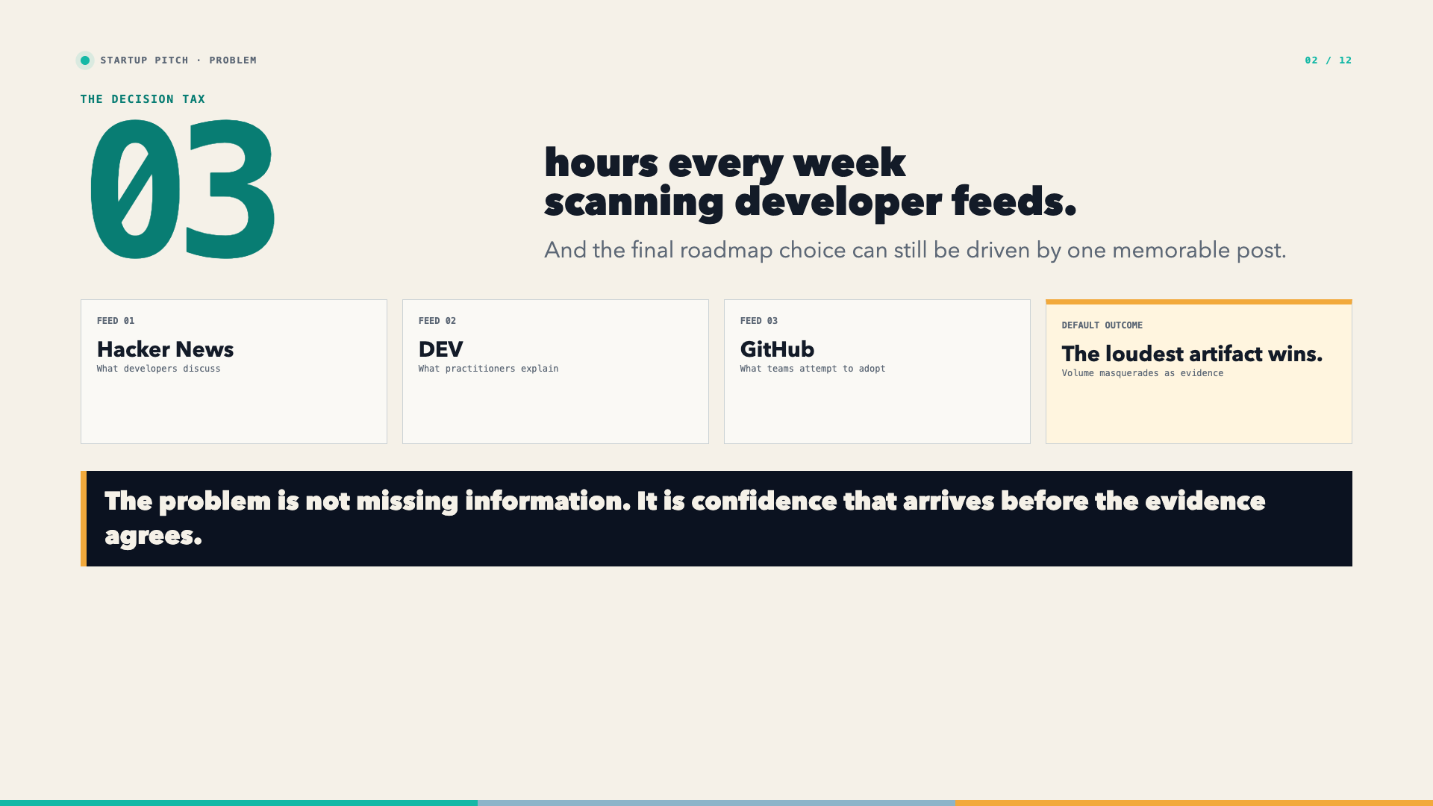
Notes:
“My starting pain point was concrete: about three hours every week scanning developer feeds.
Hacker News showed what people were discussing. DEV showed what practitioners were taking time to explain. GitHub showed what builders were attempting to adopt. But organizing those feeds did not remove the real risk. One memorable artifact could still win the roadmap.
That changed the problem definition. SignalBrief is not mainly fighting missing information. It is fighting confidence that arrives before independent evidence agrees. Saving time matters, but making the decision safer matters more.”
Transition: “That problem is most painful for teams too small to have a dedicated research function.”

Slide 3
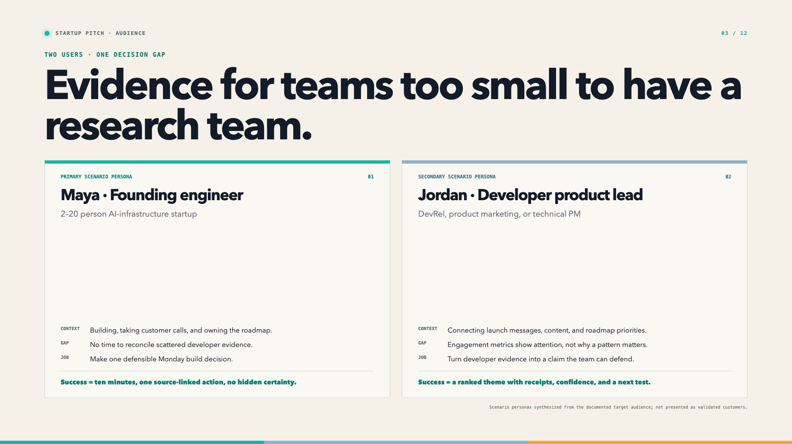
Notes:
“The primary scenario persona is Maya, a founding engineer at a two-to-twenty-person AI-infrastructure startup. She builds, takes customer calls, and owns the roadmap. Her job is to make one defensible Monday build decision without spending half a day reconciling feeds.
The secondary persona is Jordan, a developer product or marketing lead. Jordan needs to connect content, positioning, and launch priorities to actual technical behavior—not just engagement counts.
Both need a ranked theme with receipts, confidence, and a next test. These are scenario personas derived from the documented target audience; I am not presenting them as validated customers.”
Transition: “For those users, the competitive distinction is a job—not a longer feature list.”

Slide 4
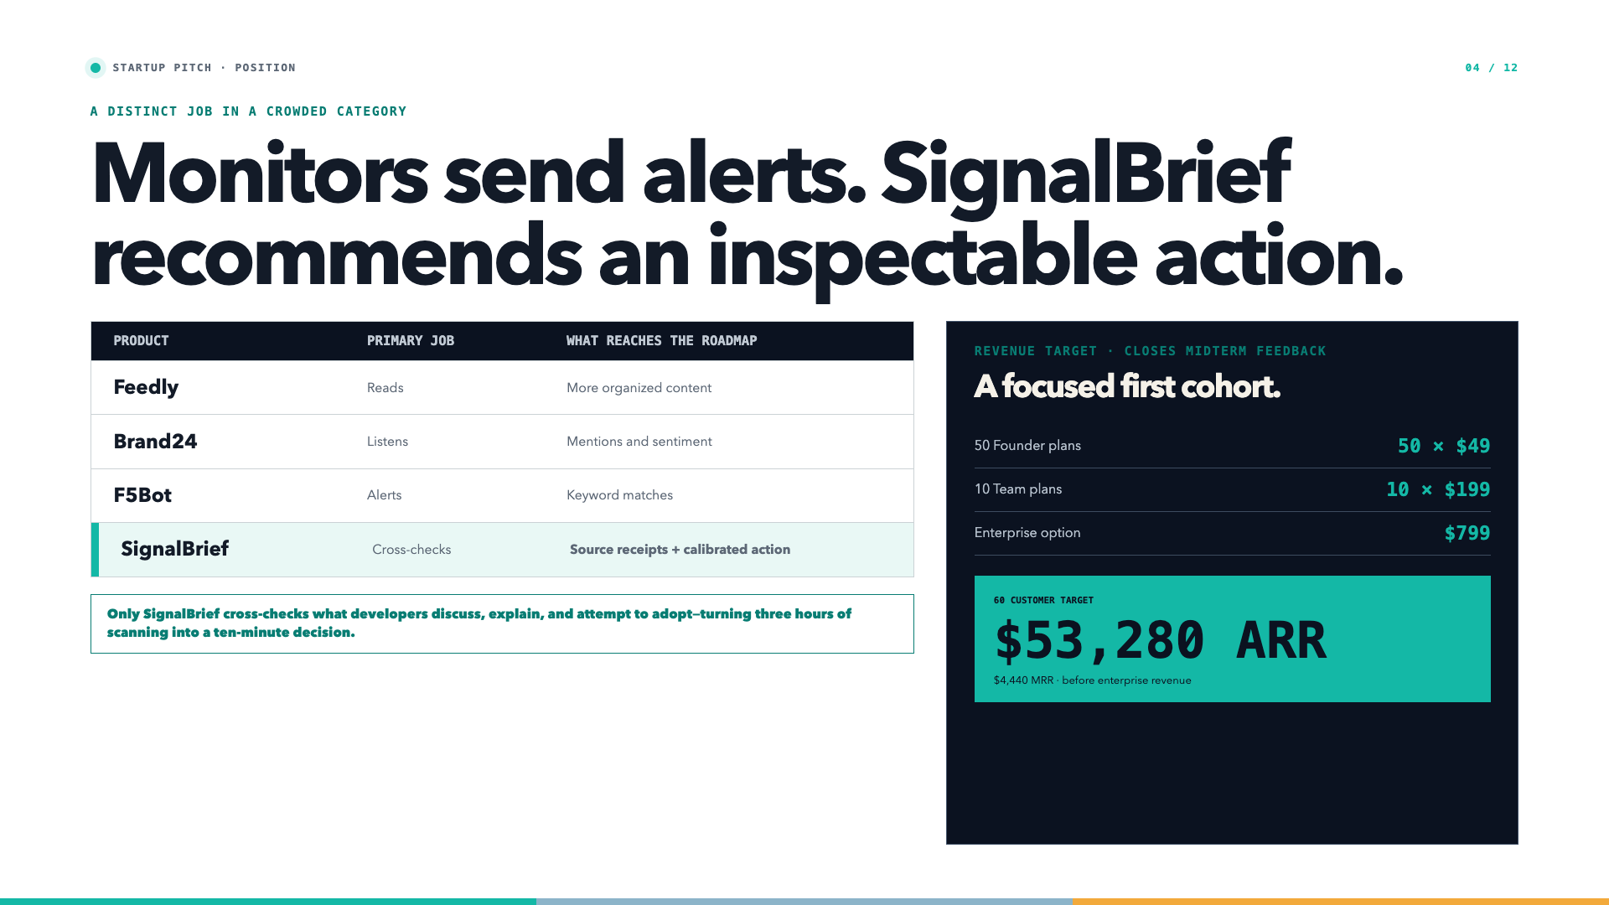
Notes:
“Feedly reads and organizes content. Brand24 listens for mentions and sentiment. F5Bot alerts on keywords. Those products are useful, but they stop before the decision.
SignalBrief owns a narrower job: cross-check independent developer behaviors, preserve the receipts, and recommend an inspectable action. The UVP is simple: it is the only weekly brief that turns three hours of scanning into a ten-minute, source-linked decision for a founding engineer.
I also closed the business-viability gap from my midterm feedback. The three tiers remain forty-nine dollars for Founder, one-ninety-nine for Team, and seven-ninety-nine for Enterprise. A focused first target of fifty Founder plans and ten Team plans produces four-thousand four-hundred forty dollars in monthly recurring revenue, or fifty-three-thousand two-hundred eighty dollars in ARR, before any Enterprise revenue.
That is a customer-count target and explicit revenue math—not a market-size fantasy.”
Clock check: 3:30.
Transition: “The identity system was designed to make that positioning visible.”

Slide 5
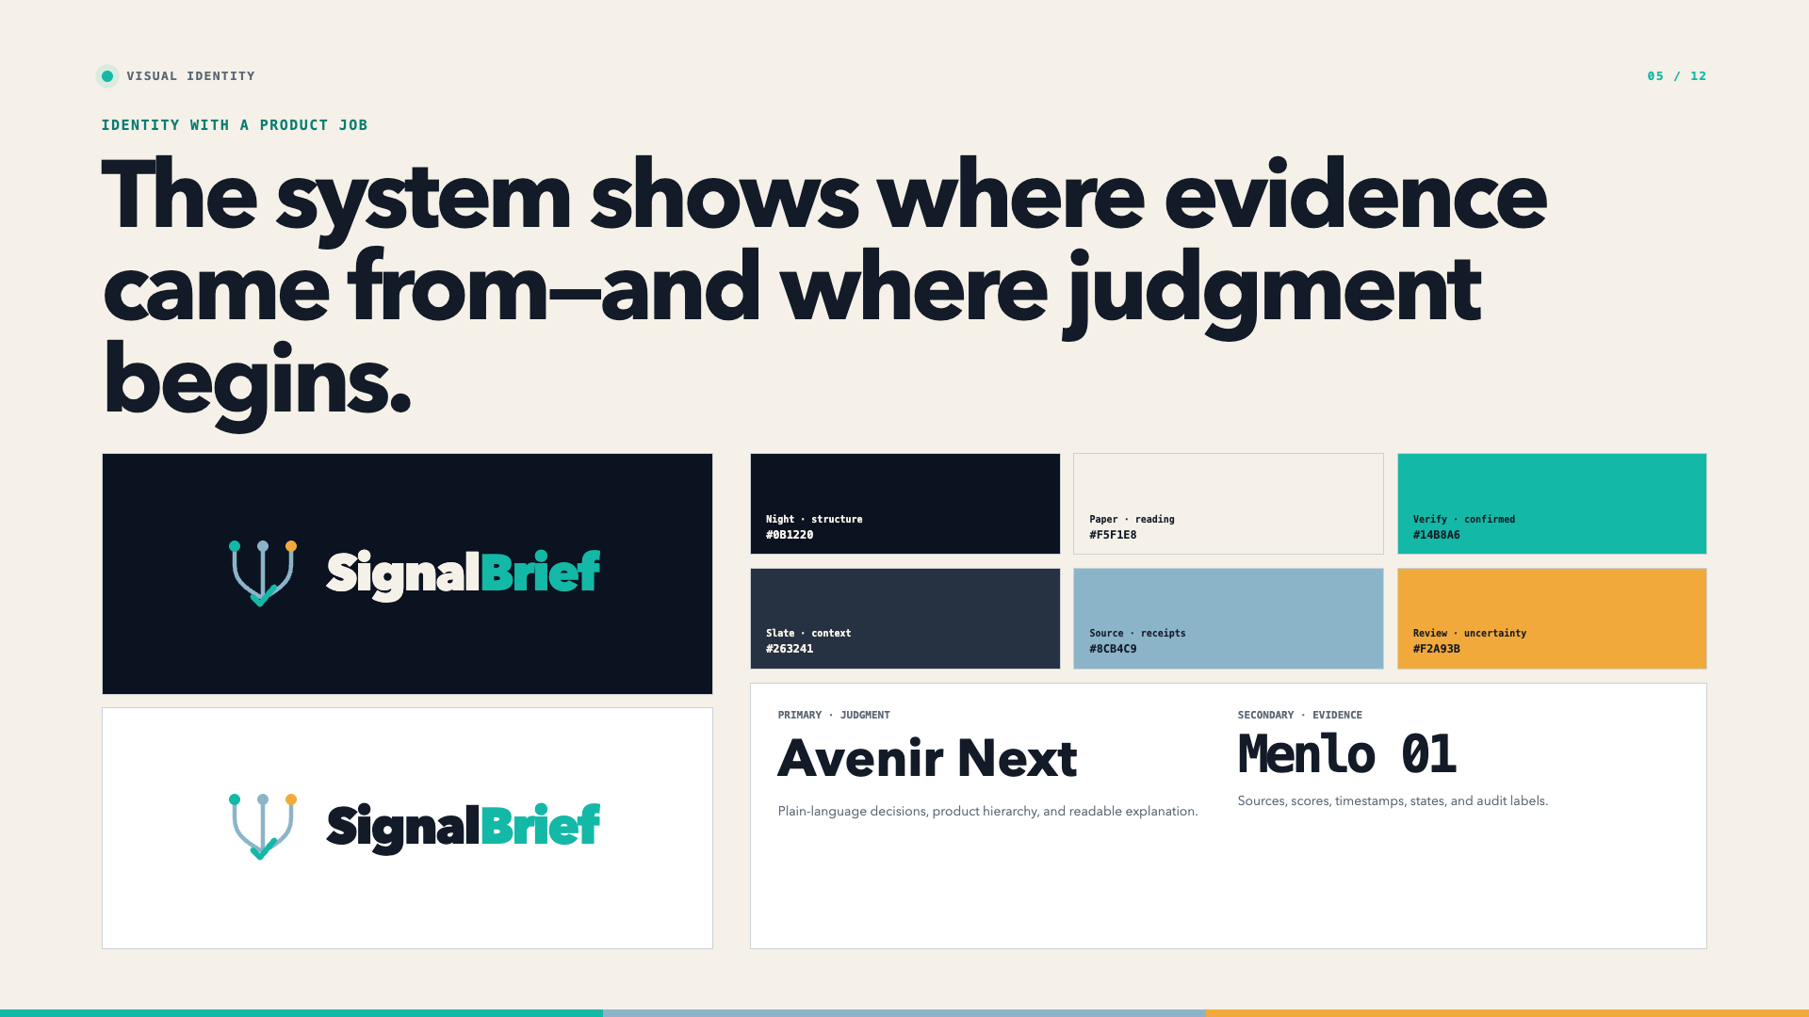
Notes:
“The Triple Trace mark is the product strategy in one symbol. Three colored paths represent discussion, practitioner writing, and attempted adoption. They converge, but the verification check remains separate because agreement still requires judgment.
The palette is semantic. Night is the evidence field. Paper supports reading and explanation. Verify teal marks confirmed evidence and primary action. Source Sky marks context and receipts. Review amber is reserved for uncertainty and human intervention. Slate structures secondary information.
Avenir Next carries plain-language judgment. Menlo is reserved for sources, scores, timestamps, and system state. That rule keeps the brand technical without turning every sentence into code.”
Transition: “The same point of view changes shape across channels without changing meaning.”

Slide 6
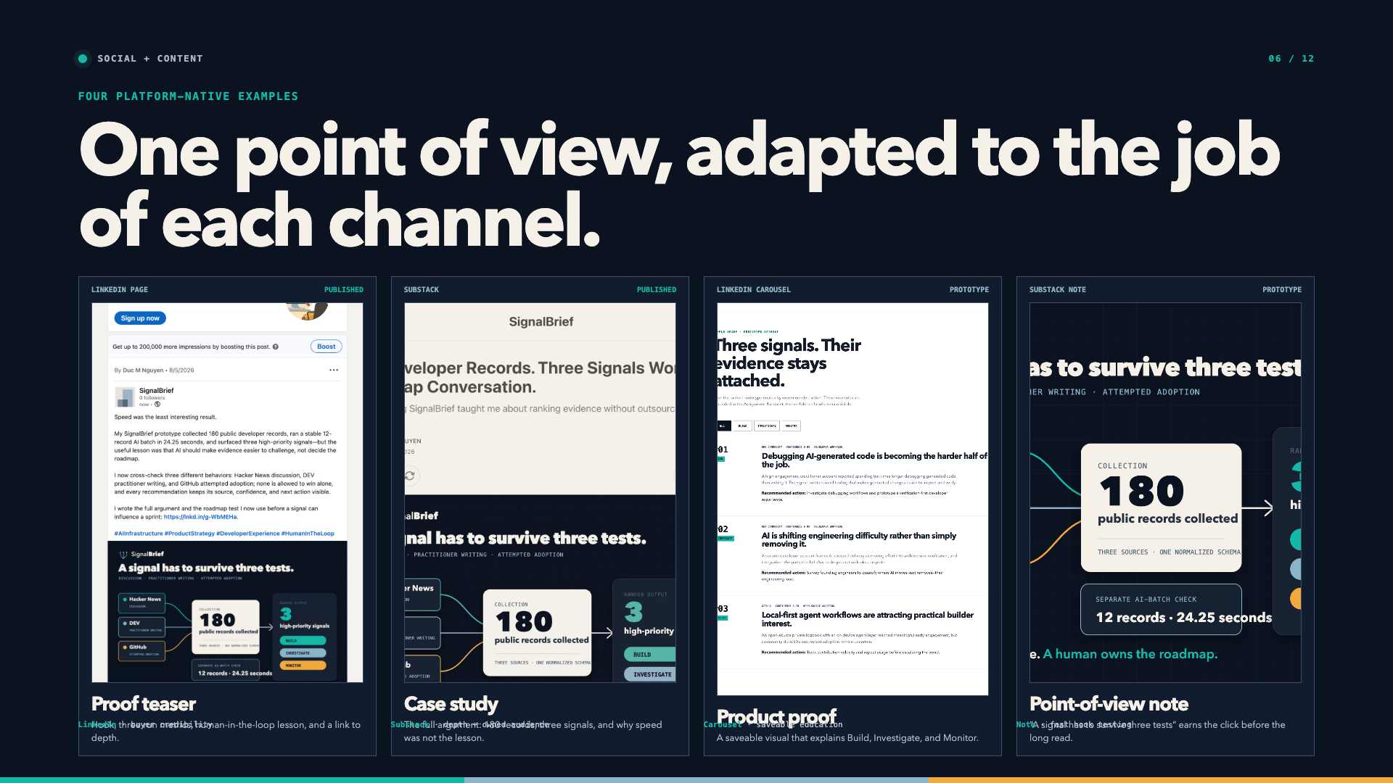
Notes:
“Here are four platform-native examples, with published and prototype status labeled clearly.
The published LinkedIn Page post leads with proof: one hundred eighty collected records, a separate twelve-record AI batch, and the human-in-the-loop lesson. LinkedIn’s job is buyer and partner credibility.
The published Substack article earns depth. It explains why speed was the least interesting result and gives the full method behind the ranking.
The prototype carousel makes Build, Investigate, and Monitor saveable and teachable. The prototype Substack Note pressure-tests the hook: ‘A signal has to survive three tests.’
The visual system stays consistent—Night, the three source colors, Menlo receipts, and Verify actions—but the content respects what each channel is for. LinkedIn earns attention and credibility. Substack earns trust through depth. The carousel teaches. The Note tests the hook quickly.”
Transition: “Those brand principles also became working interface behavior.”

Slide 7
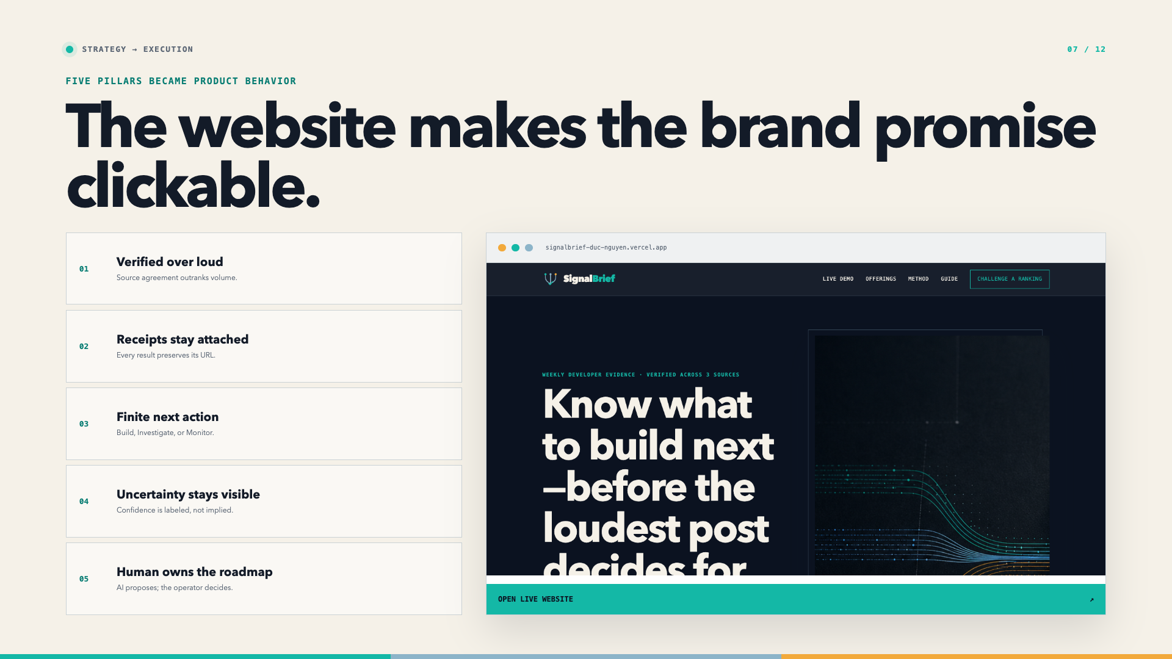
Notes:
“Five brand pillars are implemented in the live website.
Verified over loud becomes source agreement. Receipts stay attached becomes inspectable URLs. Finite next action becomes Build, Investigate, or Monitor. Uncertainty stays visible becomes confidence labels. Human owns the roadmap becomes the review gate.
This matters because the site does not merely describe a trustworthy product. Its navigation moves directly from the value proposition to the working demo and two-page guide. The brand promise is clickable.”
Clock check: 6:30.
Transition: “The reason I insisted on inspectability came from the first version of the product.”

Slide 8
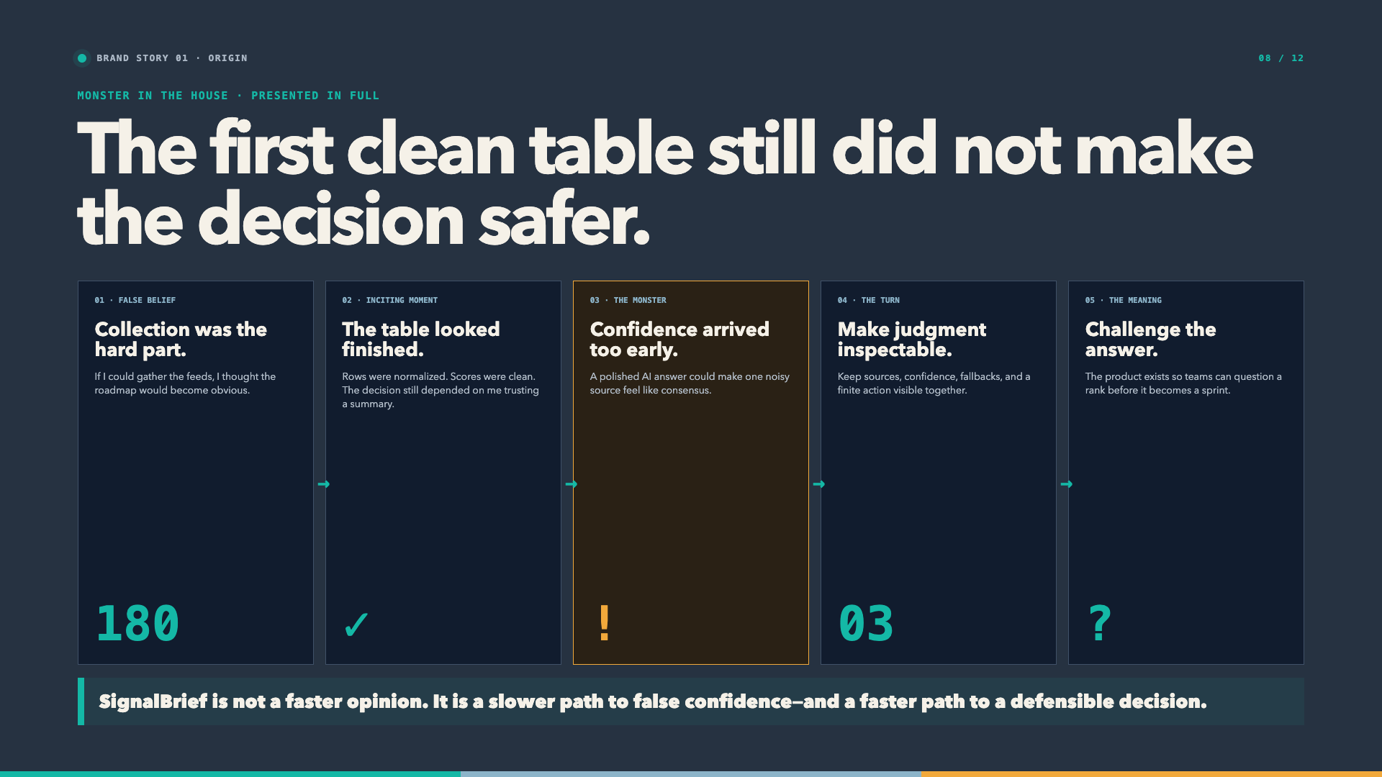
Notes:
“The origin story begins with a false belief: I thought collection was the hard part.
I was spending three hours across feeds, so I built the pipeline. It normalized public records into one clean schema. The first successful run gave me a table that looked finished. That should have felt like the solution.
Instead, it became the inciting moment. The table was clean, but the decision was not safer. I still had to trust that a score or an AI summary understood what mattered. A polished answer could make one noisy source feel like consensus.
That was the monster in the house: confidence arriving too early. It was not a dramatic hallucination. It was more dangerous because it looked reasonable.
The turn was to change the product from a summary machine into an inspectable decision system. Every recommendation had to keep its source, confidence, model state, and finite next action visible. The workflow needed a parser gate, a labeled deterministic fallback, and a human review step.
That technical decision became the brand meaning. SignalBrief is not a faster opinion. It is a slower path to false confidence and a faster path to a defensible decision.
The story resolves with a different promise: do not ask users to trust the ranking. Give them a way to challenge it before it becomes a sprint.”
Transition: “The second story shows what that looks like on a Monday morning.”

Slide 9
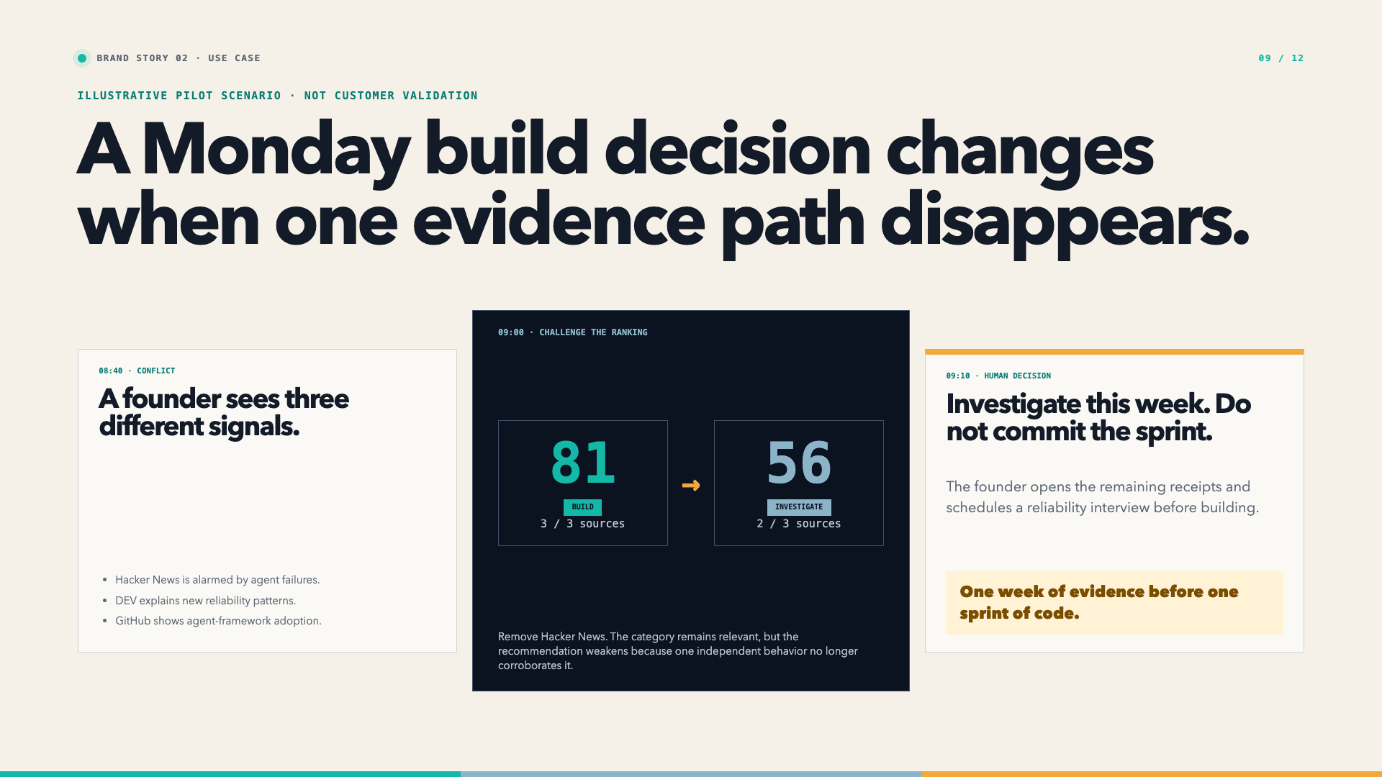
Notes:
“This is an illustrative pilot scenario, not a fabricated customer result.
A founder sees agent failures discussed on Hacker News, reliability patterns explained on DEV, and adoption on GitHub. With all three behaviors present, the evidence scores eighty-one and suggests Build.
She removes Hacker News and reruns the analysis. The score falls to fifty-six and the action changes to Investigate because one independent behavior no longer corroborates the claim.
The human decision changes: schedule a reliability interview this week instead of committing a sprint. One week of evidence protects one sprint of code.”
Clock check: 9:30.
Transition: “That outcome depends on a workflow where failure states remain visible.”

Slide 10
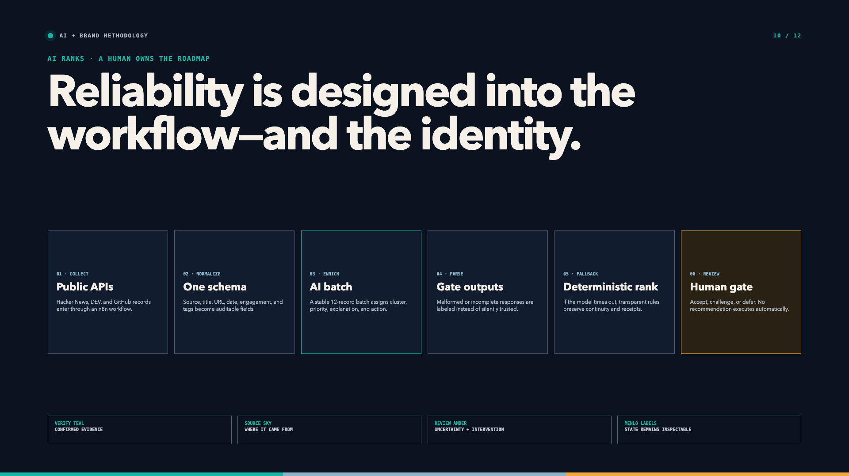
Notes:
“n8n collects three public sources and normalizes them into one schema. A stable twelve-record AI batch assigns cluster, priority, explanation, and recommended action. A parser rejects malformed or incomplete output instead of silently trusting it. If the model is unavailable, a deterministic fallback preserves continuity and receipts. Finally, a human accepts, challenges, or defers the rank. Nothing executes automatically.
The identity reinforces the same boundary: teal marks verified evidence, sky marks its source, amber marks uncertainty and intervention, and Menlo keeps system state inspectable.”
Transition: “Now I will challenge the ranking live.”

Slide 11
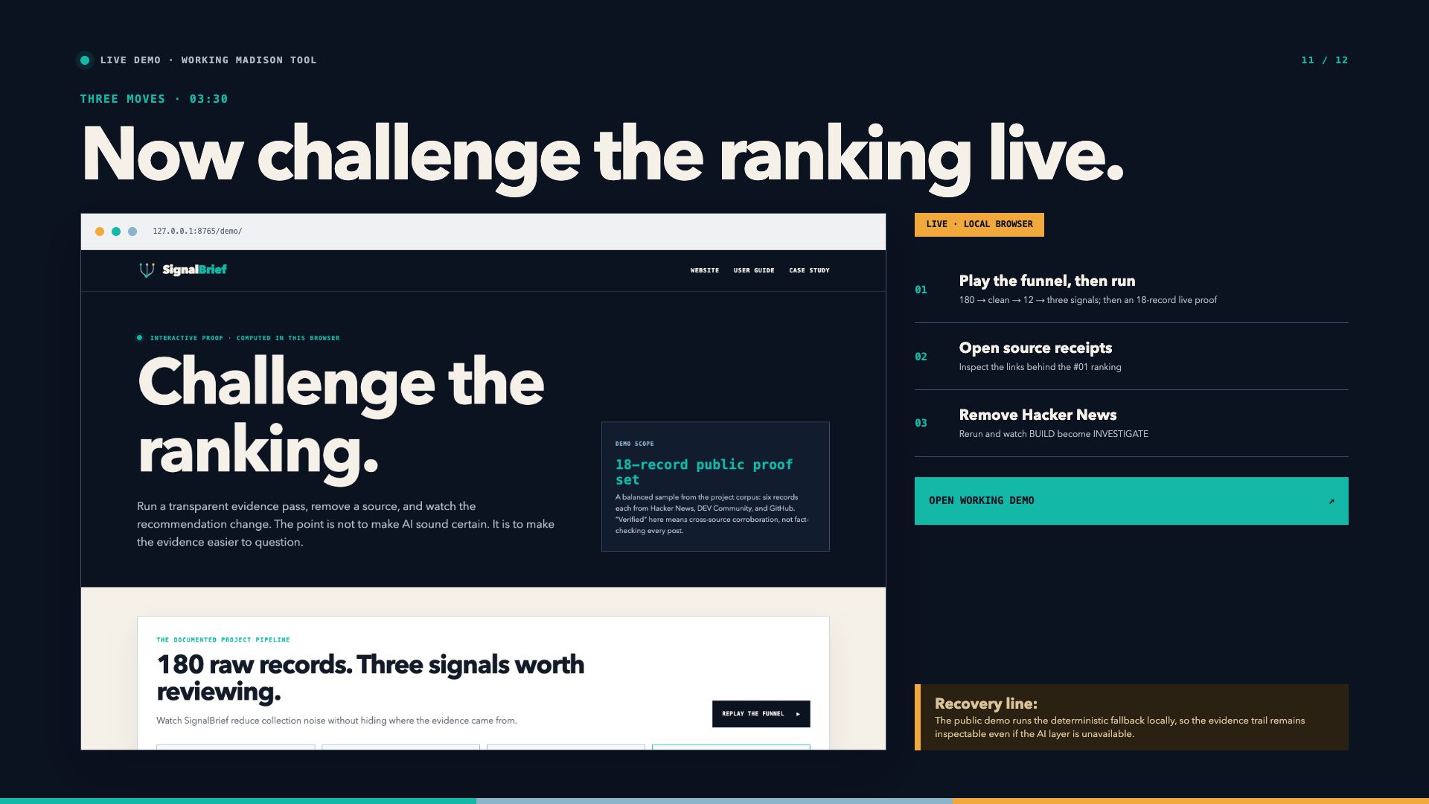
Notes:
Open the prepared local demo tab: 127.0.0.1:8765/demo — http://127.0.0.1:8765/demo/. Use the public URL instead only after /demo/ is deployed successfully.
Move 1 — Show the funnel, then run | about 65 seconds
At the top of the demo, click Play the funnel if it has not already played.
“The full project began with one hundred eighty public records: sixty each from Hacker News, DEV, and GitHub. They were normalized, deduplicated, and validated. A stable twelve-record batch was AI-enriched, producing three high-priority signals for human review. I keep those scopes visible because filtering and AI analysis are different steps.”
Scroll to the interactive proof.
“This separate working proof uses eighteen balanced records: six Hacker News records, six DEV records, and six GitHub records. It is smaller so the source-removal test is fast and repeatable. It runs locally in the browser, so no API key or personal data is exposed.
I will keep the Roadmap priority lens and all three sources selected, then run the evidence pass.”
Click Run evidence pass.
“The interface visibly moves through Collect, Cross-check, Rank, and Review. It detects five patterns. Agent systems ranks first with three-of-three source agreement and a Build recommendation.”
Move 2 — Inspect | about 55 seconds
Open Inspect source receipts on the first card.
“The rank is not the evidence. These are the evidence receipts. Each row preserves the source behavior, title, engagement within that source, and public URL. Engagement is normalized inside each platform, so GitHub stars do not automatically overpower DEV reactions.
The score is forty-two percent source agreement, twenty-two percent within-source strength, and thirty-six percent volume, recency, and fit for this decision lens.”
Click Needs evidence.
“The human gate records a challenge. It does not execute the recommendation.”
Move 3 — Remove a source | about 65 seconds
Uncheck Hacker News, then click Run evidence pass.
“Now the same proof set has twelve records and only two of three independent behaviors. Agent systems still ranks first, but the score falls from eighty-one to fifty-six and the action weakens from Build to Investigate.
That change is the product and the brand promise in one interaction. Hacker News can influence the result, but it cannot own it.”
Return to deck | about 25 seconds
“The AI-enriched production path and this public deterministic path are deliberately labeled separately. The public path is also the recovery mode: even if the model layer times out, the evidence trail remains inspectable.”
Return to slide 12.
Clock check: 13:45.

Slide 12
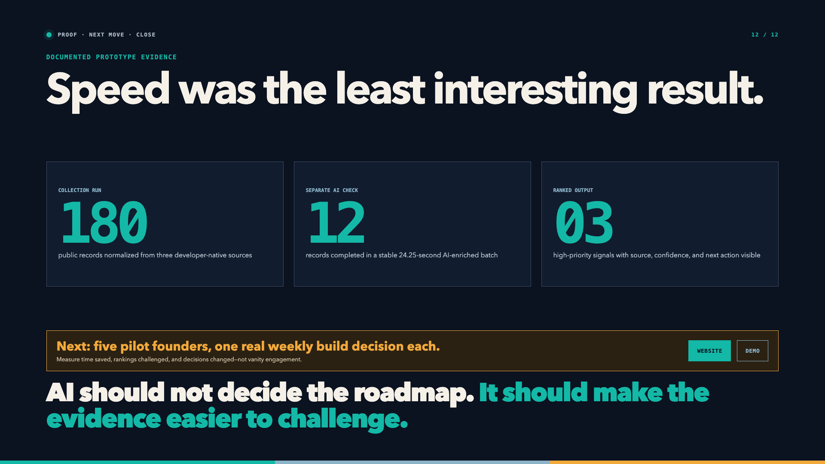
Notes:
“The documented prototype collected one hundred eighty public records. Separately, a stable twelve-record AI-enriched batch completed in twenty-four point two-five seconds. That batch surfaced three high-priority signals with source, confidence, and next action visible. I keep those scopes separate because trust starts with accurate proof.
The next move is five pilot founders bringing one real weekly build decision each. I will measure time saved, rankings challenged, and decisions changed—not vanity engagement.
AI should not decide the roadmap. It should make the evidence easier to challenge.”
Stop. Do not add an improvised second ending.

