Slide 1
F
FINAL EXAM. PATH A
vaibhav.
I ship developer tools engineers actually adopt.
PATH A
COURSE
Personal Brand
INFO 7375
VAIBHAV SINGH · FINAL EXAM · DEC 2026
1 / 15
Notes:
OPEN (0:00 - 0:45). 45 seconds only.
Say: 'Good morning. I'm Vaibhav Singh. I ship developer tools engineers actually adopt.'
PAUSE 1 beat.
'That's the positioning I've been building all semester. Today I'll walk you through the strategy, the visual system, the story that started it, and the tool I'm building to prove it.'
'This is Path A. Personal brand. Fifteen minutes.'
ADVANCE. Do not linger.

Slide 2
02
THE PROBLEM
Maintainers are drowning in mentions.
But starving for signal.
3.9M+
63k+
300+
downloads on Random Word (a weekend project I forgot about)
weekly downloads on Nightwatch (BrowserStack, in production)
mentions per week Random Word gets in the wild today
0
3+ hrs
1
dashboards that tell me which 5 to act on this week
per week lost to triage that never actually gets done
person doing the triage (me), on my weekends
"Maintainers can SEE their mentions. But they can’t tell what to DO with them."
VAIBHAV SINGH · FINAL EXAM · DEC 2026
2 / 15
Notes:
PROBLEM (0:45 - 1:45). 60 seconds.
SAY: 'Let me tell you about a problem I have myself.'
Walk through the stats quickly. Don't read every one. Group them:
'I shipped Random Word to learn Python packaging. 3.9 million downloads. I ship the Nightwatch reporter at BrowserStack. 63k weekly. These packages get 300+ mentions per week across GitHub, Reddit, HN, and Stack Overflow.'
Then land the dark card: 'And zero dashboards tell me which 5 to act on.'
END with the pull-quote: 'Maintainers can SEE their mentions. But they can't tell what to DO with them.'
ADVANCE.

Slide 3
03
AUDIENCE
The audience is three concentric rings.
All three ask the same question when they read this deck.
01
02
03
HIRING MANAGERS
RECRUITERS
STARTUP CTOs
Senior engineering leaders at developer-tools companies
Engineering recruiters at those same companies
Founders needing whiteboard-to-production, no hand-off
Vercel · Linear · Anthropic · Stripe
The 6-second scan of the top of the resume
10-person teams, staff-level trust required
All three ask the same question. Has this person shipped something people actually use?
VAIBHAV SINGH · FINAL EXAM · DEC 2026
3 / 15
Notes:
AUDIENCE (1:45 - 3:00). 75 seconds.
SAY: 'The audience is three concentric rings.'
Walk through each. Ring 1: 'Senior engineering hiring managers at dev-tools companies. Vercel, Linear, Anthropic. The kind of place where the person reading my resume has themselves shipped a package with adoption.'
Ring 2: 'Recruiters at those same companies. Six-second scan.'
Ring 3: 'Startup CTOs. Whiteboard-to-production, no hand-off.'
LAND (point to the callout): 'All three ask the same question. Has this person shipped something people actually use? Everything I've built answers that question in six seconds.'
ADVANCE.

Slide 4
04
THE PERSONAS
The maintainers I’m building Olembic for.
Two archetypes. Both real. Both me, eight months ago.
PERSONA 01
PERSONA 02
Maya. Solo maintainer, full-time job
Alex. Small team on a dev tool
Ships an OSS library that hit 500k+ npm downloads. Codes for a living. Maintains on weekends.
Three-person team maintaining a testing framework with real production users.
PAIN
PAIN
40 GitHub notifications a day. Can’t tell which matter. Opens 12, actions 2, feels behind.
One person doing community. Always behind. Adoption signals lost in noise.
WANTS
WANTS
The 5 signals worth stopping her weekend for. Ranked. Explained.
A weekly queue. Three signals this week. Not three hundred.
The maintainer’s inbox is not a coverage problem. It’s a triage problem.
VAIBHAV SINGH · FINAL EXAM · DEC 2026
4 / 15
Notes:
PERSONAS (3:00 - 4:30). 90 seconds.
SAY: 'Two personas. Both real. Both were me, eight months ago.'
MAYA: 'Maya is a solo maintainer with a full-time job. Ships an OSS library with real adoption. Codes during the week. Tries to maintain on weekends. 40 GitHub notifications a day, no idea which matter. Opens 12, actions 2, closes tab feeling behind.'
'What Maya wants: 5 signals worth stopping her weekend for. Ranked. Explained.'
ALEX: 'Alex is on a 3-person team maintaining a testing framework. One person does community. They're always behind. Adoption signals get lost in the noise.'
'What Alex wants: a weekly queue. Three signals this week. Not three hundred.'
LAND: 'The maintainer's inbox is not a coverage problem. It's a triage problem.'
ADVANCE.

Slide 5
05
WHY ME
Five years shipping tools engineers adopt.
Verifiable public numbers. No adjectives required.
3.9M+
63k+
500k
NPM DOWNLOADS
WEEKLY DOWNLOADS
USERS, ZERO DOWNTIME
Random Word · TypeScript · shipped 2020 · still growing
Nightwatch Reporter Revamp · React · BrowserStack · prod
Kubernetes / FluxCD migration · BrowserStack · 2024
These aren’t claims. They’re numbers you can verify without taking my word for it.
VAIBHAV SINGH · FINAL EXAM · DEC 2026
5 / 15
Notes:
CREDIBILITY (4:30 - 5:30). 60 seconds.
SAY: 'Why me?'
Walk each card, don't read the labels. Just the story:
'Random Word is on npm. I built it in 2020 to learn how to package a Python library. 3.9 million downloads. Still growing.'
'The Nightwatch reporter I revamped at BrowserStack. Currently downloaded 63,000 times a week. Live in production for thousands of teams.'
'The Kubernetes migration I ran at BrowserStack in 2024. 500 thousand users. Zero downtime cutover.'
LAND: 'These aren't claims. They're numbers you can verify without taking my word for it.'
ADVANCE.

Slide 6
06
THE PRODUCT FRAMEWORK
You don’t get another dashboard. You get 5 signals.
The 4-Signal Framework. Every classification has a source-weighted confidence score.
SIGNAL
SILENCE
SURFACE
SUBSCRIBE
Act now
Ignore
Consider
Watch
Reproducible bug from a real user. Reply within 48h.
Praise retweets, drive-by stars. Doesn’t predict anything.
Repeated question hinting at a docs gap. Batch weekly.
Adjacent tool citing you. Might shift ecosystem gravity.
Prescriptive, not descriptive.
VAIBHAV SINGH · FINAL EXAM · DEC 2026
6 / 15
Notes:
OLEMBIC FRAMEWORK (5:30 - 7:00). 90 seconds.
SAY: 'This is the 4-Signal Framework. It's how Olembic classifies every mention it ingests.'
Walk each card, briefly:
'SIGNAL. Act now. Reproducible bug from a real user. These are early warnings of churn.'
'SILENCE. Ignore. Retweets, drive-by stars. These don't predict anything.'
'SURFACE. Consider. Repeated questions that hint at a documentation gap.'
'SUBSCRIBE. Watch. When an adjacent tool cites you, that's an ecosystem shift.'
LAND: 'Every classification comes with a source-weighted confidence score. Prescriptive, not descriptive. That's the entire product.'
ADVANCE.

Slide 7
07
COMPETITIVE LANDSCAPE
Every tool in this space optimizes for the wrong thing.
Coverage is a solved problem. Triage is not.
Factor
GitHub Insights
Mention.com
Sprout Social
Olembic
Time to insight
Hours
Hours
Hours
15 seconds
Output style
Charts
Feed
Feed
Ranked actions
Source weighting
None
None
None
Per-project
Domain awareness
Repo only
Generic
Generic
Dev tools
Confidence scoring
✗
✗
✗
✓
Positioning. Prescriptive where competitors are just descriptive.
VAIBHAV SINGH · FINAL EXAM · DEC 2026
7 / 15
Notes:
COMPETITIVE (7:00 - 8:00). 60 seconds.
SAY: 'Here's the landscape. Four tools. Same factor grid.'
Point to the header row. 'GitHub Insights. Mention.com. Sprout Social. And Olembic.'
Walk down the rows briefly. Don't read every cell:
'Every existing tool takes hours. Every one gives you a feed or a chart. None weight sources by what matters for YOUR project. None are domain-aware for developer tools. And none carry confidence scores.'
LAND: 'Positioning: prescriptive where competitors are descriptive.'
ADVANCE.

Slide 8
08
POSITIONING MATRIX
We win where others can’t compete.
Two axes. One empty quadrant. That’s where Olembic lives.
DEV-NATIVE
Meltwater
OLEMBIC
sweet spot
Sprout Social
GitHub Insights
Mention.com
GENERIC
COVERAGE
TRIAGE
The tools worth building answer one question. What should I stop what I’m doing for?
VAIBHAV SINGH · FINAL EXAM · DEC 2026
8 / 15
Notes:
POSITIONING (8:00 - 9:00). 60 seconds.
SAY: 'Same landscape, plotted on two axes.'
'X-axis: coverage on the left, triage on the right.'
'Y-axis: generic tools at the bottom, developer-native at the top.'
Point: 'Sprout Social and Mention.com sit in the lower-left. Generic tools, coverage-first.'
'GitHub Insights is lower-right. Developer-native but still coverage. Charts, not answers.'
'Meltwater and other enterprise brand tools are upper-left. Some triage, but still generic.'
'And the upper-right? Empty. That's the corner Olembic lives in. Developer-native, triage-first. Nobody else is there.'
LAND: 'The tools worth building answer one question. What should I stop what I'm doing for?'
ADVANCE.

Slide 9
09
VISUAL IDENTITY
Signal and Static.
One system. Two neutrals. One accent. Reserved for the signal color.
COLOR PALETTE
TYPE STACK
#0F0F14
Ink
#F0EDE4
Paper
Aa
Fraunces
Display serif. For the ideas.
text · dark surfaces
background
Aa
Inter
Body sans. For the work.
#E63946
Vermillion
#5A5A62
Stone
the signal color
muted text
01
JetBrains Mono
Monospace. For labels and code.
A serif for the idea. A sans for the work. Monospace for the code.
VAIBHAV SINGH · FINAL EXAM · DEC 2026
9 / 15
Notes:
VISUAL IDENTITY (9:00 - 10:00). 60 seconds.
SAY: 'This is Signal and Static. The design system that runs everything.'
PALETTE: 'Two neutrals do 90 percent of the work. Ink for text and dark surfaces. Paper for backgrounds. Then vermillion. Named for the historical red pigment scribes used in medieval manuscripts to mark corrections. The signal color. One vermillion element per screen. That's the rule.'
TYPE: 'Three typefaces, three jobs. Fraunces for the ideas. Inter for the work. JetBrains Mono for anything that came out of a terminal.'
LAND: 'A serif for the idea. A sans for the work. Monospace for the code.'
ADVANCE.

Slide 10
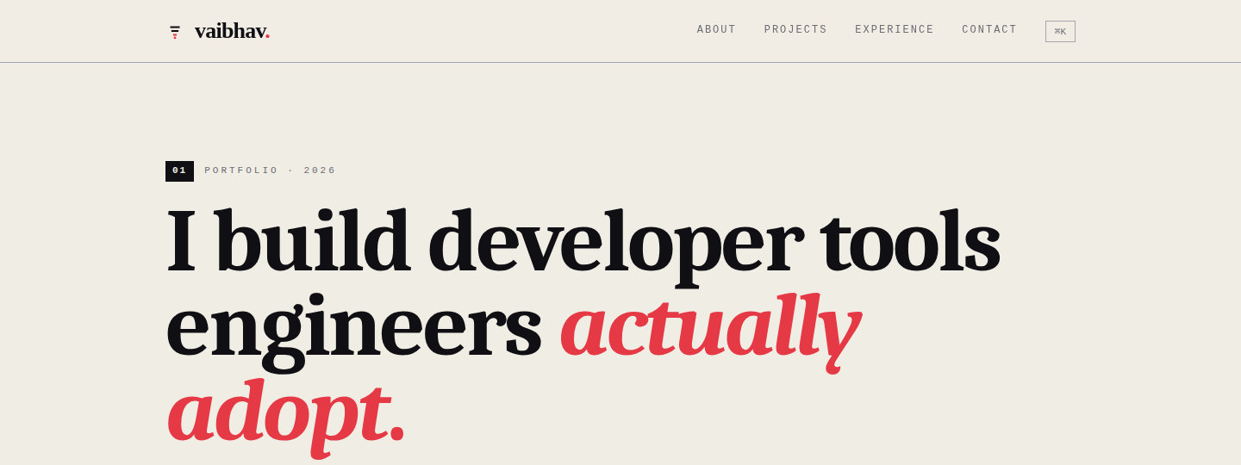
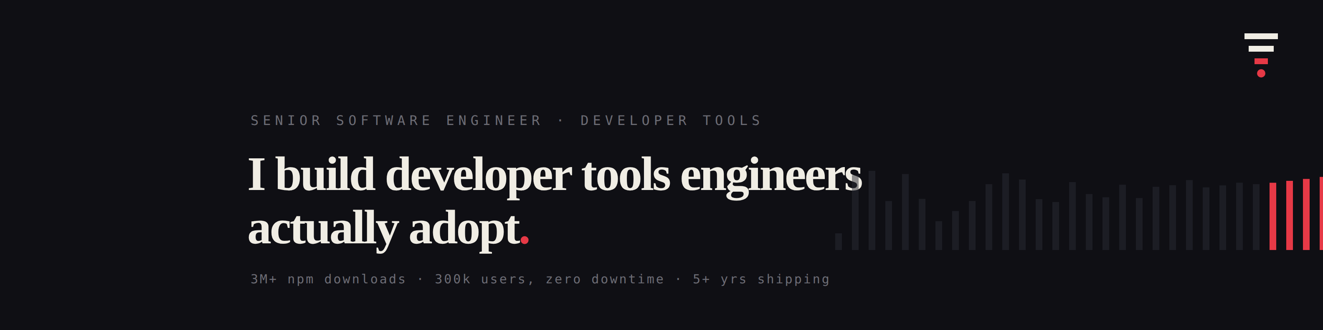
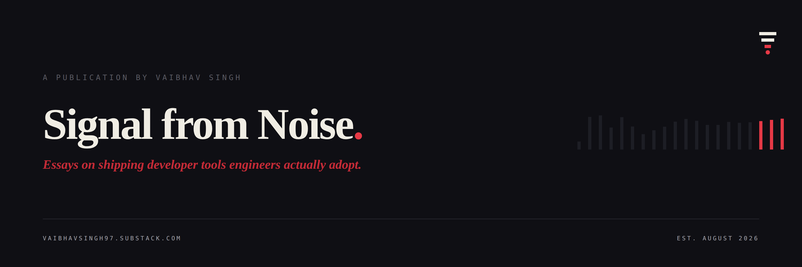
10
BRAND CONSISTENCY
Three surfaces. Same grammar.
Cohesion by design. Not by duplication.
WEBSITE
announces a positioning claim
LINKEDIN
announces a person
SUBSTACK
announces a body of work
Same palette. Same typefaces. Same mark. Different jobs.
VAIBHAV SINGH · FINAL EXAM · DEC 2026
10 / 15
Notes:
SURFACES (10:00 - 10:45). 45 seconds.
SAY: 'Same design system, three surfaces. Watch what each one does.'
'The website announces a positioning claim. I build developer tools engineers actually adopt.'
'The LinkedIn banner announces a person. Senior software engineer, developer tools.'
'The Substack header announces a body of work. Signal from Noise, essays on shipping tools.'
'Same palette. Same typefaces. Same mark. Different jobs. That's cohesion.'
ADVANCE.

Slide 11
11
BRAND VOICE
The same voice, across every channel.
Same period. Same restraint. Same measured-not-claimed.
PRIMARY
SECONDARY
TERTIARY
LinkedIn.
Substack.
GitHub / OSS.
Networking, hiring signals
Long-form thought leadership
Build-in-public, technical
"Every brand monitoring tool I have used treats the maintainer’s inbox as a coverage problem. This is a solved problem, and it’s the wrong problem."
"The bottleneck for a solo maintainer with real users isn’t visibility. It’s triage. Which 3 signals out of 300 predict churn before they show up in your download graph?"
"Random Word: cryptographically random words from diverse dictionaries. Zero dependencies. TypeScript. 3.9M downloads and counting."
Voice is the brand. Everything else is decoration.
VAIBHAV SINGH · FINAL EXAM · DEC 2026
11 / 15
Notes:
VOICE (10:45 - 11:30). 45 seconds.
SAY: 'Same voice, across every channel.'
Point to each column: 'Primary: LinkedIn, hiring signals. Secondary: Substack, thought leadership. Tertiary: GitHub, build-in-public.'
'Read all three excerpts side by side. Notice: same declarative rhythm. Periods, not exclamation marks. No adjectives when the numbers do the work. That's what voice-as-brand looks like.'
LAND: 'Voice is the brand. Everything else is decoration.'
ADVANCE.

Slide 12
12
ORIGIN STORY
The story behind Olembic.
FRAMEWORK: OVERCOMING THE MONSTER
1
2
3
4
THE OVERWHELM
THE PATTERN
THE CATEGORY ERROR
THE BUILD
Random Word hit 3.9 million downloads. A weekend project I built to learn Python packaging. Suddenly there were 300 mentions a week and one person triaging. Me. On weekends.
I kept a private log. Three kinds of signals mattered, almost always. Reproducible bugs from real users. Adjacent tools citing me. Repeated docs-gap questions. Everything else was noise.
Once I saw the pattern, I couldn’t unsee it. Every mention-tracking tool optimizes for coverage. Maintainers need triage. It’s not a feature gap. It’s a category error.
I started Olembic that week. Bandit-weighted source scoring. RAG over public developer chatter. Five signals out of three hundred. Prototype, not shipped. Working on my machine.
Story → Values. Measured · Shipped · Depth · Open · Honest
VAIBHAV SINGH · FINAL EXAM · DEC 2026
12 / 15
Notes:
ORIGIN STORY (11:30 - 13:00). 90 seconds. Slow down.
SAY: 'The story behind Olembic. Overcoming the Monster.'
PAUSE.
BEAT 1: 'Random Word hit 3.9 million downloads. Weekend project. Suddenly 300 mentions a week and one person triaging. Me. On weekends.'
BEAT 2: 'I kept a private log. Three kinds of signals mattered, almost always. Reproducible bugs from real users. Adjacent tools citing me. Repeated docs-gap questions.'
BEAT 3 (this is the pivot, do NOT rush): 'Once I saw the pattern, I couldn't unsee it. Every mention-tracking tool optimizes for coverage. Maintainers need triage. It's not a feature gap. It's a category error.'
BEAT 4: 'I started Olembic that week. Bandit-weighted source scoring. RAG over public developer chatter. Prototype, not shipped. Working on my machine.'
LAND: 'Story to values. Measured. Shipped. Depth. Open. Honest.'
ADVANCE.

Slide 13
13
BEFORE / AFTER
What changes when you flip the frame.
Maya’s Sunday, both ways.
BEFORE OLEMBIC
WITH OLEMBIC
Maya’s Sunday.
Maya’s Sunday.
✗
40 GitHub notifications from the week, unread
✓
5 signals triaged, each with a confidence score
✗
No idea which to open first
✓
Reproducible bug from user w/ 20 stars = SIGNAL
✗
Opens 12 in tabs, reads 8, answers 2
✓
Retweet + praise emojis = SILENCE
✗
Realizes 3 hours have passed
✓
Answers the 3 that matter, closes tab
✗
Closes tab feeling behind
✓
20 minutes total. Feels caught up.
3 hours → 20 minutes. From coverage to triage.
VAIBHAV SINGH · FINAL EXAM · DEC 2026
13 / 15
Notes:
BEFORE/AFTER (13:00 - 13:45). 45 seconds.
SAY: 'What changes when you flip the frame. Maya's Sunday, both ways.'
Point to BEFORE briefly: '40 GitHub notifications, no idea which to open first, three hours, closes tab feeling behind. Every solo maintainer's weekend.'
Then AFTER: '5 signals triaged. Reproducible bug is SIGNAL. Retweet is SILENCE. Answers three, done in twenty minutes. Feels caught up.'
LAND: 'Three hours to twenty minutes. From coverage to triage.'
ADVANCE.

Slide 14
14
LIVE DEMO
The system, in action.
Website + Olembic prototype. Two minutes each.
01
02
03
WEBSITE
OLEMBIC
SUBSTACK
The brand, shipped
The prototype, running
The argument, published
vaibhavsingh97.com. Hero, metrics above the fold, three projects, "Now" section, footer. One design system end-to-end.
The 4-Signal Framework applied to a real package. Watch the bandit reweighting sources. Watch five signals surface out of three hundred.
Signal from Noise. First essay: the maintainer’s inbox is not a coverage problem. Published, promoted, indexed.
BACKUP PLAN. If the prototype breaks live, screenshots are ready in a backup tab. Keep talking.
VAIBHAV SINGH · FINAL EXAM · DEC 2026
14 / 15
Notes:
DEMO TRANSITION (13:45 - now moving into browser). This is the SIGNPOST slide.
SAY: 'The system, in action. Three surfaces. Two minutes each.'
'01 Website. The brand, shipped.'
'02 Olembic. The prototype, running.'
'03 Substack. The argument, published.'
'Let me show you.'
Then IMMEDIATELY switch to the browser. Do not linger on this slide.
IN THE BROWSER (roughly 3 minutes total):
WEBSITE (~1 min):
- Point out ink/paper/vermillion applied through hero
- Scroll to metrics: 'Adoption numbers above the fold'
- Scroll to featured work
- Scroll to 'Now' section: 'Deliberate contrast beat'
- Scroll to writing, footer: 'Substack link, availability badge'
OLEMBIC (~90 sec):
- 'Prototype. Not shipped. Honest state.'
- Show the pipeline running against a real package
- Point out source weighting: 'HN comment vs Rails release note, different weights, per-project learned'
- Show the top-5 output: 'Five signals, not three hundred'
- Explain methodology: 'RAG plus bandit-weighted source scoring'
SUBSTACK (~30 sec):
- Show the article headline
- Point out the byline mentions Olembic honestly
IF ANY BREAKS: Switch to backup tab. Keep talking. Never apologize.
Return to slide 15 for the close.

Slide 15
15
CLOSING
Why did you build this?
The question behind every slide I built.
THE STORY
answered why
I got tired of my own excuse.
THE STRATEGY
answered for whom
Solo maintainers with real users and no time.
THE DEMO
answered how
Triage-first architecture. Source-weighted learning.
If all three connect, the question answers itself.
VAIBHAV SINGH · FINAL EXAM · DEC 2026
15 / 15
Notes:
CLOSING (14:30 - 15:00). 30 seconds. Slow down.
Return to slide 15 from the browser.
SAY: 'Every hiring manager asks the same question when they see this work. Why did you build this?'
PAUSE.
'The story answered why. I got tired of my own excuse.'
'The strategy answered for whom. Solo maintainers with real users and no time.'
'The demo answered how. Triage-first architecture, source-weighted learning.'
BEAT.
'If all three connect, the question answers itself.'
PAUSE.
'Thank you. I'm happy to take questions.'
END. Do not go past 15:00.

