Slide 1
🛡️
Sentinel GRC Ops
AI-Powered Compliance Intelligence
for the Modern GRC Analysts
Hammad Rana · INFO 7375 — Branding & AI · Northeastern University
huggingface.co/spaces/HammadRana1/sentinel-grc-ops
● LIVE MVP
Notes:
I built a live compliance tool called Sentinel GRC Ops. It's running right now — you can open it on your phone. Let me show you the problem it solves.
A bit of context on why I built this — this summer I'm also taking a Cybersecurity and Audit course, and while going through that material I kept thinking, a lot of this compliance work is repetitive and manual. And I realized that with AI we can make this process much quicker and more efficient. That's what led me to build Sentinel.

Slide 2
THE PROBLEM
Every Monday Morning, GRC Analysts Face This:
⏱
$
!
2–3 Hours Wasted
$20K–$200K/Year
No Time to React
Manual review of 20–30 weekly CISA advisories. Cross-referencing spreadsheets by hand.
Enterprise GRC platforms (ServiceNow, LogicGate) require huge budgets and IT teams to configure.
By the time an analyst finishes manual triage, critical vulnerabilities are already being exploited.
"A GRC analyst at a 200-person company doesn't have $50K for ServiceNow, an IT team to configure Drata,
or 3 hours every Monday to manually read 25 CISA advisories."
Notes:
Compliance analysts get 20-30 new CISA security advisories every Monday. Each one needs to be read, triaged, and mapped to compliance frameworks like ISO 27001 or SOC 2. That's 2-3 hours of manual spreadsheet work — every single week.
The alternative is enterprise tools like ServiceNow — $50K a year, months to set up. Most small teams can't afford that.
So they're stuck doing it manually. That's the problem.

Slide 3
THE SOLUTION
From Advisory to Briefing in Under 10 Minutes
1
2
3
4
→
→
→
Live CISA Feed
AI Validation
Groq AI Analysis
Briefing Report
Auto-fetched
every run
Quality gate
filters noise
Llama 3.1 maps
to controls
HTML cards
you can download
OUTPUT:
Advisory #1 CISA KEV | Severity: CRITICAL | ISO 27001: A.12.6.1 | SOC 2: CC7.1 | GDPR: Art. 32 | Action: Apply patch...
✅ 5 advisories analyzed · ✅ 3 frameworks mapped · ✅ Download HTML report · ✅ Zero cost
Notes:
Sentinel does this in four steps. But first — CISA stands for the Cybersecurity and Infrastructure Security Agency. It's a US government body that publishes real-time advisories about active cybersecurity vulnerabilities and threats. Think of it as the official source of truth for what's being exploited right now.
So Sentinel pulls those live advisories automatically. Validates them. Sends each one to an AI that maps it to the right compliance controls — with severity and a recommended action. Outputs a briefing you can download.
2-3 hours becomes under 10 minutes. Free.

Slide 4
THE MAGIC
The Secret Sauce
AI
We use AI to...
Tech Stack
translate raw vulnerability language into named compliance controls automatically — what a GRC analyst does manually in 3 hours, Sentinel does in seconds.
Data:
CISA RSS Feed (live)
?
Why now?
AI:
Groq Llama 3.1 8B
Free-tier LLM inference (Groq's Llama 3.1 8B) + public CISA RSS feed = a $0/month pipeline that simply wasn't possible without accessible AI APIs.
UI:
Gradio on HF Spaces
Cost:
$0 / month
G
Think of it like Google's PageRank...
PageRank automatically ranked billions of web pages by authority so you didn't have to manually sort them. Sentinel does the same for vulnerabilities — our AI automatically ranks and maps each one by compliance risk, so the analyst doesn't have to do it by hand.
Setup:
Zero config
Notes:
One sentence — we use AI to translate security language into compliance language automatically.
This works because Groq offers free-tier LLM inference plus CISA's feed is public. Zero dollars a month to run.
Think of it like Google's PageRank — PageRank automatically ranked billions of web pages by authority so you didn't have to manually sort them. Sentinel does the same thing for vulnerabilities — our AI automatically ranks and maps each one by compliance risk, so the analyst doesn't have to do it by hand.

Slide 5
BUSINESS MODEL
Our Intended Go-to-Market & Revenue Model
MOST POPULAR
Free
Pro
Team
$0
$39
$99
forever
/ month
/ month
✓ Up to 10 advisories/run
✓ Unlimited advisories
✓ 5 user seats
✓ All 3 frameworks
✓ Scheduled weekly runs
✓ Custom framework rules
✓ HTML report download
✓ Email briefing delivery
✓ Audit trail export
✓ Public HF Spaces
✓ API access
✓ Priority support
Projected Year 1: 200 Pro users = $93,600 ARR · Year 2: 50 Team accounts = $59,400 ARR · Total TAM: $2.3B GRC software market
Notes:
Freemium. Free gets analysts in — no signup needed.
Pro at $29 a month adds scheduled runs and email delivery. Team at $99 adds five seats and audit trail exports.
200 Pro users in year one is $70K ARR. GRC market is $2.3 billion.

Slide 6
GO-TO-MARKET
How We Get the First 10 Customers
🚀
📝
🤝
Week 1–4
Month 2–3
Month 3–6
Community Launch
Content Engine
Direct Outreach
→ Post to r/cybersecurity, r/netsec
→ Weekly 'CISA Advisory Digest' newsletter
→ LinkedIn to solo GRC analysts
→ Share on LinkedIn GRC groups
→ YouTube: 'Monday GRC Briefing' series
→ ISACA / (ISC)² chapter presentations
→ Submit to HuggingFace trending
→ SEO: 'CISA advisory compliance mapping'
→ Partner with GRC bootcamps
Key metric: Free → Pro conversion at 5% = 1 paying customer per 20 free users · CAC target: <$15 via organic community channels
Notes:
Week one — Reddit and LinkedIn GRC communities where analysts already hang out.
Month two — free weekly newsletter. We run the tool, send you the output, you convert when you want automation.
Month three onwards — direct LinkedIn outreach and ISACA chapter presentations.
5% conversion rate, under $15 customer acquisition cost.

Slide 7
COMPETITION
We Own the White Space
LOW ACCESS BARRIER
HIGH ACCESS BARRIER
HIGH OUTPUT
SPECIFICITY
🛡️
Drata
Paid · Integration setup
SOC 2/ISO 27001 evidence
No AI-reasoned CISA mapping
SENTINEL GRC OPS
Free · Live feed · Named controls
AI severity · Zero setup
✅ WHITE SPACE
LOW OUTPUT
SPECIFICITY
ServiceNow GRC
$50K–$200K/yr · Enterprise only
[Open — no tool here]
Tines
Enterprise · Alerts only, no mapping
The gap: nobody offers automatic AI-reasoned CISA-to-control mapping, for free, with zero setup. Enterprise vendors can't. Automation tools don't.
Notes:
Three competitors — none doing what we do.
ServiceNow — enterprise standard, $50K minimum, can't go free. Drata — good for audit evidence but no automatic AI-reasoned CISA mapping. Tines — routes alerts, not compliance reasoning.
The gap: nobody maps live CISA advisories to named controls using AI, for free, with zero setup. That's our position.

Slide 8
DEVELOPMENT PLAN
Where We Are. Where We're Going.
● LIVE MVP
✓
Q3
Q4
Q1
NOW
Q3 2026
Q4 2026
Q1 2027
Live MVP
v1.0 Launch
v2.0 Scale
Enterprise
✓ Gradio UI deployed
○ Scheduled runs
○ Team accounts
○ SSO / SAML
✓ CISA feed live
○ Email delivery
○ Custom frameworks
○ Custom LLM prompts
✓ Groq AI working
○ User accounts
○ API access
○ White-label option
✓ 3-framework mapping
○ Pro tier billing
○ Audit trail export
○ SLA guarantees
Notes:
It's live today. Next quarter — scheduled runs and billing. After that — team accounts and API access. Longer term — enterprise features.
Goal right now is real users on the free tier.

Slide 9
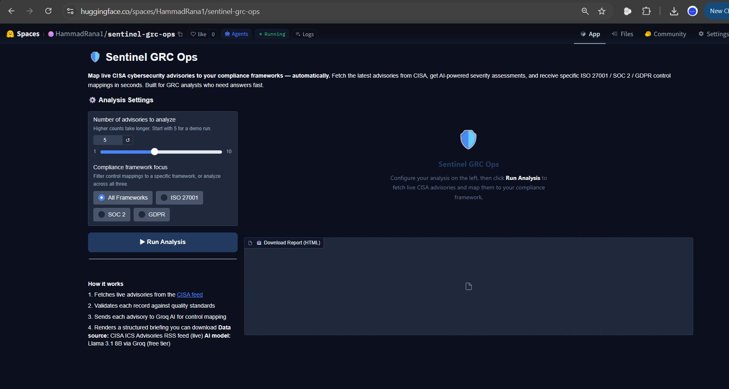
PROOF OF CONCEPT
This Is What It Looks Like
huggingface.co/spaces/
HammadRana1/sentinel-grc-ops
✓
Live CISA data
Real advisories, not mock data
AI
AI analysis
Groq Llama 3.1 mapping controls
3
3 frameworks
ISO 27001, SOC 2, GDPR
✓
User-tested
3 real GRC professionals
Notes:
This is what the tool actually looks like — running live right now on HuggingFace Spaces.
You can see the two inputs on the left, hit Run Analysis, and within seconds you get a full compliance briefing. Real CISA advisories, real AI analysis, real output you can download.
Three professionals have already tested it. It works. Go ahead and try it yourself — URL is on screen, no signup needed.

Slide 10
🛡️
Thank You
huggingface.co/spaces/HammadRana1/sentinel-grc-ops
Notes:
Thank you. Happy to take any questions.

