Slide 1
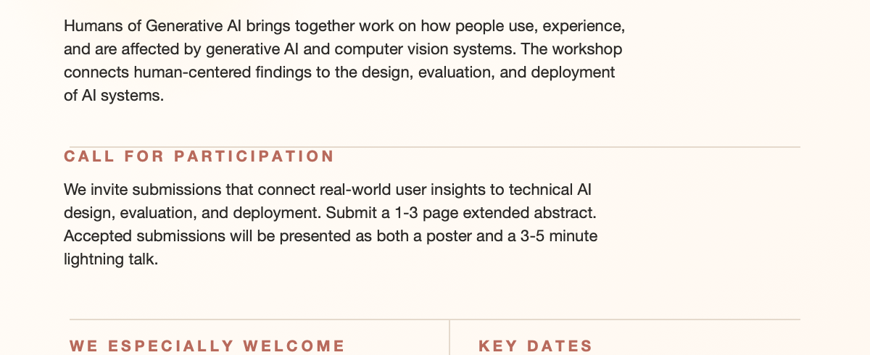
CVPR WORKSHOP | JUNE 3 OR JUNE 4, 2026 | DENVER, COLORADO
Humans of
Generative AI
A workshop on how people use, experience, and are affected by
generative AI and computer vision systems.
ABOUT THE WORKSHOP
Humans of Generative AI brings together work on how people use, experience,
and are affected by generative AI and computer vision systems. The workshop
connects human-centered findings to the design, evaluation, and deployment
of AI systems.
CALL FOR PARTICIPATION
We invite submissions that connect real-world user insights to technical AI
design, evaluation, and deployment. Submit a 1-3 page extended abstract.
Accepted submissions will be presented as both a poster and a 3-5 minute
lightning talk.
WE ESPECIALLY WELCOME
KEY DATES
• Social science findings that should shape
the technical design of AI systems
• Technical designs that address unmet
user needs or real-world harms
• Evaluation methods grounded in how
people actually use and experience
AI systems
• Interdisciplinary work spanning CV, ML, HCI,
safety, security, ethics, and social science
Submission deadline: (11:59 PM AOE)
• April 10, 2026
Submission deadline
• April 24, 2026
Notification of acceptance
• May 22, 2026
Camera-ready deadline
Full CFP and website at https://humansofgenerativeai.github.io/

