Slide 1
Customer Segmentation and RFM Analysis
R
F
M
Know the customer, treat them right, grow their value
Notes:
In this presentation we first explain what customer segmentation is and why it matters, then walk through the RFM method with real examples.

Slide 2
What is segmentation?
Customer segmentation — the process of dividing the entire customer base into small, manageable groups (segments) based on similar characteristics and behaviour.
Segment 1
Segment 2
Instead of treating every customer the same, each group gets a strategy that fits its needs.
Segment 3
All customers
Segment 4
Notes:
Segmentation means grouping customers with similar behaviour together. On the left is a mixed customer base; on the right, segments grouped by colour.

Slide 3

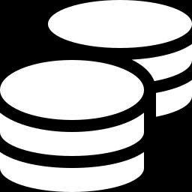
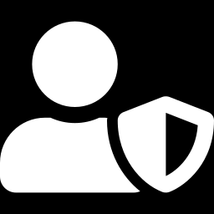
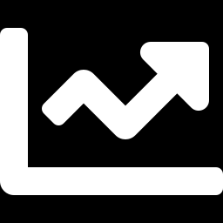
Why is it needed and why does it matter?
Personalised marketing
Budget savings
Each group gets the right message, offer and channel — campaigns become more effective.
Money is spent on the customers who will deliver the most results, not on everyone.
Customer retention
Revenue growth
Customers at risk of churning are spotted in time and won back.
Upsell and loyalty programmes are built for valuable customers.

Slide 4
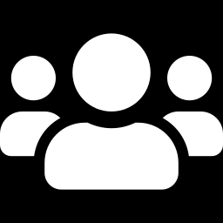
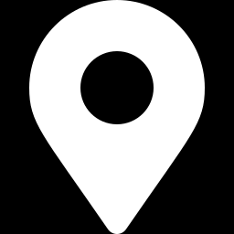


Main types of segmentation
Demographic
Geographic
Psychographic
Behavioural
Age, gender, income, education
Country, city, region
Lifestyle, interests, values
Purchase date, frequency, amount
E.g.: students aged 18–25
E.g.: Baku vs. the regions
E.g.: people who do sports
RFM belongs to this type

Slide 5
What is RFM?
A behavioural segmentation method that scores customers by answering 3 simple questions
R
F
M
Recency
Frequency
Monetary
How many days since the last purchase?
How many times did they buy?
How much did they spend in total?
Lower is better
Higher is better
Higher is better

Slide 6
Recency — days since the last purchase
Analysis date = last purchase date + 1 day
Last purchase in the dataset is 10.06.2023 → analysis date 11.06.2023. One day is added so that a customer who bought on the last day doesn't get a Recency of 0.
Example: two customers from the dataset
Customer 1029
1 day
Last purchase: 10.06.2023
Active customer
Recency = Analysis date − Last purchase date
Customer 1046
44 days
If a customer purchased several times, the latest date is used.
Last purchase: 28.04.2023
Hasn't returned in a long time

Slide 7
Frequency — how often they buy
Shows how many orders a customer placed in a given period. Customers who buy more often are more loyal.
94.6%
of customers bought only once (895 of 946). That's why Frequency doesn't separate customers well — a key characteristic of this dataset.

Slide 8
Monetary — total amount spent
The sum of all of a customer's purchases. Customers who spend more are more valuable to the company.
1 129 AZN
705 AZN
36 AZN
Customer 1011
Customer 1029
Customer 9985
2 orders
1 order
1 order
In the dataset: average spend 543 AZN, minimum 12 AZN, maximum ~1,130 AZN.
Notes:
Amounts are the per-customer sum of the TransactionAmount column. The currency is shown as AZN for illustration.

Slide 9
Scoring: 1–5 points per metric
R
Quintiles (5 equal groups), reversed: most recent purchase → 5
ID | Recency | Freq. | Monetary | R | F | M | Code
1011 | 34 | 2 | 1 129 | 3 | 5 | 5 | 355
1025 | 22 | 1 | 359 | 4 | 4 | 2 | 442
1029 | 1 | 1 | 705 | 5 | 4 | 4 | 544
1046 | 44 | 1 | 860 | 2 | 4 | 5 | 245
F
Rule: 2–3 purchases → 5, 1 purchase → 4
M
Quintiles: highest spenders → 5
The three scores combine into the RFM code: R=3, F=5, M=5 → "355"
The examples are real customers from the dataset.

Slide 10
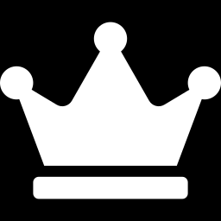

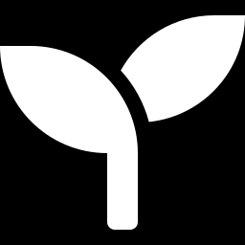
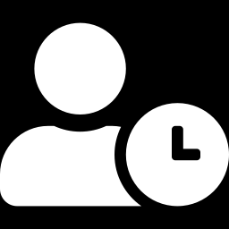
From scores to segments
VIP
High Value
Medium Value
Low Value
R ≥ 4, M ≥ 4, F = 5
R ≥ 3, M ≥ 4
R ≥ 3, M ≤ 3
R ≤ 2 (everyone else)
Most active and highest spenders
Strong customer base
Has potential
Inactive or lost customers
Strategy:
Strategy:
Strategy:
Strategy:
Reward them, loyalty programme
Upsell, premium offers
Increase basket value, cross-sell
Win-back campaign
Notes:
Rules are applied bottom-up: everyone starts as Low Value, then Medium, High and finally VIP. A stricter rule overwrites the previous one.

Slide 11
Results in our data
946
customers, split into 4 segments
25.6% → 41.5%
VIP + High customers → share of revenue
2.2% → 5.1%
VIP customers → share of revenue
Notes:
Figures were calculated by comparing R_score as a number (with corrected logic).

Slide 12
Key findings and recommendations
1
No Pareto effect
Recommendations
Revenue is spread evenly across customers — the 80/20 rule doesn't hold.
Use business-based thresholds instead of quintiles
Build better differentiation for Frequency
Introduce loyalty, upsell and subscription mechanisms
Run a win-back campaign for Low Value
2
The VIP layer is weak
A premium customer layer hasn't formed; there is no loyalty mechanism.
3
Frequency doesn't differentiate
~95% of customers purchased only once.

