Slide 1
Welcome!
Air Pollution causes Respiratory Health Problem.

Slide 2
Our Team
Name | ID
Reazul Islam | 2024000000051
Humayra Hasib Hia | 2024000000076
Samia Islam | 2024100000357

Slide 3
Table of Content
Introduction
Variable
Data Collection Method
What kind of Data we’ve collected?
Graphical Representation
Conclusion

Slide 4
Introduction
Air pollution is one of the major environmental problems in urban areas, causing serious threats to human health. Rapid urbanization, increased vehicle use, dust, and different types of smoke have significantly degraded air quality. This study aims to examine the health problems caused by air pollution and identify the major pollution sources affecting people’s daily lives

Slide 5
Variables
Dependent Variable
Respiratory Health Problem
Independent Variable
Cooking Fuel
Cooking Stove
Ventilation in Kitchen
Cooking Exposure time
Road proximity.

Slide 6
Data Collection Method
Study : Cross-Sectional study
Target population : Affected people in Respiratory Problem
Sampling Technique : Random
Data Collection Technique : Face-to-Face (through Google form)

Slide 7
What kind of Date we have Collected?
General
Number or e-mail
Male of Female
Age group
Living area
Important
Do you or your household member suffering from any types of respiratory health problem?

Slide 8
Data of Independent Variable
Types of fuel they are using
Types of stove they are using
If they are having ventilation in their kitchen
Their total cooking smoke exposure time
If they are living near of a busy road or not.

Slide 9
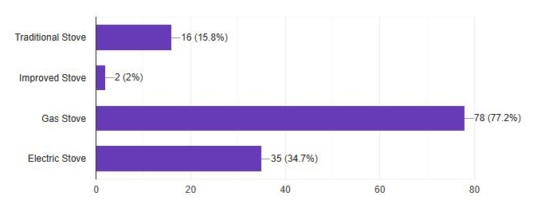
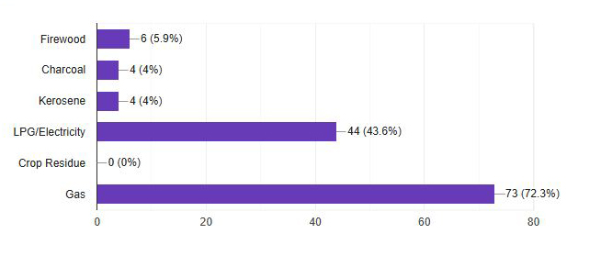
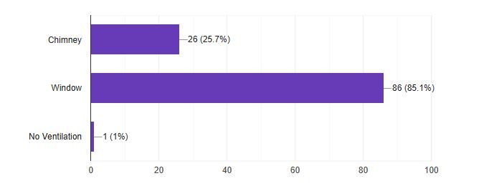
Graphical representation
Stove
Fuel
Ventilation

Slide 10
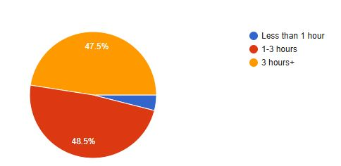
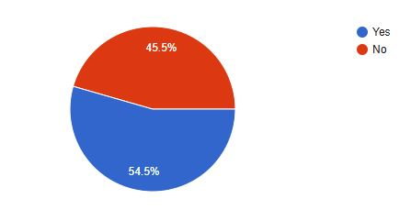
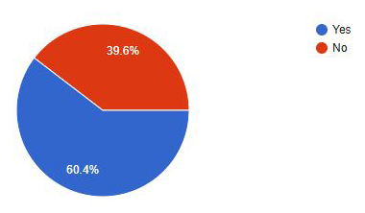
Graphical representation
Cooking Exposure Time
Road Proximity
Respiratory Problem Rate

Slide 11
Conclusion
We prove that :
Cooking smoke make our lungs hurt.
The longer you stay in smoke, the sicker you get.
Switch to clean fuel like electricity.
Let air the bad air out and fresh air in through window.
Spend less time directly in the cooking smoke.

Slide 12
Thank You !

