Slide 1

WELCOME TO MY PROJECT PRESENTATION NAME:HUMAYRA KHANUM ID:161-15-7325

Slide 2

TOPIC:PASSWORD PROTECTED PERSONAL DIARY!

Slide 3
About Personal Diary Management System:
In this console application, you can add, view, edit and delete records. Records can be added with many information such as duration of task, name, address, time and date. In this project, you need to enter a password to add,view, edit or delete record. Password is required to view the main menu or to add record.

Slide 4
FLOW CHART
START
PASSWORD
MAINMENU
ABOUT
ADD
VIEW
DELETE
SEARCH
FEEDBACK
1.Record number 2.Date of record 3.Name of person 4.place of meeting 5.notes
EXIT

Slide 5
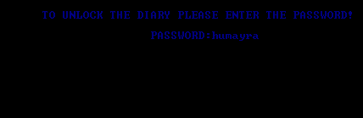
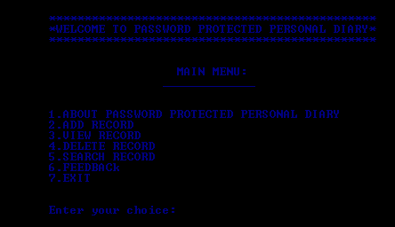
Output Screenshots: 1.Entering password one can access to the personal diary.
Screenshort: 1
Screenshort: 2

Slide 6
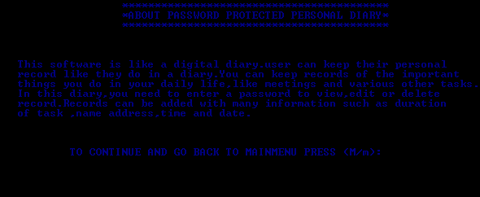
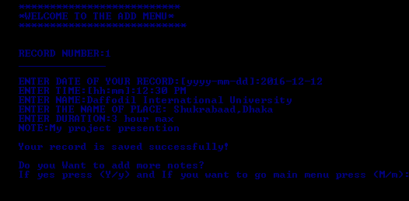
1.This option shows what is the management for!It’s a short discription.
Screenshort: 3
2.This is the adding option.where one can store one’s personal information.
Screenshort : 4

Slide 7
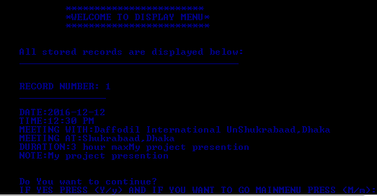
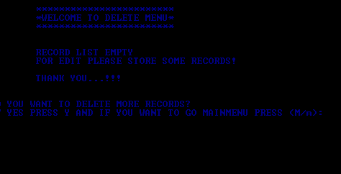
This option shows the stored records
Screenshort:5
This is delete option .when no record is stored it shows empty screenshort: 6

Slide 8
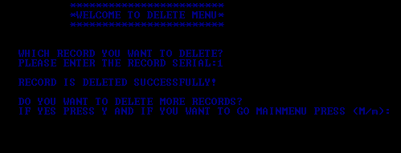
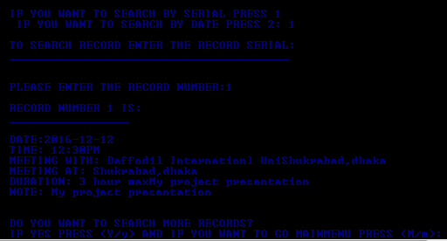
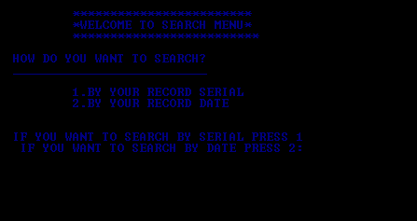
after deleting any record from the diary! Screenshort: 7
In 2 ways records can be searched: screenshort: 8
Showing the searching value is found! Screenshort: 9

Slide 9
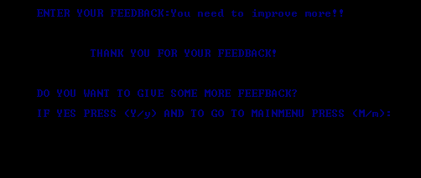
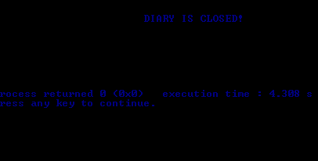
All Feedback will store in feedback file. Screenshort: 10
After pressing the exit option the diary will be closed
Screenshort: 11

Slide 10
LIMITATITIONS: 1.Edit password can be a option of mainmenu. 2.All records should stored in file 3.Edit record
Conclusion: This system is also called digital diary which has made easy for us to keep our personal information safely!!!

Slide 11


