Slide 1

Group 1
Members
Farzana Islam Adiba -01
Humayra Ferdous -08
Shovon Roy - 35
Mehedi Hasan- 25
SM Sarwar Nabin-1782
Md Sohel Rana
E-content on Electronics Circuit lab

Slide 2
Roles of the team members
Group Members | Role
Farzana islam adiba | Team leader,designer, environment compiler
Humayra Ferdous | Coordinator, content expert,education sociologist
Mehedi hasan | producer
Shovon roy | Art director, education technologists, education sociologist
S M Sarwar | education psychologists, scale and evaluation experts
sohel | Producer

Slide 3
Contents
Objectives
Multimedia contents
Tools we have used
Content criteria
System description
Future work

Slide 4
Objectives
Educational Goal: Students will achieve basic circuit operation in circuit lab profoundly.
Partial Goal: Multimedia will enhance the learning medium, environment and encourage students to solve circuit problems easily.
General Goal: Our goal is to make the topic more reliable, more fruitful for the improvement on understanding circuit.

Slide 5
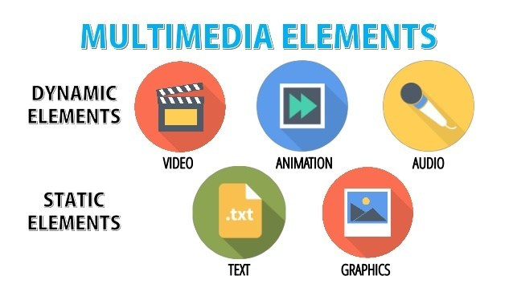
Multimedia elements

Slide 6
Technical Criteria Storyboard
A storyboard is a graphic organizer in the form of illustrations or images displayed in sequence for the purpose of pre-visualizing a motion picture, animation, motion graphic or interactive media sequence.
Storyboarding is used in software development as part of identifying the specifications for a particular set of software.

Slide 7
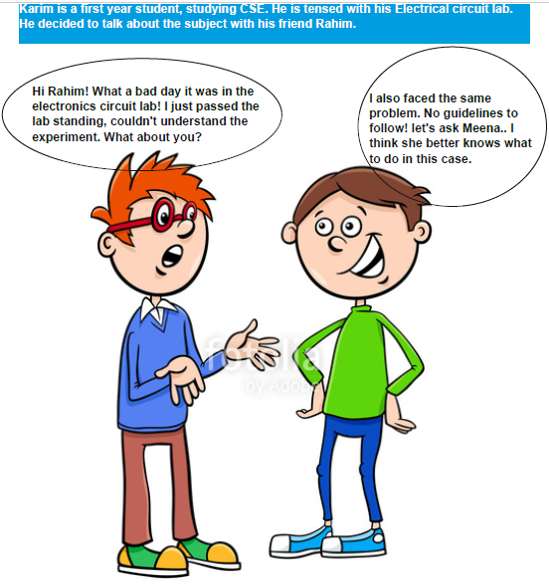
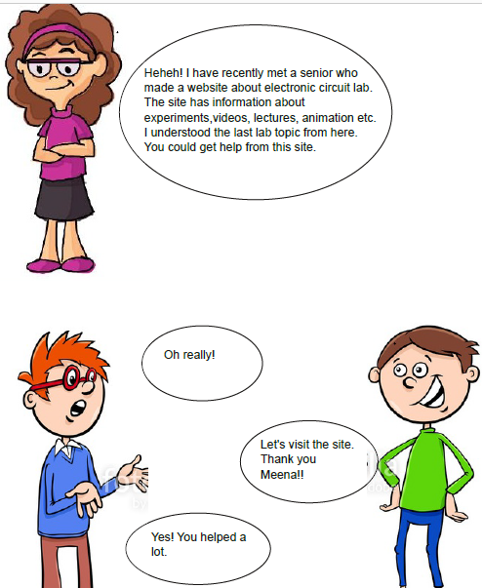
Technical Criteria
Storyboard(Contd.)

Slide 8
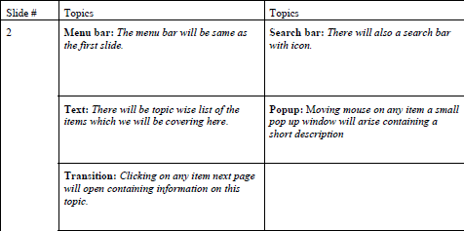
Steps

Slide 9
Tools we have used
  Audio tools
Rosegarden:
Rosegarden is a free software digital audio workstation program developed for Linux with ALSA and Qt4. It acts as an audio and MIDI sequencer, scorewriter and musical composition and editing tool. It is intended to be a free alternative to such applications as Cubase.

Slide 10
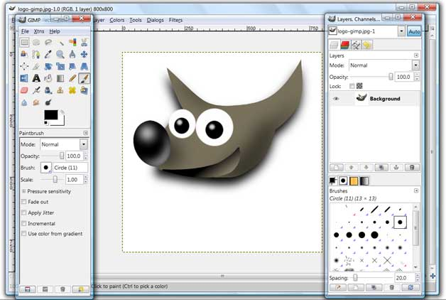
Tools we have used(contd.)
Image processing tools
Gimp: GIMP is a cross-platform image editor available for GNU/Linux, OS X, Windows and more operating systems. It is free software, you can change its source code and distribute your changes.

Slide 11
Tools we have used(contd.)
Video editing tools
CamStudio
CamStudio is able to record all screen and audio activity on your computer and create industry-standard AVI video files and using its built-in SWF Producer can turn those AVIs into lean, mean, bandwidth-friendly Streaming Flash videos (SWFs)

Slide 12
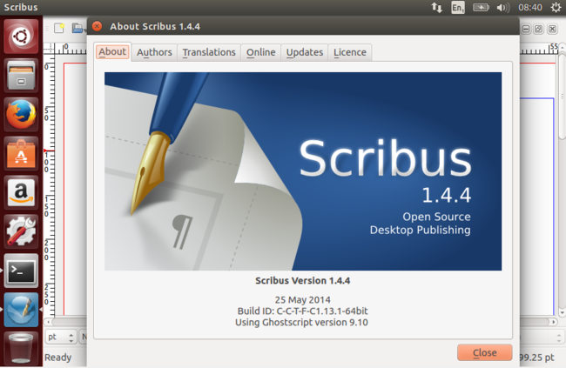
Tools we have used(contd.)
Scribus
Scribus is a desktop publishing (DTP) application written in Qt and released under the GNU General Public License as free software. There are native versions available for Unix, Linux, BSD, macOS, Haiku, Microsoft Windows, OS/2 and eComStation operating systems. Many free programs are included in this DTP package.

Slide 13
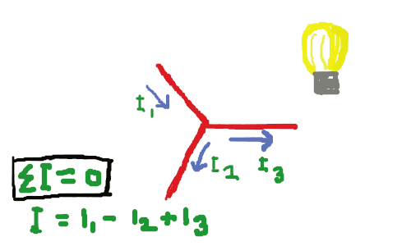
Content Criteria
Graphic

Slide 14
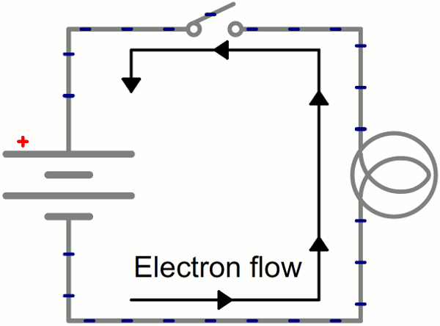
Content Criteria(contd.)
Animation

Slide 15
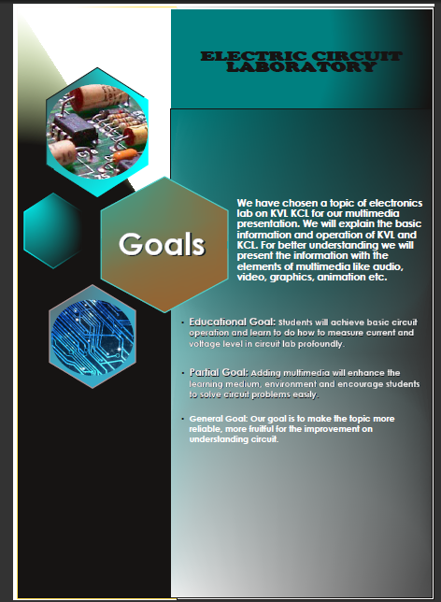
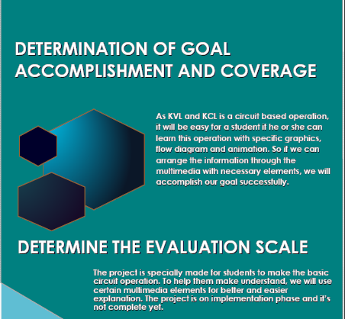
Content Criteria(contd.)
Scribus

Slide 16

Content Criteria(contd.)
Audio

Slide 17
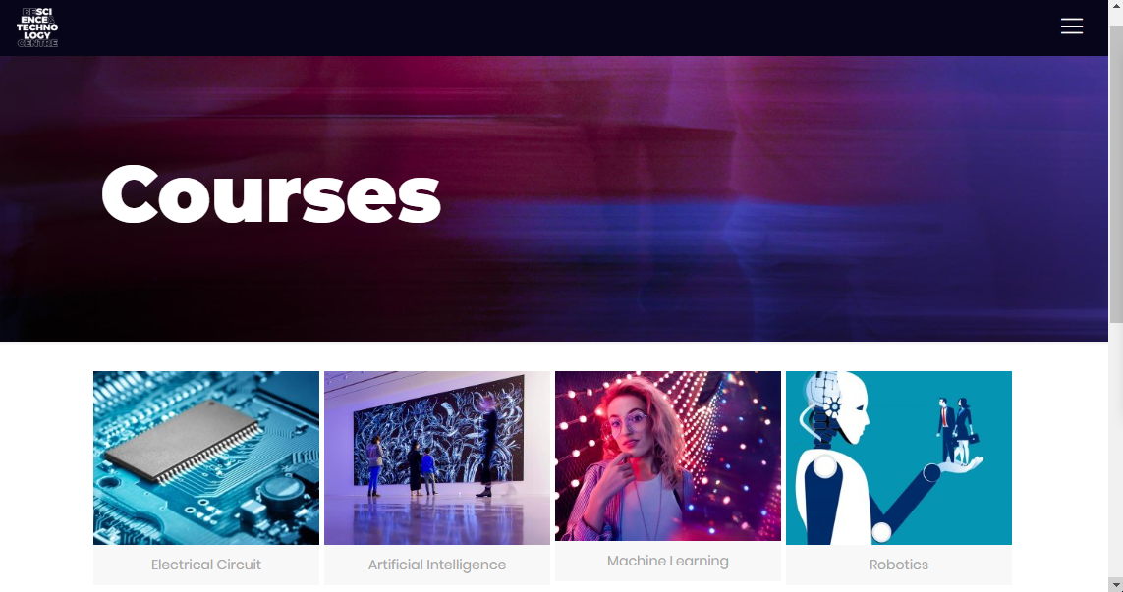
Content Criteria(contd.)
Video

Slide 18
Prototype Review
We have developed a web based interface for e-content. The link is below:-
https://hawaisoft.com/multimediaproject/

Slide 19

Future Works
After the reviews gathered from 1st semester students, we will identify the fields to which further improvements can be achieved and more information can be included counting on their demands.

Slide 20

Thank You

