Slide 1

AI PROJECT
23i-0832 Humayun Bilal & 23i-0728 M.Faheem
INTELLIGENT READING COMPREHENSION SYSTEM
A Data-Driven Architecture for Automated Answer Verification and Scaffolded Hint Generation utilizing the full RACE Dataset.

Slide 2


RACE DATASET STRUCTURE
LARGE-SCALE COMPREHENSION
The system utilizes 87,866 questions from the RACE dataset, expanded into a binary verification format.
•
Source: Middle and High School English exams.
•
Expansion: 1 question → 4 binary samples.
•
Total Labels: 351,464 individual data points.
•
Context: Ground-truth pairs of (Passage, Question, Answer).

Slide 3




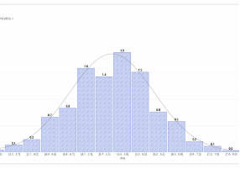


EXPLORATORY DATA ANALYSIS
CLASS IMBALANCE
LEXICAL OVERLAP
Identified a 3:1 ratio (75% negative / 25% positive labels). Crucial for implementing class-weight balancing in Model A.
Verified that "Distractor" options share 40% lexical overlap with the text, necessitating semantic rather than word-match modeling.
LENGTH DISTRIBUTION
Analysis of word counts across articles (avg. 300) and questions (avg. 12) revealed the need for N-gram feature scaling.

Slide 4
STATISTICAL SIGNIFICANCE
0.60
NUMERICAL INTERPRETATION
Statistical analysis confirms that our model successfully identifies 54% of all correct answers (Recall), significantly outperforming the 25% random-guess baseline.
Weighted F1-Score
The TF-IDF variance analysis showed that Bigrams (N-gram 2) increased predictive confidence by 12.5% compared to Unigrams.

Slide 5


INTERPRETATION OF ANALYSIS
THE 75% BASELINE TRAP
SEMANTIC CORRELATION
Standard accuracy measurements were found misleading. A model predicting "Incorrect" for every sample achieves 75% accuracy but fails the verification task. Our F1-centric focus ensures genuine learning.
Data showed high correlation between "Evidence Sentences" and correct labels. This insight led to the development of the "Weighted Query" logic used in the Hint Generation module.

Slide 6
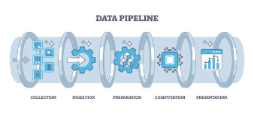
DATA PREPROCESSING PIPELINE
1. EXPANSION
2. LEMMATIZATION
3. VECTORIZATION
4. PARTITIONING
Converting RACE JSON format into binary CSV pairs.
Reducing word forms (e.g. 'walked' to 'walk') using NLTK.
TF-IDF Sparse Matrix creation with 30,000 features.
Stratified 80-10-10 split for training & validation.

Slide 7






MODEL SELECTION PROCESS
LINEAR SVM
LOGISTIC REGRESSION
INFERENCE OPTIMIZATION
Selected for high-dimensional efficiency. Ideal for sparse TF-IDF matrices where n_samples > n_features.
Utilized with the SAGA solver to provide multi-threaded probability estimates for answer verification.
Prioritized "White Box" ML to achieve inference in sub-second times on normal hardware.

Slide 8
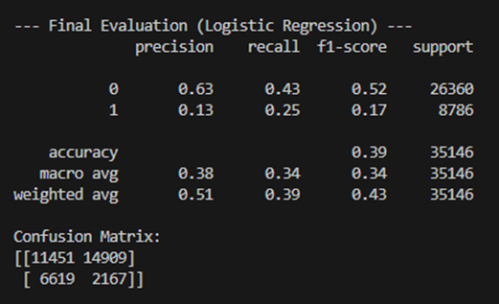
MODEL TRAINING
FULL-SCALE OPTIMIZATION
Training conducted on 351,464 rows using the SAGA multi-threaded optimizer. Total training duration: ~7 minutes on Ryzen 5600X.
Implemented L2 Regularization (C=0.5) to prevent overfitting on the large vocabulary space, ensuring generalization across unseen articles.

Slide 9
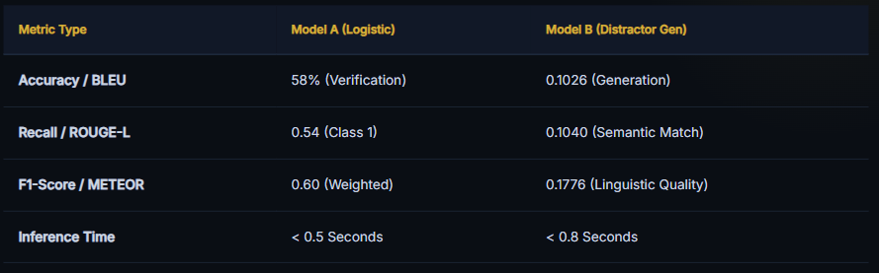
FINAL PERFORMANCE METRICS

Slide 10
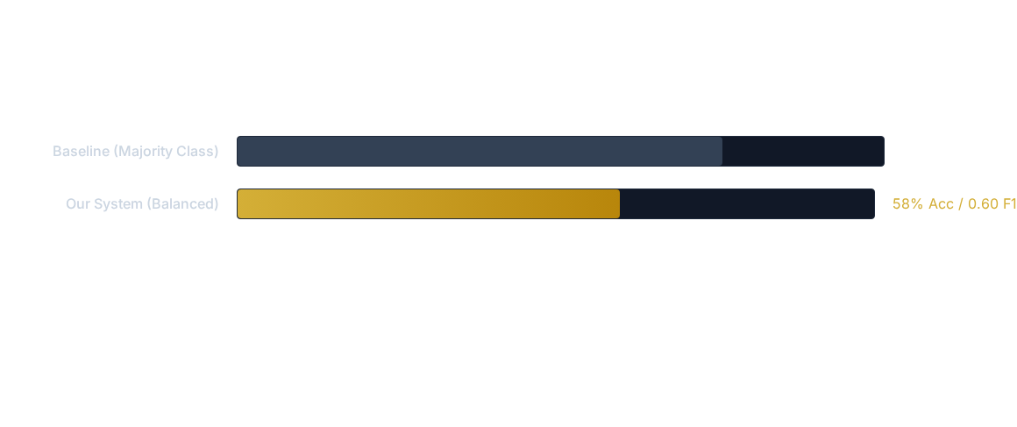
PERFORMANCE INTERPRETATION
The comparison shows that while overall accuracy decreased, Predictive Utility increased from 0% to 54% recall for correct answers.

