Slide 1
Sensor-LSM9DS0
The 9-axis Accelerometer, Magnetometer & Gyroscope
With Temperature Sensing

Slide 2
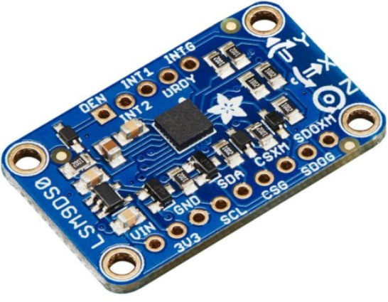
The Sensor

Slide 3
The Budget to use this sensor readings and convert it into human readable values
1. LSM9DS0 sensor - C$ 27
2. Raspberry Pi Kit - C$ 87
3. Jumper Wires - C$ 04
4. Solderless Breadboard - C$ 05
5. Shipping Charges - C$ 19
Total - C$ 142

Slide 4
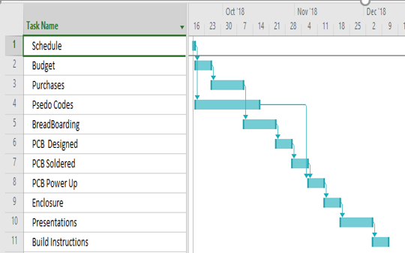
The Schedule

Slide 5
Major Challenges
1. The raw readings of the sensor was coming at ‘6b’ address instead of ‘6a’ address.
Solution- Connected SDOG terminal of the sensor to Ground and the error was corrected.
2. When the python software was installed in Raspberry Pi to process the signals from the sensor, there was a value error.
Solution- The address in the file ‘adafruit_lsm9ds0.py’ need to be changed from ‘6b’ to ‘6a’ since we changed the raw data from sensor from ‘6b’ to ‘6a’.

Slide 6
How I Could Do This
Sem1- Tech 101(Electric), Tech103(Digital), Esol120(English)
Sem2- Tech153(Technical C), Esol220(English)
Sem3- Ceng215(Digital), Ceng216(Software Eng.)
Sem4- Ceng250(PC OS & Internals) , Ceng252(Embedded)

Slide 7
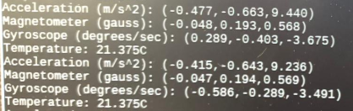
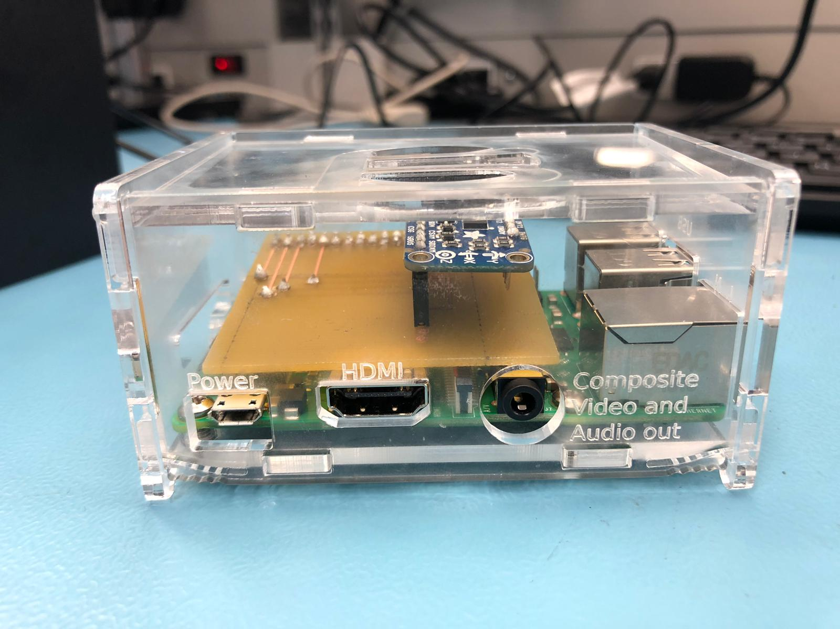
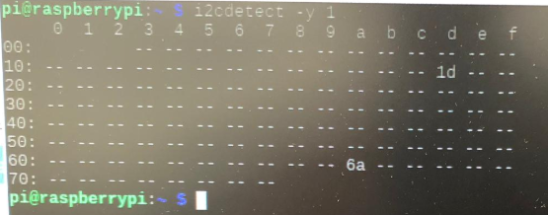
The Final Unit with Readings

