Slide 1
Designing a dynamic CI/CD Pipeline using AWS Code Pipeline for Pet Adoption Web Application
VIRTUALIZATION

Slide 2
TEAM
instructor
IMRAN MUHAMMAD
Reshmi Harikumar Lathakumari
Shreya Bhoir
Vimmi Cherusserykkaran

Slide 3
PROJECT GOAL
Streamline and improve software development and deployment processes for efficient and reliable delivery of new features and updates to the Pet Adoption web application.

Slide 4
Project Approach
Thorough understanding of Pet Adoption application requirements.
Customization of CI/CD pipeline with build and production environments.
Integration of AWS Code Pipeline with AWS Code Build and VS Code for version control.
Use of Docker for consistent deployments.
Stress on collaboration, customization, security, automation, and continuous improvement.

Slide 5
METHODOLOGY
Needs analysis with Docker integration.
Backend development using Python and MySQL for the database.
Selection of AWS as a hosting provider.
Creation of an all-inclusive CI/CD pipeline.
Use of VS Code for code management and AWS Code Pipeline for CI/CD.

Slide 6
Technologies and Tools:
Cloud Platform: AWS
CI/CD Tools: AWS CodePipeline
Version Control System: AWS Code Commit
Docker: Docker for containerization
Front-end: HTML, CSS, Js
Back-end: Python
Database System: MySQL
Development Tools: VS Code

Slide 7
Tasks we did:
Docker Containerization: Create configured Docker containers.
CI/CD Pipeline Setup: Establish a comprehensive pipeline for front-end, back-end, and database components.
Environment Setup: Configure staging and production environments with Docker containers.
Front and Back-end Development: Develop components based on specifications.
Database Design and Implementation: Create database structure and perform CRUD operations.
Documentation: Create detailed documentation for code, database, Docker containers, and pipeline configuration

Slide 8
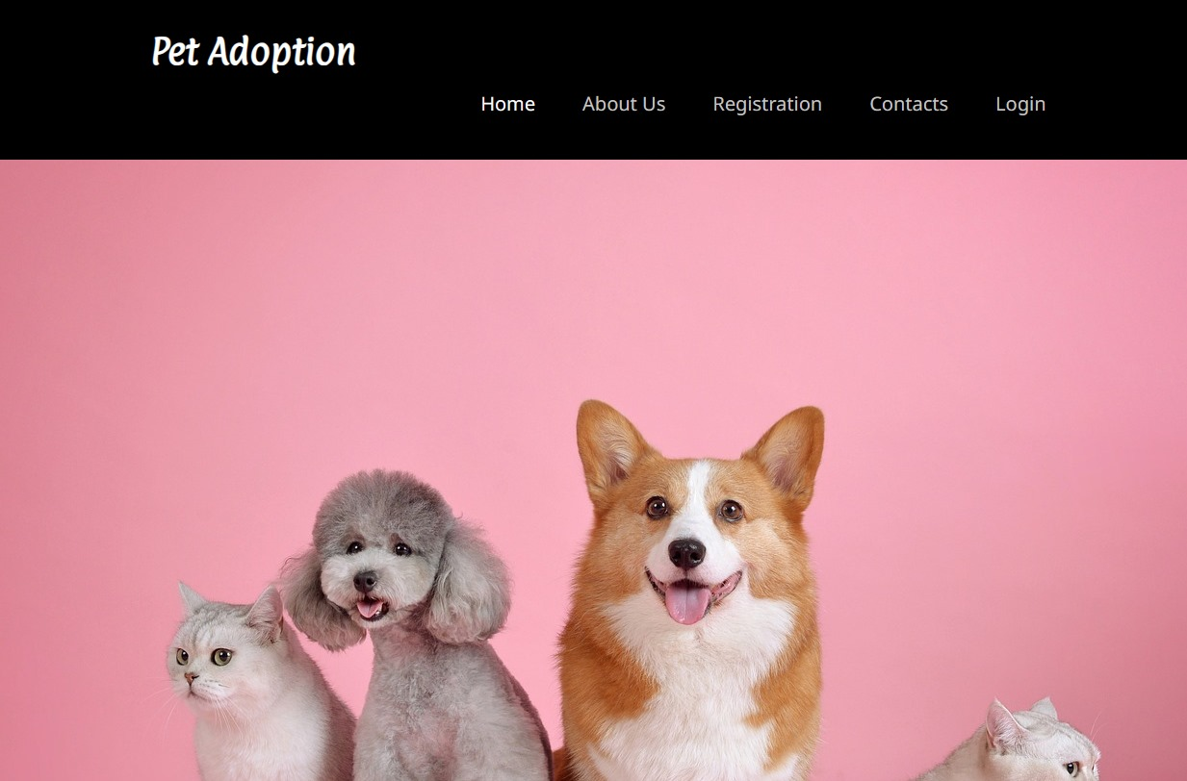
HOME PAGE

Slide 9
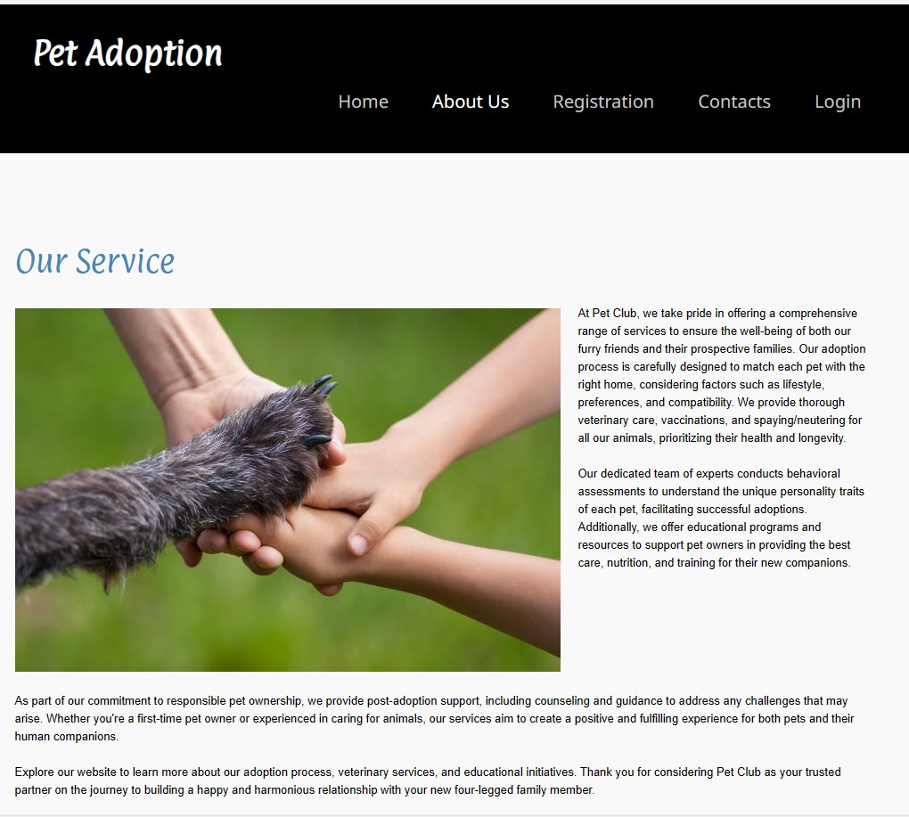
ABOUT US

Slide 10
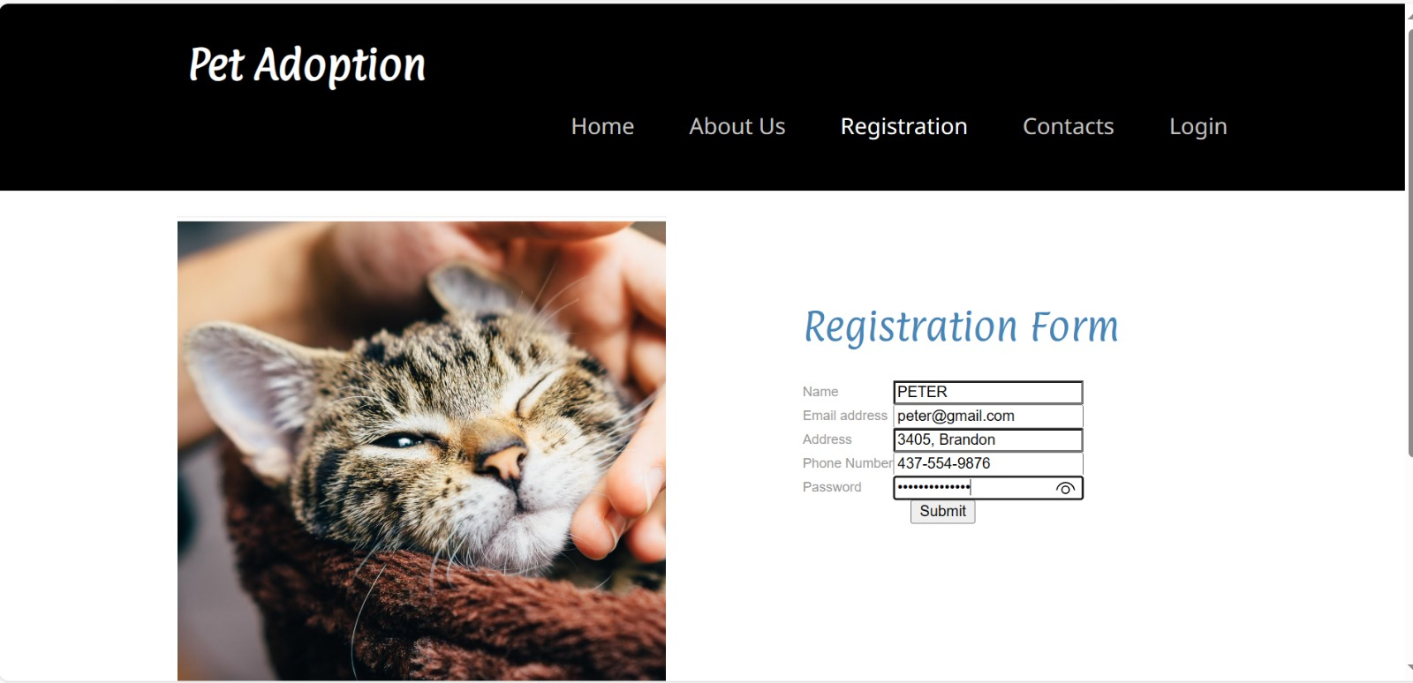
REGISTRATION PAGE

Slide 11
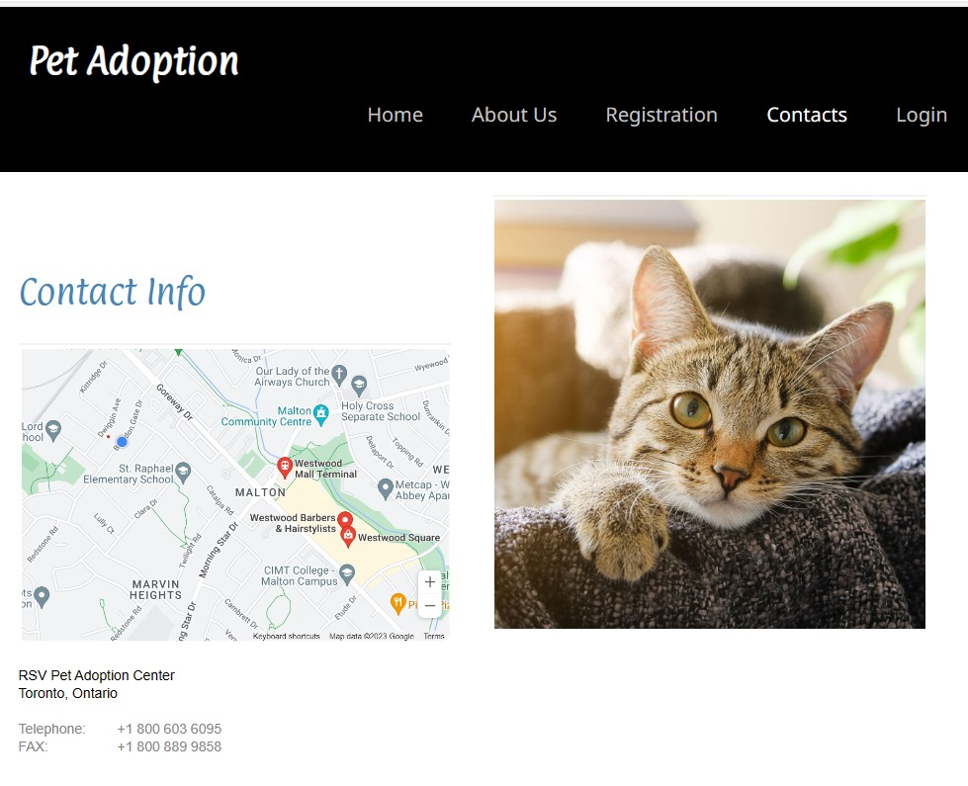
CONTACT US

Slide 12
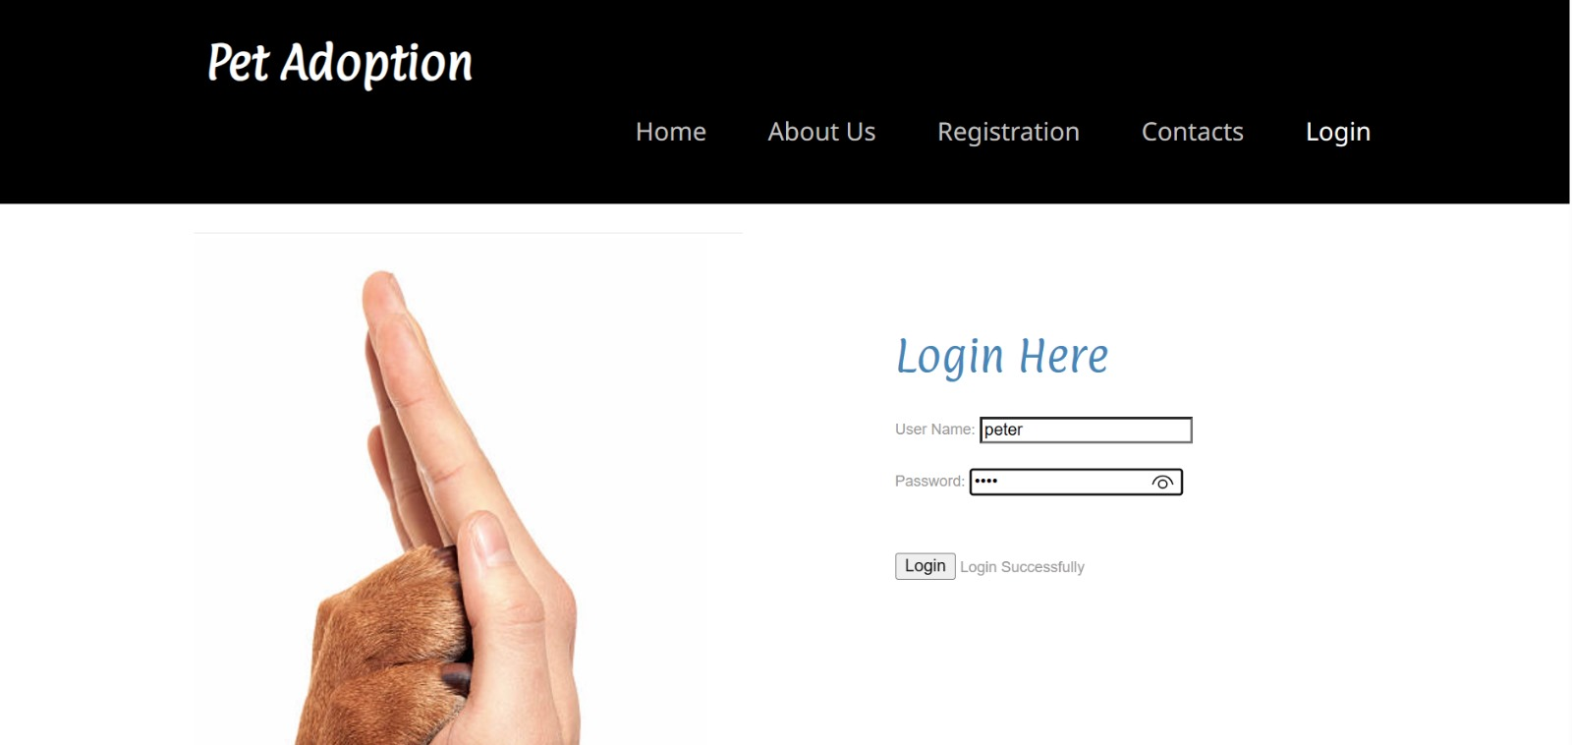
LOGIN PAGE

Slide 13
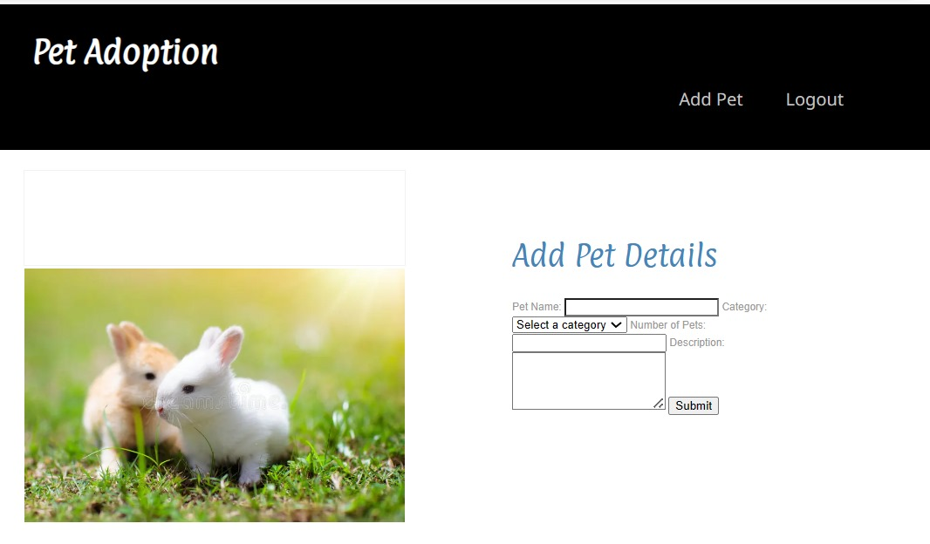
ADD PET- ADMIN ACCESS ONLY

Slide 14
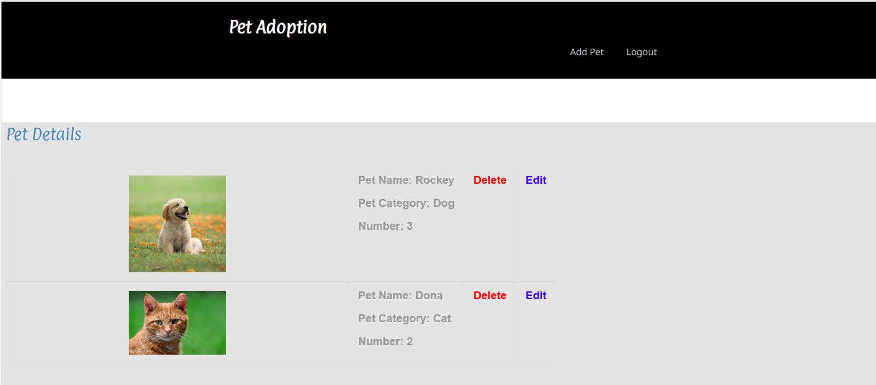
VIEW PAGE- ADMIN

Slide 15
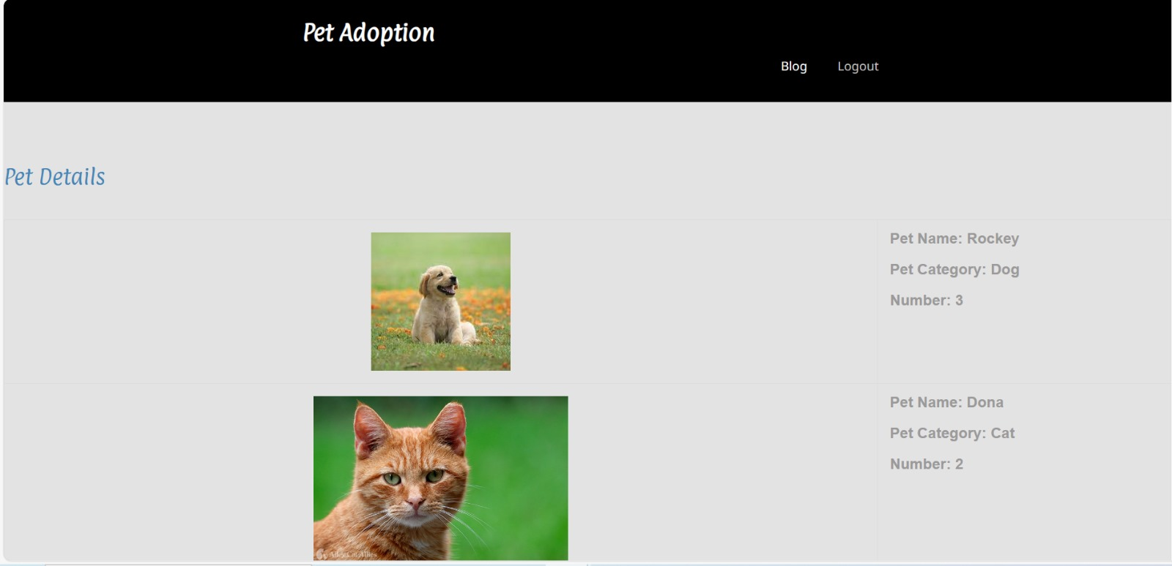
VIEW PAGE- USER

Slide 16
SUMMARY
Deep understanding of CI/CD and best practices
Efficient and reliable software delivery
Automation of deployments using Docker and AWS
CI/CD pipeline with stage settings covering the full application stack
VS Code for code management
Automated testing for code quality

Slide 17
THANK YOU

