Slide 1
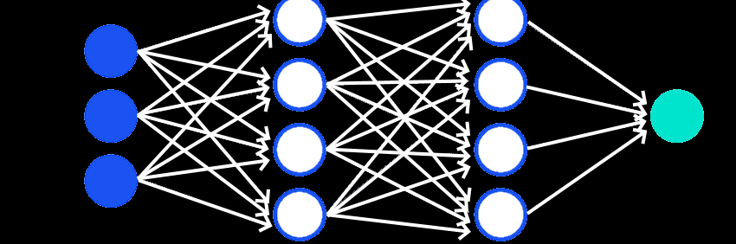
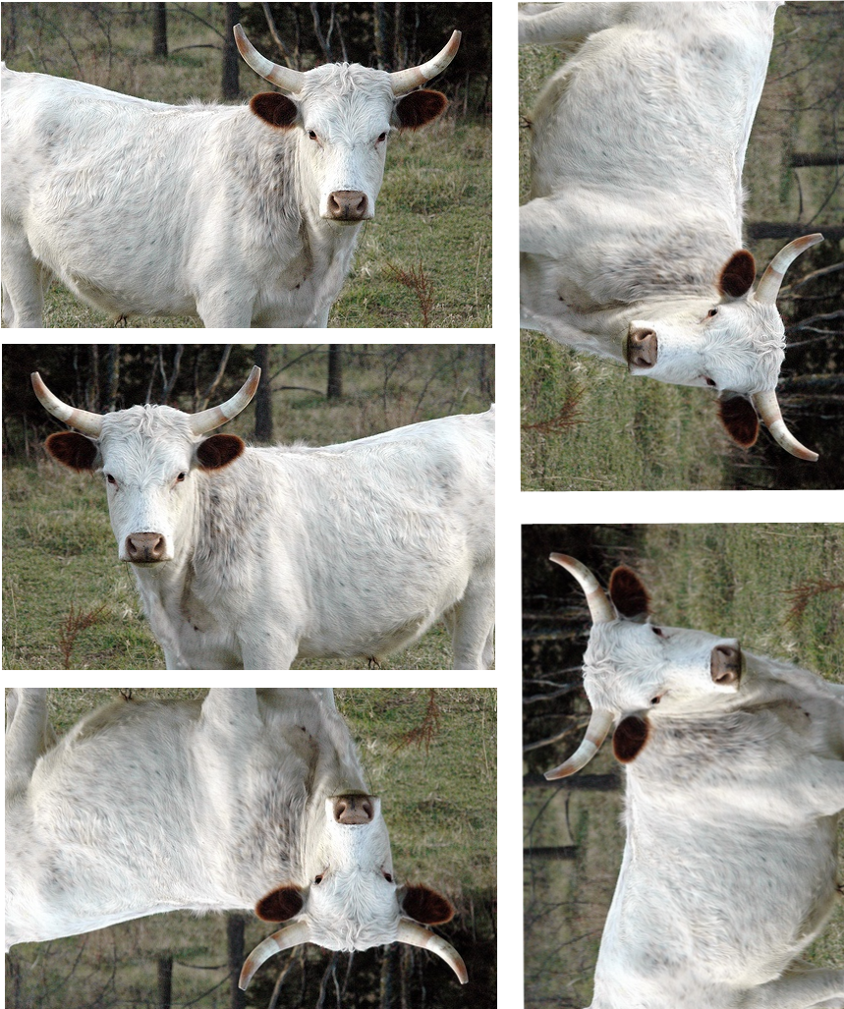
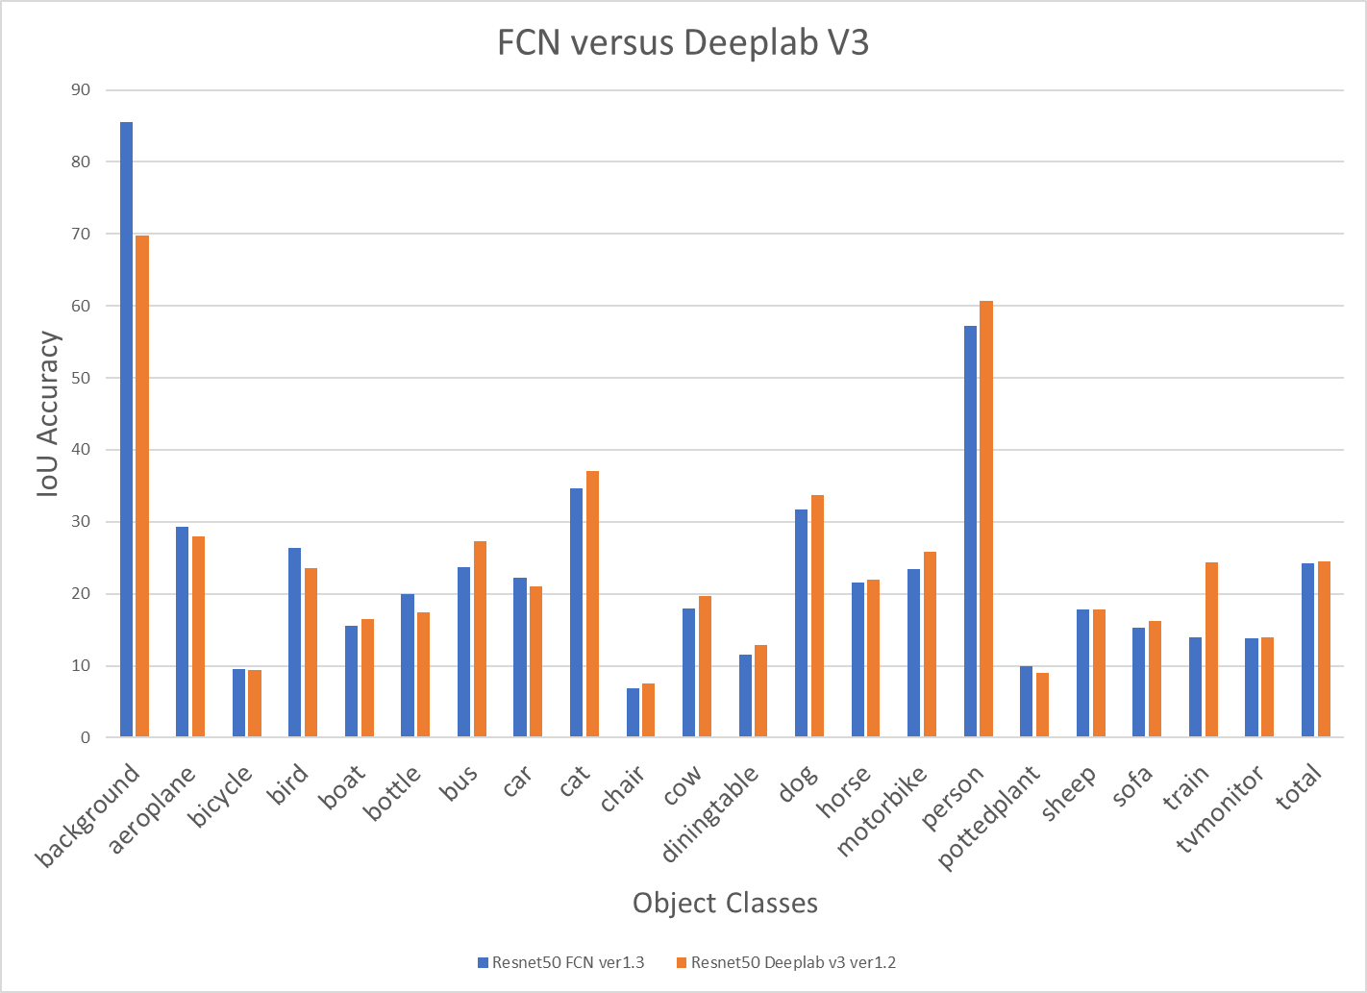
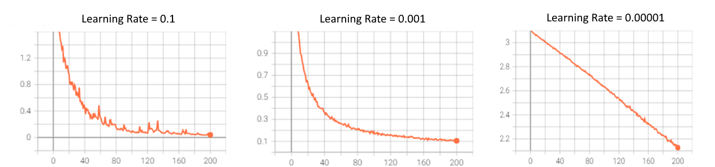
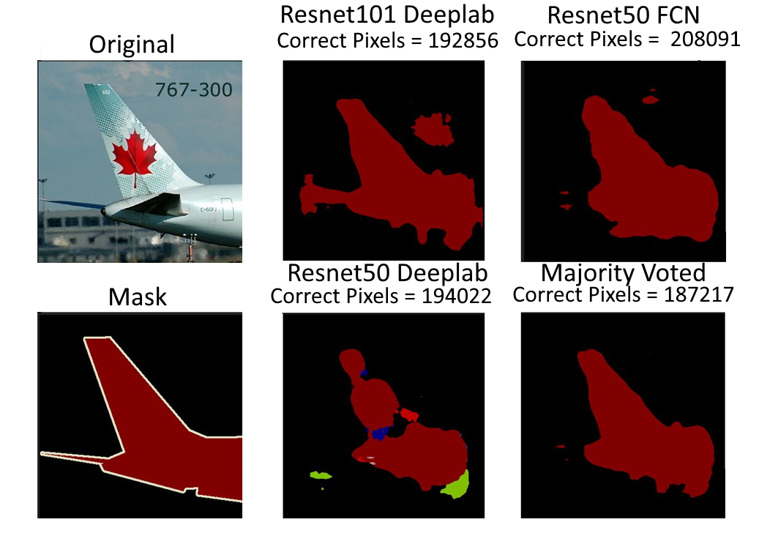
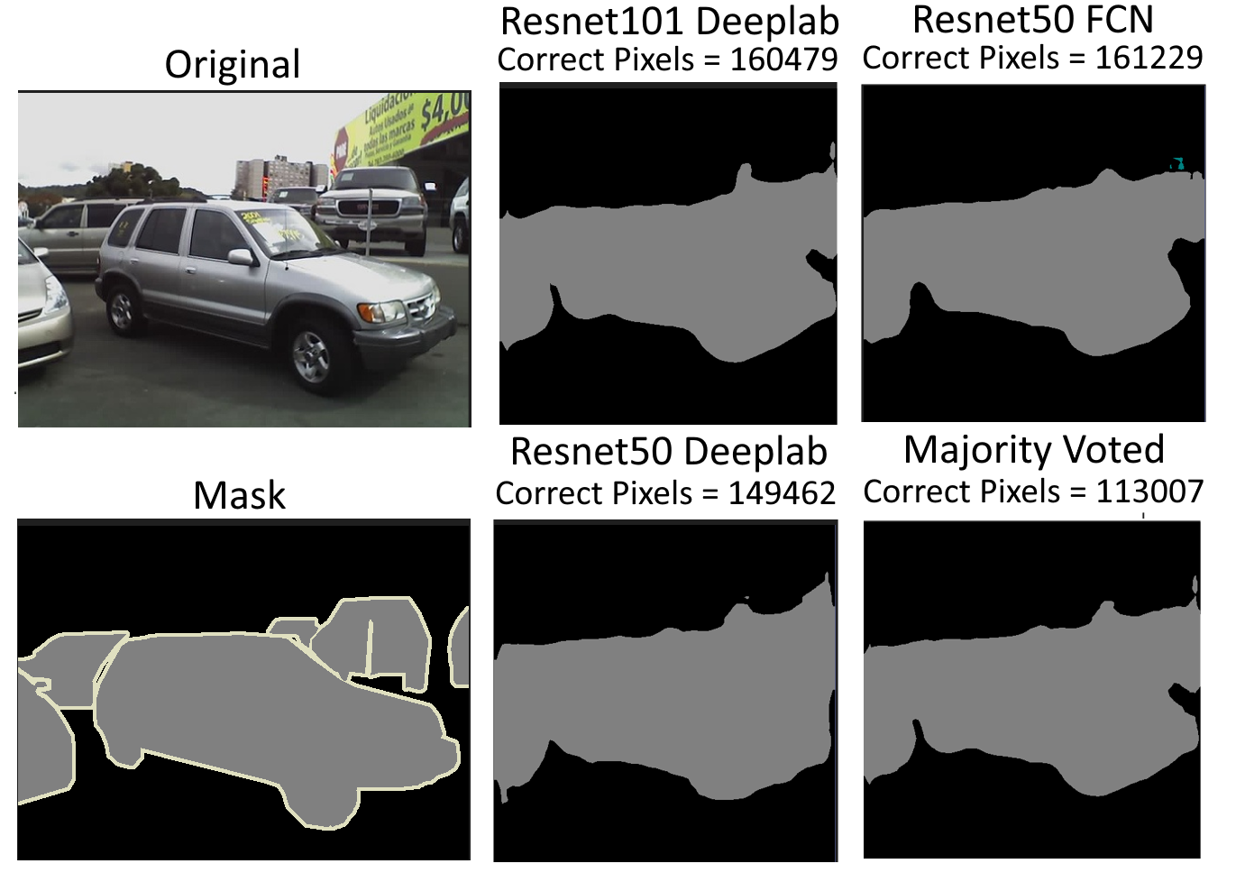
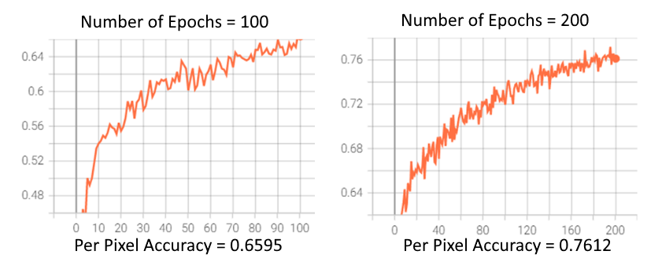
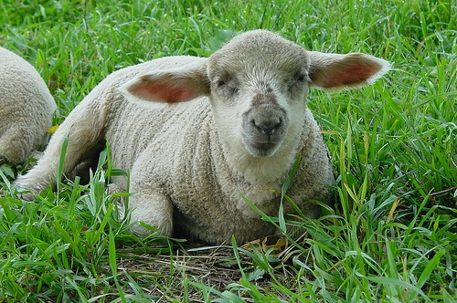
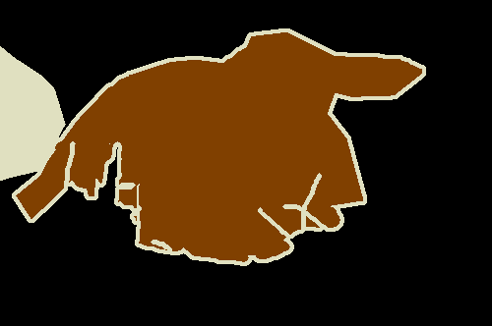
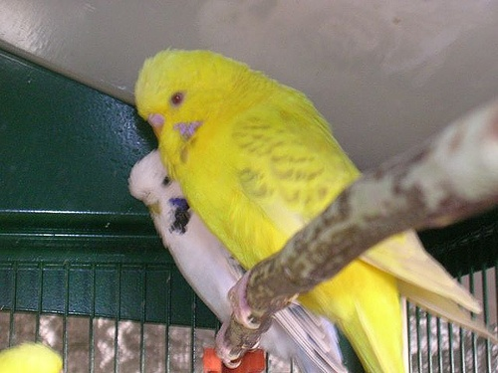

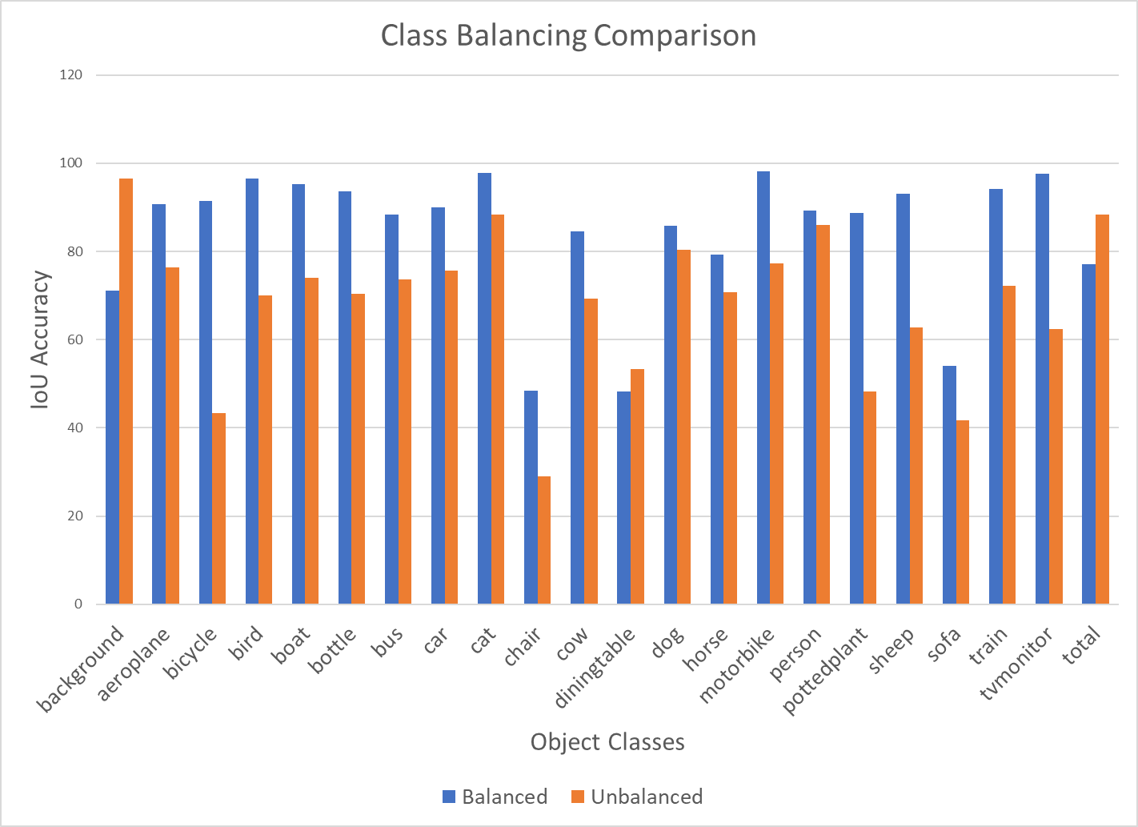
Using Deep Learning to Develop an Android App for Image Segmentation
Alessa Castillo | Faculty Advisor: Dr. Ahana Roy Choudhury | Valdosta State University
Problem Definition
Methods for Testing Accuracy
Results
Analyze the effects of the following on the accuracy of three convolutional neural networks trained on the PascalVOC dataset:
Intersection over Union
Per Pixel
Image Augmentations
This method quantifies the degree of overlap between the object segmented by the model and the actual object in the image
This method calculates the ratio of correctly guessed pixels to the number of pixels in the image
The training images and their masks were randomly rotated or flipped to increase the generalization of the training data
Learning rate | Class balancing
Number of epochs | Augmentations
Majority voting
The Deeplab model was trained using image augmentations while the FCN model was not
Observations
Hypotheses
Learning Rate
Majority Voting
Learning rates 0.0001 or lower are expected to yield a low accuracy model due to undershooting
Learning rates of 0.1 or higher are expected to yield a low accuracy model due to overshooting
Class balancing is expected to increase the accuracy of classes with low frequency and decrease the accuracy of classes with high frequency
Increasing the number of epochs to train the dataset is expected to increase the accuracy of the model
Adding augmentations of random rotating and random horizontal flips to the images is expected to increase the accuracy of the model
Majority voting using all three trained models is expected to increase the accuracy of the segmented image
The majority voting segmentation mask was created by comparing the segmentation outputs of the three models trained
The Resnet101 Deeplab mask was compared pixel by pixel to the other two models and the pixel was changed if the other two shared the same pixel value.
The large learning rate graph shows many spikes which indicates that gradient descent is overshooting and not converging to the global minimum steadily
The good learning rate graph arrives at the minimum without the loss spikes of the previous graph
The linear descent with the small learning rate indicates that the gradient descent is converging too slowly
Number of Epochs
Project Overview
This project uses Android Studio to build an application that loads an image and produces a segmented mapping of the image based on objects in the image
PascalVOC 2012 is the dataset used to train the models It consists of 21 object classes and their masks
This project trains three untrained models from the Semantic Segmentation subpackage of models from PyTorch
1. Resnet101 Deeplab 2. Resnet50 Deeplab 3. Resnet50 FCN
Conclusion
Class Balancing
A learning rate of 0.001 was found to be the most optimal learning rate to train the models with
Class balancing was found to increase the accuracy of low frequency classes and lower the accuracy of high frequency classes
The model trained over 200 epochs was found to be more accurate that the model trained over 100 epochs
Image augmentations were found to decrease the accuracy of the model
Majority voting was found to decrease the accuracy of the model
There is an uneven distribution of images across the 21 object classes in the PascalVOC dataset.
The frequency of each class was calculated by counting the number of instances of each class using the segmented mask provided as labels for the training set images
Image
Mask
Image
Mask
Works Cited
Object | Index | Color | Object | Index | Color
Background | 0 |  | Dining table | 11
Airplane | 1 |  | Dog | 12
Bicycle | 2 |  | Horse | 13
Bird | 3 |  | Motorbike | 14
Boat | 4 |  | Person | 15
Bottle | 5 |  | Potted plant | 16
Bus | 6 |  | Sheep | 17
Car | 7 |  | Sofa | 18
Cat | 8 |  | Train | 19
Chair | 9 |  | TV monitor | 20
Cow | 10 |  | Unlabeled | 255
[1] Arun K. “Understanding Learning Rate in Machine Learning”, Great Learning. August 24, 2020. https://www.mygreatlearning.com/blog/understanding-learning-rate-in-machine-learning/
[2] Daniel j. Bell. “Epoch (machine learning)”, Radiopedia. May 27, 2020 https://radiopaedia.org/articles/epoch-machine-learning?lang=us#:~:text=An%20epoch%20is%20a%20term,of%20data%20is%20very%20large.
[3] Anne Bonner. “The Complete Beginner’s Guide to Deep Learning: Convolutional Neural Networks and Image Classification”, Towards Data Science, February 2, 2019.https://towardsdatascience.com/wtf-is-image-classification-8e78a8235acb
[4] Jason Brownlee. “How to Control the Stability of Training Neural Networks With the Batch Size”, Machine Learning Mastery. January 21, 2019.https://machinelearningmastery.com/how-to-control-the-speed-and-stability-of-training-neural-networks-with-gradient-descent-batch-size/
[5] Sik-Ho Tsang. “Review: DeepLabv3 — Atrous Convolution (Semantic Segmentation)”, Towards Data Science. January 19, 2019.
https://towardsdatascience.com/review-deeplabv3-atrous-convolution-semantic-segmentation-6d818bfd1d74
[6] Priya Dwivedi. “Understanding and Coding a Resnet in Keras”, Towards Data Science. January 4, 2019. https://towardsdatascience.com/understanding-and-coding-a-resnet-in-keras-446d7ff84d33
[7] “Image Segmentation”, Tensorflow. https://www.tensorflow.org/tutorials/images/segmentation
[8] Jeff Tang. “Image Segmentation DeeplabV3 on Android”, PyTorch. https://pytorch.org/tutorials/beginner/deeplabv3_on_android.html
[9] Oleksii Sheremet. “Intersection over union (IoU) calculation for evaluating an image segmentation model”, Towards Data Science. July 24, 2020. https://towardsdatascience.com/intersection-over-union-iou-calculation-for-evaluating-an-image-segmentation-model-8b22e2e84686
Notes:
To change this poster, replace our sample content with your own. Or, if you'd rather start from a clean slate, press the New Slide button on the Home tab to insert a new page. Now enter your text and pictures in the empty placeholders. If you need more placeholders for titles, subtitles or body text, copy any of the existing placeholders, then drag the new one into place.

