Slide 1
Identifying the most important variables influencing a team’s match outcome in Rugby 7s
Rob Chudzik
Springboard Capstone 1 Project

Slide 2
Project Objective
Project Objective
Identifying the most important variables influencing a team’s match outcome in Rugby 7s
Problem Statement
In team sports performance analysis, there are myriad performance variables that impact a team’s performance and match outcome.
The challenge for performance analysts and coaches is to determine which of these variables have the largest impact on a team’s performance and match outcome, i.e., a win or a loss.

Slide 3
Client
The client for this project is the coaching staff of an International Men’s Rugby 7s team (“the team”), and as such, the project will focus on identifying the most important variables for this particular team.
Understanding the most impactful variables will allow the coaching staff to take action to improve in these areas by either allocating more training resources, or by adjusting the team’s tactical or strategic game plans in relation to team strengths and weaknesses.

Slide 4
Data Sources
The source of the data used for this project is World Rugby, the sport’s global governing body.
World Rugby compiles a statistical report at the completion of each tournament throughout the course of the Sevens World Series. For the purposes of this project, I collected data from the 2015-16, 2016-17, and 2017-18 Sevens World Series.

Slide 5

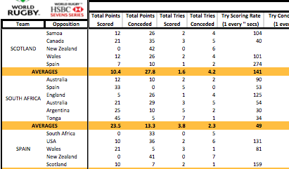
Data Wrangling
Data wrangling challenges
2015-16, 2016-17 World Series data in PDF format
2017-18 World Series data in Excel format
Two different data import, cleaning, and transformation scripts were required to handle the different data formats.

Slide 6
Data Wrangling
An additional challenge was inconsistent features between the PDF and Excel reports.
Steps were taken to develop a common set of features that existed across both reports, or could be engineered from data that existed.

Slide 7
Feature Engineering
Feature engineering included creating:
A “Conversion %” feature (from “Tries” and “Total Points”)
An “Avg Possession Time” feature (total 'Possession Time’/ number of 'Possessions’)
A ‘Result’ feature: Win = 1, Loss = 0, Tie = 2
Created ‘Diff’ data – differential in the total points of the US and their opponent. Represents both teams’ performance in one data point.
Ex., USA 12 – Fiji 24; Diff is -12

Slide 8
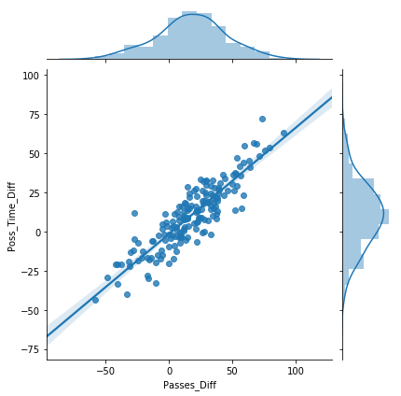
Exploratory Data Analysis (EDA)
Exploration of correlations between variables
Analysis of correlations revealed that the strongest positive correlation is between the Possession Time Difference and Passes Difference (r=0.89).
Makes intuitive sense, as typically the more time a team has possession of the ball, the more passes they will make.

Slide 9
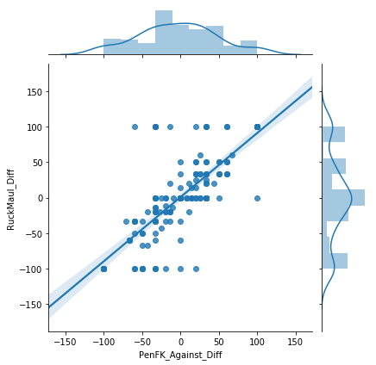
EDA
Additionally, a moderately strong positive correlation between the Penalty-Free Kick Against Diff variable and Ruck Maul Diff (number of rucks/mauls by a team) (r=0.77).
As the number of a team’s rucks rises, so does the incidence of penalties - likely from ruck infringements/penalties.
The ruck is often the most penalized area of the game - that the more rucks in a match, the more potential for penalties.

Slide 10
Data Pre-processing
For each model, the same pre-processing steps were followed:
Features that would bias the prediction, or that were non-numerical, were dropped.
An example of a feature that would bias the prediction is the score differential (‘Score_Diff’)
Because the scale of each feature’s values was so varied, the data needed to be scaled for better model performance, using the scikit-learn ‘StandardScaler’ library.

Slide 11
Model Building
Four different types of classification models were built to predict the result of the matches, and then extract the most important features from that model:
Decision Tree
Logistic Regression
Random Forest
XGBoost (gradient boosted trees)
Each model’s performance was evaluated, and the best performing model was selected as the final model.

Slide 12
Model Selection
The classification models were built, tuned and evaluated.
Each model was tuned using scikit-learn’s GridSearchCV for finding the best hyperparameters.
Model | Precision | Recall | F1 Score
Decision Tree | 0.63 | 0.62 | 0.61
Logistic Regression | 0.55 | 0.52 | 0.53/0.60*
XGBoost | 0.50 | 0.50 | 0.49 / 0.50*
Random Forest | 0.67 | 0.64 | 0.58/0.64*
* sklearn.metrics f1_score

Slide 13
Random Forest Model
After evaluation of performance metrics (using scikit-learn metrics.f1_score) of each model, the Random Forest model was chosen, given it’s higher scores.
Further hyperparameter tuning was performed, using Randomized Search (from scikit-learn’s RandomizedSearchCV) in addition to GridSearchCV.
The model was then run against an unseen validation data set from the most recent tournaments this year. Interestingly, the model performed even better on the validation data, with an F1 score of 0.76.

Slide 14
Feature Importance
The objective of the project is to not only predict the outcome of a match, but also “identify the most important variables influencing a team’s match outcome in Rugby 7s”.
The project’s success is dependent upon providing actionable information that the client – coaching staff of a National 7s team – can use to inform their planning and preparation.

Slide 15
Feature Importance
The method used to identify these important features is the ‘feature_importances_’ attribute of the RandomForestClassifier algorithm, which provides the required method to extract the model’s feature importance.
The table at right shows the feature importances, in order of importance.
Feature | Importance
Contestable_KO_Win_pct_Diff | 0.190070
Poss_Time_Diff | 0.184493
Ruck_Win_pct_Diff | 0.150908
Passes_Diff | 0.149123
PenFK_Against_Diff | 0.105448
Lineout_Win_Pct_Diff | 0.084172
RuckMaul_Diff | 0.060571
Scrum_Win_Pct_Diff | 0.052753
Cards_diff | 0.022462

Slide 16
Actionable Insights
Understanding the most important features of the model is a critical element of solving this project’s “business problem”.
But, the analysis is not meaningful if the insight is not actionable and useful for improving the team’s performance.

Slide 17
Actionable Insights
Contestable Kickoffs Win % (Contestable_KO_Win_pct_Diff)
Contestable Restart Win Percentage as a key factor in USA wins is not surprising, and has become a hallmark of the USA game.
Winning kickoffs often leads to higher time of possession per match, denying the opposition the ball
Serves as solid confirmation of the choice of tactics
Potential actions include:
allocating more training time to kickers and “jumpers” on kickoffs
recruitment focus should be on players who have the required skills or skill potential in these two areas

Slide 18
Actionable Insights
Possession Time and Passes (Poss_Time_Diff and Passes_Diff)
As mentioned earlier, a strong correlation was found between these two features.
makes intuitive sense
the longer a team has the ball, the more passes they are likely to make, passing away from defensive pressure.

Slide 19
Actionable Insights
Ruck Win % (Ruck_Win_pct_Diff )
Observing the USA’s style of play, it becomes clear why Possession Time, Passes and Ruck Win Percentage (‘Ruck_Win_pct_Diff’) are important features in predicting a win or loss for the USA.
The USA plays a patient, possession game, passing the ball from sideline to sideline, winning their rucks to retain possession until the defense is broken down, stretched out of their shape or a favorable matchup is created, and a break is made for a score.

Slide 20
Actionable Insights
The team is successful when these features all work together.
More passes = more possession, and ball retention at the tackle (Ruck Win Percentage) ensures continued possession.
Continued possession is often turned into points.
Combined with winning their own kickoffs, their possession can starve the opposition of the ball
“you can’t score if you don’t have the ball”

Slide 21
Actionable Insights
Actionable insights in this area are twofold:
First, the importance of these features and their relationship to each other serves as data-based confirmation of an effective game plan, which leads to wins when executed
Secondly, a training focus on the elements of the game that this game plan requires – long and accurate passing, contact skills at the tackle, and rucking/cleanout skills to retain possession – will support this game plan.

Slide 22
Future Work
Player/Roster Data
A team’s roster for each match could have an impact on the consistency of the team’s performance across different matches or different tournaments.
Adding match data for individual players enables individual player rating of their contribution or impact to the team
including the impact of not having top players in the team (for ex., due to injury)

Slide 23
Future Work
Tournament Location and Schedule
Exploration of the impact of the tournament location* and the distance a team has to travel to the tournament
Impact of the physiological effects of travel and recovery on the players, ultimately impacting their physical performance
Exploring the distance a team has to travel to the first tournament of a leg, and comparing the team’s performance in the 1st vs. 2nd leg of a tournament would add previously unexplored relationships to the analysis
* The Sevens World Series is played over 5 different “legs” around the world across 5 continents, with each leg consisting of two tournaments on consecutive weekends, typically in the same general geographic region.

Slide 24
Conclusions
Feature importance is an important tool in model evaluation, but 76% model accuracy is not a reliable predictor of a match's outcome.
Interrelationship between Passes, Possession, Ruck Win Percentage, and Contestable Restart Win Percentage does appear to be a strong indicator for the USA
However, the game of Rugby 7s may be too volatile to develop strong and accurate predictors at the match level, at least using the feature set that were used in this model

Slide 25
Conclusions
Preparation for the Sevens World Series cannot be done with data and statistics alone.
Only tell part for the story and offer no context
However, data and statistics can be used to analyze how a team potentially matches up against opponents
Using this data analysis as a starting point for further video analysis inquiry into tactics and technique can provide a tactical advantage

Slide 26
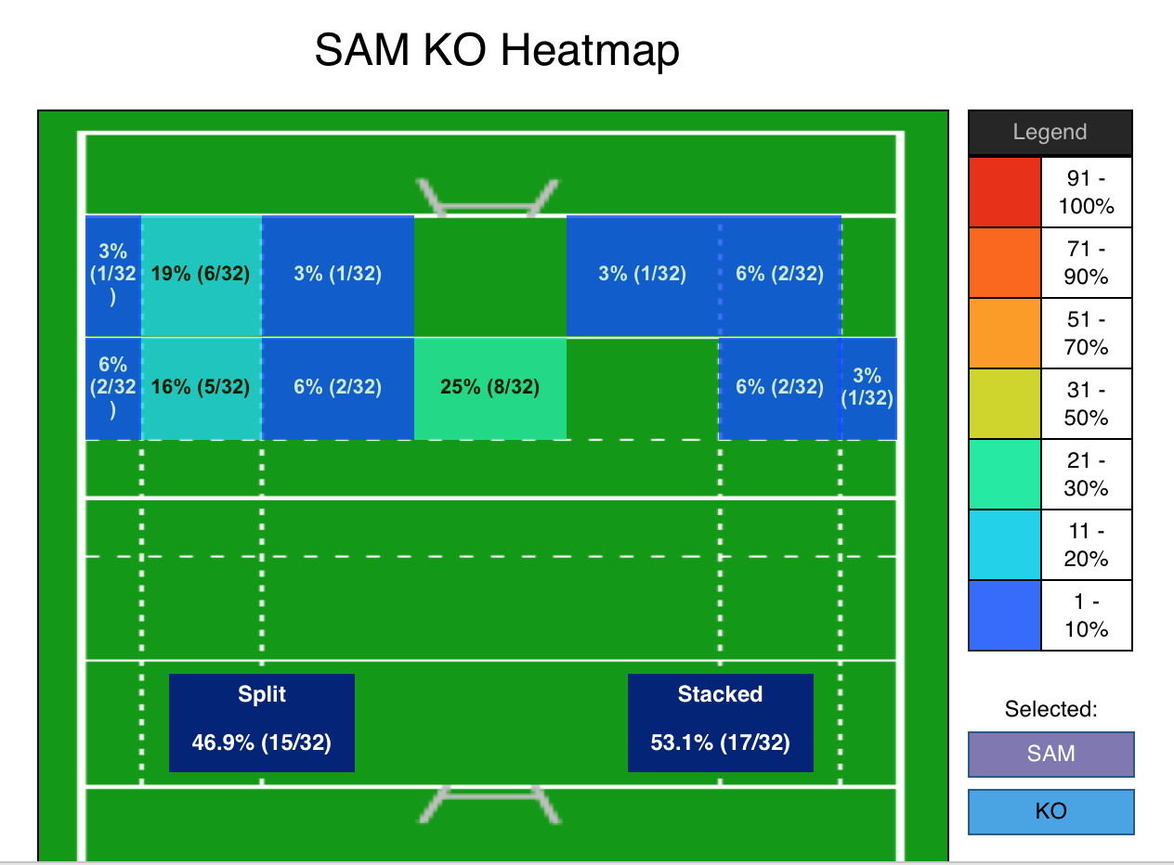
Conclusions
When predictive models are used in tandem with video analysis to provide context, they can combine to form a powerful tool, and is an area that is undoubtedly beginning to be utilized by top teams looking for an advantage.
Kickoff Heatmap

