Slide 1
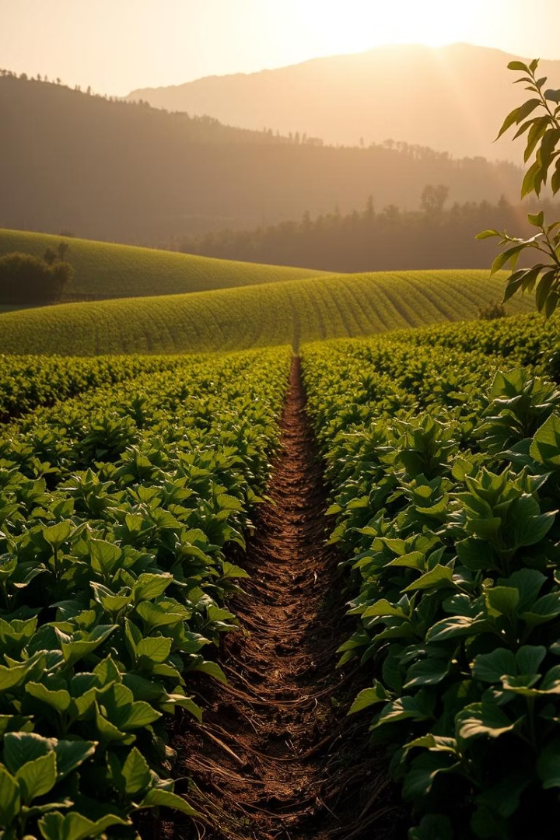

SmartAgro Database: Supporting SDG 2 - Zero Hunger
The SmartAgro database supports Sustainable Development Goal 2 (Zero Hunger) by optimizing agricultural data management to improve food production and distribution.
by Lufene Mark Travis

Slide 2
Problem statement
Despite agriculture being the backbone of Uganda's economy, smallholder farmers face persistent challenges including limited access to reliable data, inefficient supply chain management, and significant post-harvest losses. These issues contribute to low productivity, food insecurity, and poor market access, particularly in rural areas. Current agricultural data systems are fragmented, manual, and lack real-time insights, making it difficult for farmers, policymakers, and stakeholders to make informed decisions. This gap in data-driven agriculture hinders progress toward sustainable development goal 2: zero hunger. There is a pressing need for an integrated digital solution that can centralize, analyze, and disseminate agricultural information to support sustainable farming practices, improve food distribution, and enhance the resilience of the food system.

Slide 3
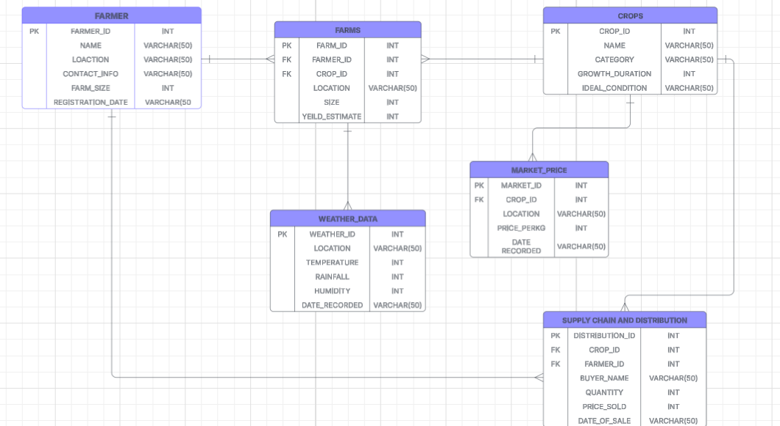
ERD DIAGRAM

Slide 4
HOW IT WORKS
Data Collection
Sources: Farmers, agricultural officers, weather stations, and market observers.
Methods: Stakeholder interviews, field visits, questionnaires, and document analysis.
Tools: Web and mobile interfaces for data entry (e.g., farmer profiles, crop details, sales).
Data Storage
Collected data is structured and stored across six main tables:
Relationship Mapping
The database links key entities: Farmers to their farms, farms to their crops, crops to prices, and so on.
These relationships allow for analysis such as:
Data Analysis & Automation
Algorithms predict yields, detect post-harvest losses, and forecast market demand.
Weather data supports timely alerts for climate adaptation.
Dashboards and reports track real-time performance and SDG alignment.
Decision Support
Insights from data help:
Farmers improve productivity and reduce waste.
Traders access stable markets.
Policymakers and NGOs identify hunger hotspots and plan interventions.
Impact Monitoring
Continuous evaluation tracks:
Crop yield changes, loss reductions, market participation rates.
Automated dashboards and regional reports provide accountability and scalability.

Slide 5
Conclusion
The SmartAgro database is a strategic digital innovation that empowers Uganda’s agricultural sector to address the multifaceted challenges of food insecurity. By centralizing and analyzing critical data on farming activities, crop production, market prices, weather patterns, and supply chains, the system directly supports Sustainable Development Goal 2: Zero Hunger. It enhances decision-making, improves smallholder productivity, reduces food waste, and facilitates resilient agricultural practices. With a clear monitoring framework and alignment to SDG targets such as increased productivity and stable food markets, SmartAgro lays the foundation for a more food-secure and data-driven future in Uganda and beyond.

