Slide 1


Bharati vidyapeeth university college of engineering,pune
RFID based automatic attendance system using raspberry pi
[ E&TC 3rd Year Mini-Project Report ]

Slide 2

Project By
Group Members-
AMIT KUSHWAHA
ASHISH MAGDUM
CHANDRASHEKHAR SINGH
DINESH YADAV
https://github.com/HumbleBee14/rfid_attend

Slide 3
INTRODUCTION
The aim of this project is to maintain the record of the students’ attendance by using RFID tags. Each student is issued with his/ her authorized tag, which can be used for swiping in front of the RFID reader to record their attendance
In most of the colleges and schools, attendance is recorded manually – such a process consumes lots of time. In this proposed system, attendance system is implemented by using advanced wireless technology “RFID”. Only the authorized students are provided with the RFID tags. This tag consists of an inbuilt integrated circuit for storing and processing information
We have designed this automatic attendance system using Raspberry pi 3 board which is a small single-board computer developed on ARM CPU & running Raspbian Operating system which is based on UNIX/LINUX.
Working: RFID Card reader which has Unique ID associated with every card is used to identify every student and is used to take attendance of every student who scans his/her card on the scanner which records the data and stores it in a local database server.
The advantage of using this automatic system is the automation of manual work of taking attendance & flexibility in analysing the data.

Slide 4
Components list
HARDWARE:
Raspberry Pi Board
MFRC522 RFID Reader
16x2 LCD Display
Power Source
Cables
SOFTWARES:
Python [Backend]
Database: SQL,SQlite3 [Backend]
Webpage: HTML/PHP [Frontend]
GUI App: Tkinter [Frontend]
#Approx Cost: ₹4000

Slide 5
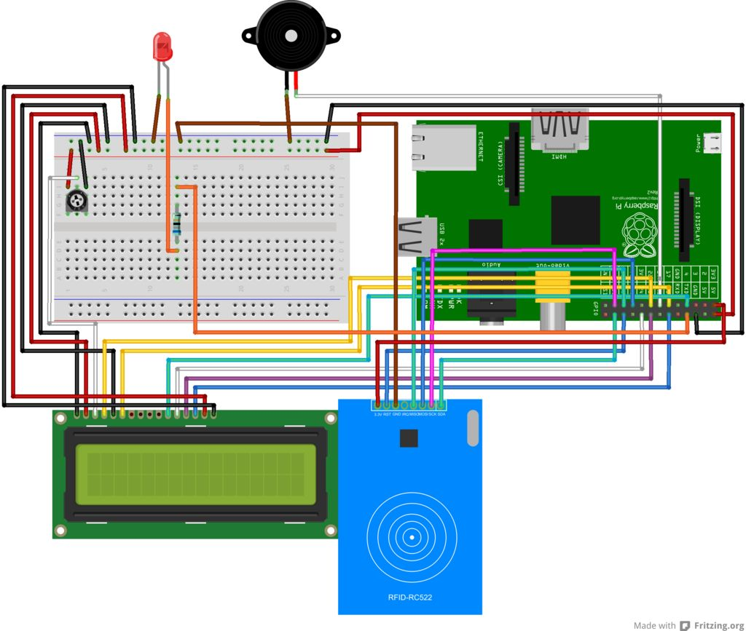
Circuit diagram

Slide 6
Circuit Working
The data stored in this tag is referred to as the identification and attendance of the person. Once the student places the card in front of the RFID reader, it reads the data and compares the data stored in the microcontroller which is programmed by using Python programming language. If the data matches, then it displays the information on the LCD. This RFID attendance system also makes use of the status button for retrieving the status of students’ attendance, which is interfaced to the microcontroller. By using this advanced concept, a lot of time can be saved as all the students’ attendance information is directly stored in the database

Slide 7
Related RFID Applications
As a Attendance Management System in Schools/Colleges/Offices.
RFID Technology for Device Control and Authentication in Industries.
RFID Technology For Books Tracking in Libraries.
RFID Technology for Intelligent Tollgate System.
RFID Technology for Authenication of Passport Details

Slide 8
