Slide 1
Harnessing data from long-term sites to understand the N demands of soil C sequestration
Kent Connell, Brendan O’Neill, & Jennifer Blesh
Tri-Societies Meeting
10/30/2023

Slide 2




Slide 3
Role of N for soil C sequestration
SOM has a C:N ratio of ~10 – 12
100 – 200 Tg of N required to reach the SOC sequestration rates proposed by 4 per mille
C markets need to understand the interactions between multiple biogeochemical cycles and management practices

Slide 4
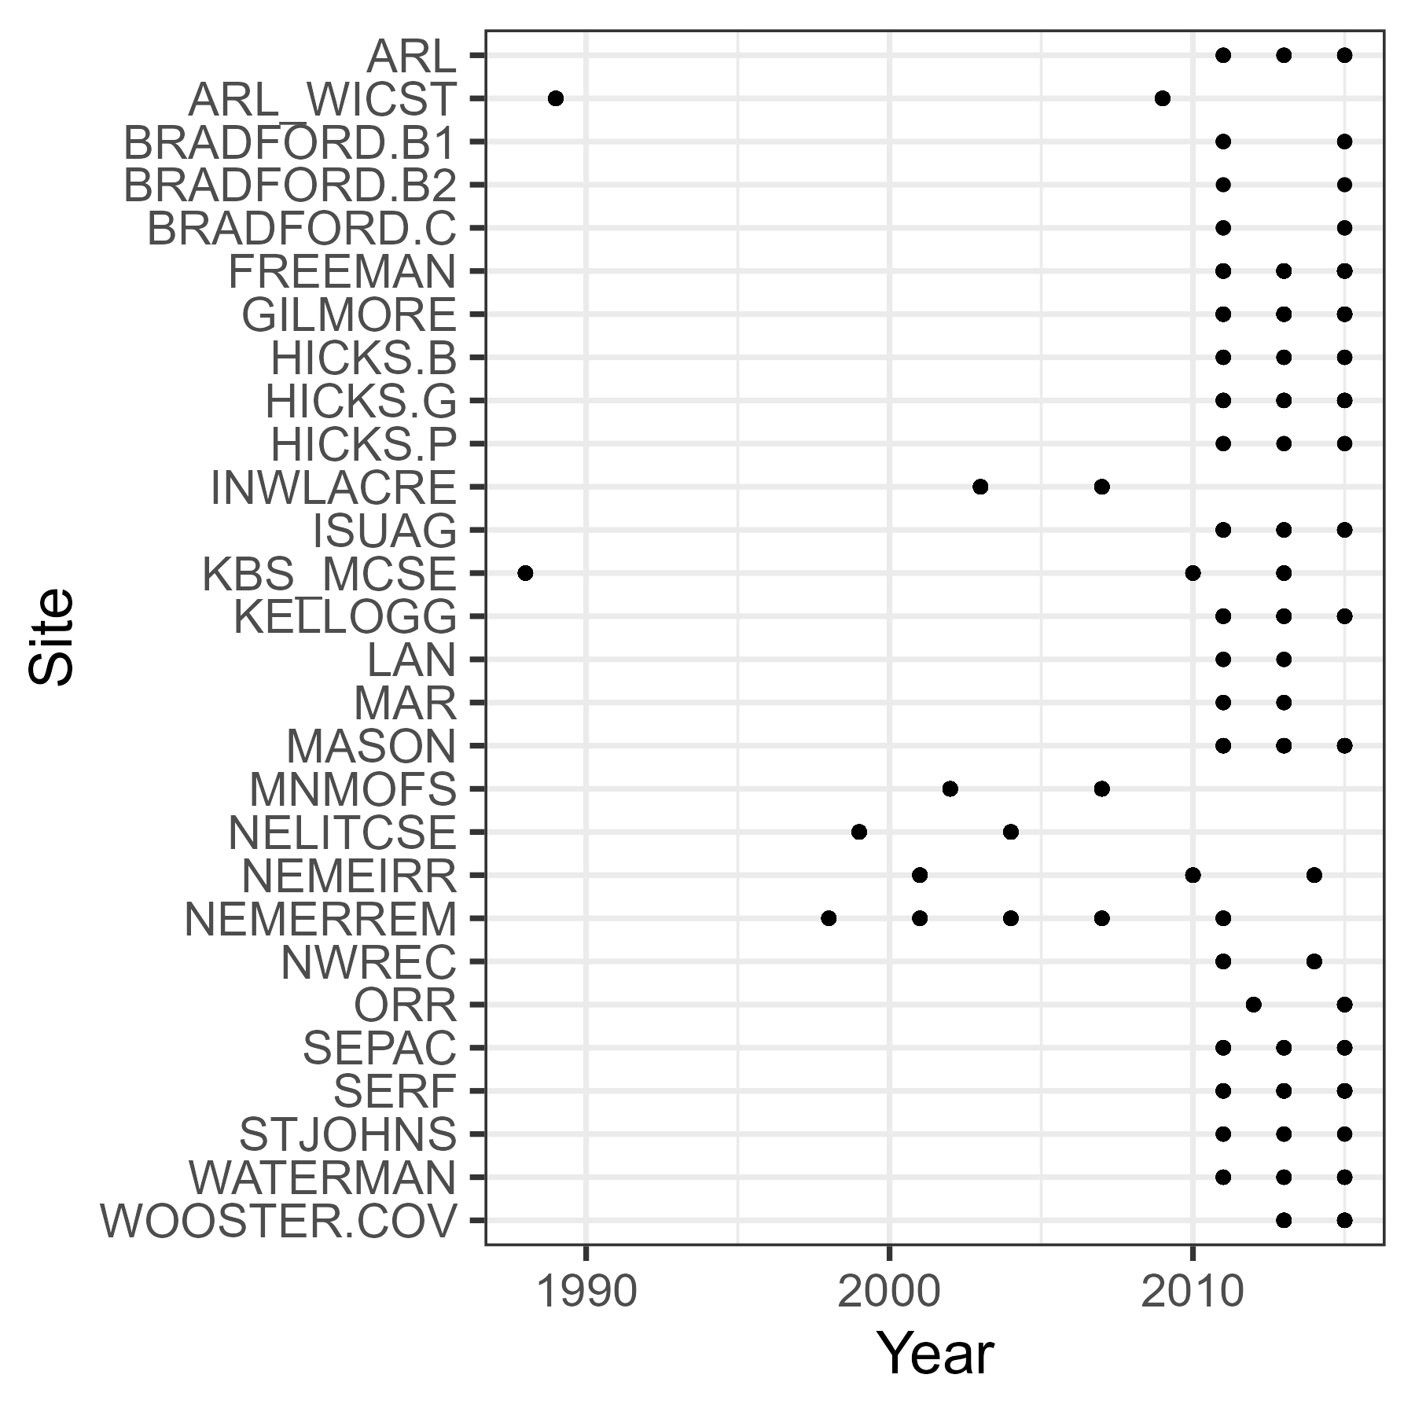
Soil C database
Data taken from long-term agricultural experimental stations
9 states across the US Midwest
Soil C stocks calculated at a depth of 60 cm
Average N inputs from fertilizer and N fixation at each site were calculated across the same time period in which soil C was collected
Still accumulating soil C data for the database

Slide 5
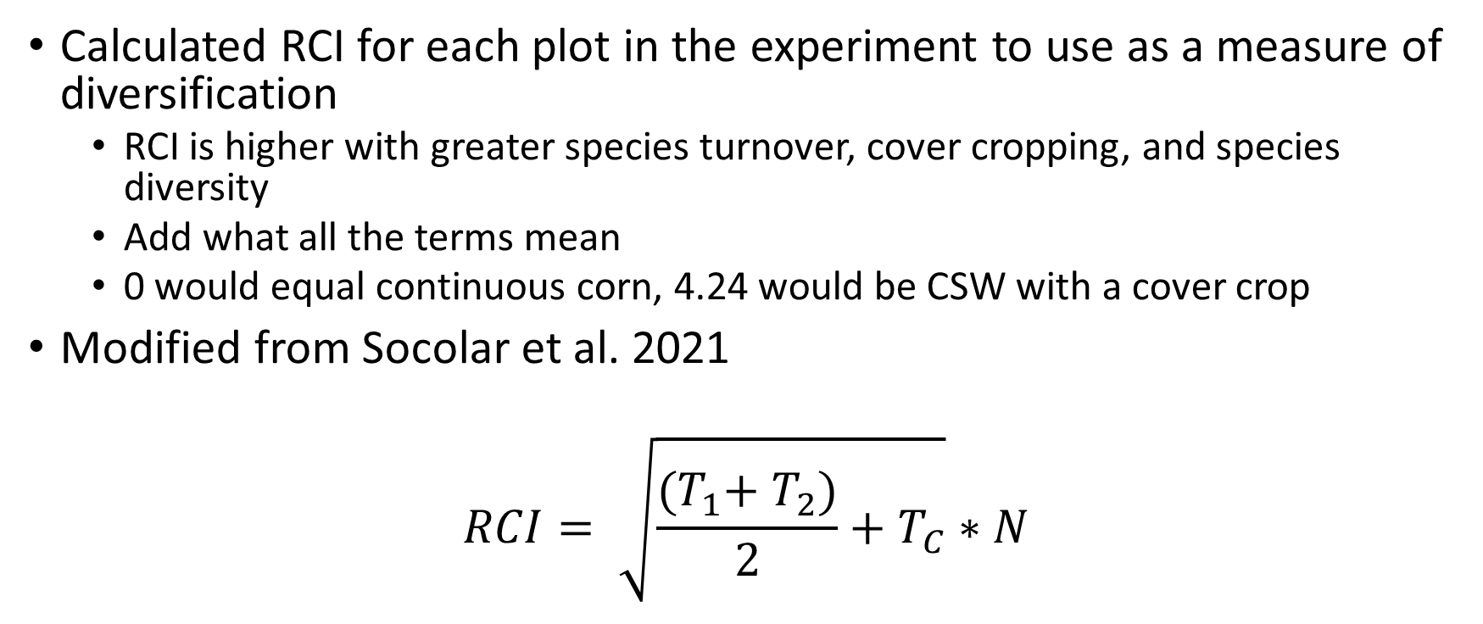
Rotational complexity index
Calculated RCI for each plot in the experiment to use as a measure of diversification
RCI is higher with greater species turnover, cover cropping, and species diversity
Add what all the terms mean
0 would equal continuous corn, 4.24 would be CSW with a cover crop
Modified from Socolar et al. 2021
$$RCI= \sqrt{\frac{{(T}_{1}+ T_{2})}{2}+T_{C}}∗N$$

Slide 6
Across experimental sites, how is the rate of SOC change per unit N impacted by management and diversification?
Hypothesis 1: SOC accumulation per unit N input will increase across the diversification gradient because higher diversity systems will retain a greater proportion of N in the system
How does agroecosystem SOC accumulation change with N inputs?
Hypothesis: SOC accumulation will increase with greater N inputs up to a certain point after which additional N will provide no additional SOC benefits
Hypothesis 2: SOC accumulation per unit N input will be greater in systems with less tillage intensity and in systems that use cover crops

Slide 7
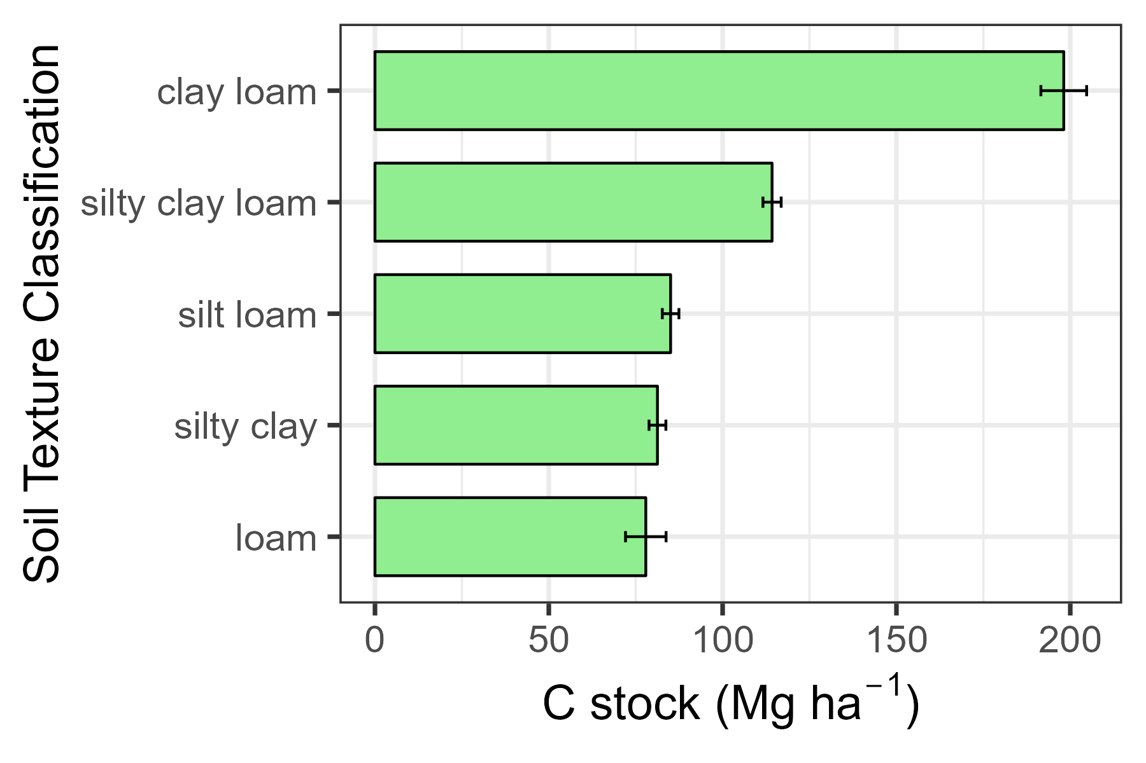
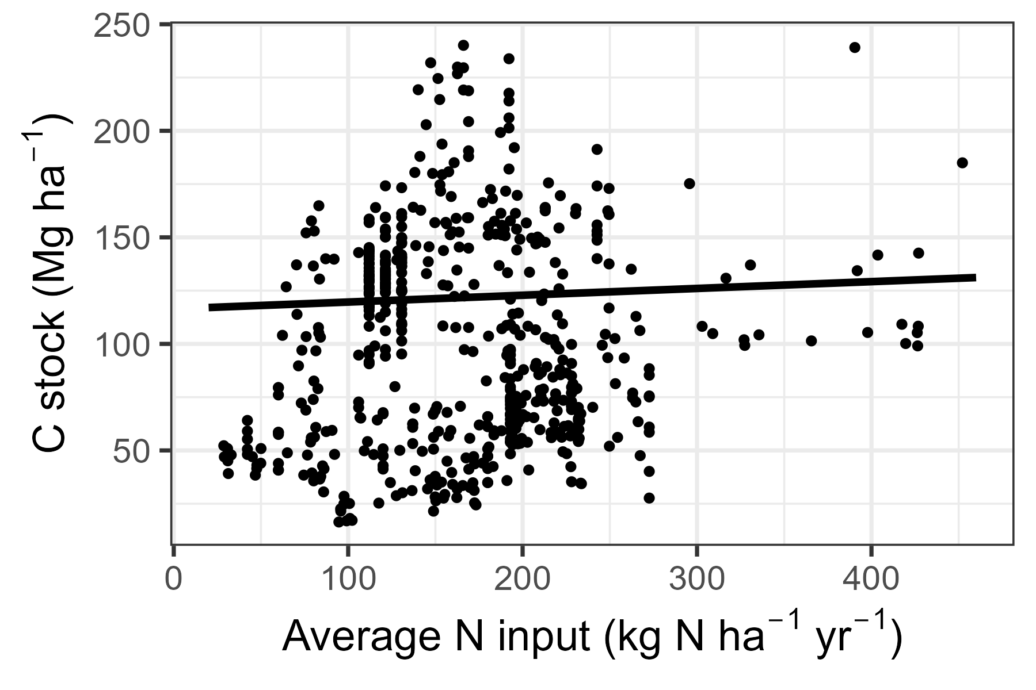
Final soil C stocks were impacted by soil texture and annual N inputs
Notes:
Because of the impact of soil texture on soil C, we include soil texture as a term in all models

Slide 8
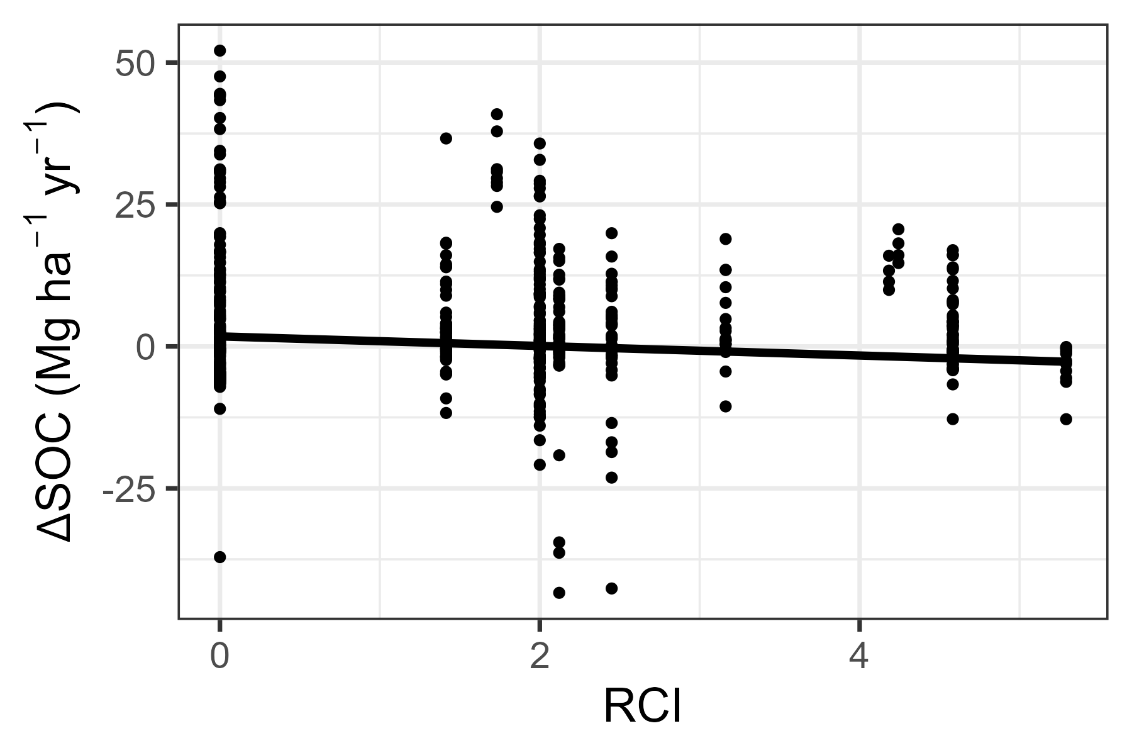
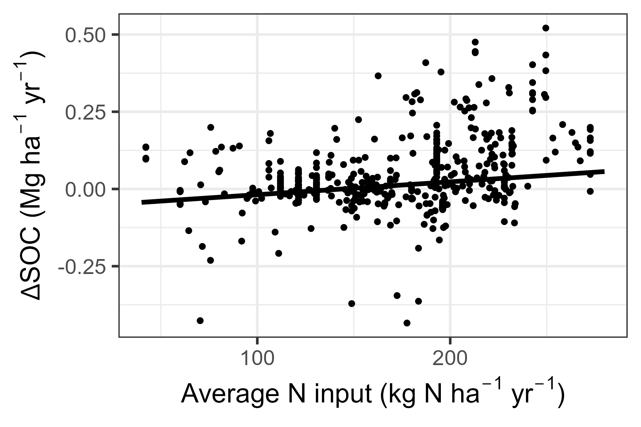
SOC increases at a faster rate in less complex rotations and with greater N inputs

Slide 9
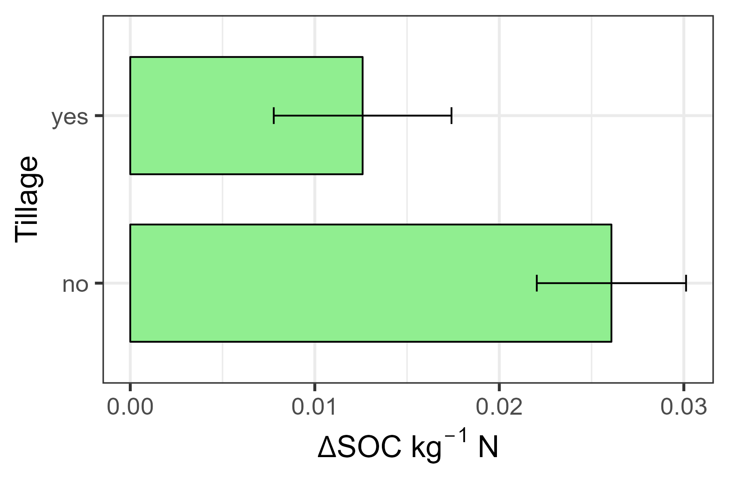
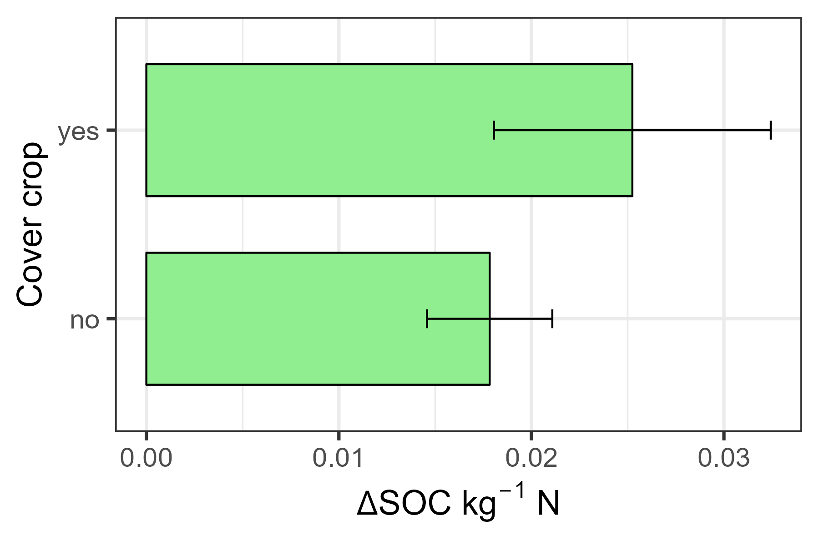
SOC increases more per unit N under no-till systems and when cover crops are used

Slide 10
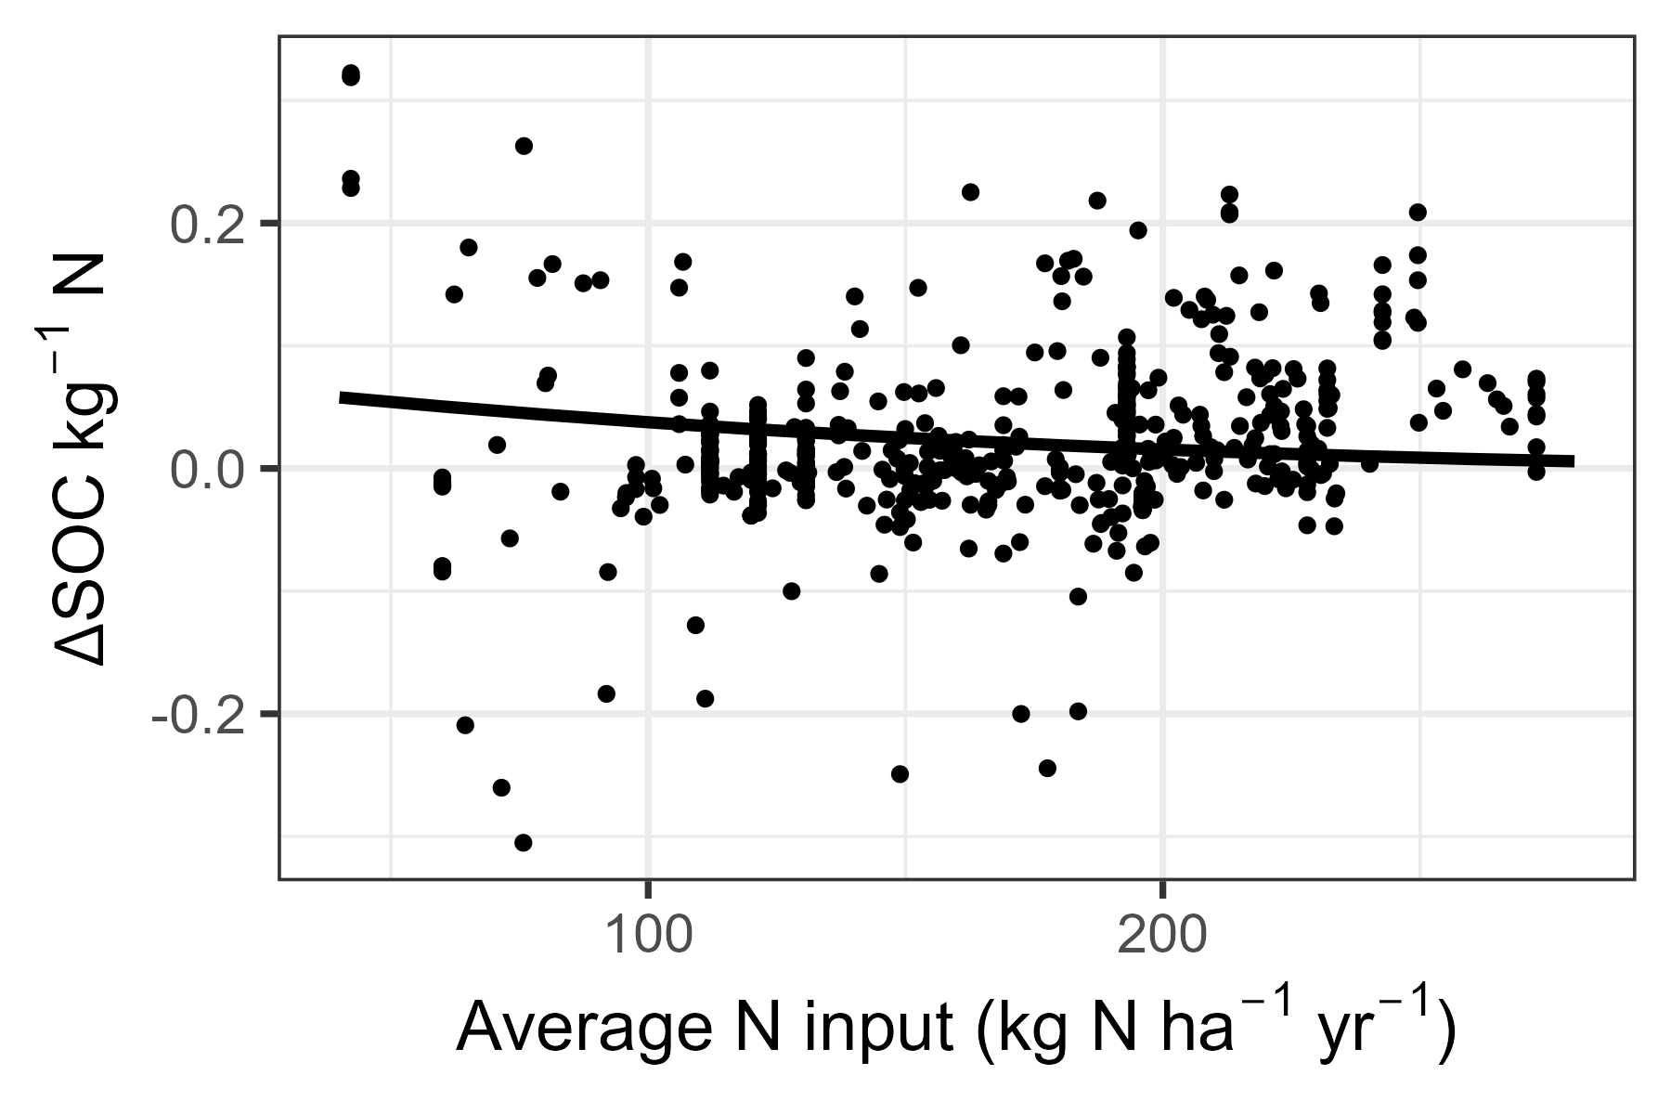
The SOC benefit of N inputs attenuates as N inputs increase

Slide 11
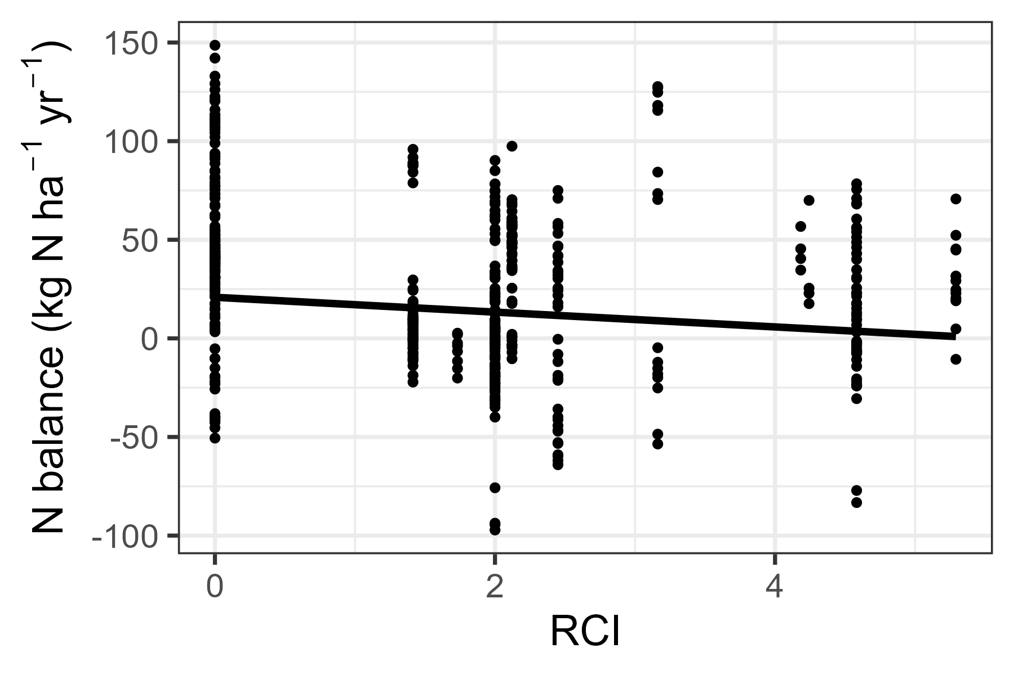
N surpluses decrease across the diversification gradient

Slide 12
Conclusions & next steps
While the N requirement for soil C accumulation did not change across the diversification gradient, it is lower in systems with lower disturbance and cover crop usage
There are diminishing returns in terms of soil C accumulation with each additional unit of N input
Preliminary results suggest trade-off between gains in SOC and N surpluses
We will calculate global warming potential of different systems
How will these patterns hold as longer-term data is added to the database?

Slide 13
Acknowledgments
Austin Crane
Environmental Defense Fund
Everyone responsible for collecting and organizing data from participating sites

