Slide 1
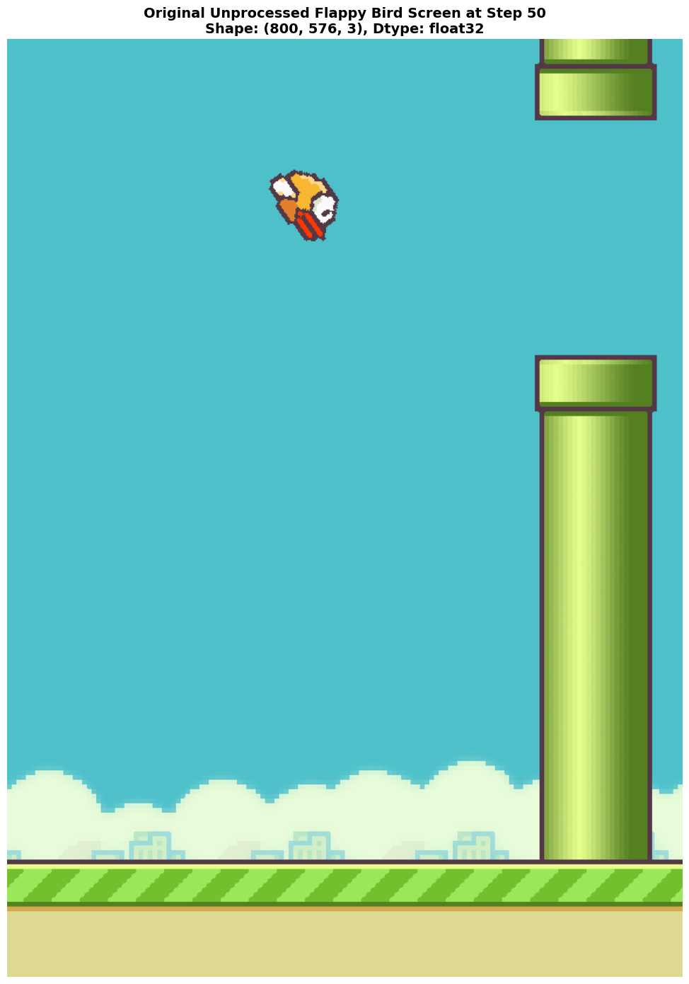
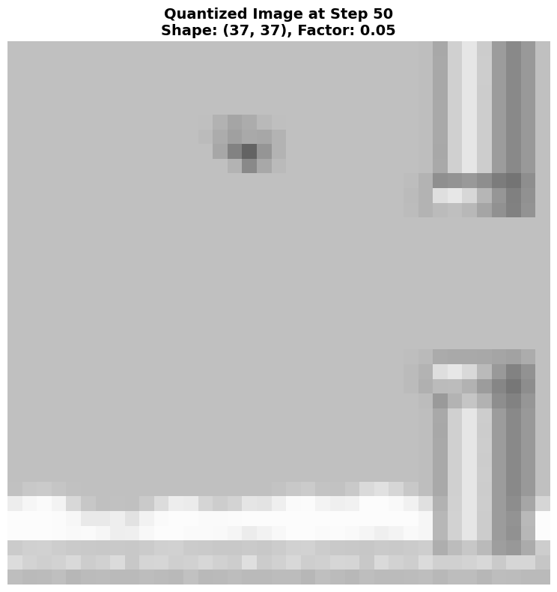
From 800×576 to 37×37: Compressing Visual Input by 99.9%

Slide 2
