Slide 1

People & Workplace
Portal — Training.
Engineering & Solutions That Move Air, Smartly.
HR · CRM · PMC project management — a guided tour
www.humiley.com • contact@humiley.com
HML-DECK-0001 Rev 01.0 • Issued 2026 · Rev 01.0

Slide 2
PART 01
Getting Started

Slide 3
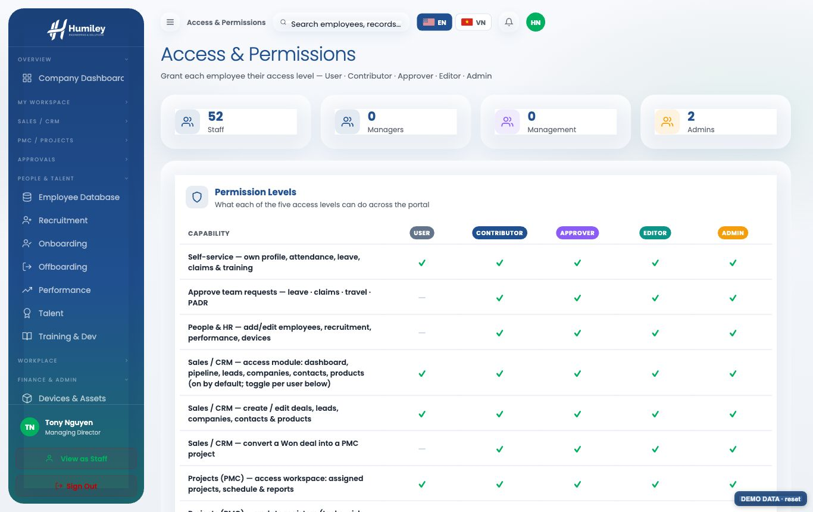

01
Five access levels
▸ Sign in with Microsoft 365 — no password to remember.
▸ Levels build on each other: User → Contributor → Approver → Editor → Admin.
▸ What you see and can do is set by your level + the modules enabled for you.
ACCESS
Page 02 / 19
HML-DECK-0001 Rev 01.0

Slide 4
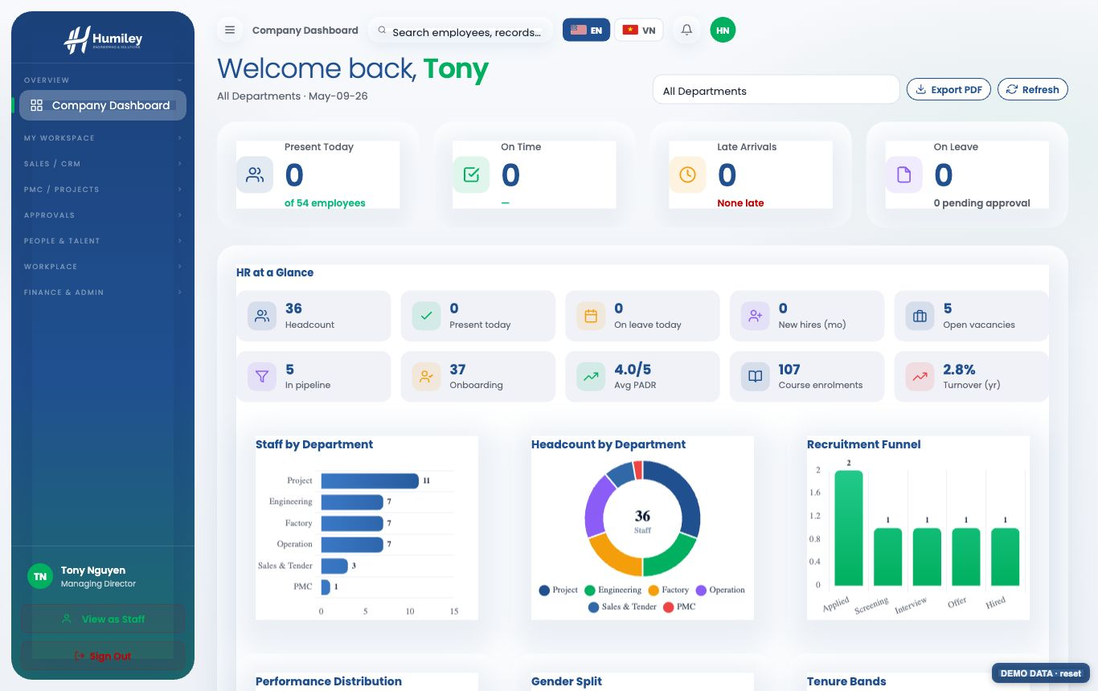
01
Company dashboard
▸ A live snapshot: headcount, attendance, leave, recruitment, performance.
▸ PowerBI-style charts update from real data; filter by department.
▸ Export the view to a branded PDF anytime.
HR DASHBOARD
Page 03 / 19
HML-DECK-0001 Rev 01.0

Slide 5
PART 02
People & HR

Slide 6
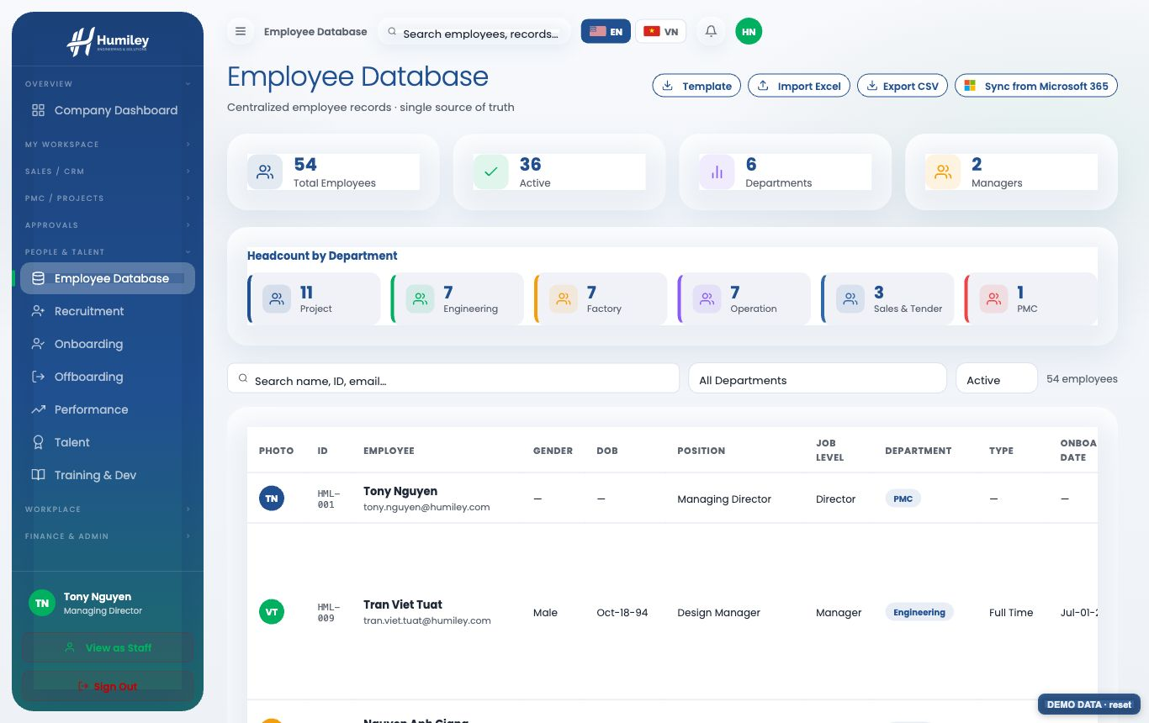
02
Employee database
▸ Full employee records: role, department, devices, documents.
▸ Add, edit, import from Excel/CSV; export for reporting.
▸ Self-service: staff manage their own profile, leave, claims & training.
EMPLOYEE DATABASE
Page 04 / 19
HML-DECK-0001 Rev 01.0

Slide 7
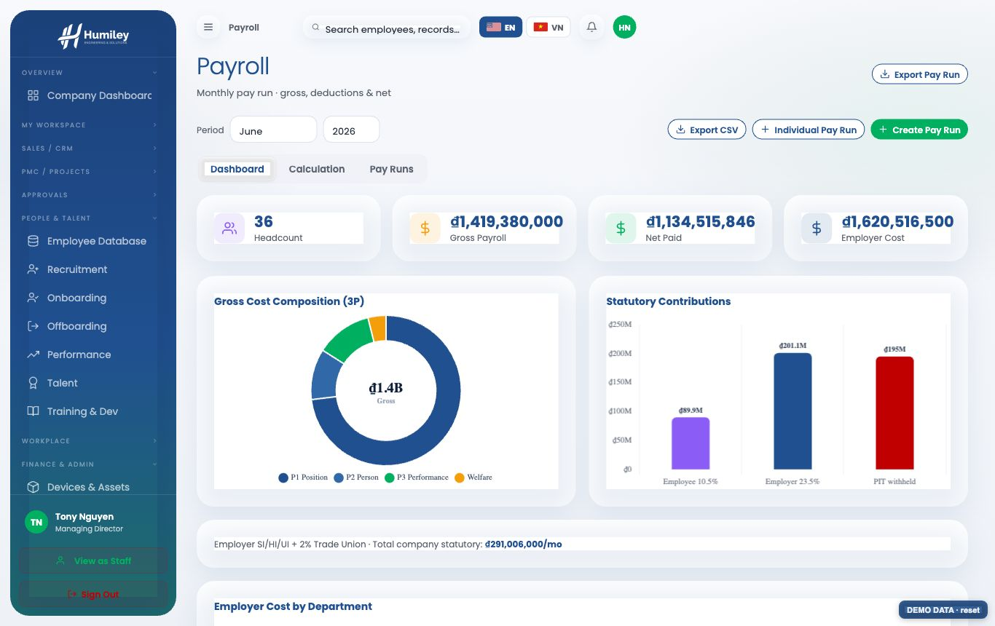
02
Payroll & finance
▸ Monthly pay runs with PIT, SI and employer cost computed automatically.
▸ Visible to Approver+ only; only Editor/Admin can run or edit payroll.
▸ History kept from 2024 — trend charts and exportable reports.
PAYROLL
Page 05 / 19
HML-DECK-0001 Rev 01.0

Slide 8
PART 03
PMC — Project Workspace

Slide 9
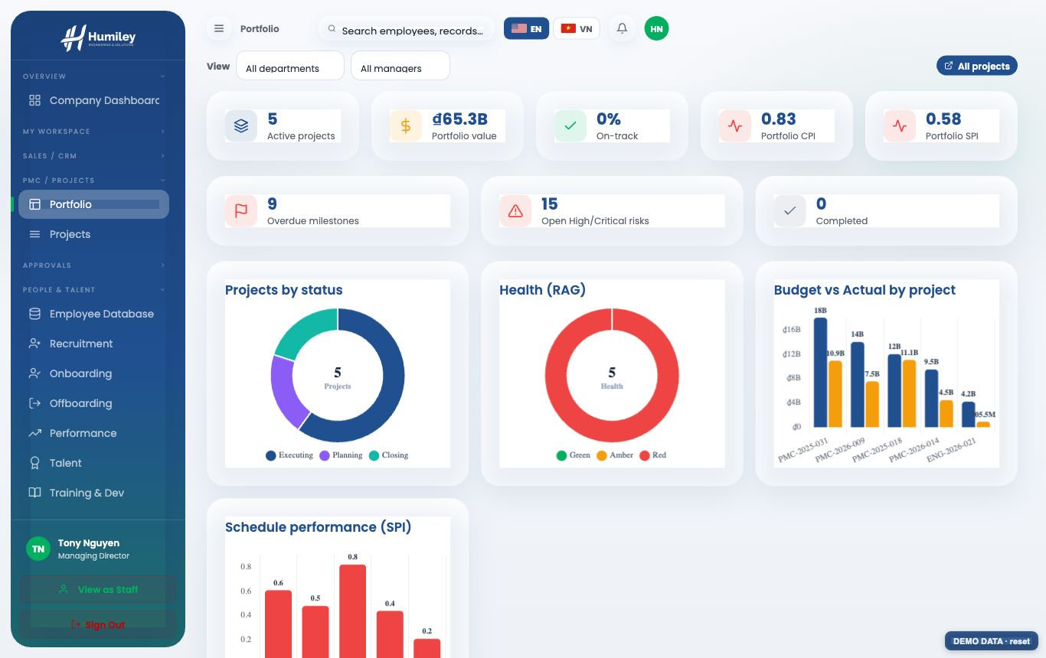
03
Project portfolio
▸ Every project at a glance: value, health (RAG), CPI/SPI, milestones.
▸ Staff see assigned projects; managers see the whole portfolio.
PORTFOLIO
Page 06 / 19
HML-DECK-0001 Rev 01.0

Slide 10
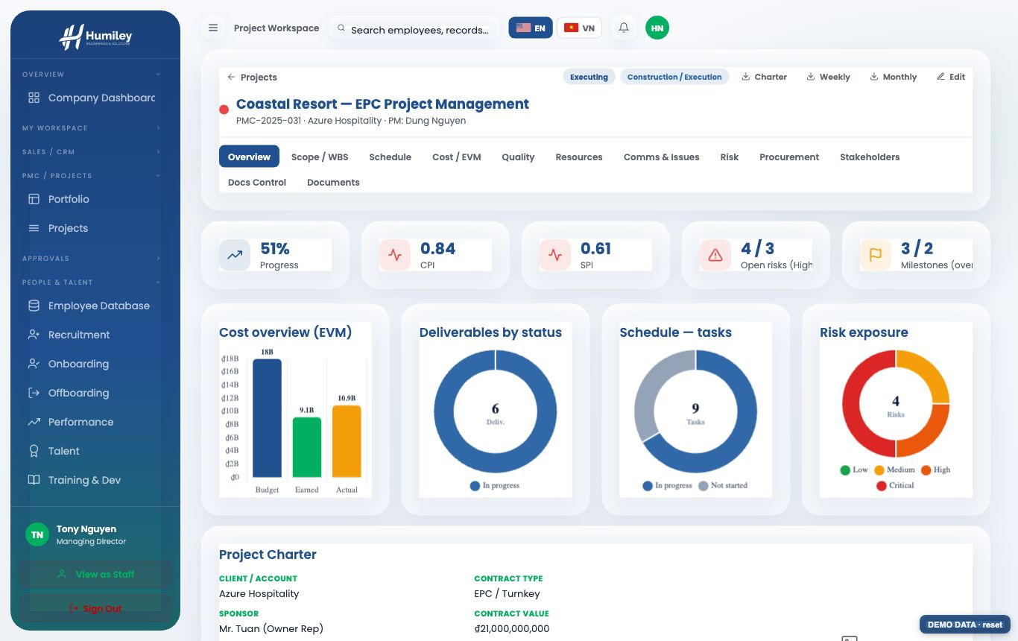
03
Project overview
▸ KPI tiles + charts: cost (EVM), deliverables, schedule, risk exposure.
▸ The project charter, change log and lessons learned, all in one place.
OVERVIEW
Page 07 / 19
HML-DECK-0001 Rev 01.0

Slide 11
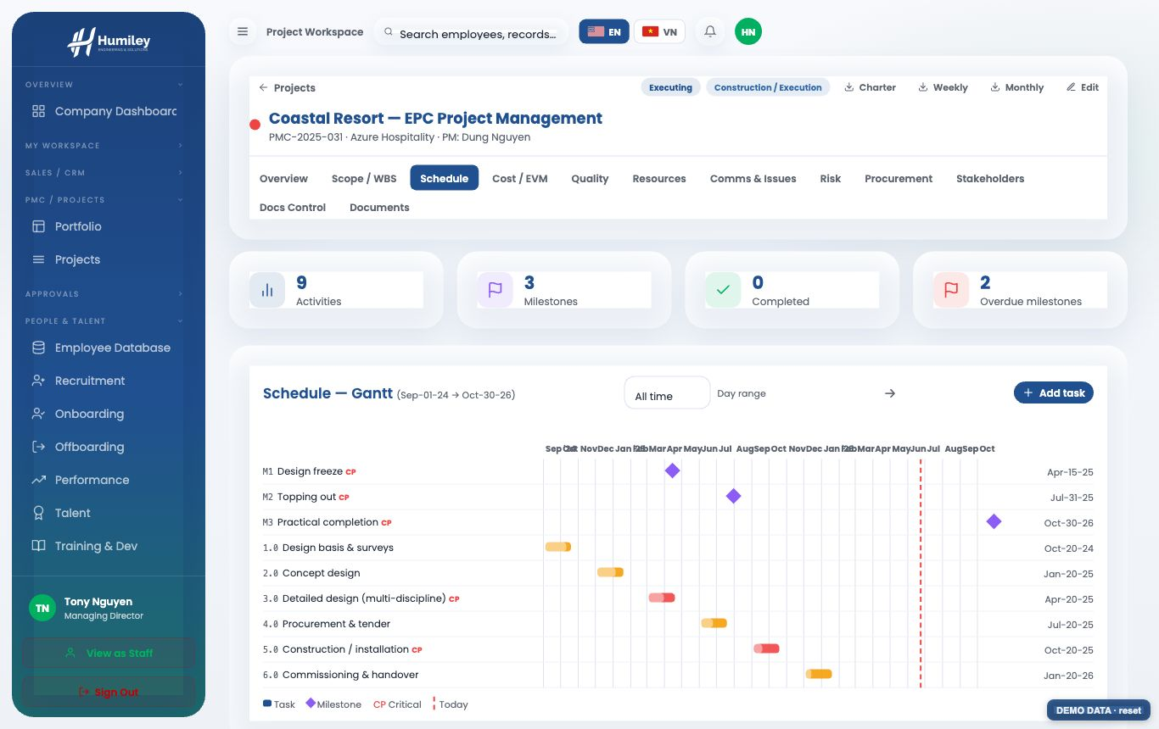
03
Schedule — Gantt
▸ A Gantt timeline with milestones, the critical path and a today line.
▸ Filter by all / year / month, or a custom day-to-day range; export PDF.
SCHEDULE
Page 08 / 19
HML-DECK-0001 Rev 01.0

Slide 12
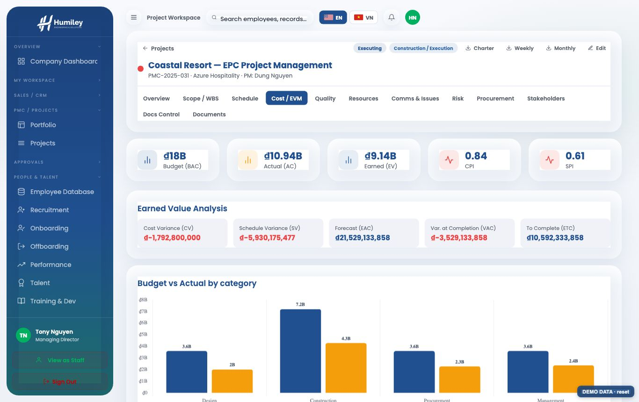
03
Cost & earned value
▸ Budget vs committed vs actual by category, with CPI/SPI and forecast (EAC).
▸ Earned-value analysis gives an early warning on cost and schedule.
COST / EVM
Page 09 / 19
HML-DECK-0001 Rev 01.0

Slide 13
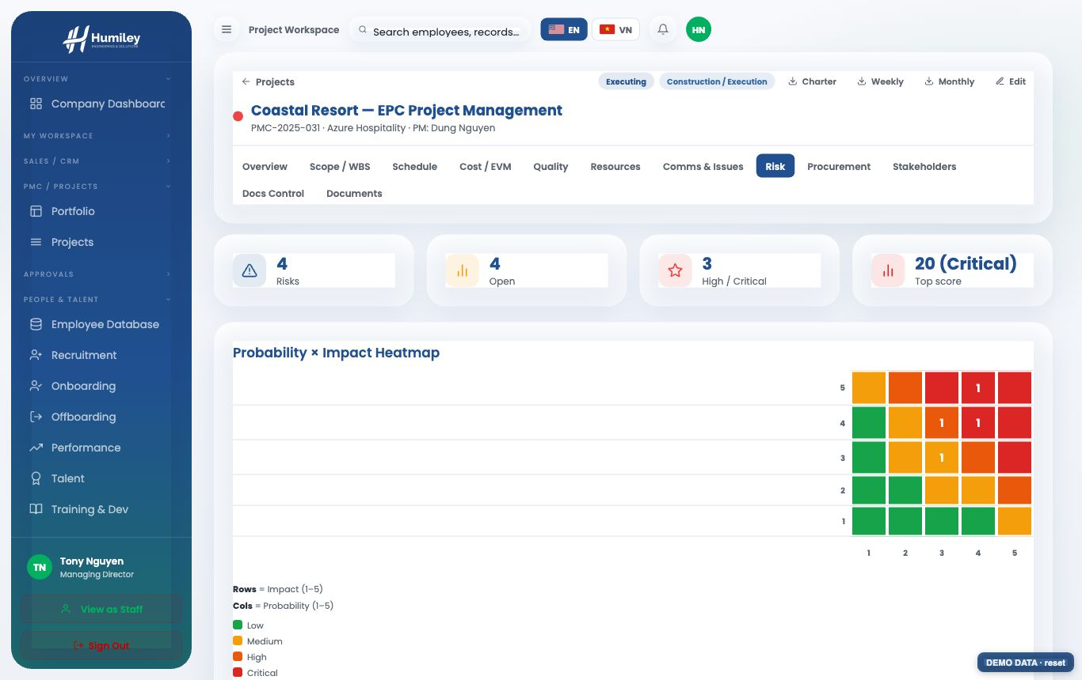
03
Risk register & heatmap
▸ Probability × impact heatmap; auto-scored bands (Low→Critical).
▸ Filter the register by category, response, owner, contractor or status.
RISK
Page 10 / 19
HML-DECK-0001 Rev 01.0

Slide 14
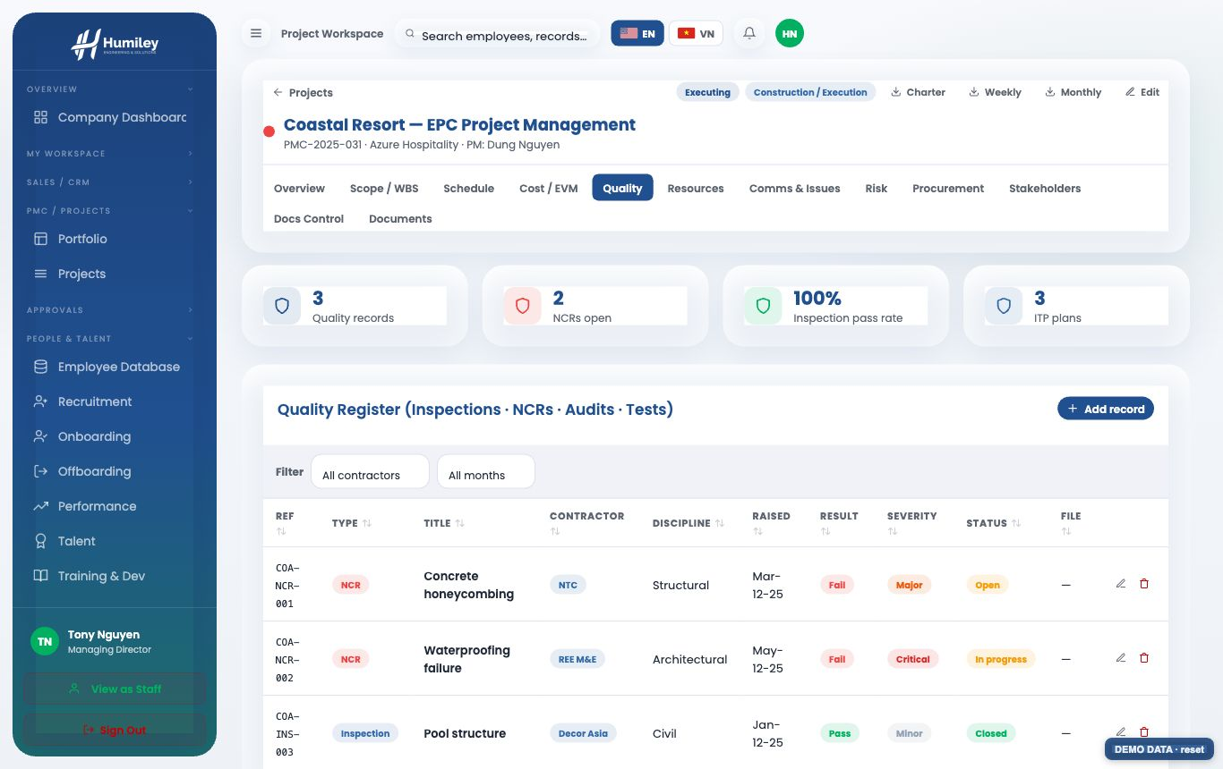
03
Quality & ITP timeline
▸ Inspections, NCRs, audits and tests in one quality register.
▸ Inspection & Test Plans on a timeline with a day-range filter.
QUALITY / ITP
Page 11 / 19
HML-DECK-0001 Rev 01.0

Slide 15
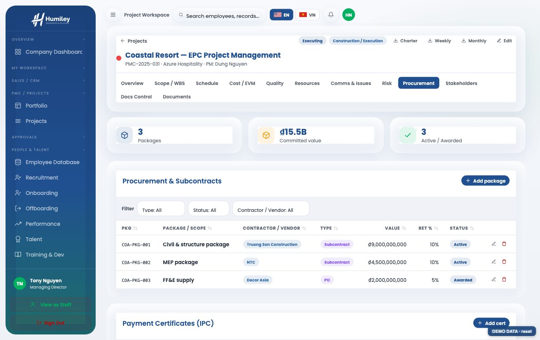
03
Procurement & contracts
▸ Subcontract packages, vendors, values, retention and payment certificates.
▸ Filterable register; cost/procurement edits are manager-only.
PROCUREMENT
Page 12 / 19
HML-DECK-0001 Rev 01.0

Slide 16
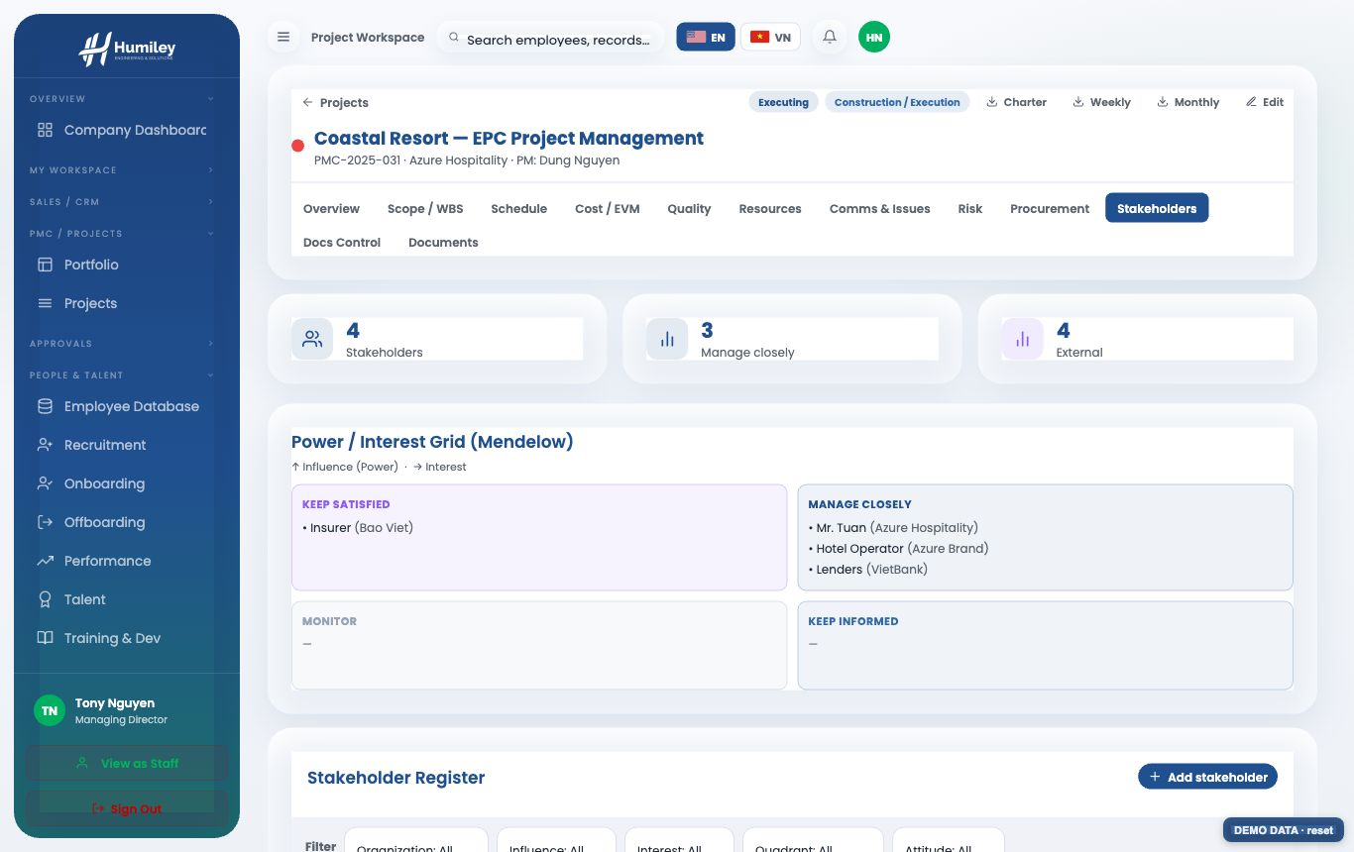
03
Stakeholders (Mendelow)
▸ Power / interest grid places each stakeholder in the right quadrant.
▸ Track influence, interest and attitude to plan engagement.
STAKEHOLDERS
Page 13 / 19
HML-DECK-0001 Rev 01.0

Slide 17
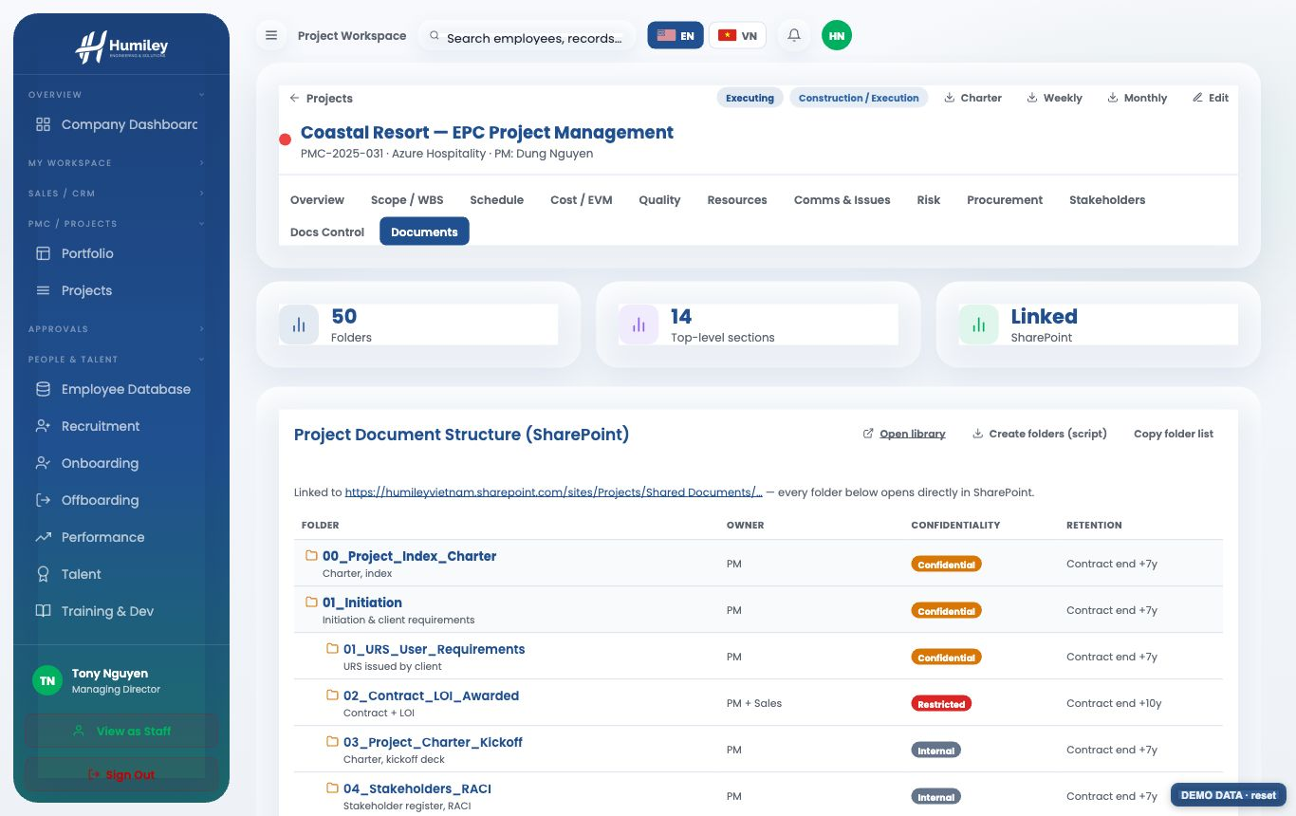
03
SharePoint document structure
▸ Paste the project's SharePoint link in Edit → it builds the full folder tree.
▸ 50 standard PMC folders with owner, confidentiality and retention.
▸ Every folder is a one-click link straight into SharePoint.
DOCUMENTS
Page 14 / 19
HML-DECK-0001 Rev 01.0

Slide 18
PART 04
Sales & Administration

Slide 19
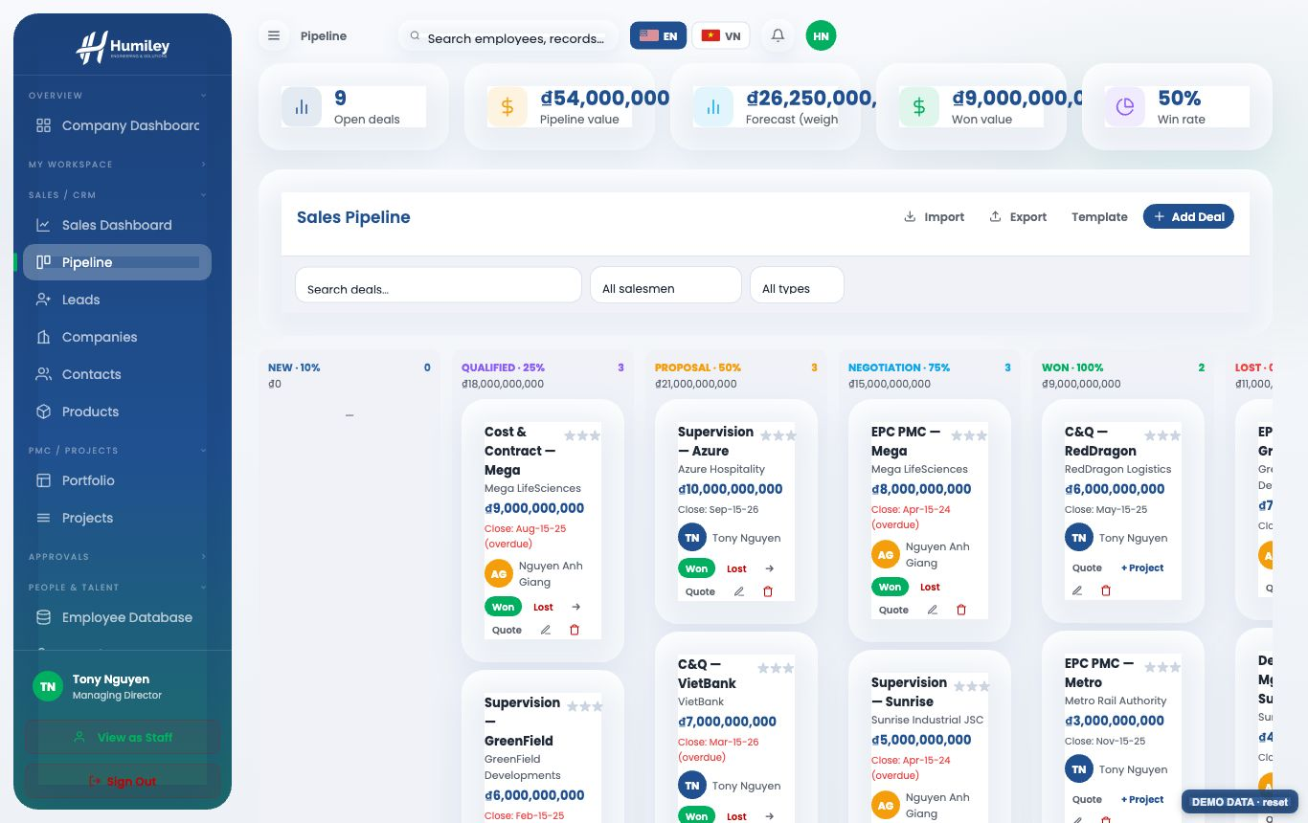
04
Sales pipeline (CRM)
▸ Deals by stage with value and probability; companies, contacts, products.
▸ Convert a Won deal into a PMC project in one click (manager+).
CRM
Page 15 / 19
HML-DECK-0001 Rev 01.0

Slide 20
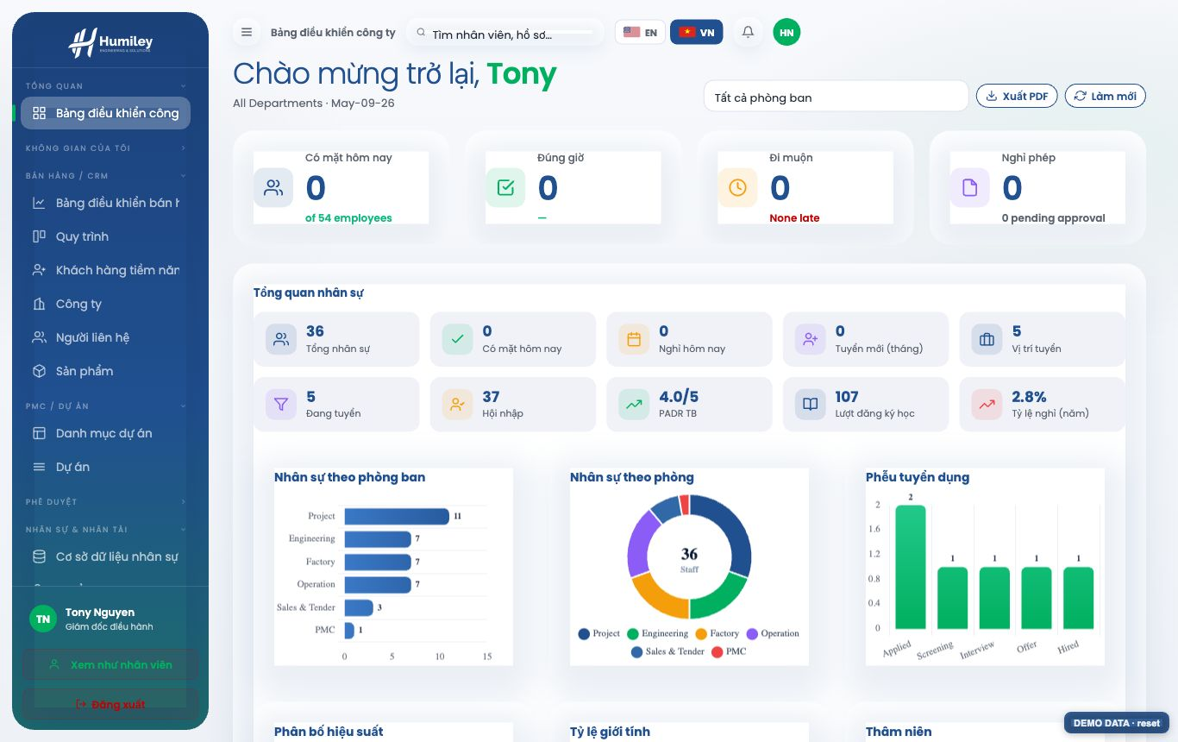
04
English & Vietnamese
▸ Switch the whole portal between EN and VN with the flag in the top bar.
▸ Labels, menus, tables and chart legends all translate.
LANGUAGE
Page 16 / 19
HML-DECK-0001 Rev 01.0

Slide 21
Questions?
+84 (28) 7300-1010
contact@humiley.com
www.humiley.com
2nd Floor, 68 Nguyen Hue, Sai Gon Ward, HCMC, Vietnam
Engineering & Solutions That Move Air, Smartly.

