Slide 1
Company name: Skylark

Slide 2
devices
Router
Switch
Server: Web
Server: DNS
Server: DHCP
PC (wired)
Laptop (Wireless)
Printer

Slide 3
Network diagram

Slide 4
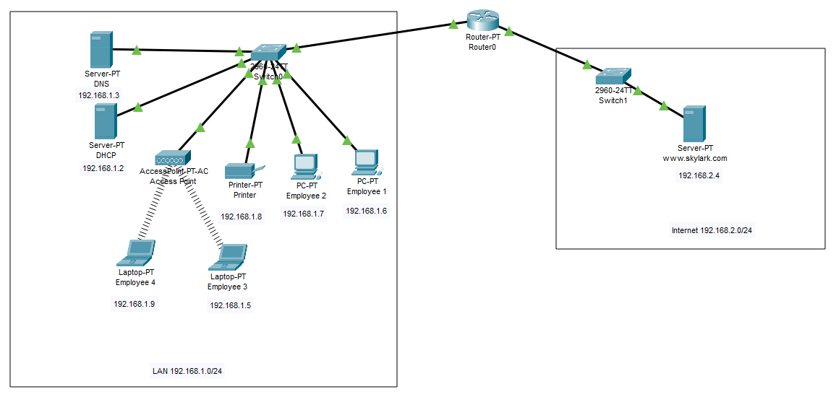

Slide 5
discussion

Slide 6
The network consists of a local network LAN 192.168.1.0/24 and Internet 192.168.2.0/24
The local network consists of a DNS server, DHCP server, and clients.
Clients, Employee 1 and Employee 2 are connected through wire whereas Employee 3 and Employee 4 are connected wireless.
DHCP conducts all the IP configuration.
The printer is connected by wire and accessible by all the employees.
LAN is connected with the Web server through the router.

Slide 7
THANK YOU
Humira Saria

