Slide 1

100%
GET SCORE
GIVE SCORE
LEARNING
SEARCH BUTTON
SETTINGS
TO-DO REMINDERS
NOTIFICATIONS
Photo
FRAME OF MIND
ADD
VIEW
MY SCORE
FEEDS / WORK AREA
FULL NAME
MY SPACE
ABOUT ME
MY PERSONAL PROFILE
MY DOCUMENTS
SKILL MATRIX
FRAME OF MIND
MY COACH
SKILL MATRIX
MY DEVELOPMENT PLAN
MY PROFESSIONAL PROFILE
MY ACTIVITIES
REPORTS AND DASHBOARD
MY GOALS
MY ACCOMPOLISHMENTS
I AM COACH
SWOT
MY WORK
POST (PHOTO/VIDEO/ARTICLES)
JOBS
MY CONNECTIONS
MESSENGER
MY RESUME
MY OWN SITE
EMAIL
GROUPS
TOOLS
WHITE BOARD
ASSESSMENT TOOL
PLANNER
REWARDS AND RECOGNITION
SURVEY
EVERYDAY NOTES

Slide 2
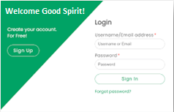

1. Sign-Up: | First Name *
 | Last Name *
 | Email ID (With Verify option) *
 | Contact Number (With Verify OTP option) *
2. Log-In Authentication and Page
User Name or Email*
Password*
Forget Password

Slide 3
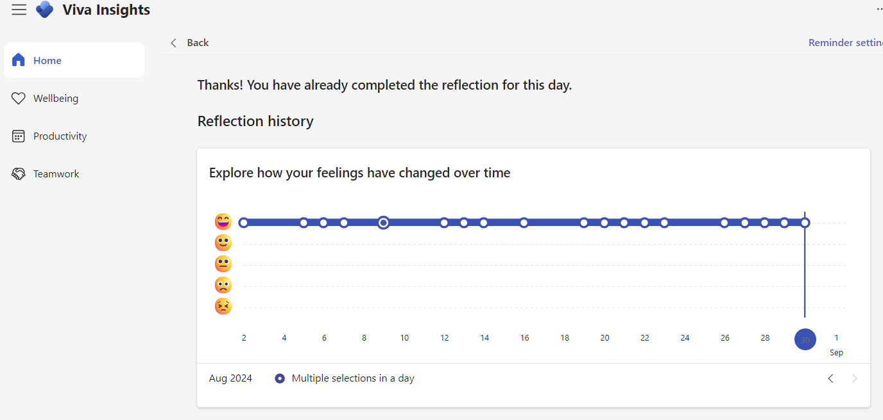
FRAME OF MIND

Slide 4
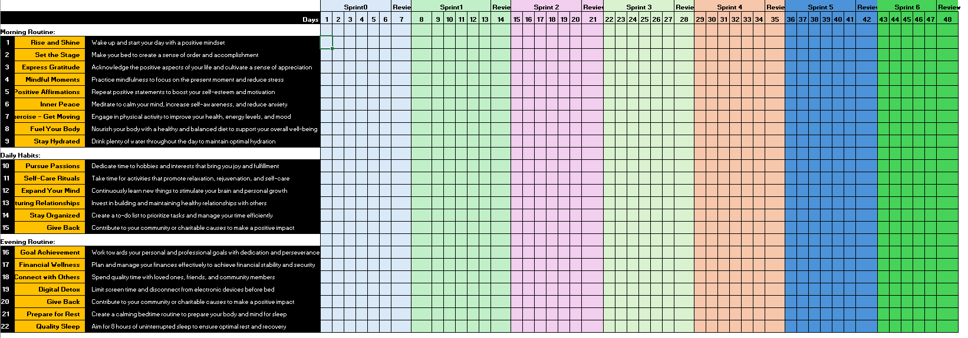
DAILY HABIT TRACKER

Slide 5
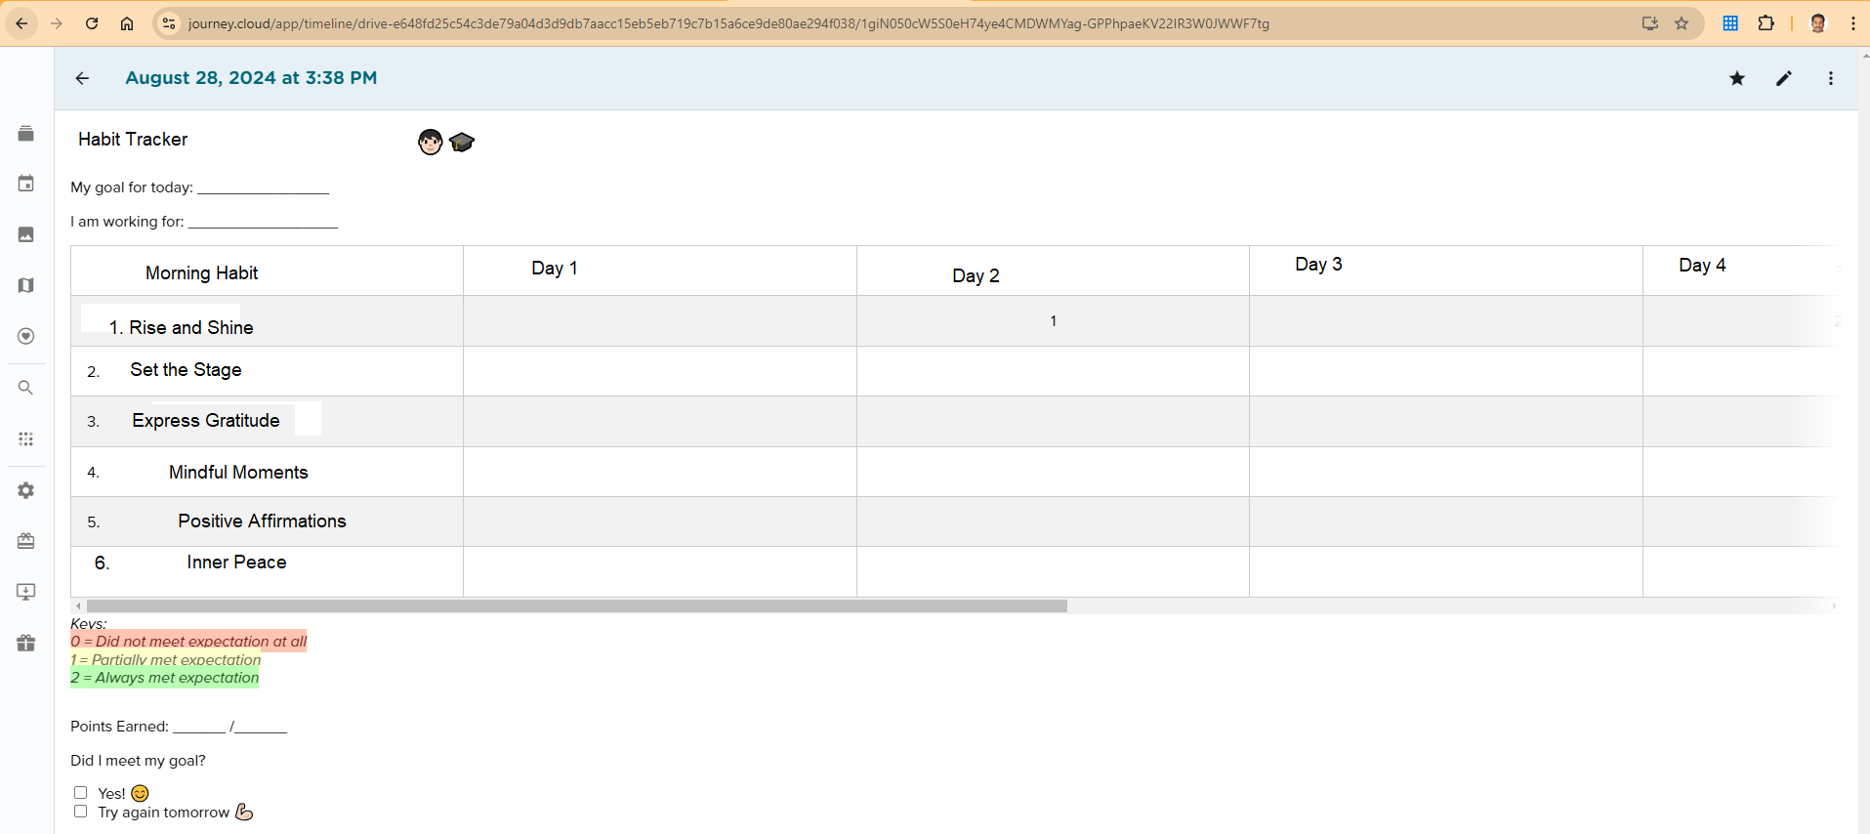
DAILY HABIT TRACKER

Slide 6
MY PERSONAL PROFILE
My Personal Profile: | Full Name*
 | First Name *
 | Middle Name
 | Last Name *
 | Preferred Full Name*
 | Email ID (With Verify OTP option) *
 | Contact Number (With Verify OTP option) *
 | Gender *
 | Date of Birth (DD-MM-YYYY) *
 | Marital Status
 | Country *
 | State *
 | City *
 | Pincode *
 | Nationality
 | Country of Birth
 | Place of Birth
 | Current Country
 | Current City

Slide 7
MY PROFESSIONAL PROFILE
Work Experience: | Overall Work Experience
Current Organization | Current Organization Name
 | Company Location
 | Start Date
 | Job Responsibilities
Honors/Awards/ Publications | Honor or Award or Publications
 | Description
 | Institution
 | Issue Date
 | Attachment
 | Add More
Previous Experience: | Title
 | Company Name
 | Start Date
 | End Date
 | Job Responsibilities
 | Add More
Functional Skills |  | Proficiency
 | 1
 | Add More
Technical Skills |  | Proficiency
 | 1
 | Add More
Education | College/University
 | Degree
 | Area of Study
 | Degree Completed?
 | Date Completed
 | Add More
Language Skills | Language
 | Speaking Proficiency
 | Writing Proficiency
 | Reading Proficiency
Certifications/Licenses | Certification/License
 | Description
 | Institution
 | Effective Date
 | Expiration Date
 | Attachment
 | Add More

Slide 8
MY DOCUMENTS
Resume | 1
 | Add More
Cover Letter | 1
 | Add More
Portfolio | 1
 | Add More
Accomplishment Documents | 1
 | Add More
Educational Documents | 1
 | Add More
Professional Documents | 1
 | Add More
Personal or KYC Documents | 1
 | Add More
Bank Documents | 1
 | Add More
Other Documents | 1
 | Add More

Slide 9
MY WORK
Posts
Shorts/Videos
Articles
Journals
Others

Slide 10
SWOT ANALYSIS
Strength | 1
 | Add More
Opportunity | 1
 | Add More
Weakness | 1
 | Add More
Diversion/Distraction: | 1
 | Add More
Threats | 1
 | Add More

Slide 11
SKILL MATRIX
SI. No | Skill Matrix* | 1 | Proficiency
 | java | Add More
SI. No | Skill Gap* | 1
 | reactjs | Add More

Slide 12
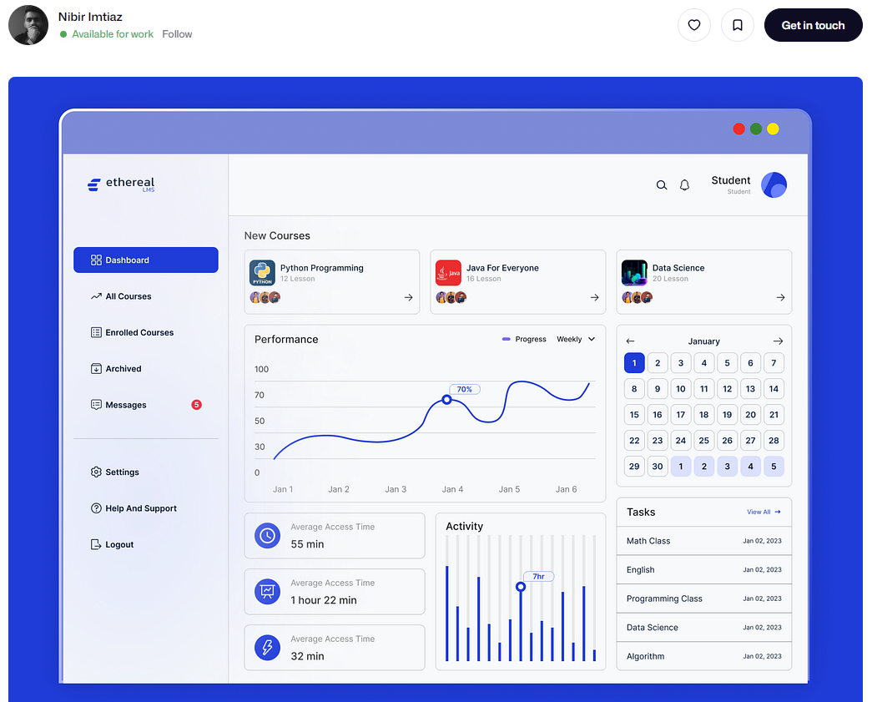
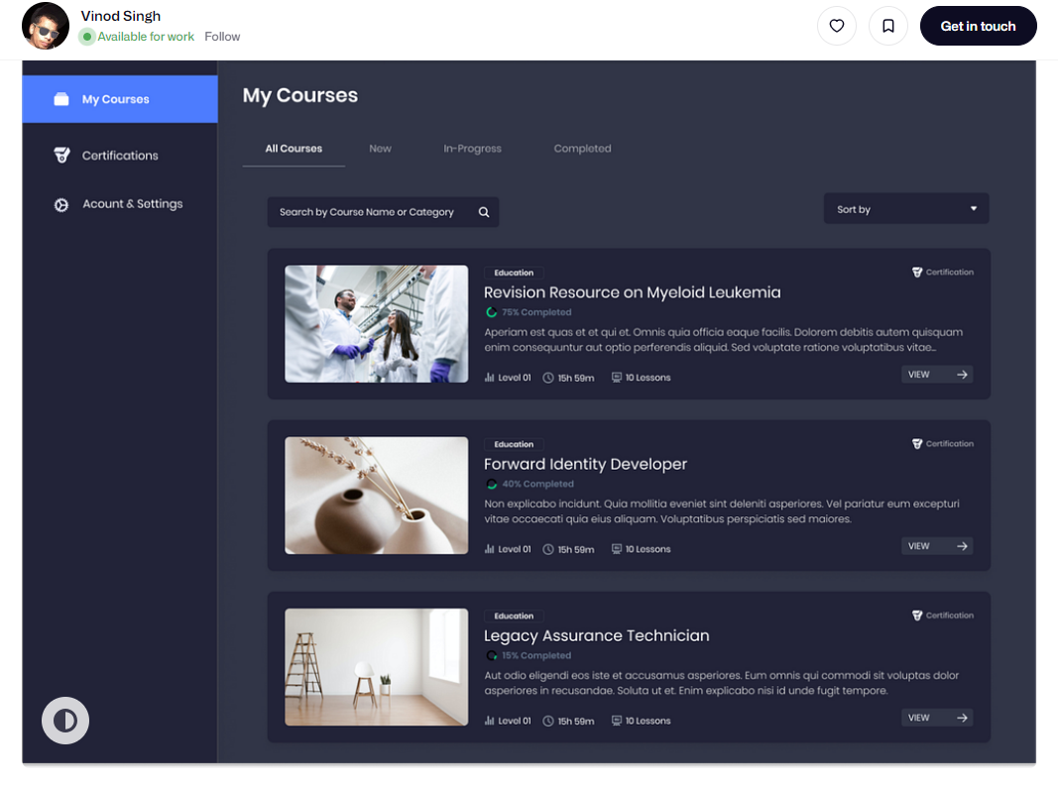
LEARNING
Course create, assign.

Slide 13
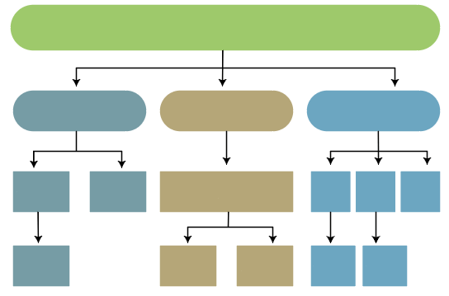
MY GOALS
CREATE MAIN GOAL
CREATE SUB-GOAL
Main Goal
Categories of Goals
Link Main Goal
Sub-Goal Name
Description
Start Date
Expected Due Date
Link Goal
Coach
Required Effort
Utilized Effort
Spent Effort
Status
Accompolishment
Actual Completion Date
Weightage
Measurement Criteria
Spiritual Goals
Fitness Goals
Family Goals
Career Goals
Financial Goals
Social Goals
Intellectual Goals
Category of Goal
Category of Goal
Category of Goal
Goal 1
Goal 2
Goal
Goal 1
Goal 2
Goal 3
Select Goal Type
Goal Name
Description
Start Date
Expected End Date
Link Sub-goal
Coach
Effort Required
Status
Weightage
Expected Due Date
Actual Completion Date
Accomplishment
Measurement Criteria
Sub-Goal1
Sub-Goal1
Sub-Goal2
Sub-Goal1
Sub-Goal2

Slide 14
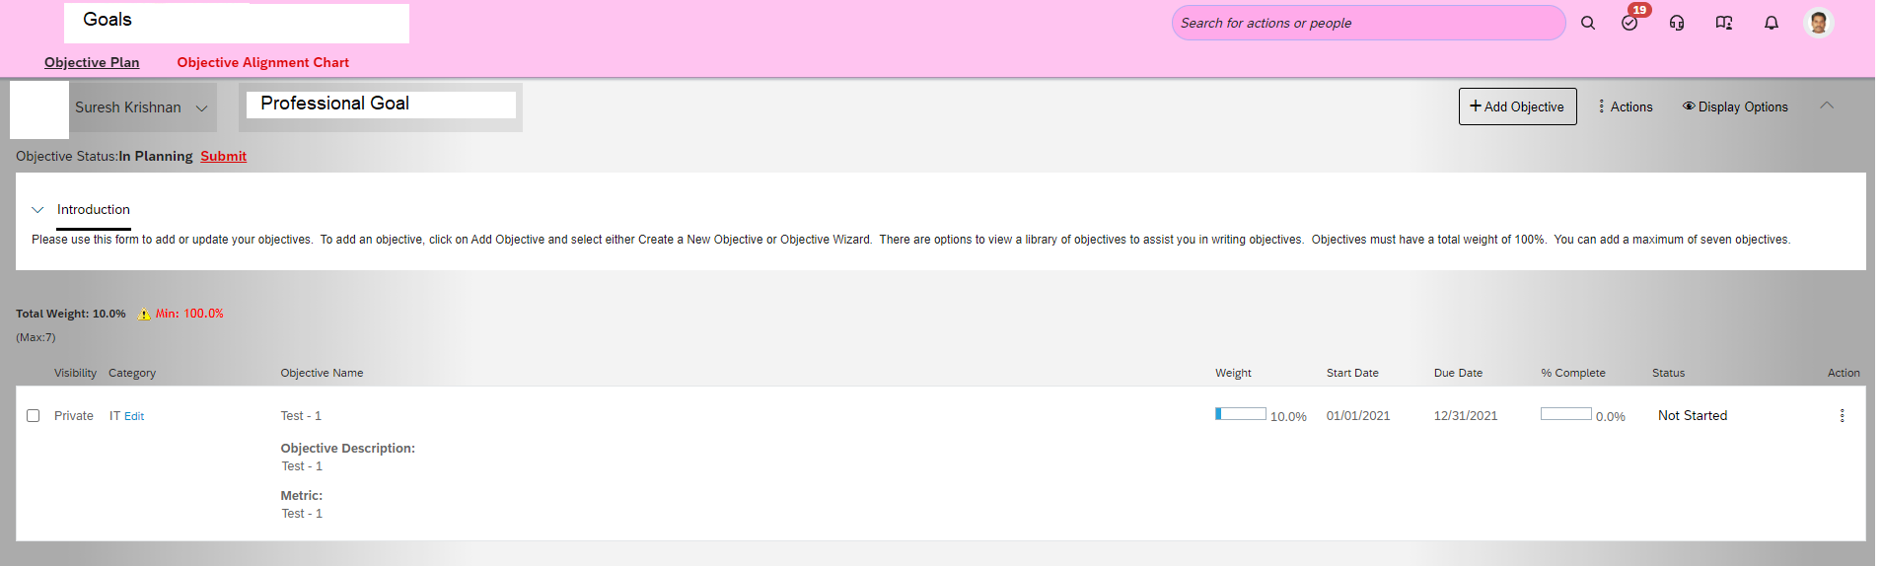
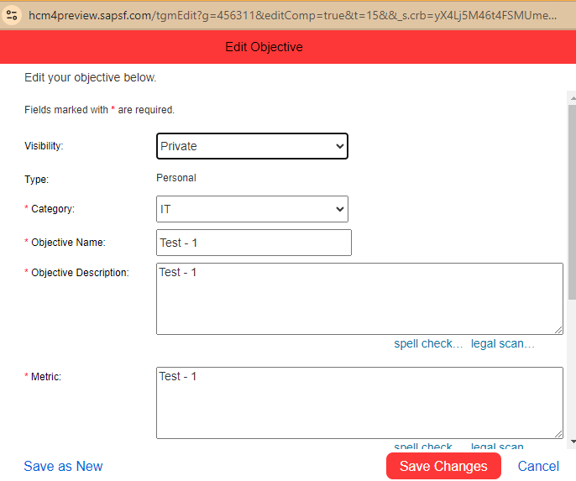
MY GOALS
Main Goal
Category of Goal
Category of Goal
Category of Goal
Goal 1
Goal 2
Goal
Goal 1
Goal 2
Goal 3
Sub-Goal1
Sub-Goal1
Sub-Goal2
Sub-Goal1
Sub-Goal2

Slide 15
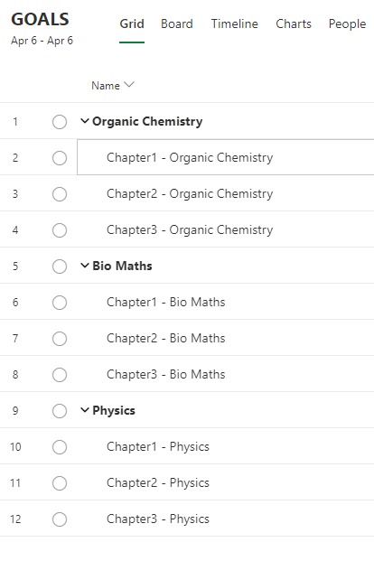
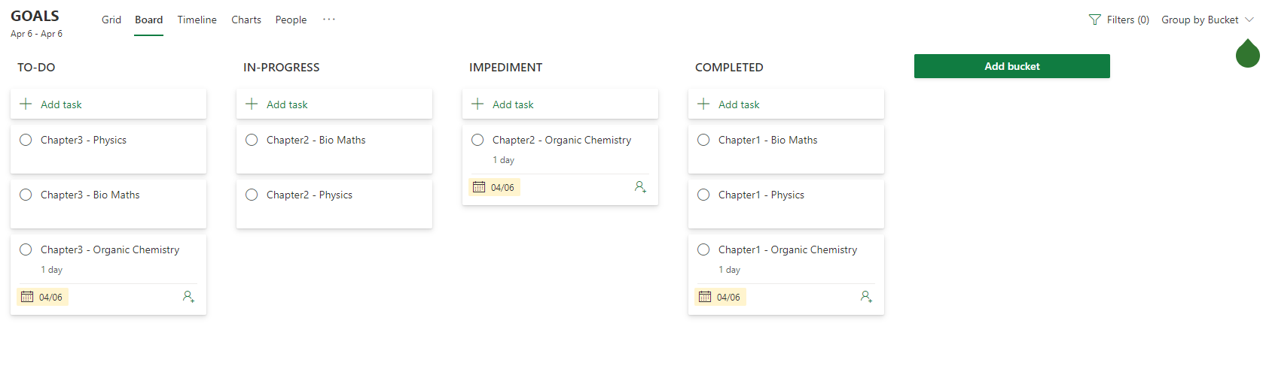
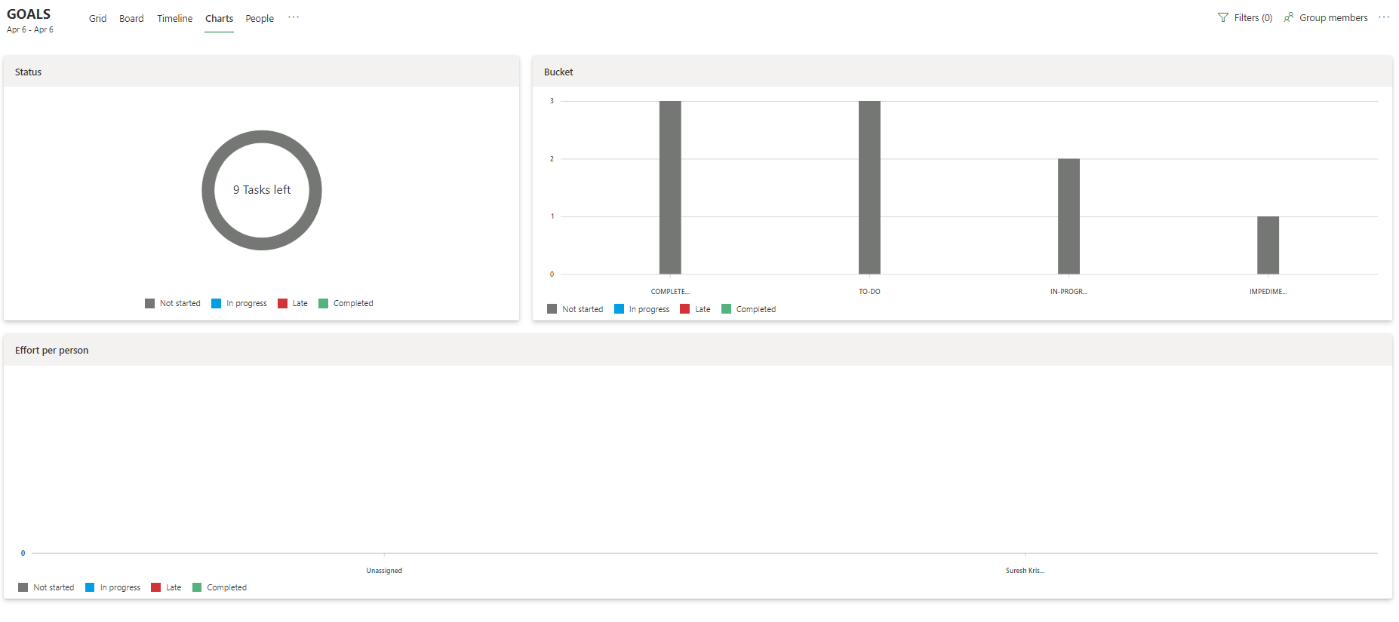
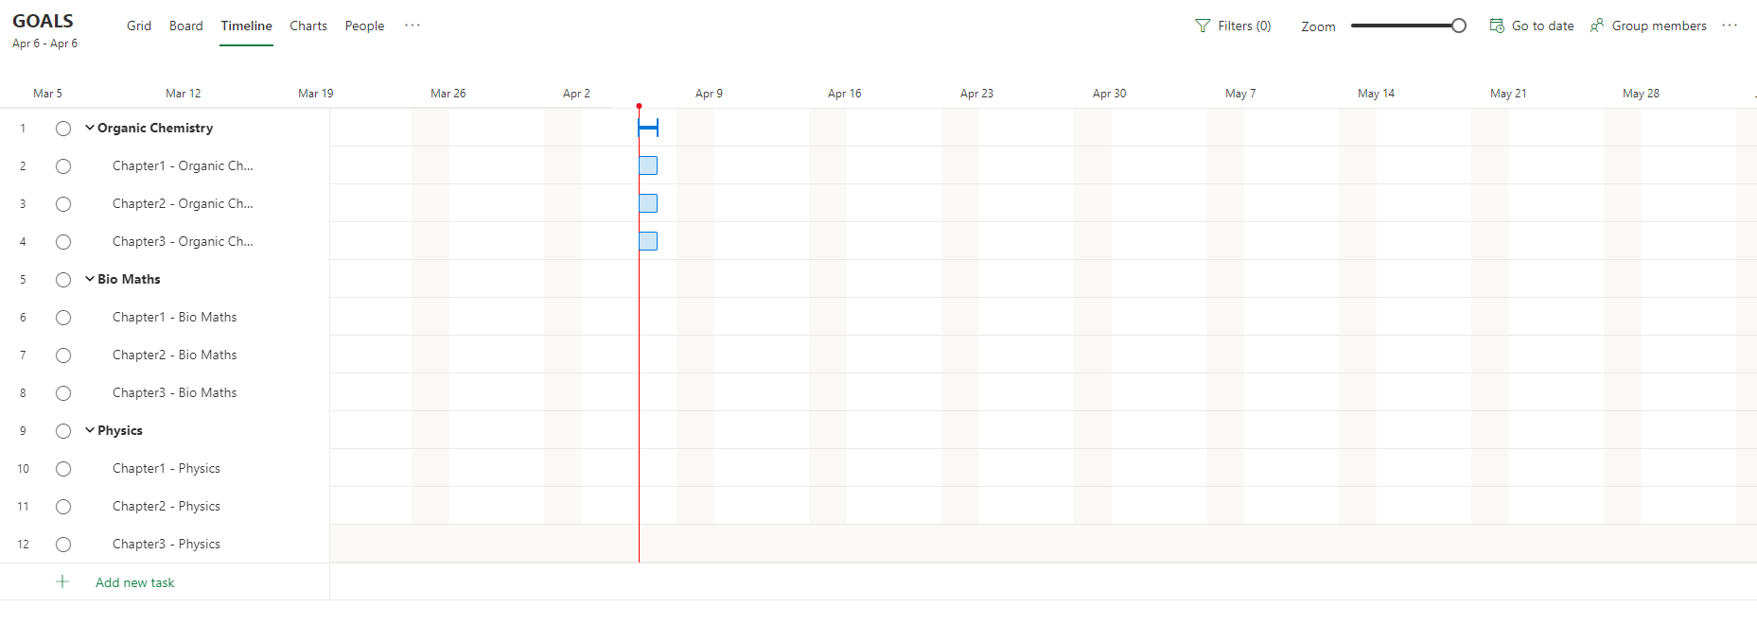
GOAL VIEW - GRID
GOAL VIEW - BOARD VIEW
GOAL VIEW – CHART
GOAL VIEW – TIMELINE

Slide 16
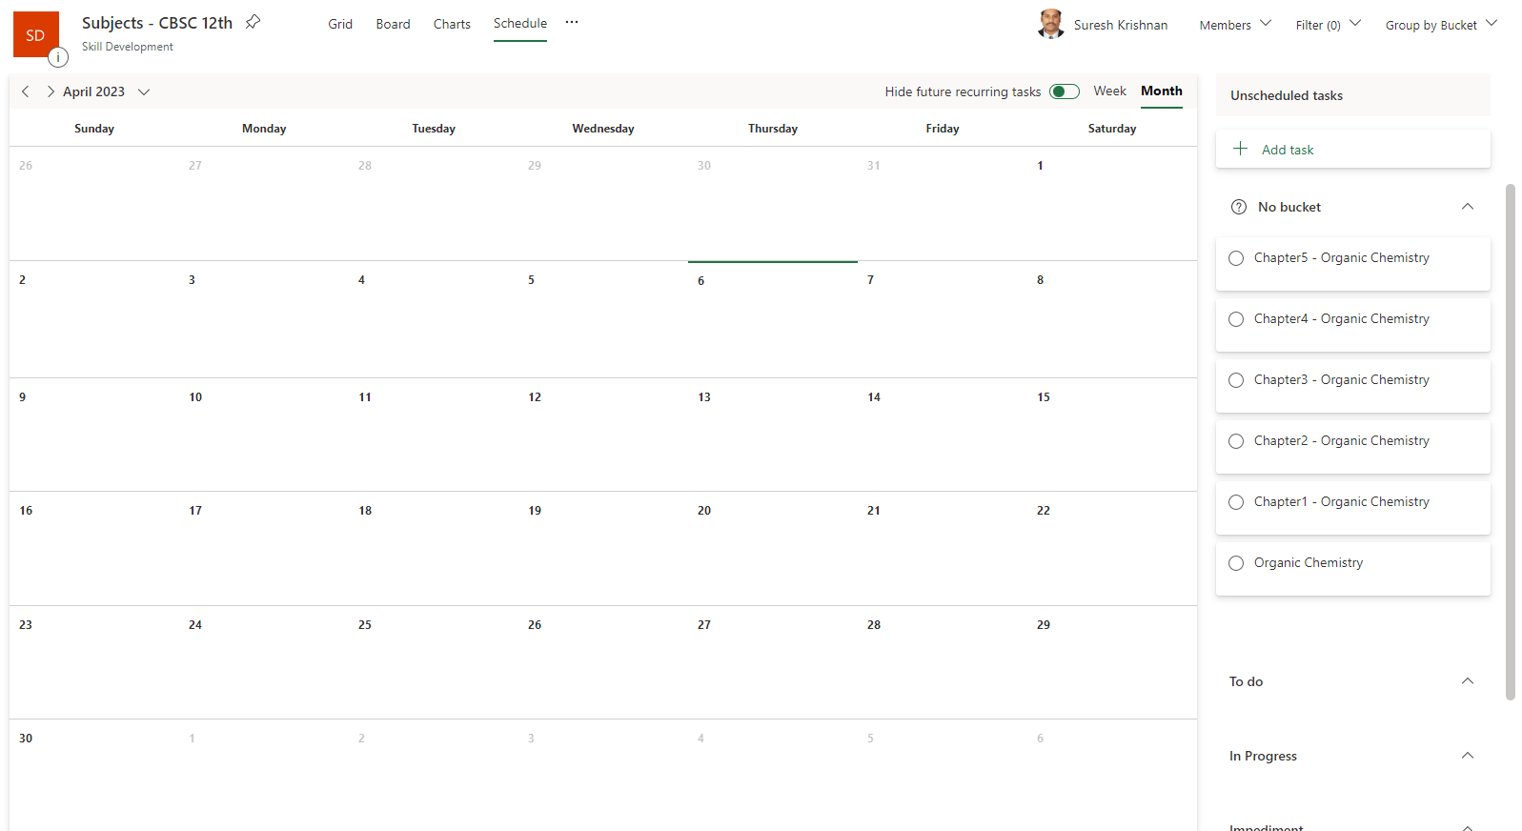
GOAL - SCHEDULE

Slide 17
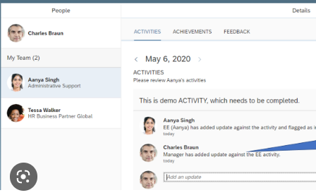
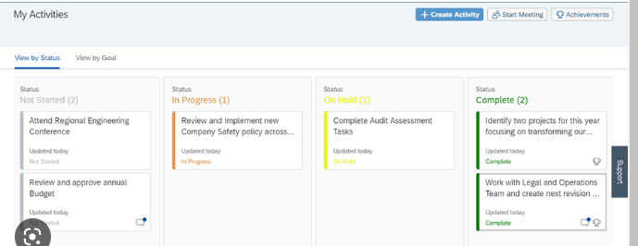
MY ACTIVITIES

Slide 18
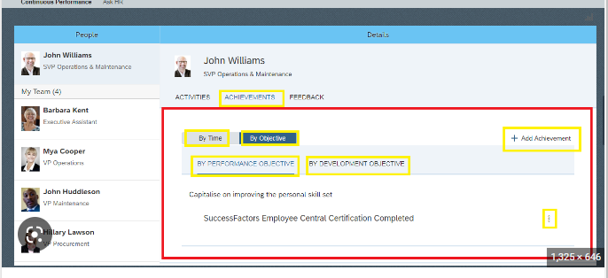
MY ACHEIVEMENTS

Slide 19
SCORE CARD
MY SCORE CARD | View My Score
 | Get Score from Others
 | Give Score to Others

Slide 20
ADMIN CENTER

Slide 21

User Profile (Personal and Professional)
Set Goals
Set Development Plan
Learning Track
Continuous Performance Management
Rewards and Recognition
Payroll Details – Statutory Information
Compensation and Benefits
Off Boarding

