Slide 1

Lose-the-Snooze
Design Project Presentation (Shan Banga & Harjot Gill)

Slide 2

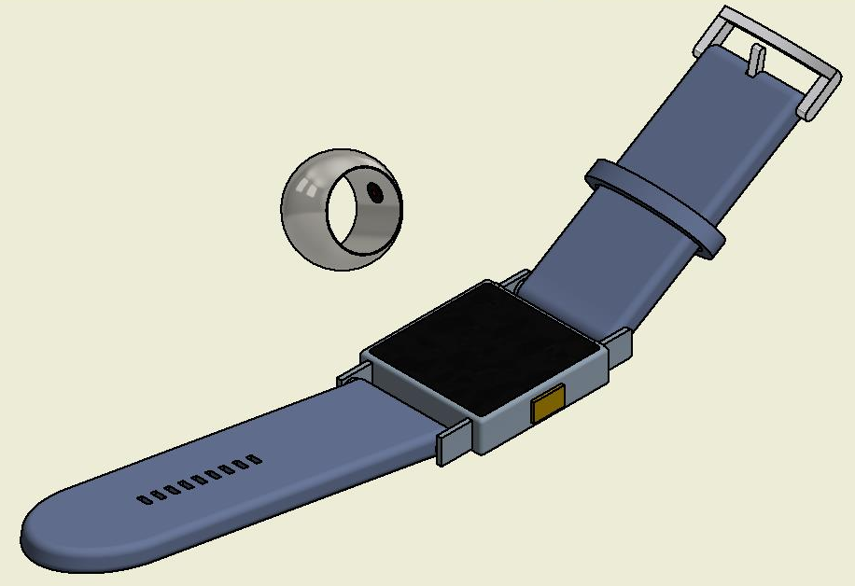
Introduction/Problem Statement
There are many times when sleep gets the best of us when we need to be attentive. For example, those college students who work full time and go to school tend to fall asleep during their lectures due to a lack of sleep. It would be nice to have something to help prevent this from happening and do so with . We have designed a ring that will be recommended to be worn at night to analyze an individual’s body activities as they sleep. These readings will then be transferred over to our personalized smart watch through bluetooth, which will then use that data to recognize if the owner has fallen asleep and begin to vibrate in order to wake them.

Slide 3
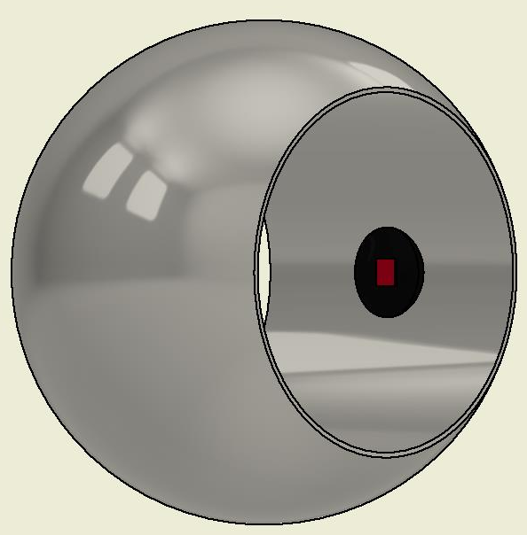
How does it work?
The ring is designed with an in-built sensor that will analyze an individual’s body activities such as blood pressure, body temperature and other heart rate affecting activities thus it would be recommended to be worn at night. The ring will then store these readings and transfer it to the smart watch through bluetooth every 24 hours. The watch while being worn along with the ring throughout the day will observe the individual’s bodily readings and once it matches it with a similar reading from its database, it will have realized that the person has fallen asleep. This will result in the watch to start vibrating in order to waken them, if the person does not react to the gentle vibrations it will gradually increase. The vibrations can then be turned off once the individual taps on the the watch’s screen.
Sensor

Slide 4
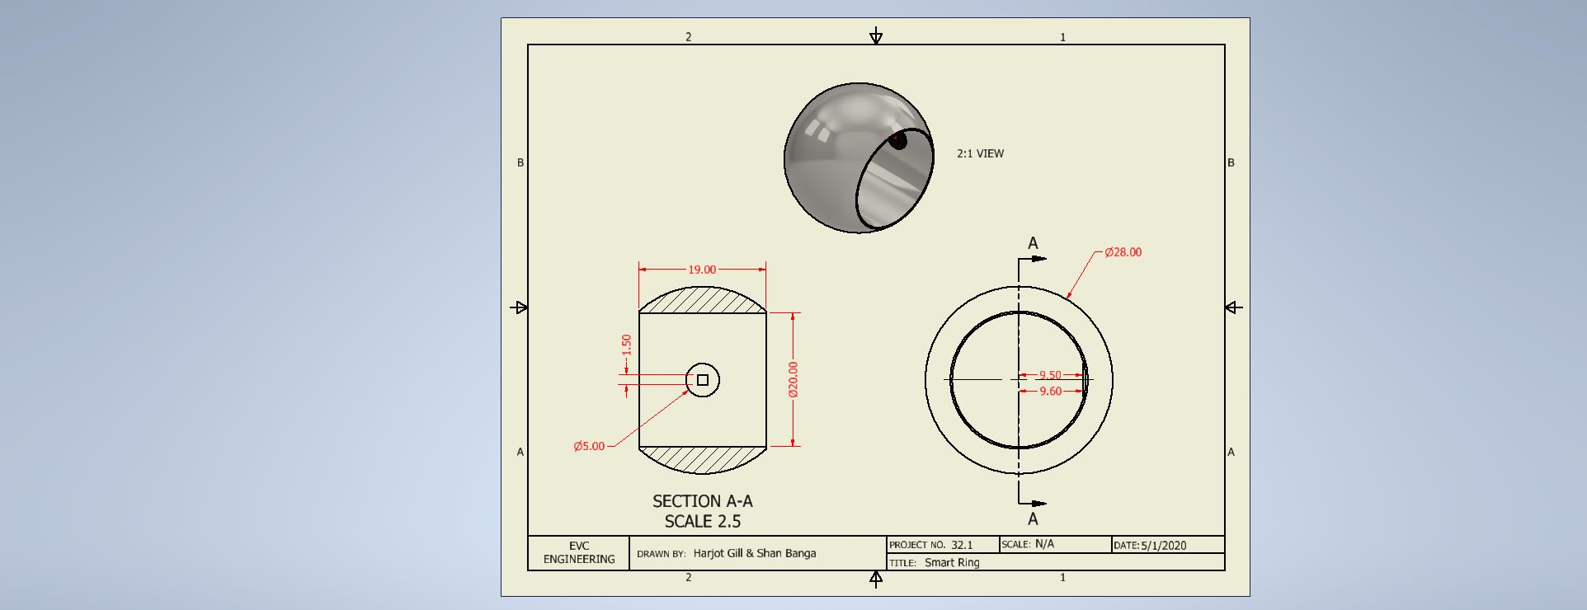
The Ring

Slide 5
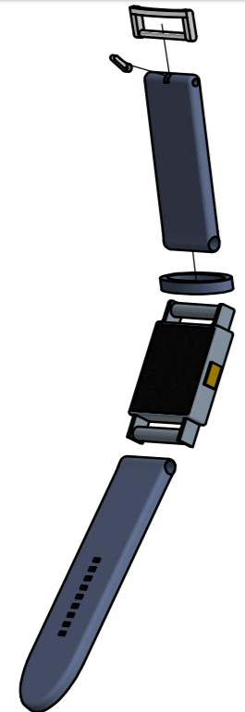
The Watch
Wi-Fi (802.11b/g/n 2.4GHz)
Bluetooth 5.0
Built-in rechargeable lithium-ion battery with wireless charging
Up to 18 hours of battery life
Water resistant 50 meters
Barometric altimeter
Optical heart sensor
Electrical heart sensor
Accelerometer up to 32 g-forces
Improved ambient light sensor
Capacity 32GB
Ion-X strengthened glass
NTC body temperature sensor

Slide 6
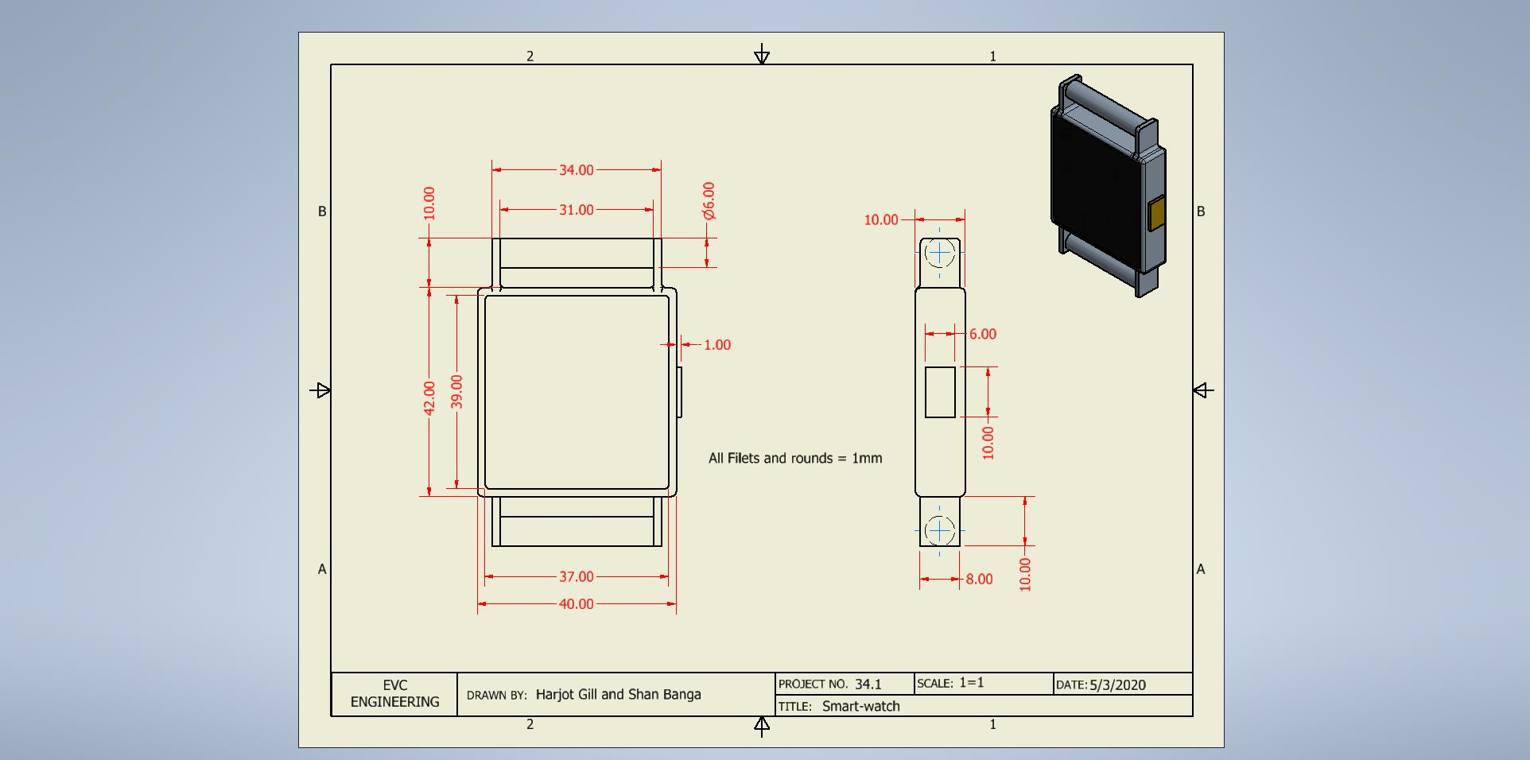
The Watch
Screen is 3mm offset

Slide 7
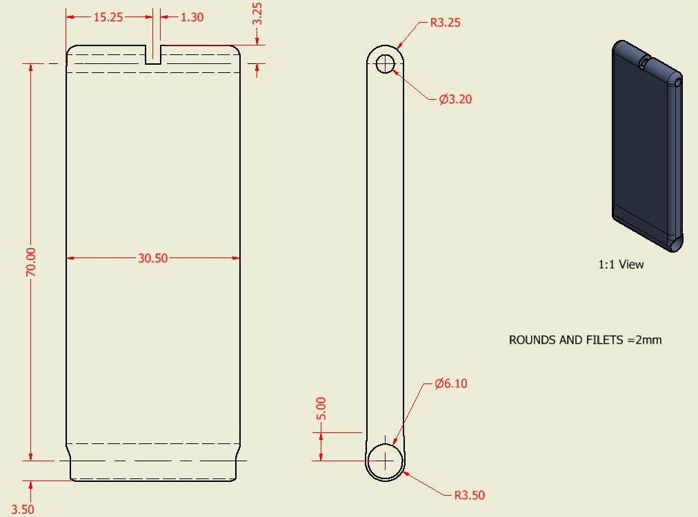
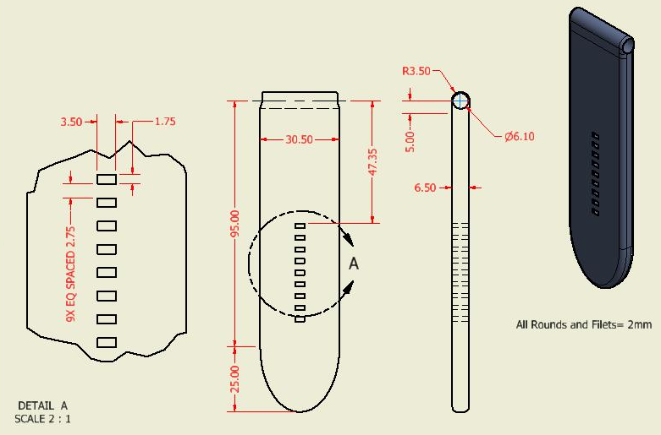
Design Drawings: Bottom and Top Strap

Slide 8
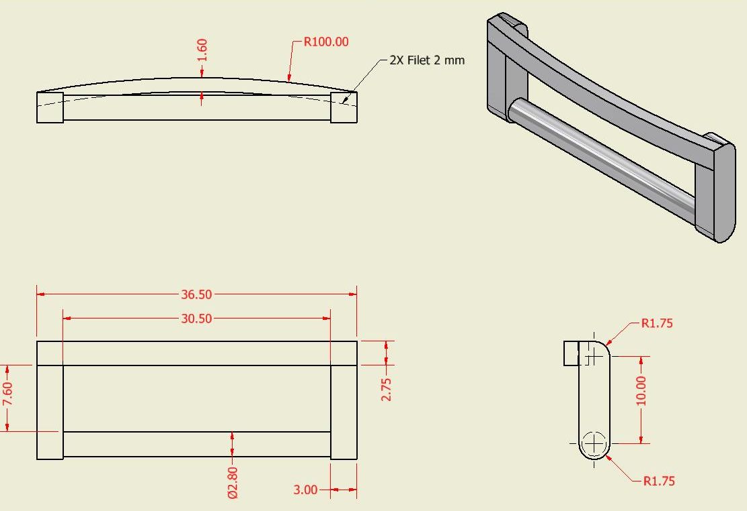
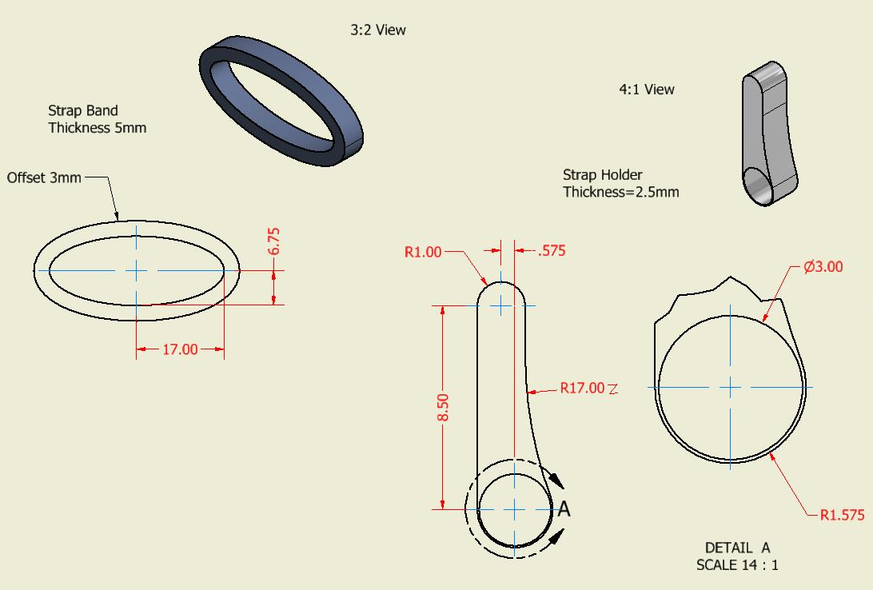
Additional Parts

Slide 9
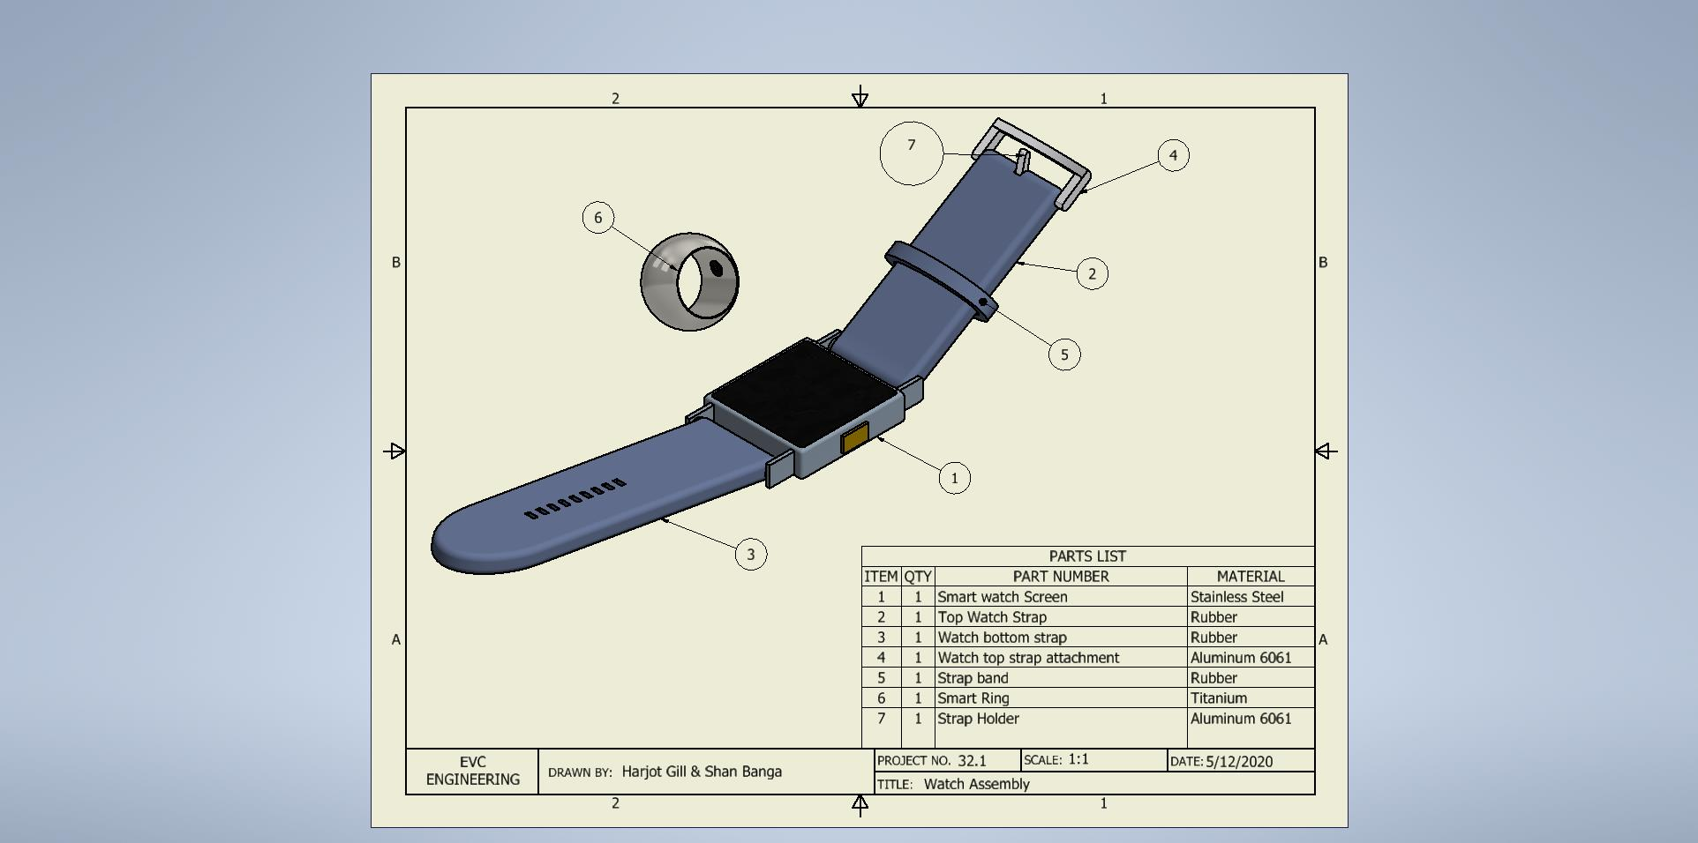
Finalized Model

Slide 10
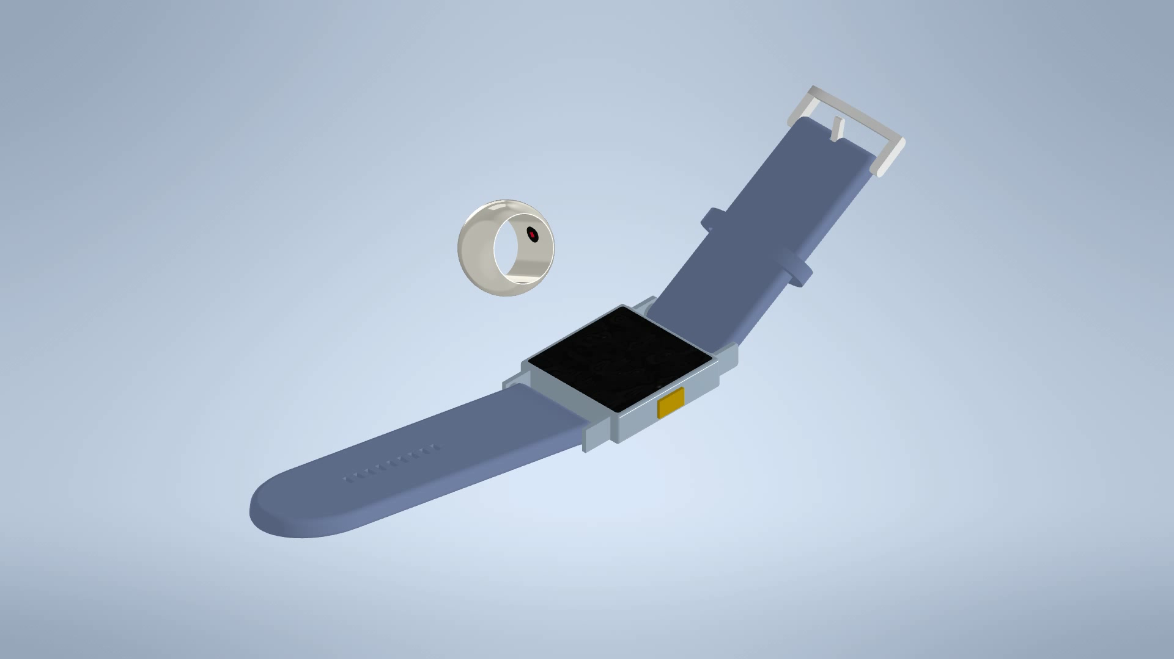
Presentation

