Slide 1
Lesson 3

Slide 2
Table of contents
01
02
03
04
Introduction
Compiler vs Interpreter
Introducing IDLE & CMD
Main difference
Play a game
Syntax & Comments
Rock, paper & scissors
Definitions

Slide 3


Python Installation
1. Go to any search browser and search Python download
2. Fisrt website that will appear will be python.org (link)
3. Click “download python 3.12.6” for windows
4. After downloading, open it from your downloads and perform installation.
5. Check for “add python.exe to path” and click on customize installation and click next
6. Check for “All users” and let other setings default then click next
7. Under advanced options check in for “install python 3.12 for all users.
8. Click on install. After installation under setup was successful click close

Slide 4
Python Running
1. Open your command prompt and type python and enter click, this will appear
Python 3.12.5 (tags/v3.12.5:ff3bc82, Aug 6 2024, 20:45:27) [MSC v.1940 64 bit (AMD64)] on win32
Type "help", "copyright", "credits" or "license" for more information.
2. Type print("hello world"), press enter , this output will display= hello world
3. Now search for “IDLE python” and click on it. A IDLE shell will appear.
4. Type print("hello world"), press enter , this output will display= hello world
5.Your python is successfully running

Slide 5
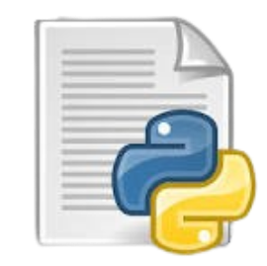
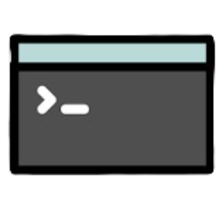
Introducing IDLE & CMD
IDLE
CMD
1. Integrated Development and Learning Environment
2. The IDLE Python shell is an interactive interface within IDLE where you can type Python commands and see the results immediately.
3. It’s helpful for testing small pieces of code without needing to write a full script.
4. It’s great for beginners to practice and see real-time results.
1. Command Line Interface
2. The Command Prompt in Windows is used execute Windows-specific commands.

Slide 6
Exploring IDLE & CMD
Make them familiar with Interfaces (Practical Introduction)
Practice: Print hello world
Add two numbers
Print hello world with escape sequence.
Exercise: print your age
Print your name

Slide 7
Question about IDLE & CMD
Question: Why cannot we execute python commands in cmd? Why we have to use IDLE?
Answer: Command line Interface is use to run commands of a system. Cmd doesn’t directly understands python commands.
But cmd can run some python commands such as
python –version (to check the version of python)
Installing & Uninstalling Python packages (using pip install command)
Opening Python file (python filename.py)

Slide 8
Online Python Interpreter
Show them some online python interpreter.
Explain difference between Compiler vs Interpreter
Python is interpreted language.

Slide 9
What is Python Syntax & Comments?
Syntax: These are a set of rules that must be follow to write code for the computer to understand and execute it correctly.
Structure: Just like grammar in human languages, syntax defines the correct arrangement of words and symbols in code.
Errors: If the syntax is incorrect, the code will result in errors and won’t run as intended.
Comment: A comment is a part of the coding file that the programmer does not want to execute, rather the programmer uses it to either explain a block of code or to avoid the execution of a specific part of code while testing.

Slide 10
What is Python Syntax & Comments?
Syntax: These are a set of rules that must be follow to write code for the computer to understand and execute it correctly.
Structure: Just like grammar in human languages, syntax defines the correct arrangement of words and symbols in code.
Errors: If the syntax is incorrect, the code will result in errors and won’t run as intended.
int a = 16 print("my age is" + a) Wrong syntax
a = 16 print("my age is " + str(a)) correct syntax

