Slide 1
Lesson 4

Slide 2
Table of contents
01
02
03
04
Comments
Variable
Single and multi line
Definition
Variable name convention
Scope of Variable
Some rules
Local and Global variables

Slide 3


Comments
A comment is a part of the coding file that the programmer does not want to execute, rather the programmer uses it to either explain a block of code or to avoid the execution of a specific part of code while testing.
Main Types:
There are two types of comments
1. Single line comment
2. Multiple line comment

Slide 4

Comments
Single line comment: when the statement you want to hide from display is single line. For example: Explaining in one line about the functionality of block of code.
Representation: It starts with #
Example: huna is the only output

Slide 5
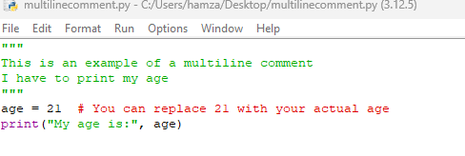
Comments
Multi-line comment: when the statement you want to hide from display are multiple lines. For example: Explaining in paragraph about the whole code.
Representation: It starts with “”” and ends with “””
Example:

Slide 6
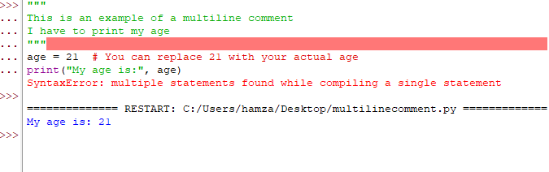
Comments
Multi-line comment: when the statement you want to hide from display are multiple lines. For example: Explaining in paragraph about the whole code.
Representation: It starts with “”” and ends with “””
Example: Error in idle shell.

Slide 7
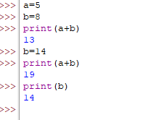

Variables
Variable: It is just like box where we store things. In programming Box will be variables and things will be data stored in the memory of computer. Data must be stored in the memory before it is processed.
In programming, a variable is a value that can change, depending on conditions or on information passed to the program.
Example:

Slide 8
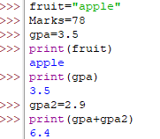
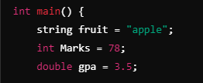
Variables
In python, the programmer does not need to declare the variable type explicitly, we just need to assign the value to the variable.
In programming, a variable is a value that can change, depending on conditions or on information passed to the program.
Example:

Slide 9
How to name Variables
1. The first character of a variablename must be alphabet (a-z,A-Z) or underscore (_)
2. The characters allowed within the name are underscore, digits, upper-case letters, lowe-case letters.
3. Special symbols such as %^&*!!@# are not allowed
4. Blank space or comma are not allowed
5. Variables are case sensitive.
6. Variable name can’t start from number

Slide 10
How to name Variables
Valid Variable Names | Invalid Variable Names
age = 25 | 1name = "John" → Starts with a number (invalid).
Name = "Alice" | first-name = "Sam" → Contains a hyphen (invalid character).
_height = 5.9 | total%score = 95 → Contains a special symbol % (invalid)
score_1 = 100 | my score = 50 → Contains a space (invalid).
total_marks = 85 | $color = "orange“ → special character in the begining

Slide 11
Scope of Variables
Global Variable: A variable that is defined outside of a function and can be accessed from anywhere in the code, including inside functions.
Local Variable: A variable that is defined inside a function and can only be accessed within that function. It is not available outside the function.

Slide 12
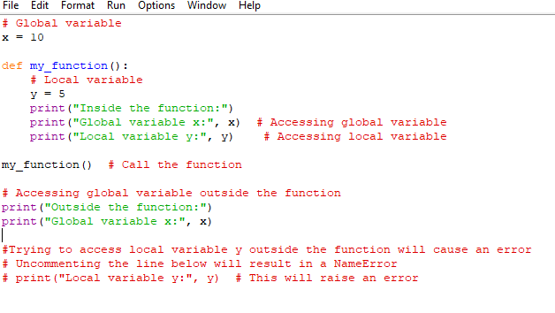

Scope of Variables
Correct Example

Slide 13
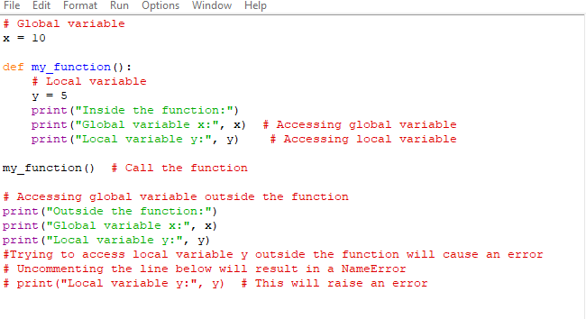
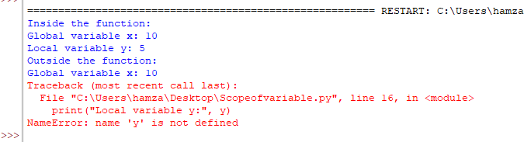
Scope of Variables
Incorrect Example

