Slide 1

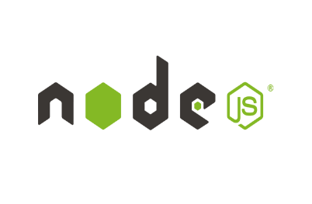


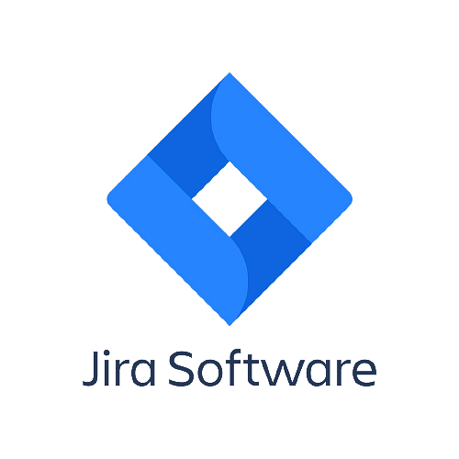
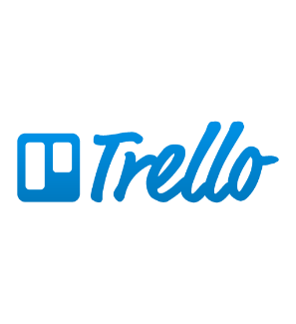
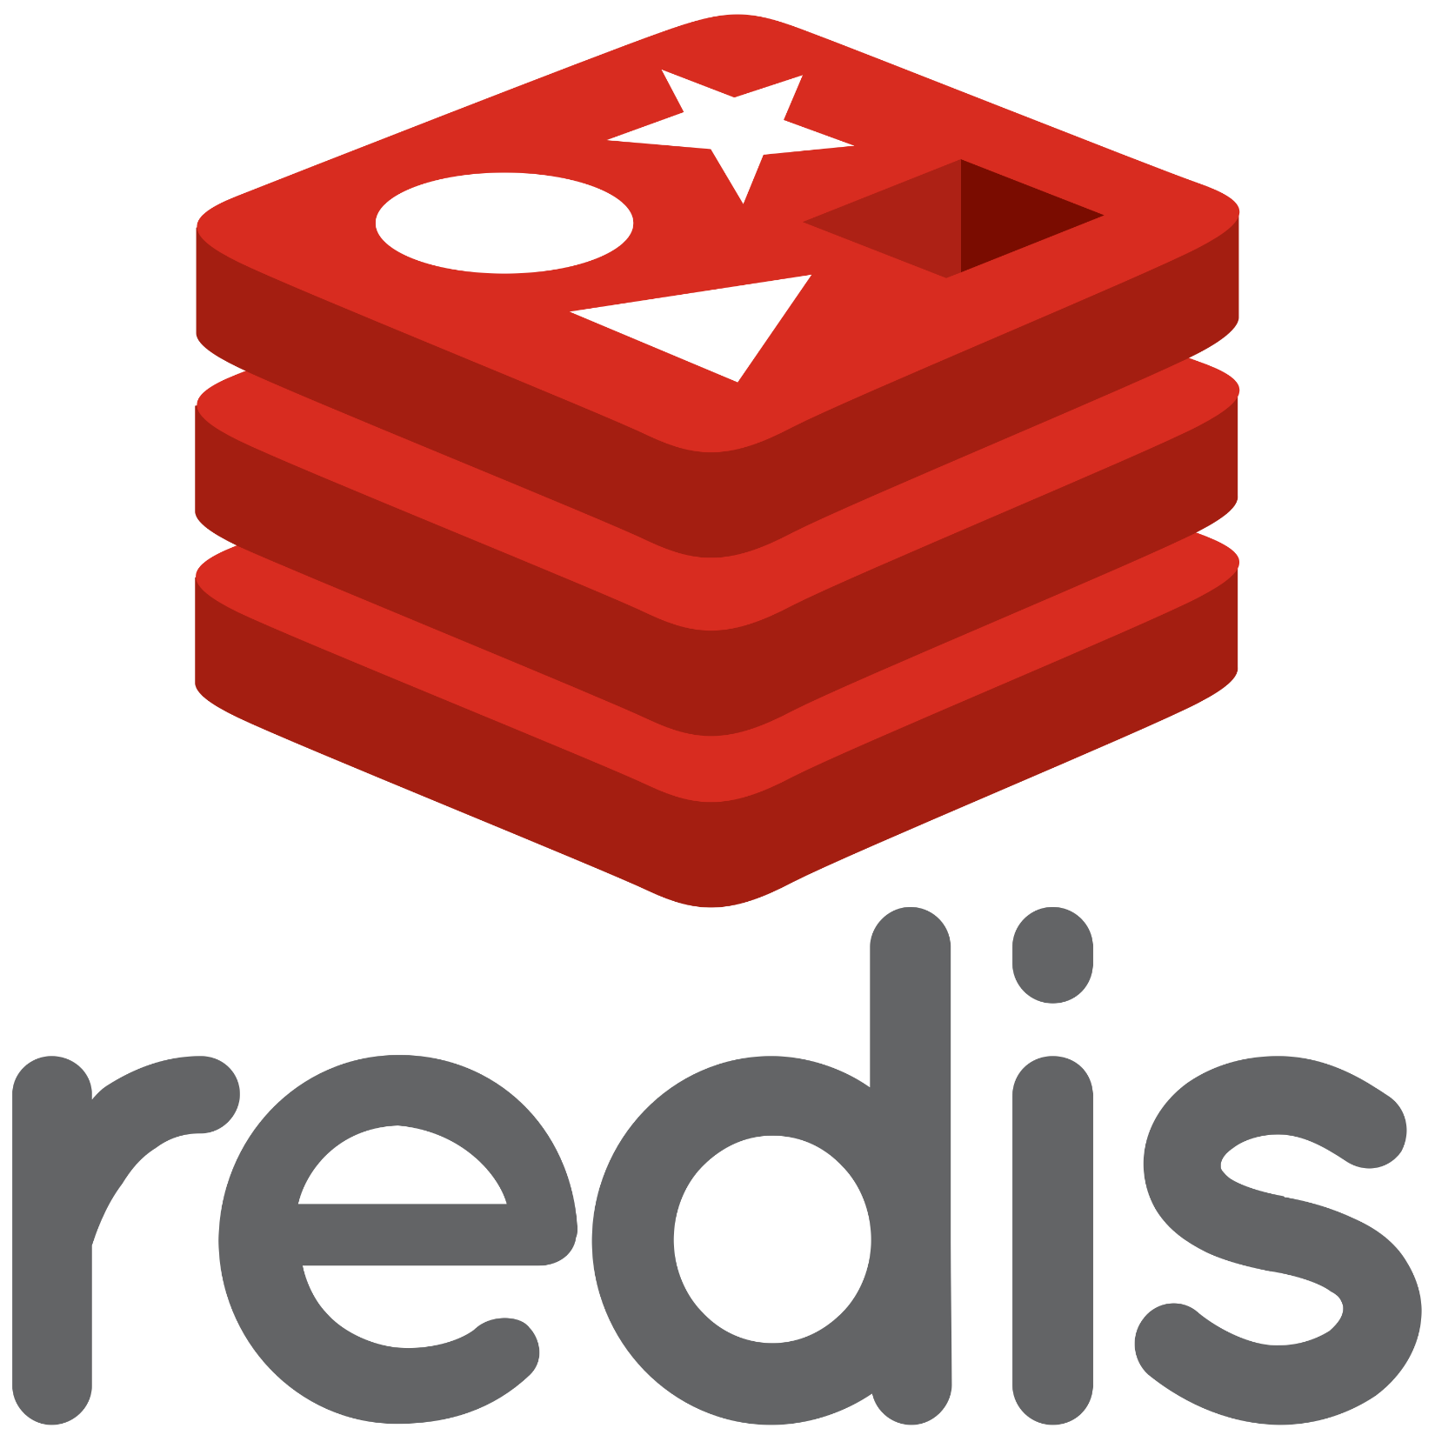


Technology Stack
Employee Portal
Database
Nodejs, React js, Nextjs
postgresql
Admin Portal
Project Management
Nodejs, Strapi, Redis
Jira Trello Microsoft Teams

